Slide 1

Introduction to
Machine Learning
with Python
2019 0000 옥현빈
2019 2650 이정훈

Slide 2
Contents
What is Machine Learning?
2. Supervised & Unsupervised
3. Problems
4. Impressions

Slide 3
What is Machine Learning?

Slide 4
What is Machine Learning?
Tom Mitchell (1998)
T = Task
P = Probability
Well-posed Learning Problem
A computer program is said to learn from experience E
with respect to some task T and some performance measure P,
if its performance on T, as measured by P, improves with experience

Slide 5
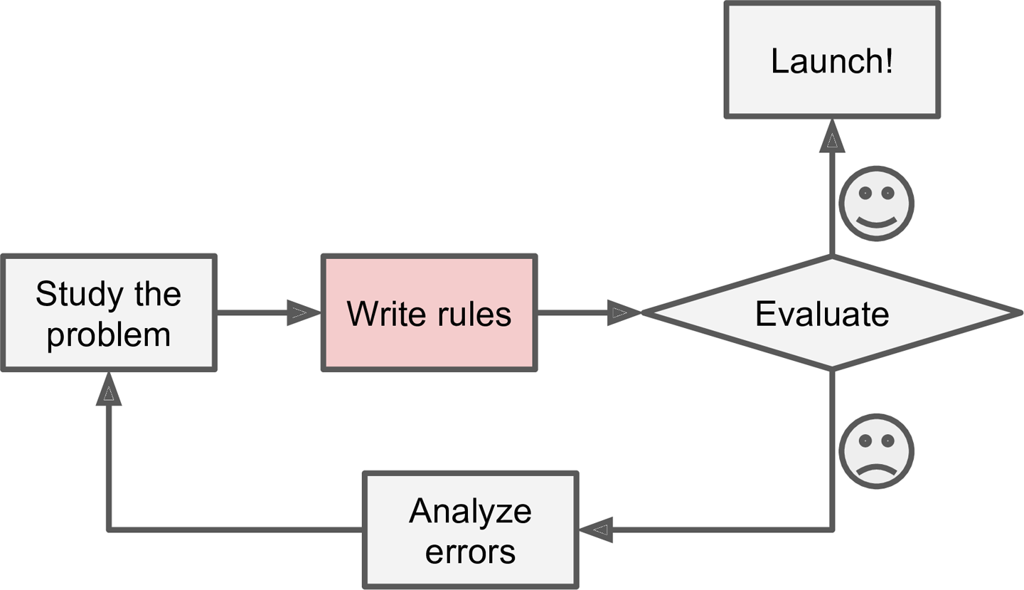
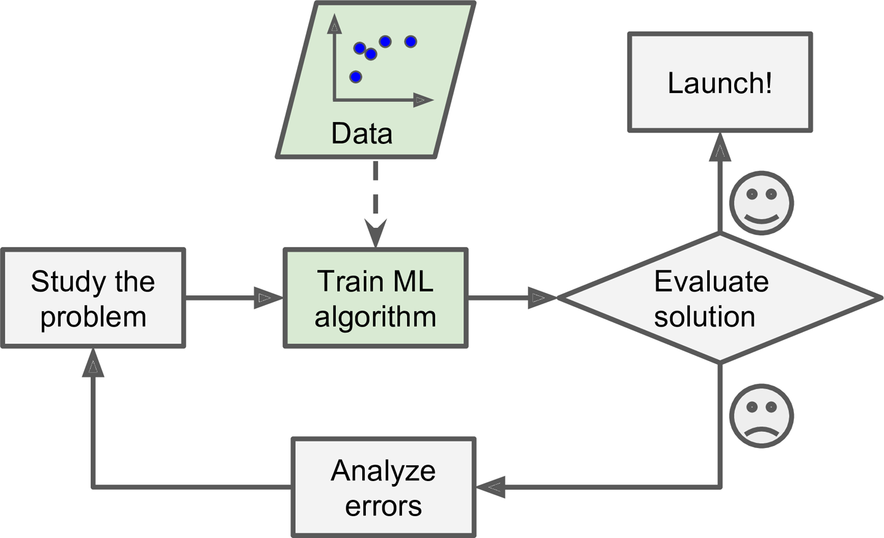
What is Machine Learning?
Traditional Approach
Machine Learning Approach

Slide 6
Supervised & Unsupervised

Slide 7
Supervised & Unsupervised
Installing Sckit Learn
$ pip install numpy scipy matplotlib ipython scikit-learn pandas pillow
Numpy
Pandas
Matplotlib

Slide 8
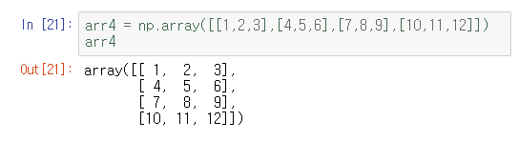
Supervised & Unsupervised
Installing Sckit Learn
$ pip install numpy scipy matplotlib ipython scikit-learn pandas pillow
Numpy
Pandas
Matplotlib

Slide 9
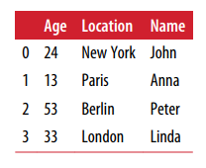
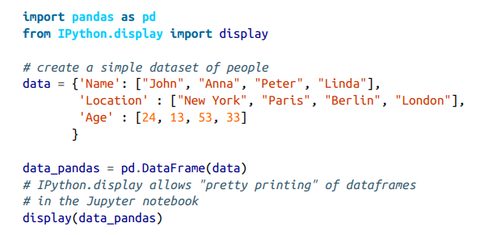
Supervised & Unsupervised
Installing Sckit Learn
$ pip install numpy scipy matplotlib ipython scikit-learn pandas pillow
Numpy
Pandas
Matplotlib

Slide 10
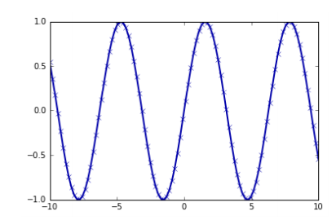
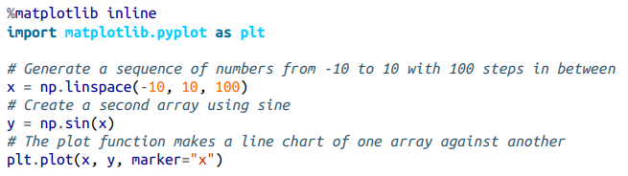
Supervised & Unsupervised
Installing Sckit Learn
$ pip install numpy scipy matplotlib ipython scikit-learn pandas pillow
Numpy
Pandas
Matplotlib

Slide 11
Supervised & Unsupervised
Supervised Learning
Given input, and we have examples of input / output pairs
Ex) 32 x 44 / 3 x 5 = 1408 / 15 -> 9 x 3 = 27
Classification
1. Binary Classification : Discrete valued output 0 or 1
2. Multiple Class Classification : apple, lemon, grape, etc …
Regression
Predict continuous valued out put
Real number or an arbitrary number rather than 0 and 1(like Binary Classification)

Slide 12
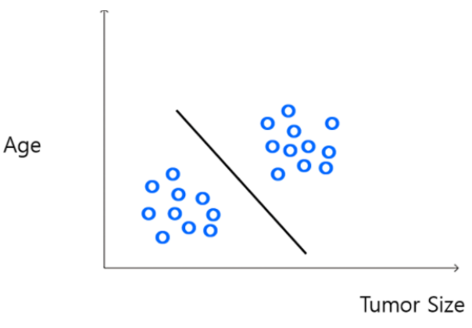
Supervised & Unsupervised
Unsupervised Learning
Input has not Right Answer for data set of output Not Given Data set Clustering Algorithm

Slide 13
Supervised & Unsupervised
Unsupervised Learning
Input has not Right Answer for data set of output Not Given Data set Clustering Algorithm
Wrong Prediction Result as Do not Feed Back

Slide 14
Problems

Slide 15
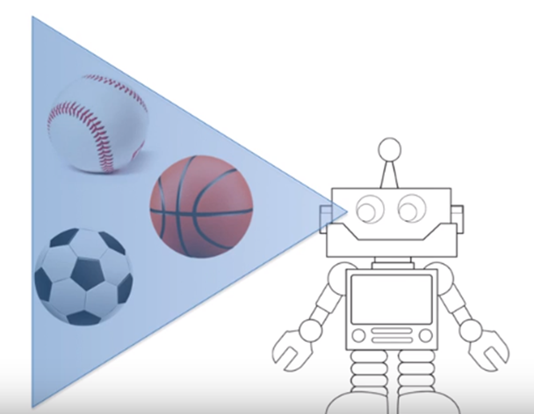
Problems
Underfitting

Slide 16
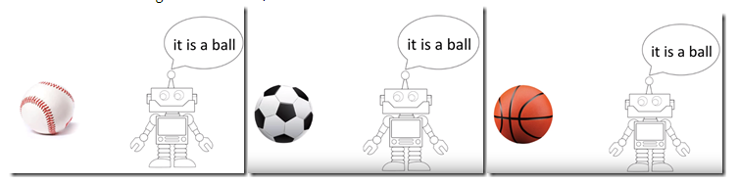
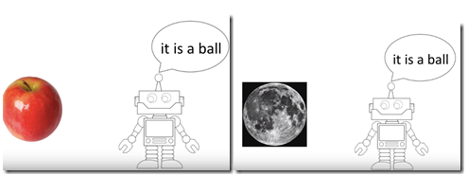
Problems
Underfitting

Slide 17
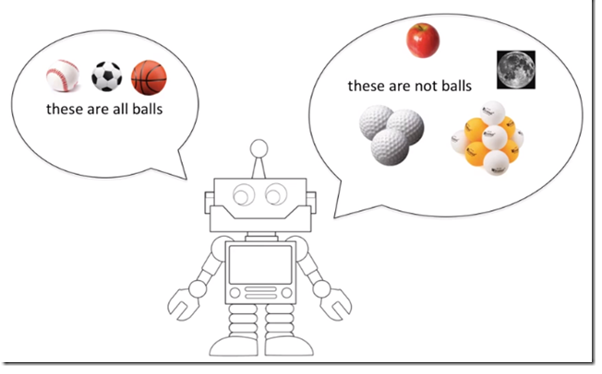
Problems
Overfitting

Slide 18

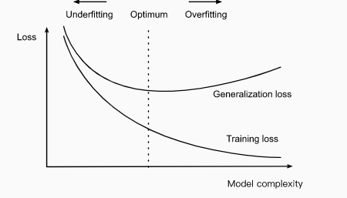
Problems
Solutions

Slide 19


Problems
Solutions

Slide 20
Impressions

Slide 21
Thank You

