Slide 1

Machine Learning Project
REVIEW
Loan Risk Prediction Assesment System
Presented by
Mr. B.Chaitanya (24B11CS027)
Mr. S.Teja Naga Satya Ganesh(24B11CS394)
Mr. K. Yugandhar (24B11CS205)
Mr. A. Sumanth(25B21CS011)
Department of Computer Science And Engineering

Slide 2

INTRODUCTION
The Loan Risk Assessment System is a machine learning-based application that analyze an applicant’s financial and loan-related information to estimate the risk associated with a loan application.
• Simplicity: User-friendly input fields allow applicants to provide basic personal, financial, and credit information without technical knowledge.
• Accuracy: Multiple trained machine learning models are used to analyze the applicant’s data and provide a reliable loan risk prediction.
• Speed: The system processes the entered information quickly and provides the risk assessment result instantly.
Technology Stack:
Language: Python
Libraries: pandas, NumPy, scikit-learn, XGBoost, imbalanced-learn, pickle
Models: Logistic Regression, Random Forest, XGBoost
Techniques: Data Preprocessing, Feature Engineering, SMOTE
Interface: Streamlit
Tools: VS Code, Google Colab, Command Prompt / Terminal

Slide 3
PROBLEM STATEMENT
Traditional loan assessment methods may be time-consuming and less effective in identifying high-risk applicants. This project uses loan and financial history data with Machine Learning to provide accurate, data-driven loan risk assessment. The system analyze important factors such as income, loan amount, credit history, previous loans, repayment behavior, and existing debt to identify the risk associated with a loan application. By combining relevant financial information and applying suitable machine learning algorithms, the system helps in making faster and more consistent risk assessments. The proposed system can support financial institutions in reducing potential loan risks and improving the overall loan evaluation process.

Slide 4
OBJECTIVES OF THE PROJECT
To clean and prepare the loan application and financial history datasets for analysis.
To identify and select the most relevant financial and loan-related features for risk prediction.
To integrate loan application data with previous financial and credit history for better assessment.
To train and compare three Machine Learning models — Logistic Regression, Random Forest, and XGBoost.
To handle imbalanced data using SMOTE and improve the reliability of model predictions.
To predict the risk level of a loan applicant based on the provided financial information.
To provide the prediction through a simple and user-friendly Streamlit interface.

Slide 5
SCOPE OF THE PROJECT
The scope of the Loan Risk Assessment System is to develop a Machine Learning-based system that helps assess the risk associated with loan applications using applicant and financial history data. The system analyzes important factors such as income, loan amount, employment details, credit history, previous loans, repayment behavior, and existing debt.
The project includes data collection, data preprocessing, data integration, exploratory data analysis, feature engineering, and handling of imbalanced data. Machine Learning algorithms such as Logistic Regression, Random Forest, and XGBoost are trained and compared to identify the model suitable for loan risk prediction.
The system also provides a Streamlit-based user interface where users can enter applicant information and receive a loan risk prediction. The proposed system can assist banks and financial institutions in making faster and more consistent preliminary loan assessments. It can also be extended in the future by incorporating larger datasets, additional financial features, real-time data, and advanced Machine Learning techniques.

Slide 6
MODULE DESCRIPTION
The system consists of the following modules:
1. Preprocessing Module (preprocess.py): Cleans the data, encodes text columns, selects features and saves the tools.
2. Training Module (train_models.py): Trains Logistic Regression, Decision Tree and Random Forest and compares them.
3. Prediction Module (predict.py): Console interface that asks questions and shows the risk result.
4. Saved Files: artifacts.pkl (encoders, scaler, features) and trained_models.pkl (all models).

Slide 7
DATASET DESIGN
Dataset
Dataset: loan_risk_dataset_1000_rows.csv (1,000 records, 10 columns)
Target: Loan_Risk (Low / High)
Numeric columns:
• Age
• Monthly_Income
• Loan_Amount
• Loan_Term_Months
• Credit_Score
• Previous_Defaults
• Monthly_Debt_Payment
Identification columns:
• Loan_Application_ID
• Name
Target column:
• Loan_Risk — represents the assessed loan risk of the applicant as Low or High.
The dataset contains applicant and financial information that can be used to analyze loan risk. Important factors such as income, loan amount, credit score, previous defaults, loan term, and monthly debt payment are considered for predicting the risk level of an applicant.

Slide 8
DATA PREPROCESSING
Checking Missing Values:
The dataset was checked for missing or null values using appropriate Pandas functions. The target column Loan_Risk was also examined to identify missing target values. Records with missing target values were removed to ensure reliable model training.
Removing Duplicate Records:
Duplicate records were identified using the duplicated() function. Duplicate rows were removed to prevent repeated information from affecting the Machine Learning models.
Handling Missing Values:
Missing values generated during the DTI calculation were handled using median imputation. The SimpleImputer with the median strategy was applied to the training data, and the same transformation was applied to the test data.
Target Encoding:
The categorical target variable Loan_Risk was converted into numerical values for Machine Learning. Low risk was represented as 0 and High risk as 1.
Handling Invalid Values:
During feature engineering, invalid values such as zero or negative values in Monthly_Income and negative values in Monthly_Debt_Payment were identified and converted to missing values. This prevents invalid financial values from affecting further calculations.

Slide 9
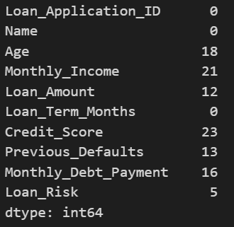
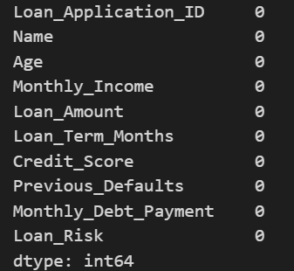
DATA PREPROCESSING
AFTER PREPROCESSING

Slide 10
Exploratory Data Analysis
Exploratory Data Analysis (EDA)
EDA was performed to understand the structure and characteristics of the loan dataset.
The dataset contains 1,000 records and 10 columns.
The distribution of the Loan_Risk target variable was analyzed.
Numerical features such as Age, Monthly_Income, Loan_Amount, and Credit_Score were examined.
Loan_Term_Months and Monthly_Debt_Payment were also analyzed to understand their distributions.
Statistical summaries such as mean, minimum, maximum, and standard deviation were obtained.
Histograms were used to visualize the distribution of numerical features.
Box plots were used to identify possible outliers in the numerical variables.
The relationship between important financial features and Loan_Risk was explored.
Correlation analysis was performed to identify relationships between numerical features.
Visualizations were used to identify important patterns and trends in the dataset.
EDA helped in understanding the factors that may influence the loan risk of an applicant.
The findings from EDA were used to support further feature engineering and Machine Learning model development.

Slide 11
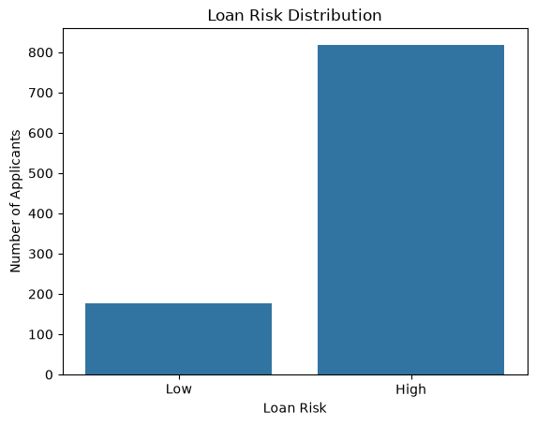
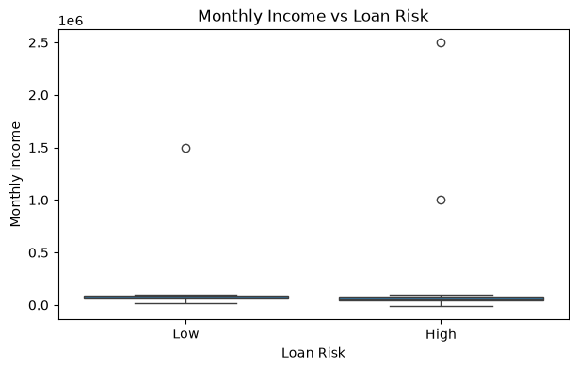
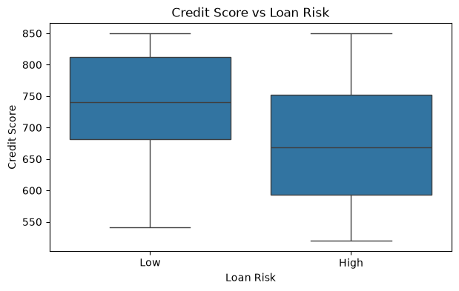
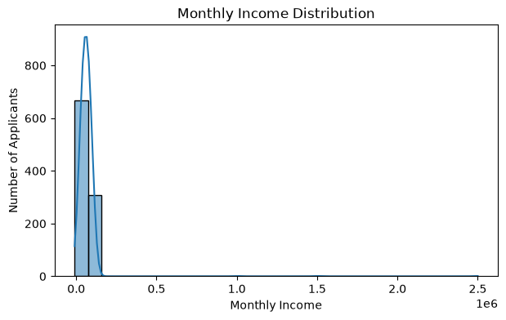
Exploratory Data Analysis
THESE ARE SOME EDA DIAGRAMS WHICH WE IMPLEMENTED IN OUR PROJECT

Slide 12
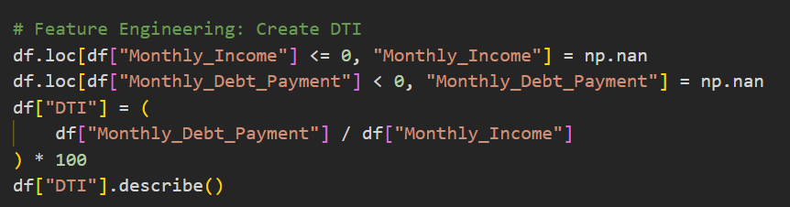
FEATURE SELECTION
Feature Selection
After performing EDA, the important features required for loan risk prediction were selected based on their relevance to the applicant's financial condition and loan details.
The following 7 features were initially selected:
• Age
• Monthly_Income
• Loan_Amount
• Loan_Term_Months
• Credit_Score
• Previous_Defaults
• Monthly_Debt_Payment
These features were used as the initial input variables for the Machine Learning models.
Feature Engineering – DTI
After feature selection, a new feature called Debt-to-Income Ratio (DTI) was created. DTI represents the relationship between an applicant's monthly debt payment and monthly income. The DTI feature provides additional information about the applicant's financial burden. After creating DTI, it was added to the selected features.

Slide 13
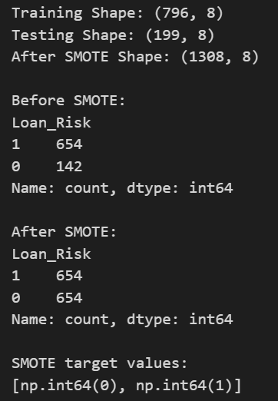
TEST,TRAIN AND SMOTE ENGINEERING
Train-Test Split & SMOTE
• The selected 8 features were separated into input features (X) and the target variable (Loan_Risk).
• The target values were converted into numerical form: Low = 0 and High = 1.
• The dataset was divided into 80% training data and 20% testing data.
• Stratified splitting was used to maintain the proportion of Low and High risk classes in both datasets.
• Missing values were handled using median imputation after the train-test split.
• SMOTE (Synthetic Minority Over-sampling Technique) was applied to the training data.
• SMOTE generated synthetic samples for the minority class and balanced the training data.
• SMOTE was applied only to the training data, while the test data remained unchanged.
• After SMOTE, the balanced training data was used for training the three Machine Learning models.
• StandardScaler was then applied to the training and testing data for the Logistic Regression model.

Slide 14
MODEL TRAINING
Model Training
• Three supervised Machine Learning classification algorithms were selected for the project: Logistic Regression, Random Forest, and XGBoost.
• Logistic Regression was used as a basic classification model to learn the relationship between the selected financial features and loan risk.
• Random Forest was trained using multiple decision trees to learn different patterns in the applicant data and combine their predictions.
• The Random Forest model was configured with 300 trees and a maximum depth of 8.
• XGBoost was used as a boosting-based model that builds decision trees sequentially to improve the learning process.
• The XGBoost model was configured with 300 estimators, maximum depth of 4, and a learning rate of 0.1.
• Random State = 42 was used in the models to maintain reproducibility during training.
• Logistic Regression was trained using the scaled feature data, while the tree-based models were trained on the prepared feature data.
• The models learned patterns from the training data by using the applicant's financial and loan-related features.
• After the training process was completed, the three trained models were ready to classify new loan applications into their respective risk categories.

Slide 15
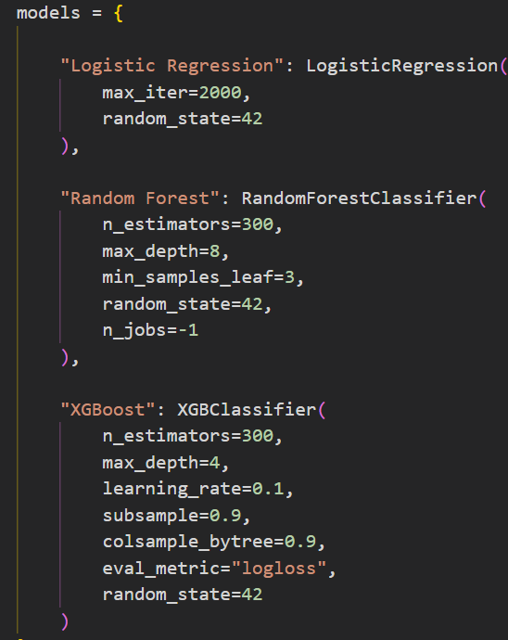
CODE FOR MODEL TRAINING
MODEL CONFIGURATION
Three machine learning algorithms—Logistic Regression, Random Forest, and XGBoost—were configured for loan risk prediction. Each model uses specific parameters to improve learning and prediction performance. Random Forest uses 300 decision trees, while XGBoost uses 300 estimators with a learning rate of 0.1. A fixed random state of 42 is used for reproducibility.

Slide 16
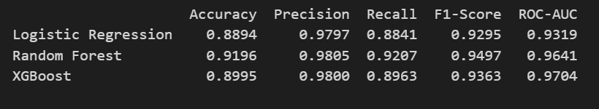
MODEL EVALUATION
Model Evaluation
• The trained models were evaluated using the 20% unseen test data.
• Different performance metrics were used to compare the prediction results of Logistic Regression, Random Forest, and XGBoost.
• Accuracy measures the overall percentage of correctly predicted loan-risk cases.
• Precision measures how many of the applicants predicted as high risk were actually high risk.
• Recall measures how many of the actual high-risk applicants were correctly identified by the model.
• F2-Score gives more importance to Recall, which is useful for identifying high-risk loan applicants.
• ROC-AUC measures the model's ability to distinguish between Low Risk and High Risk applicants.
• A ROC curve was generated to visualize the classification performance of the models at different decision thresholds.
• A confusion matrix was also used to observe correct and incorrect predictions for Low Risk and High Risk classes.
• The performance values of all three models were compared to identify how well each model classified the loan-risk categories.
• These evaluation results help determine the effectiveness of the trained models for the Loan Risk Assessment System.

Slide 17
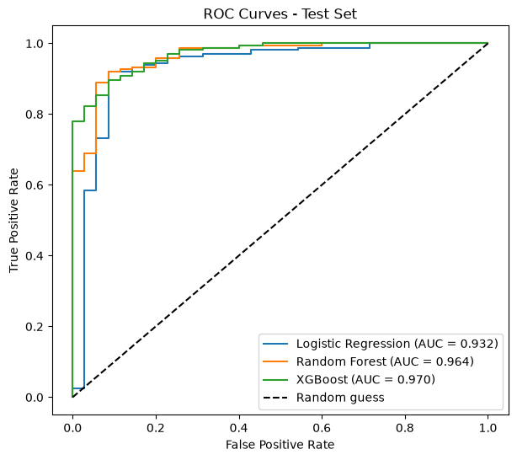
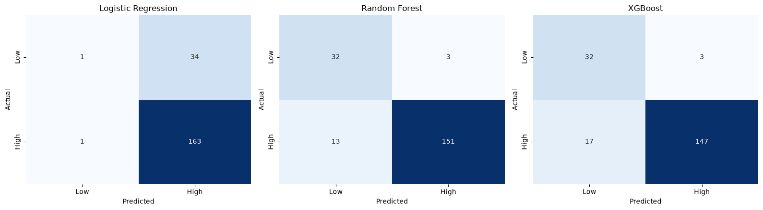
ROC AUC CURVE & CONFUSION MATRIX

Slide 18
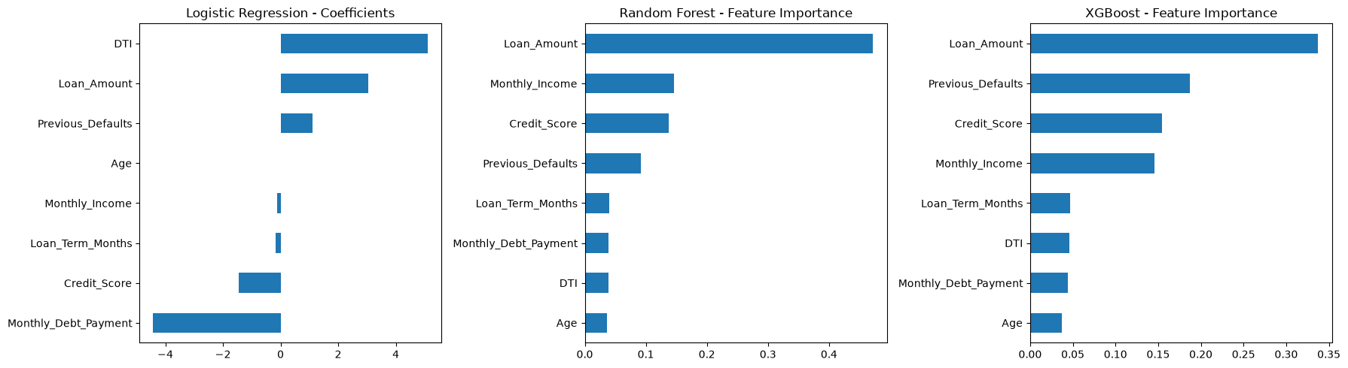
COEFFICEINTS AND FEATURE IMPORTANCE
FEATURE IMPORTANCE ANALYSIS
Feature importance analysis was performed to identify the financial factors that influence loan risk prediction. The graphs compare the feature contributions of Logistic Regression, Random Forest, and XGBoost.
In Logistic Regression, the DTI ratio and Loan Amount have strong positive coefficients, while Monthly Debt Payment has a strong negative coefficient. In Random Forest, Loan Amount is the most important feature, followed by Monthly Income and Credit Score. Similarly, XGBoost identifies Loan Amount as the most influential feature, followed by Previous Defaults, Credit Score, and Monthly Income.
Overall, the analysis shows that Loan Amount is an important factor in both tree-based models, while the relative importance of other features varies across algorithms. These visualizations help explain how different machine learning models use applicant financial information to classify loan risk.

Slide 19
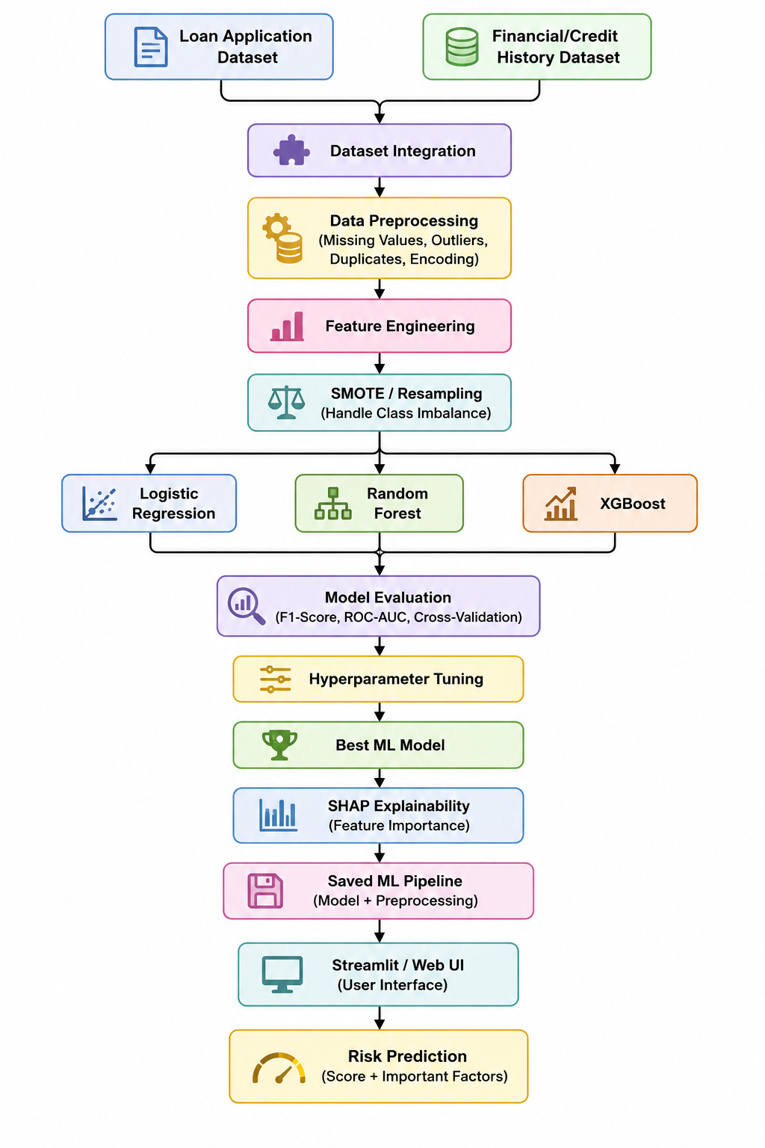
SYSTEM EXECUTION PROCESS

Slide 20
SAVING BEST MODEL AS PKL FILE
SAVING THE BEST MODEL AS A PKL FILE
After evaluating the three machine learning algorithms, Random Forest was selected as the best-performing model because it achieved the highest accuracy of 91.96%.
The trained Random Forest model is saved as a .pkl file using the Joblib library. The preprocessing imputer and selected feature names are also saved separately to ensure that new applicant data is processed consistently during prediction.
Key Points:
Model Saving: Saves the trained Random Forest model as loan_risk_random_forest.pkl.
Preprocessing: Saves the median imputer as loan_risk_imputer.pkl.
Feature Storage: Saves the selected feature names as loan_risk_features.pkl.
Model Reusability: Allows the trained model and preprocessing files to be loaded later without retraining the model.
Streamlit Integration: The saved files can be loaded by the Streamlit application to predict whether an applicant belongs to the Low Risk or High Risk category.
This process makes the trained model reusable and connects the machine learning training stage with the loan risk prediction application.

Slide 21
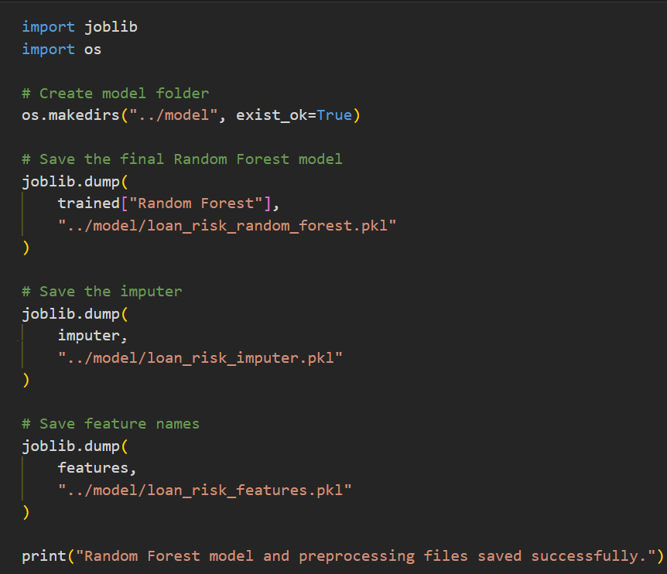
SAVING BEST MODEL AS PKL FILE

Slide 22
STREAMLIT APPLICATION OUTPUT
The system provides a simple and user-friendly Streamlit web interface for loan risk prediction.
Users can enter important applicant details such as:
  Age
  Monthly Income
  Loan Amount
  Loan Term
  Credit Score
  Previous Defaults
  Monthly Debt Payment
The system automatically calculates the Debt-to-Income (DTI) Ratio from the entered financial information.
After entering the required details, the user can click “Predict Loan Risk” to generate the prediction.
The trained Machine Learning model analyzes the input features and classifies the applicant as Low Risk or High Risk.
The interface also displays the High Risk and Low Risk probabilities along with the prediction result.
The Streamlit interface connects the trained ML model with the user input, making the prediction process fast and easy to use.

Slide 23
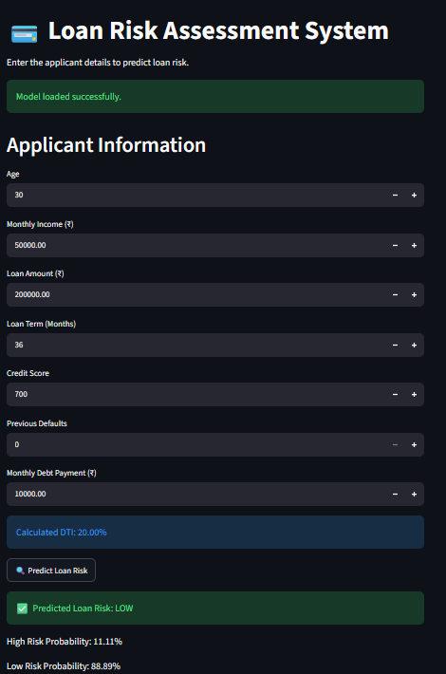
STREAMLIT APPLICATION OUTPUT

Slide 24
CONCLUSION
The Loan Risk Assessment System successfully applies Machine Learning techniques to analyze loan application and financial information and predict the risk level of applicants. The project included data cleaning, exploratory data analysis, feature selection, and the creation of the Debt-to-Income (DTI) Ratio as an additional feature.
Three Machine Learning models — Logistic Regression, Random Forest, and XGBoost — were trained using the prepared dataset. SMOTE was used to handle class imbalance and improve the representation of the risk classes during training. The models were evaluated using Accuracy, Precision, Recall, F2-Score, and ROC-AUC.
The system provides a data-driven approach for identifying Low Risk and High Risk loan applicants. With the integration of a Streamlit interface, the trained model can provide loan-risk predictions through a simple and user-friendly application. Overall, the project demonstrates how Machine Learning can be applied to support a faster, consistent, and data-based loan risk assessment process.

Slide 25
FUTURE ENHANCEMENTS
Future Enhancements:
• The system can be trained using larger and more diverse loan datasets to improve its ability to handle different applicant profiles.
• Additional financial features such as employment history, repayment patterns, and credit history can be included for more detailed risk assessment.
• Advanced Machine Learning and Deep Learning techniques can be explored to improve prediction performance.
• The system can be integrated with real-time financial and credit data for more updated risk assessment.
• The Streamlit application can be enhanced with a more interactive and user-friendly dashboard.
• The system can provide explanations for each prediction, helping users understand which factors contributed to the predicted risk.
• The application can be deployed on a cloud platform so that it can be accessed remotely.
• Future versions can include automatic model retraining when new loan data becomes available.

Slide 26
THANK YOU

