Slide 1
Rule Based Machine Translation

Slide 2
Introduction
Rule-Based Machine Translation (RBMT) is a foundational approach to machine translation, relying on linguistic rules and dictionaries to translate text from one language to another.

Slide 3
Historical Background
The first RBMT systems were developed in the early 1970s. The most important steps of this evolution were the emergence of the following RBMT systems:
Georgetown-IBM, Japanese MT systems
Today, other common RBMT systems include:
Apertium, GramTrans

Slide 4
Key Components of RBMT
RBMT systems consist of various components, including Linguistic rules (govern how words and phrases are translated), Dictionaries (provide lexical information), and Translation algorithms.
Examining these components helps us grasp the inner workings of RBMT systems.

Slide 5
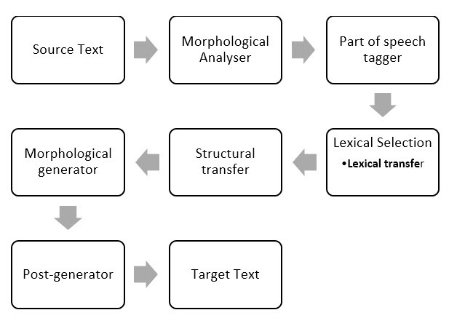

Slide 6
Types of RBMT
There are 3 different types of RBMT systems:
Direct (Dictionary Based MT) map input to output with basic rules.
Transfer RBMT (Transfer Based MT) employ morphological and syntactical analysis.
Interlingual RBMT (Interlingua) use an abstract meaning.

Slide 7
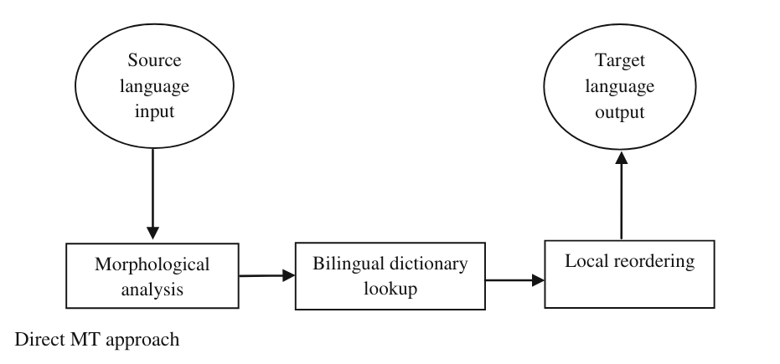
Types of RBMT

Slide 8
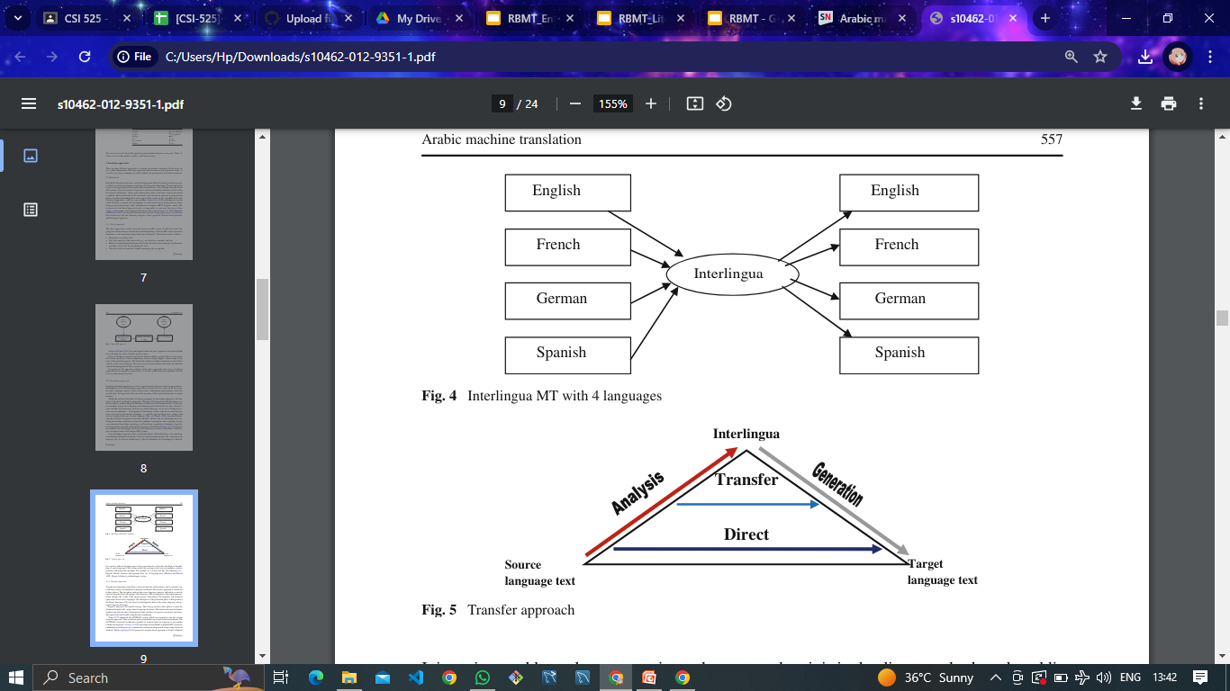
Types of RBMT

Slide 9
Types of RBMT

Slide 10
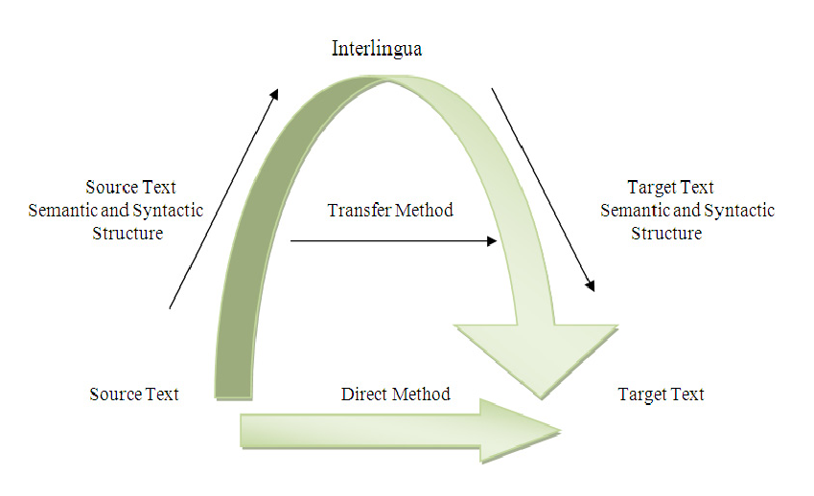
Types of RBMT

Slide 11
Basic principles
The main approach of RBMT systems is based on linking the structure of the given input sentence with the structure of the demanded output sentence, necessarily preserving their unique meaning.

Slide 12
Basic principles
The following example can illustrate the general frame of RBMT:
“A girl eats an apple.”
Source Language = English Demanded Target Language = German

Slide 13
Basic principles
Minimally, to get a German translation of this English sentence one needs:
A dictionary that will map each English word to an appropriate German word.
Rules representing regular English sentence structure.
Rules representing regular German sentence structure.
And finally, we need rules according to which one can relate these two structures together.

Slide 14
Basic principles
Accordingly, we can state the following stages of translation:
1st: getting basic POS information of each source word:
a = indef.article; girl = noun; eats = verb;
an = indef.article; apple = noun

Slide 15
Basic principles
2nd: getting syntactic information about the verb "to eat": NP-eat-NP;
here: eat – Present Simple, 3rd Person Singular, Active Voice

Slide 16
Basic principles
3rd: parsing the source sentence:
(NP an apple) = the object of eat
Often only partial parsing is sufficient to get to the syntactic structure of the source sentence and to map it onto the structure of the target sentence.

Slide 17
Basic principles
4th: translate English words into German
a (category: indef.article) => ein (category: indef.article)
girl (category: noun) => Mädchen (category: noun)
eat (category: verb) => essen (category: verb)
an (category: indef. article) => ein (category: indef.article)
apple (category: noun) => Apfel (category: noun)

Slide 18
Basic principles
5th: Mapping dictionary entries into appropriate inflected forms (final generation):
A girl eats an apple. => Ein Mädchen isst einen Apfel.

Slide 19
Matrics
BLEU (Bilingual Evaluation Understudy)
TER (Translation Edit Rate)
METEOR (Metric for Evaluation of Translation with Explicit Ordering)
NIST (NIST Automated Evaluation of Machine Translation)
WER (Word Error Rate)
Human Evaluation

Slide 20
Pros & Cons
Transparency
Control
Consistency
Coverage
Maintenance
Scalability

Slide 21
Applications
Technical Documentation Translation
Legal Translation
Medical Translation
Localization
Government and Diplomatic Translation
Enterprise Translation Solutions
Language Teaching and Learning
Low-Resource Languages

Slide 22
Challenges in RBMT
Insufficient amount of really good dictionaries. Building new dictionaries is expensive.
Some linguistic information still needs to be set manually.
It is hard to deal with rule interactions in big systems, ambiguity, and idiomatic expressions.
Failure to adapt to new domains. Although RBMT systems usually provide a mechanism to create new rules and extend and adapt the lexicon, changes are usually very costly and the results, frequently, do not pay off.
Notes:
The following are the shortcomings that are associated with RBMT approach:

Slide 23
Conclusion
Rule-based machine translation (RBMT) uses clear rules for accurate translations, but it has limits in coverage and scalability. RBMT is used in many areas and is evaluated using different metrics and human feedback. It's evolving alongside other translation methods to help people communicate across languages.
Notes:
The following are the shortcomings that are associated with RBMT approach:

Slide 24
Thank-you
MSc-AI (CSI-525 : Machine Translation)
23P0620001 (AMAN SINGH)
23P0620002 (CHANDANI JHA)
23P0620003 (DIVIJ PIRANKAR)

