Slide 1


DUAL PORT RAM-BASED IMAGE STORAGE IV B.TECH 1 SEM ECE 1 BATCH A AY:2023-2024
Student Name: B.Dedeepya(20JG1A0410) Ch.Bhargavi(20JG1A0419) K.Harika(20JG1A0446) M.Lavanya(20JG1A0459)
Faculty Coordinator: B.Lakshmi Assistant Professor, ECE Department
DEPARTMENT OF ELECTRONICS AND COMMUNICATION ENGINEERING (ECE)
GAYATRI VIDYA PARISHAD COLLEGE OF ENGINEERING FOR WOMEN
MADHURAWADA, VISAKHAPATNAM-530048

Slide 2
OBJECTIVE:
The objective of this project is to design a Dual Port RAM based image storage, which can store the pixel values of the image and can retrieve the image from the pixel values.
TOOLS USED:
1) Xilinx ISE 14.7 Design Suite.
2) Jupyter Note Book.

Slide 3
INTRODUCTION:
The workflow begins with converting an input image into hexadecimal pixel values, which are stored into a file.
The file is then processed by a Verilog based Dual-Ported RAM system.
This system reads the hexadecimal values and produces an output file containing the read pixel values.
The objective is to use dual-ported ram to read image, demonstrating effective data storage and retrieval.
The final phase involves utilizing another Python script to interpret the output file and reconstruct the original image.
The project aims for accuracy in data preservation and fidelity in image reconstruction.

Slide 4
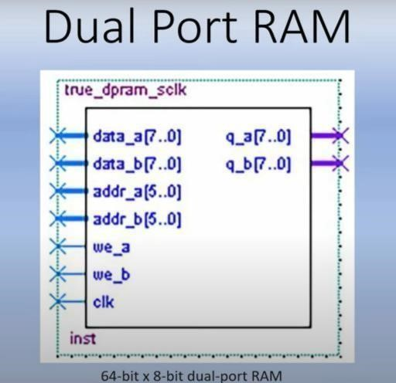
DUAL PORT RAM:
Dual-port RAM is a specialized form of memory that allows for simultaneous independent access to two different sets of data.
It consists of a memory array with two separate ports, enabling two distinct operations (read and write) to occur concurrently and independently.
Each port has its own set of address and data lines, allowing for simultaneous access without interfering with each other.
re
Dual-Port RAM

Slide 5
PROJECT IMPLEMENTAION:
INTRODUCTION:
In the design and development of advanced instruments, particularly in real-time image acquisition and radar data acquisition, there is a common problem: dealing with large amounts of data and high-speed transmission.
As the sample data increases and information processing tasks become more demanding, there is a growing need for highspeed data transmission interfaces to prevent bottlenecks and delays between system modules.
To address this, The dual-port RAM is described as offering high speed, large capacity, and low cost.

Slide 6

CONVERTING IMAGE INTO PIXEL VALUES
IMAGE
DUAL-PORT RAM BASED IMAGE STORAGE
DUAL-PORT RAM DATA READ AND OUTPUT HANDLING
RETREIVING IMAGE FROM PIXEL VALUES
Block Diagram of Project Implementation

Slide 7
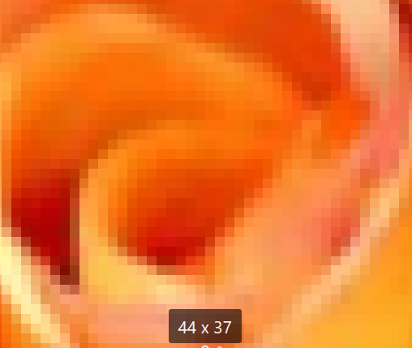
CONVERTING IMAGE INTO PIXEL VALUES:
PYTHON IMPLEMENTATION:
In this approach first convert the input image into hexadecimal pixel values.
The steps followed to this conversion are:
1)Incorporating Image as Input:
Consider an image consisting of 1628 pixels as shown in the image. Image is incorporated as input in the python code using pillow library.
Pillow is a popular Python library for image processing and manipulation. It provides extensive functionality to work with images, such as opening, creating, modifying, and saving various image file formats.
Input Image

Slide 8
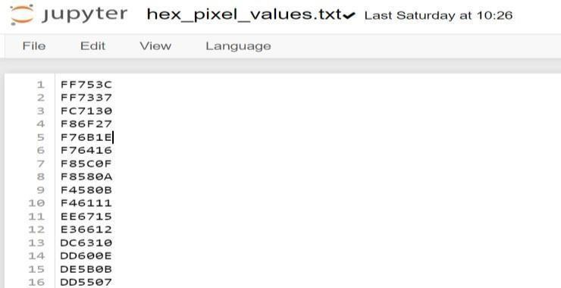
2)Extracting Pixel Data with Python Imaging Library:
Extracted the pixels from the image and converted their values into a hexadecimal format.
This converted pixel values are to be stored in a text file.
Pixel Values

Slide 9
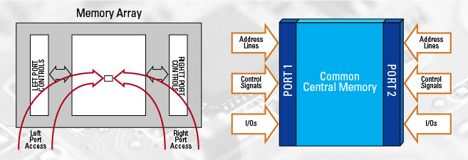
DUAL-PORT RAM DATA READ AND OUTPUT HANDLING:
VERILOG IMPLEMENTATION:
Dual-Port RAM enables simultaneous access to distinct memory locations through its independent read and write ports, facilitating concurrent data operations without contention.
In a dual-port memory system, the "left port" and "right port" refer to two separate access points or interfaces through which the memory can be accessed simultaneously.
Block Diagram of Dual-Port RAM

Slide 10
The read port of the Dual-Port RAM allows for the retrieval of stored data at specific memory addresses, offering quick and parallel data access for various modules or functional units in a design.
Retrieved data from the Dual-Port RAM's read port can be utilized for various purposes, such as feeding into computation units, transferring to output devices, or further processing within the system.
Dual-Port RAM optimizes resource utilization by enabling simultaneous read and write operations, particularly beneficial in applications requiring fast and independent access to memory locations by different components or processes.

Slide 11
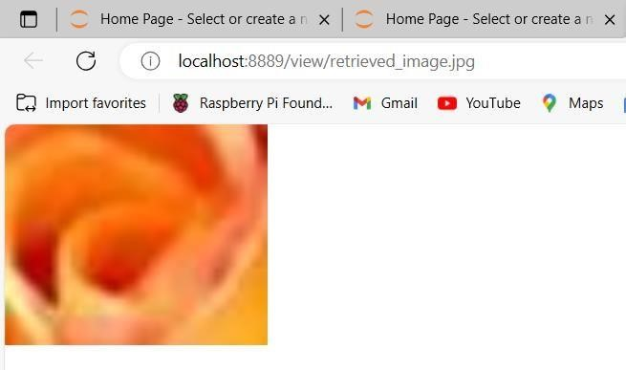
RETREIVING IMAGE FROM PIXEL VALUES:
The next step is to retrieve the input image from the pixel values.
Pixel values file is incorporated as input in the python code using pillow library.
Pillow library provides extensive functionality to work with images, such as opening, creating, modifying, and saving various image file formats.
And the output of this code is the input image of the project.
Retrieved Image

Slide 12
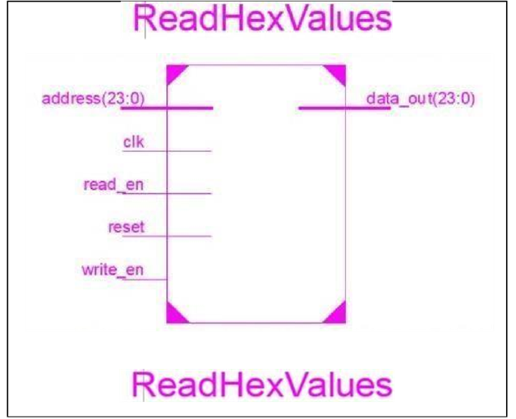
RESULTS:
1)RTL: The RTL Schematic of Data path shows that address(23:0), clk, read_en, reset, write_en are the inputs and the outputs are data_out (23:0).

Slide 13
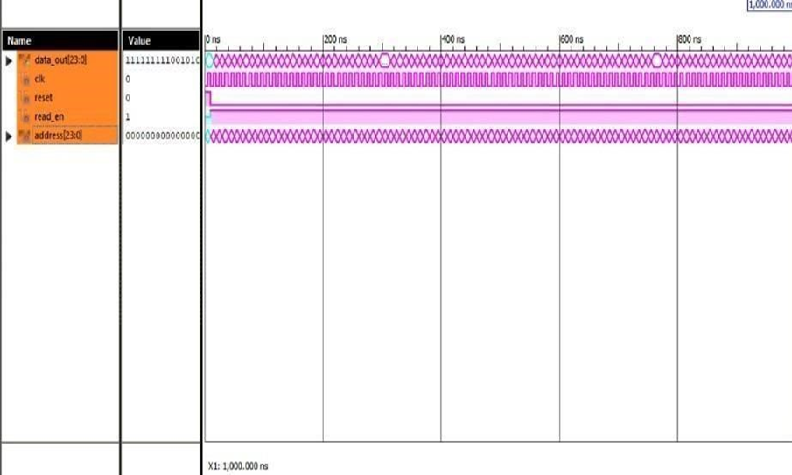
2)SIMULATION RESULTS:
The waveform of a dual-port RAM shows how these different signals interact over time during read and write operations.
It illustrates the coordination between the two ports, showcasing the independence and concurrency of access that characterizes this type of memory.

Slide 14
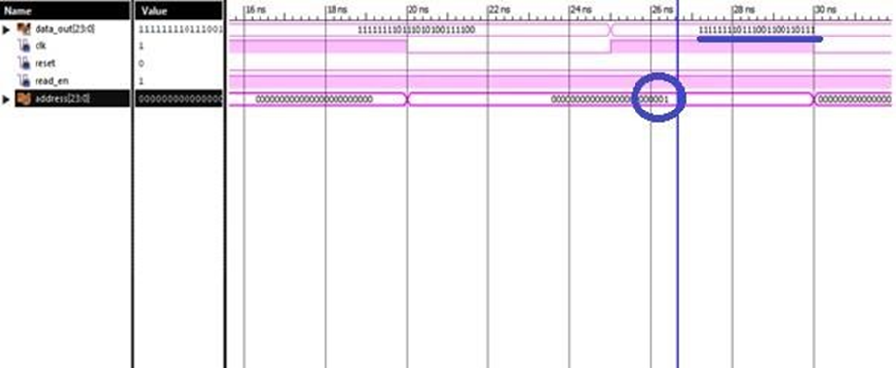
In the read enable mode at address 1 data of 1st pixcel is stored and
showed output 111111110111001100110111 and so on.

Slide 15
CONCLUSION :
The project's culmination brings forth a comprehensive image processing pipeline, seamlessly transitioning from a high-level software environment to a low-level hardware implementation.
The objectives, rooted in the conversion of image data to hexadecimal pixel values, efficient storage and retrieval through a Verilog-based dual-ported RAM system, and the ultimate reconstruction of the original image, have been met.
The integration of Python and Verilog exemplifies the evolving landscape of mixed language design, providing a versatile methodology for tackling complex challenges in digital image processing.

Slide 16
REFERENCES:
1.Haitong Li, Tony F. Wu, Subhasish Mitra and H.-S. Philip Wong, “Resistive RAM-Centric Computing: Design and Modeling Methodology”. IEEE Transactions on Circuits and Systems
2.Yuan Qinghui, male, Jining Shandong, Binzhou Polytechnic “Study on Dual-port RAM based Image Capture and Storage”, Conference Paper · January 2016.

Slide 17
Thank You

