Slide 1
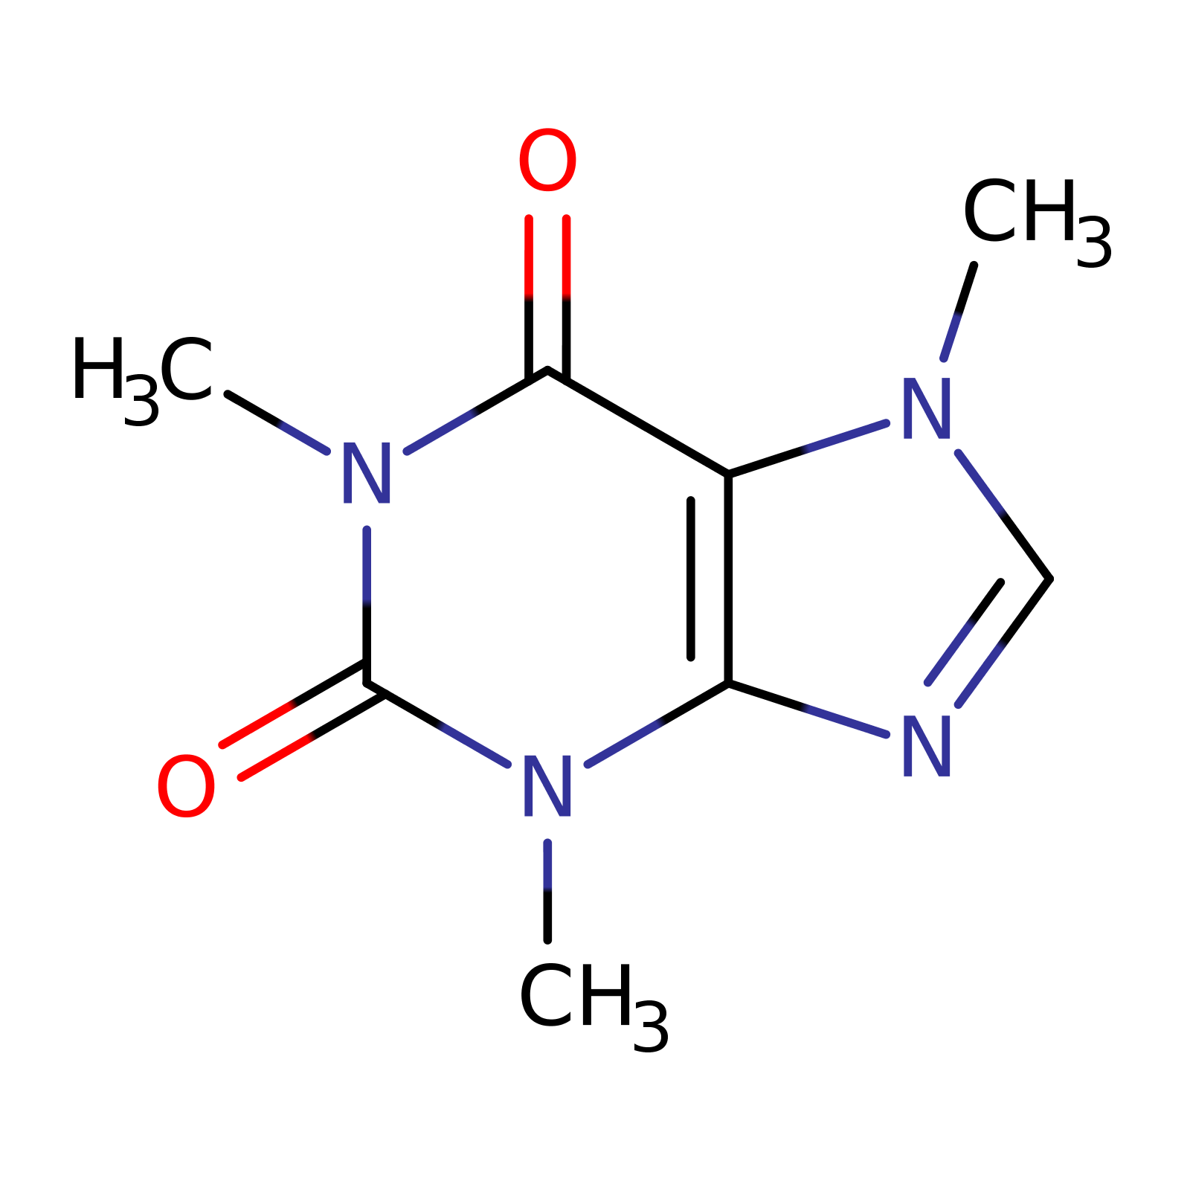

Classes
A
SMILES strings
Ontology classes
B
C
Training
data
implicit label
dependencies
C(CC/C=C\C=C\1/O[C@H]1C
Cl.COc1ccc(OC)c(c1)C(O)C
CC(=O)Oc1ccc(\C=C\C=O)c
O1C2(C1CCC(C3C(C(C3)(C)
Extended
ontology
Symbolic
semantics
D
Specific to general
E
F
G
H
Inputs
labels
Class assertions
A
C
Boxes
B
E
G
AI Model
Learn label
dependencies
Embedding
space
Geometric
regions
ELECTRA
D
F
H
Points
Backpropagation of point-in-box errors
Notes:
Containment within Boxes
implies is_a relation.
Intersection of boxes
indicate multiple parents.

