Slide 1
OOAD-Lecture 02
By
M. Taimoor Khan

Slide 2
Software Engineering vs OOAD:
Software Engineering
  What needs to be done?
  Who does it?
  When is it done?
OOAD
  What needs to be done?
  What classes are responsible for doing it?
  What classes have the job of seeing it gets done?

Slide 3
UML vs Thinking in Objects:
UML (Unified Modeling Language) is just a language; not a method or a methodology
Most of our UML will be pencil-and-paper
This course is about OOAD – Object-Oriented Analysis & Design not UML
What classes/objects?
What responsibilities to what classes?
    “Responsibility-driven design”
Patterns as guidance. These are named solution formulas
Notes:
UML notations are just sketches of how you model your system.

Slide 4
What is UML?
The Unified Modeling Language is a visual language for specifying, construction and documenting the artifacts of systems.
Has a lot more than software design tools
Lots of software for drawing pictures

Slide 5
How to Apply UML?
author’s preference
As a sketch: informal, hand-drawn documents, used for exploration
As a blueprint: detailed design documents, developed by tools that either forward- or reverse engineer code.
  forward: tool takes a picture and produces executable code (mostly stubs).
  reverse: tool takes executable code and draws a picture.
As a Programming Language: Tools produce complete executables.
As an Agile Programming: UML as a sketch.

Slide 6
Three Perspectives in Applying UML
UML does not dictate modeling perspective; e.g. you can use a class diagram for real-world concepts or Java classes.
None the less, perspectives exist:
  Conceptual: Describe the real world
  Specification (software): Describe software abstractions using specs or interfaces – no commitment to a particular implementation
  Implementation (software): Describe an implementation in a particular language.

Slide 7
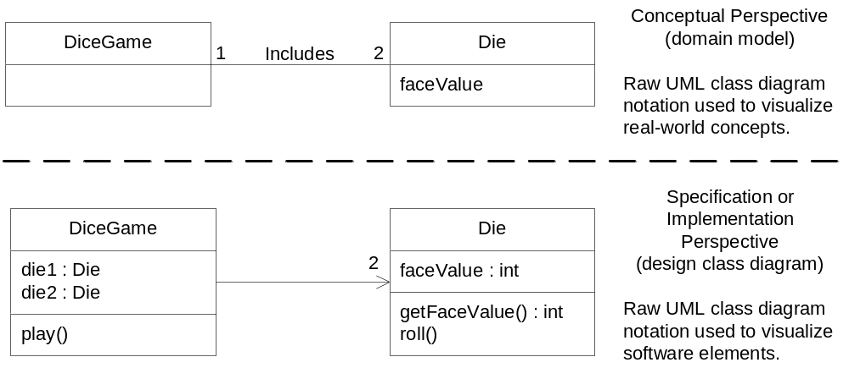
Fig. 1.6

Slide 8
Case Studies:
There are two followed in this book
  NextGen POS (Point-of-Sale)
  Monopoly

Slide 9
Use Cases
Where ever you find OOD, you also find Requirements Analysis
  What does the customer want?
  How to capture the customer needs?
UML offers Use Cases (we will see in Chapter 6) to capture customer requirements
  Use cases expressed in pictures and text.
  Use case pictures use stick figures for human agents, boxes for software agents, circles for processes
  Use case text is a line-by-line description of the user activity.

Slide 10
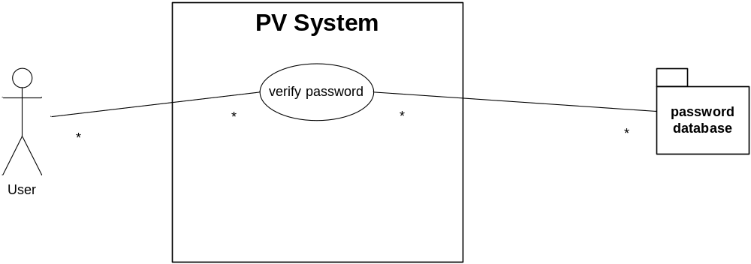
Example: Password Verification (Use Case Diagram)
software system boundary
verifies passwd against db
enters userID/passwd

Slide 11
Example: Password Verification (Use Case Text)
Scenario 1 (Success):
  user enters userID
  user enters password
  password checked against password database
  password valid, user set to go
Scenario 2 (Failure):
  user enters userID
  user enters password
  password fails to check out against password database
  password invalid, user prompted to reenter password
  After third successive failure, program aborts.

Slide 12
What is an Agile Method?
Agile proponents believe
  Current software development processes are too heavyweight or cumbersome
    Too many things are done that are not directly related to software product being produced
  Current software development is too rigid
    Difficulty with incomplete or changing requirements
    Short development cycles (Internet applications)
Notes:
Apply TIMBOXED, iterative and evolutionary development, employ adaptive planning, promote incremental delivery.
Prove agility----- Rapid and Flexible response to change.

Slide 13
What is an Agile Method?
Agile methods are considered
  Lightweight
  People-based rather than Plan-based
Several agile methods
  No single agile method
  XP most popular
No single definition
Agile Manifesto closest to a definition
  Set of principles
  Developed by Agile Alliance
Notes:
Time boxed

Slide 14
Agile Manifesto
1. Our highest priority is to satisfy the customer through early and continuous delivery of valuable software
2. Welcome changing requirements, even late in development. Agile process harness change for the customer´s competitive advantage
3. Deliver working software frequently, from a couple of weeks to a couple of months, with a preference to the shorter timescale

Slide 15
What is Analysis and Design
Analysis:
  investigate problem and its requirements; solution comes later
  ask and answer questions
  Example: Dice Game. Some questions e.g. How the user will interact?
  Requirements Analysis
    investigate requirements
  Object-oriented Analysis
    investigate objects used in and by domain

Slide 16
What is Analysis and Design
Design:
  a conceptual solution that fulfills requirements
  exclude implementation detail; not an implementation
  Example: sequence diagram of given requirements.
  How object Collaborate to fulfill the Requirements?
    Sequence Diagrams
    Class Diagram (Static view)

Slide 17
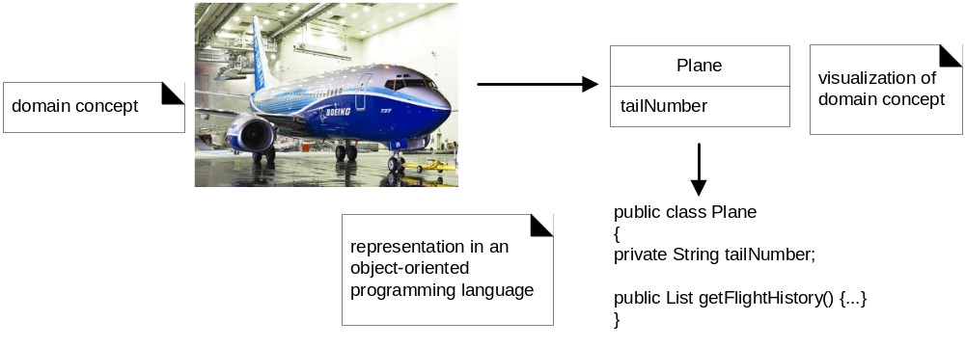
Fig. 1.2
notes in UML

Slide 18
A Short Example
Dicey: In which a program simulates a player tossing two dice.
Define Use Cases
  these are user scenarios, stories, goals
Define a Domain Model
  this is a description of the domain from the point of view of the objects involved
  identify the concepts, attributes and associations
  result is called the domain model
Play a Dice Game Use Case:
  Player requests a roll of the two dices . System presents results. If dice show 7 player wins; otherwise player loses

Slide 19
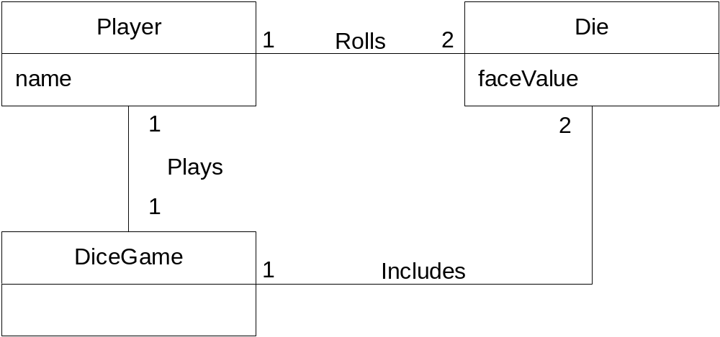
Fig. 1.3
Partial (Conceptual) Domain Model
not descriptive of the software
objects but rather of the domain

Slide 20
Assigning Responsibilities
In a program, objects collaborate – pass each other messages, make data available to one another
Common notation is called a sequence diagram.
A sequence diagram shows the flow of messages between objects
If we know where the message goes we know who is “responsible” for “responding to” the message.
Answering the message involves knowing “how” to answer the message
How close is “flow of message” to the concept of “function call”?

Slide 21
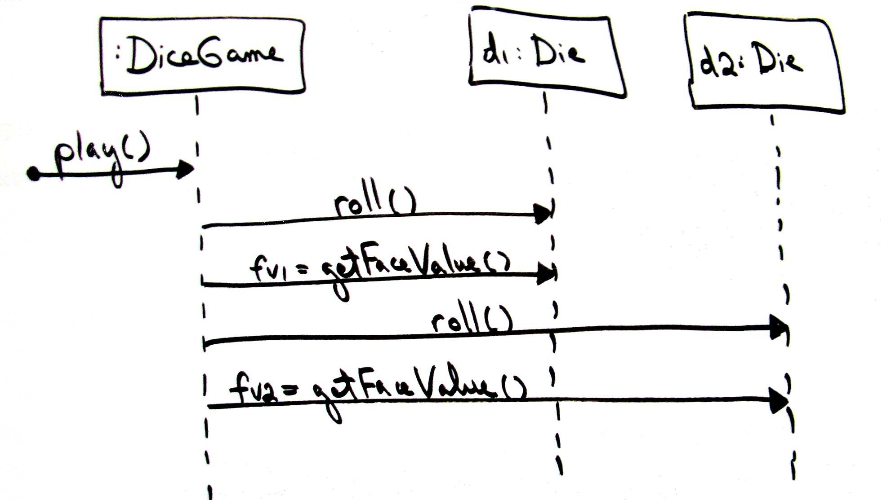
Fig. 1.4

Slide 22
Defining Classes
The preceding is a dynamic view of collaborating classes
The following is a static view of collaborating classes; more often called a class diagram.
Differs from the domain model, with similarities.
Follows the sequence diagram in the order of things.

Slide 23
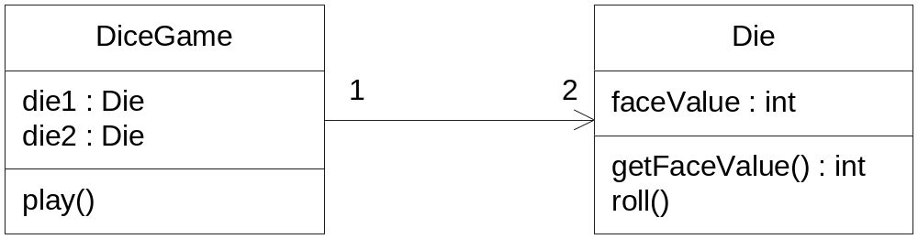
Fig. 1.5

Slide 24
Different Perspectives of “Class”.
Rectangular boxes are classes. But they can be physical things, abstract concepts, software things, events, …
A software design methods or methodologies superimposes structure/naming conventions on the various UML objects.
For example, in the Unified Process (UP), Domain Model, a box represents a conceptual class. In the Design Model they are called Design Classes.
Our book follows UP:
  conceptual class, software class, implementation class.
Notes:
Not all conceptual classes are present in design model e.g. User Conceptual Class in dice game.

Slide 25
Visual Modeling is a Good Thing
Diagrams help our understanding of things.
Text is not easy to learn from, it is so linear.
A picture is worth a thousand words.

