Slide 1
Use case diagrams
M Taimoor Khan
Taimoor.khan@nu.edu.pk

Slide 2
1. Use Case
name
Use cases specify desired behavior.
A use case is a description of a set of sequences of actions, including variants, a system performs to yield an observable result of value to an actor.
Each sequence represent an interaction of actors with the system.

Slide 3
2. Actors
name
An actor represents a set of roles that users of use case play when interacting with these use cases.
Actors are entities which require help from the system to perform their task or are needed to execute the system’s functions.
Actors are not part of the system.

Slide 4
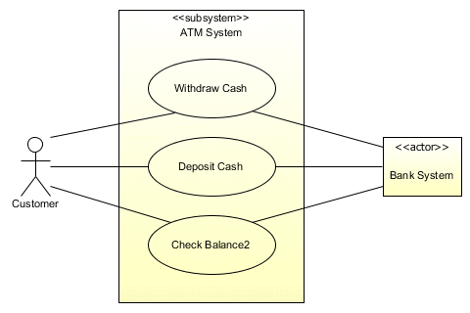
System Actor
Actors can be an automated systems
Such a system already exist and will communicate the system to be built
Can be primary or secondary user

Slide 5
3. Association
Shows presence or absence of possible communication between an actor and a use case
It presents a static view of association i.e., not giving any information about the sequence and count of messages communicated
It doesn’t have a direction and therefore doesn’t indicate the orientation of communication (Its too early for that!)

Slide 6
4. System Boundary
It has everything to be built within it
It defines scope of the system
Everything outside the boundary is system’s environment
5. System Name:
Within Boundary
Book Management System

Slide 7
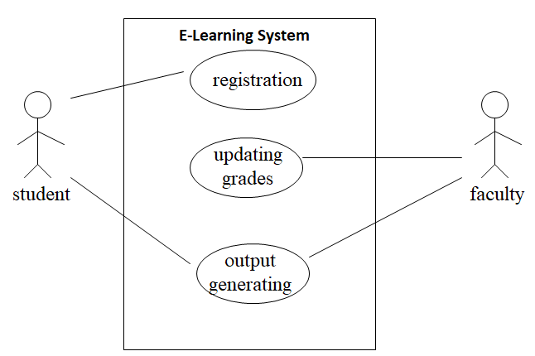
Example of Use Case Diagram

Slide 8
Relationships between Use Cases
1. Generalization - use cases that are specialized versions of other use cases.
2. Include - use cases that are included as parts of other use cases.
3. Extend - use cases that extend the behavior of other core use cases.

Slide 9
1. Generalization
The child use case inherits the
behavior and meaning of the
parent use case.
The child may add to or
override the behavior of its parent.
parent
child

Slide 10
More about Generalization
registration
non-graduate
registration
graduate
registration

Slide 11
Relationships between Actors
Generalization.
student
graduate
student
non-graduate
student

Slide 12
2. Include
The base use case explicitly incorporates the behavior of another use case at a location specified in the base
The included use case never stands alone. It only occurs as a part of some larger base that includes it
Usually needed at more than one base use case
base
<<include>>
included

Slide 13
More about Include
Enables to avoid describing the same flow of events several times by putting the common behavior in a use case of its own.
updating
grades
<<include>>
verifying
student id
output
generating
<<include>>

Slide 14
3. Extend
The base use case implicitly incorporates the behavior of another use case at certain points called extension points.
The base use case may stand alone, but under certain conditions its behavior may be extended by the behavior of another use case.
base
<<extend>>
extending

Slide 15
More about Extend
Enables to model optional behavior or branching under conditions.
<<extend>>
Exam-grade appeal
Exam copy request

Slide 16
Relationships between Use Cases and Actors
Actors may be connected to use cases by associations, indicating that the actor and the use case communicate with one another using messages.
updating
grades
faculty

Slide 17
Modified Home Heating
Home Heating
Power Up
«includes»
Power Down
Adjust Temp
Home Owner
«includes»
Change Temp.

Slide 18
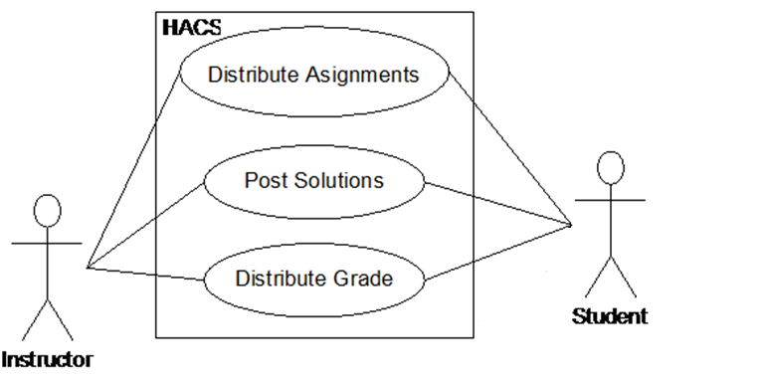

Slide 19
Example- Money Withdraw
Use Case: Withdraw Money
Author: ZB
Date: 1-OCT-2004
Purpose: To withdraw some cash from user’s bank account
Overview: The use case starts when the customer inserts his credit card into the system. The system requests the user PIN. The system validates the PIN. If the validation succeeded, the customer can choose the withdraw operation else alternative 1 –. The customer enters the amount of cash to withdraw. The system checks the amount of cash in the user account, its credit limit. If the withdraw amount in the range between the current amount + credit limit the system dispense the cash and prints a withdraw receipt, else alternative 2 –.

Slide 20
Example- Money Withdraw (cont.)
Actors: Customer
Pre Condition:
The ATM must be in a state ready to accept transactions
The ATM must have at least some cash on hand that it can dispense
The ATM must have enough paper to print a receipt for at least one transaction
Post Condition:
The current amount of cash in the user account is the amount before the withdraw minus the withdraw amount
A receipt was printed on the withdraw amount
The withdraw transaction was audit in the System log file

Slide 21
Example- Money Withdraw (cont.)
Alternative flow of events:
Customer authorization failed. Display an error message, cancel the transaction and eject the card.
Customer has insufficient funds in its account. Display an error message
Customer exceeds its legal amount. Display an error message

Slide 22
Example- Money Withdraw (cont.)
One method to identify use cases is actor-based:
- Identify the actors related to a system or organization.
- For each actor, identify the processes they initiate or participate in.
A second method to identify use cases is event-based:
- Identify the external events that a system must respond to.
- Relate the events to actors and use cases.

Slide 23
Sample Systems
Online purchase
University admission
Joining sports club
Transport system
Flight reservation
Cellular company
Recruitment agency ...

Slide 24
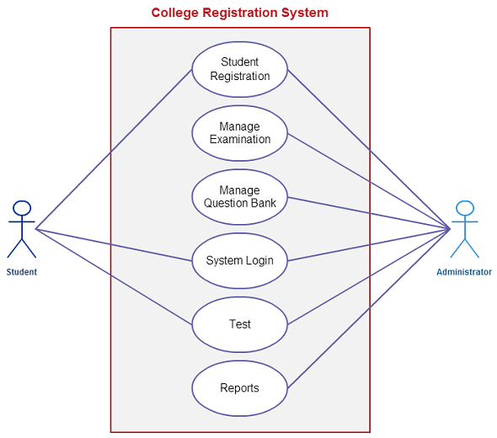

Slide 25
Multiple Use-cases in a single Use-case Diagram (do not try until you have good practice of it)

