Slide 1
OOAD Lecture 3: Software Process Models
M. Taimoor Khan
taimoor.khan@nu.edu.pk

Slide 2
Software Life-Cycle Steps
Life-cycle model (formerly, process model)
Requirements phase
Specification phase
Design phase
Implementation phase
Integration phase
Maintenance phase
Retirement

Slide 3
Different Lifecycle Models
Build-and-fix model
Waterfall model
Rapid prototyping model
Incremental model
Extreme programming
Spiral model
…

Slide 4
Build and Fix Model
Build first
version
Modify until
client is satisfied
Maintenance
phase
Development
Maintenance
Retirement
Notes:
It is unfortunate that many products are developed using what is known as the build-and-fix model.
The product is constructed without specification or any attempt at design.
The developers simply build a product that is reworked as many times as necessary to satisfy the client.
May work for small projects but is totally unsatisfactory for products of any reasonable size.
The cost of build-and fix is actually far greater than the cost of properly specified and carefully designed product.
Maintenance of the product can be extremely in the absence of any documentation.

Slide 5
Waterfall Model
Requirement
Definition
System and
Software Design
Implementation
and Unit Testing
Integration and
System Testing
Operation and
Maintenance
Notes:
The first published model of the software development process was derived from other engineering processes. Because of the cascade from one phase to another, this model is known as the waterfall model. This model is also known as linear sequential model. The principal stages of the model map directly onto fundamental development activities.
It suggests a systematic, sequential approach to software development that begins at the system level and progresses through the analysis, design, coding, testing, and maintenance.
In the literature, people have identified from 5 to 8 stages of software development.
The five stages above are as follows:
Requirement Analysis and Definition: What - The systems services, constraints and goals are established by consultation with system users. They are then defined in detail and serve as a system specification.
System and Software Design: How – The system design process partitions the requirements to either hardware of software systems. It establishes and overall system architecture. Software design involves fundamental system abstractions and their relationships.
Implementation and Unit Testing: - How – During this stage the software design is realized as a set of programs or program units. Unit testing involves verifying that each unit meets its specifications.
Integration and system testing: The individual program unit or programs are integrated and tested as a complete system to ensure that the software requirements have been met. After testing, the software system is delivered to the customer.
Operation and Maintenance: Normally this is the longest phase of the software life cycle. The system is installed and put into practical use. Maintenance involves correcting errors which were not discovered in earlier stages of the life-cycle, improving the implementation of system units and enhancing the system’s services as new requirements are discovered.
In principle, the result of each phase is one or more documents which are approved. No phase is complete until the documentation for that phase has been completed and products of that phase have been approved. The following phase should not start until the previous phase has finished.

Slide 6
Waterfall Model
Requirement
Definition
System and
Software Design
Implementation
and Unit Testing
Integration and
System Testing
Operation and
Maintenance
Notes:
Real projects rarely follow the sequential flow that the model proposes. In general these phases overlap and feed information to each other. Hence there should be an element of iteration and feedback. A mistake caught any stage should be referred back to the source and all the subsequent stages need to be revisited and corresponding documents should be updated accordingly.
Because of the costs of producing and approving documents, iterations are costly and require significant rework.

Slide 7
Rapid Prototyping Model
Rapid
Prototyping
Requirement
Definition
System and
Software Design
Implementation
and Unit Testing
Integration and
System Testing
Operation and
Maintenance
Notes:
Real projects rarely follow the sequential flow that the model proposes. In general these phases overlap and feed information to each other. Hence there should be an element of iteration and feedback. A mistake caught any stage should be referred back to the source and all the subsequent stages need to be revisited and corresponding documents should be updated accordingly.
Because of the costs of producing and approving documents, iterations are costly and require significant rework.

Slide 8
Incremental Model
Requirements phase
Verify
Specification phase
Verify
Architectural design
Verify
For each build:
Perform detailed design, implementation and integration,
test, deliver to client
Maintenance phase
Development
Retirement
Maintenance

Slide 9
Incremental Model (cont.)
Build 1
Specification
Design
Implementation, integration
Deliver to client
Build 2
Specification
Design
Implementation, integration
Deliver to client
Build 3
Specification
Design
Implementation, integration
Deliver to client
Build n
Specification
Design
Implementation, integration
Deliver to client
Specification team
Implementation, integration team
Design team

Slide 10
Spiral Model
Precede each phase by
Risk analysis
Verification
Follow each phase by
Planning of next phase

Slide 11
Simplified Spiral Model
Risk Analysis
If risks cannot be resolved, project is immediately terminated
Rapid Prototype
Specification
Design
Implementation
Verify
Integration

Slide 12
Full Spiral Model
Angular dimension (progress)
Radial dimension (cost)

Slide 13
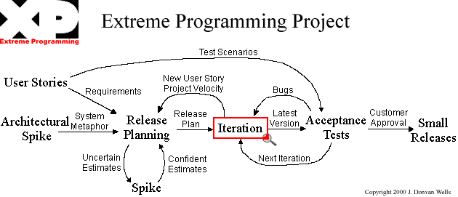
Extreme Programming

Slide 14
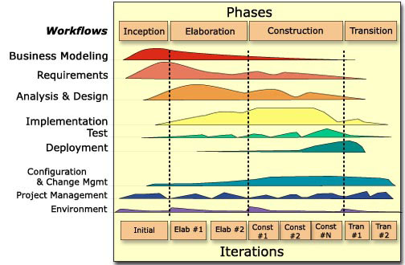
Rational Unified Process
(this Figure is from P. Krutchen’s paper)

Slide 15
Documentation Phase?
There is NO documentation phase
Every phase must be fully documented before starting the next phase
Postponed documentation may never be completed
The responsible individual may leave
The product is constantly changing—we need the documentation to do this
The design (for example) will be modified during development, but the original designers may not be available to document it

Slide 16
Phase | Documents | QA
Requirement Definition | Rapid prototype, or Requirements document | Rapid prototype Reviews
Functional Specification | Specification document (specifications) Software Product Management Plan | Traceability FS Review
Design | Architectural Design Detailed Design | Traceability Review
Coding | Source code Test cases | Traceability Review Testing
Integration | Source code Test cases | Integration testing Acceptance testing
Maintenance | Change record Regression test cases | Regression testing

Slide 17
Traceability matrix
Requirement ID | Use Case ID | UID | Class/ function | Test Case ID

