Slide 1
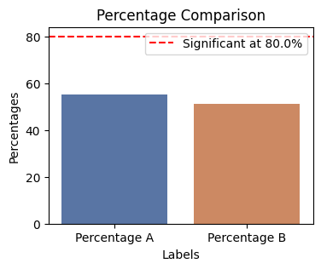
This is the title for the slide 123!
Significant at 80.0% level (p-value: 0.1758)

