Slide 1
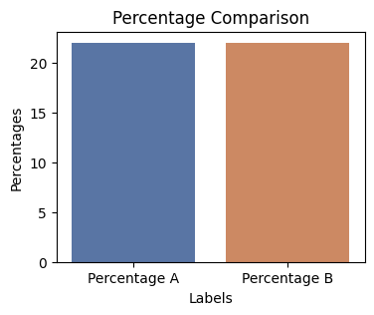
Well does this work
Not significant (p-value: 1.0000)

