Slide 1
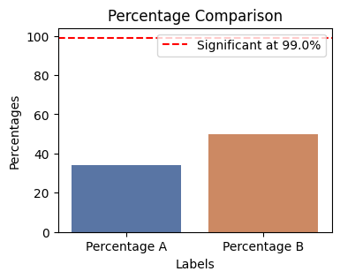
well this is some shit
Significant at 99.0% level (p-value: 0.0004)

