Slide 1
UoH Help Hub
21MCME33,Chettipally Kamal Sai
21MCME10, Pola Akhil

Slide 2
KEY HIGHLIGHTS -LOST AND FOUND
Efficient Reporting: The app enables students to swiftly report lost items by providing essential details like description and location, fostering a quick response system within the university community.
Seamless Communication: With features like cross-verification and updates, users can easily contact the owner upon finding an item, enhancing the chances of reuniting lost belongings with their rightful owners.

Slide 3
KEY HIGHLIGHTS -DONATION MANAGEMENT
Optimized Resource Utilization: The platform efficiently matches surplus resources with organization needs, ensuring that excess food and other resources from restaurants and events are redirected to charitable associations, minimizing wastage and maximizing impact.
Enhanced Transparency: Through features like real-time tracking and automated email notifications, the platform promotes transparency in the donation process, allowing users to monitor the status of their donations and fostering trust between donors and charitable associations.

Slide 4
TECHNICAL DETAILS
In our development setup, we relied on user-friendly tools like Visual Studio Code (VSCode) for coding, and Expo Go mobile app for instant testing on Android device. Node.js served as the backbone for running our JavaScript code, while React Native provided the framework for building our mobile app. To handle our data needs, we turned to MySQL as our database system. These tools, working together, made our development process smooth and efficient.

Slide 5
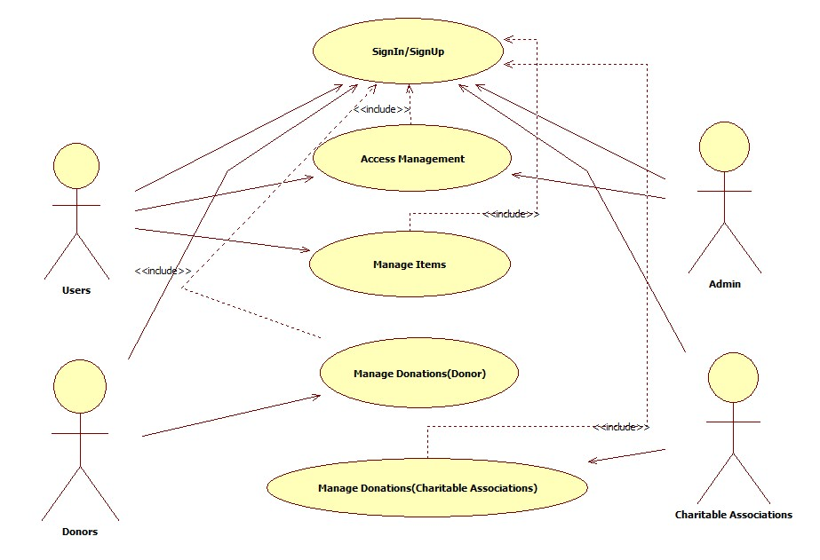
Use case diagram

Slide 6
OUTCOMES
Efficient Resource Allocation: Both the Lost and Found app and the Donation Matching Platform contribute to efficient resource allocation by streamlining processes and connecting individuals with lost items or surplus resources to those in need, reducing wastage and enhancing community support.
Improved Community Engagement: These applications foster a sense of community engagement by providing platforms for users to actively participate in helping others. Whether it's reuniting lost items with their owners or donating surplus resources to charitable organizations, users feel empowered to make a positive impact within their communities.

Slide 7
OUTCOMES
Enhanced User Experience: By offering user-friendly interfaces and seamless functionalities, both apps aim to enhance the overall user experience. With features like easy reporting and communication in the Lost and Found app, and streamlined donation matching and transparent tracking in the Donation Matching Platform, users can navigate the platforms effortlessly, leading to increased satisfaction and engagement.

Slide 8
THANK YOU

