Slide 1
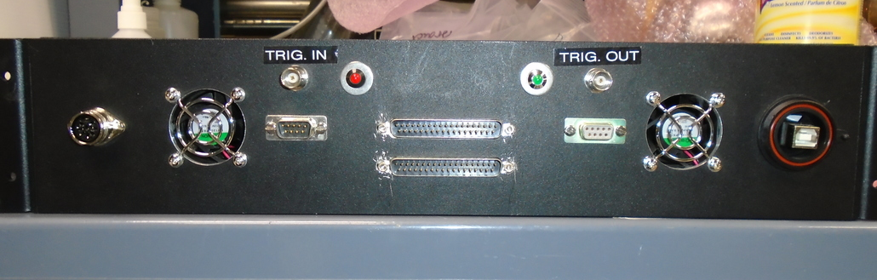
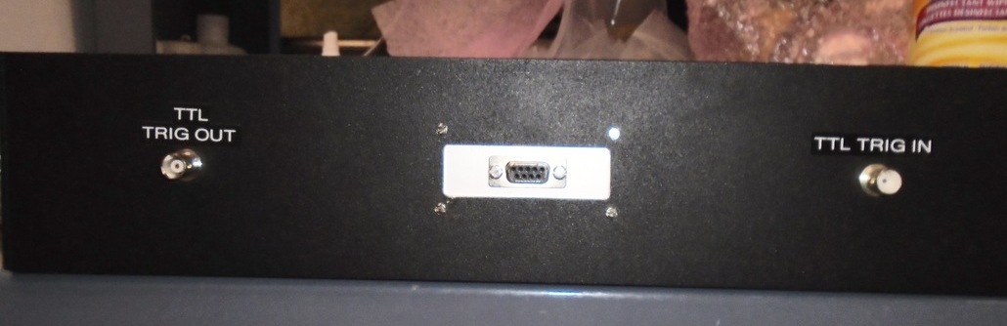
ECL Trigger_in
ECL Trigger_out
Ribbon cable to
boxes 7-12
RS232 serial
communication port
Disconnected
RS232 port
Power input
USB communication
Port
Ribbon cable to
boxes 1-6
TTL Trigger_out
TTL Trigger_in
RS232 ‘display’ port

Slide 2
TTL Trigger out
5
ECL Trigger out
4
3
2
TTL Trigger in
1
ECL Trigger in

Slide 3
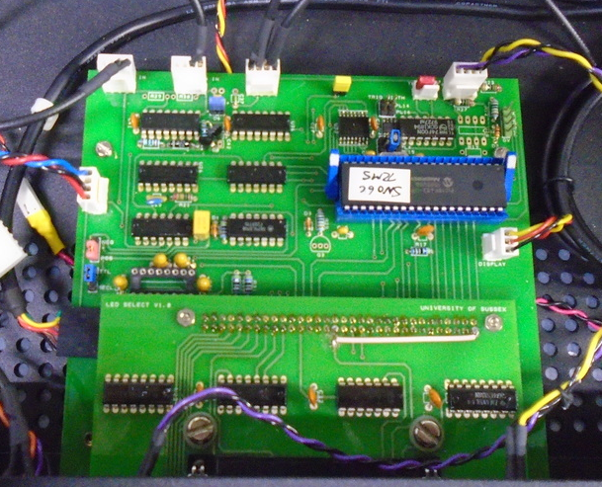
5
1
4
2
3

Slide 5
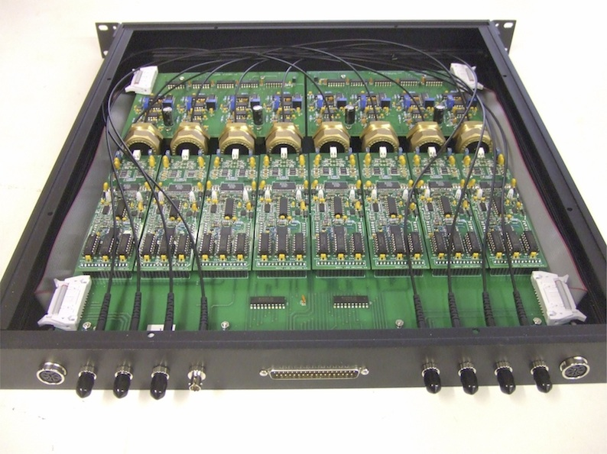
A driver & readout channel
Channel 8
Channel 1
Power Input
Power Input
Ribbon cable from
control box
Ch 1
Output
Ch 2
Output
Ch 3
Output
Ch 4
Output
Ch 5
Output
Ch 6
Output
Ch 7
Output
Ch 8
Output

Slide 6
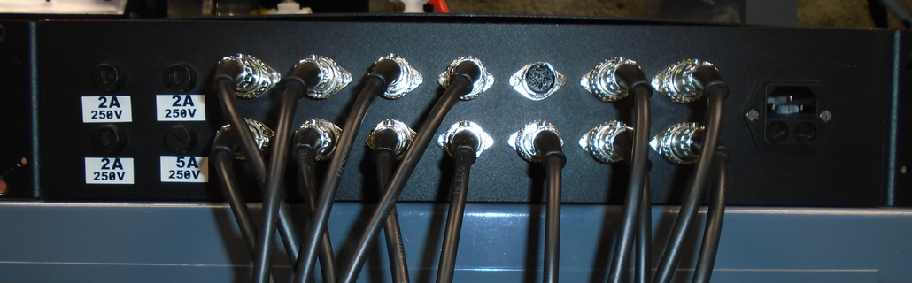
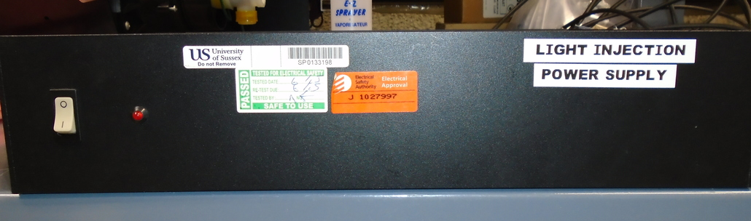
Power out lines to TELLIE boxes
Old fuse housings
Mains power in
Power on switch

Slide 7
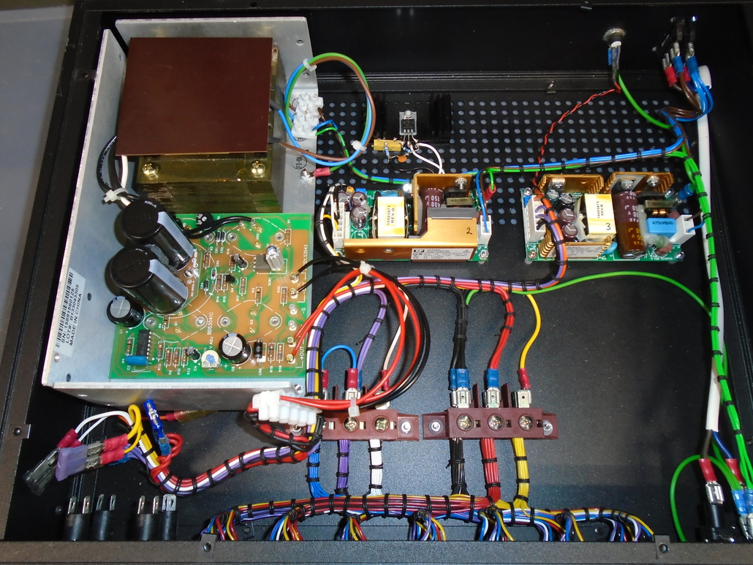
+5V Supply
+9V Supply
-5V Supply
Fuses
Probe points
Old fuse housings
Power in

Slide 8
1
ORCA
1
MTC/D
2 (x10)
ELLIE
3 (x10)
2 (x10)
Crates
Flash

Slide 9
1
ORCA
3 (x10)
1
MTC/D
2 (x10)
TUBii
ELLIE
4 (x10)
2 (x10)
Crates
Flash

Slide 10
1
ORCA
4 (x10)
1
MTC/D
3 (x10)
TUBii
ELLIE
5 (x10)
2 (x10)
3 (x10)
Crates
Flash

Slide 11
MTC/D
TUBii
EXT- ASYNC
TELLIE in
MicroZ allows us to connect TELLIE/
SMELLIE delay lines to outputs
TELLIE delay
Previously TELLIE out
SMELLIE in
Previously SMELLIE out
SMELLIE delay
Trigger latched to
50 MHz clock

