Slide 1

St. Peters Engineering College
PREDICTION OF SOIL FERTILITY USING
NAÏVE BAYES ALGORITHM
Under the Guidance of
Name of the Guide, Designation
Department of Information Technology
Presented by
Ch. Rakesh , 20BK1A1227
B. AKSHAYA REDDY , 20BK1A1216
G. NISHANTH REDDY, 20BK1A1240

Slide 2
Abstract
Abstract
Introduction
Problem Statement
Existing System
Proposed System
Software/Hardware Requirements
References
Improved crop yields from enhanced soil fertility contribute to global food security , reduced chemicals promote sustainable soil fertility and eco-friendly world.

Slide 3
Abstract
Introduction
Problem Statement
Existing System
Proposed System
Software/Hardware Requirements
References
Introduction
In this project work, Steps forbuilding a predictive model of soil fertility havebeenexplained.Soil data is received in the form of datasheets and then these are stored forfurtherprocessing.
A standard dataset is maintained for the purpose of comparison to assessthe soil fertility.Data stored is then processed using the naïve bayes algorithm. The resultant datathus obtained is compared with the previously maintained standard dataset.
Based on the accuracy of data with respect to standard data is obtained andthen the fertily of soil is concluded to fertile or infertile. This project aims at predicting soilfertility class using naïve bayes algorithm in data mining .

Slide 4
Abstract
Introduction
Problem Statement
Existing System
Proposed System
Software/Hardware Requirements
References
Problem Statement
The crop production mainly depends on the rate of soil nutrients.
It is important for the farmers to determine the soil fertility requirement for increasing the crop production yield.
This may lead to low agriculture production quality and less crop production yield because using inappropriate rate of soil nutrients .
Improper usage of soil fertilizers may results into the poor quality of production

Slide 5
Abstract
Introduction
Problem Statement
Existing System
Proposed System
Software/Hardware Requirements
References
Existing System
J48 is a program that creates a decision tree based on a set of input data.
But J48 is not suitable for huge data sets . Pruning needs to be done.
Pruning is process of removal of least used data, where we may lose accuracy.

Slide 6
Abstract
Introduction
Problem Statement
Existing System
Proposed System
Software/Hardware Requirements
References
Proposed System
Naive-Bayes Classification Algorithm
Naïve Bayes algorithm is a supervised learning algorithm, which is based on Bayes theorem and used for solving classification problems.
It is mainly used in text classification that includes a high-dimensional training dataset.
Naïve Bayes Classifier is one of the simple and most effective Classification algorithms which helps in building the fast machine learning models that can make quick predictions

Slide 7
Abstract
Introduction
Problem Statement
Existing System
Proposed System
Software/Hardware Requirements
References
Software/Hardware Requirements
HTML
SCSS
TYPESCRIPT
ANGULAR FRAMEWORK
PYTHON
NODE.JS
2/10

Slide 8
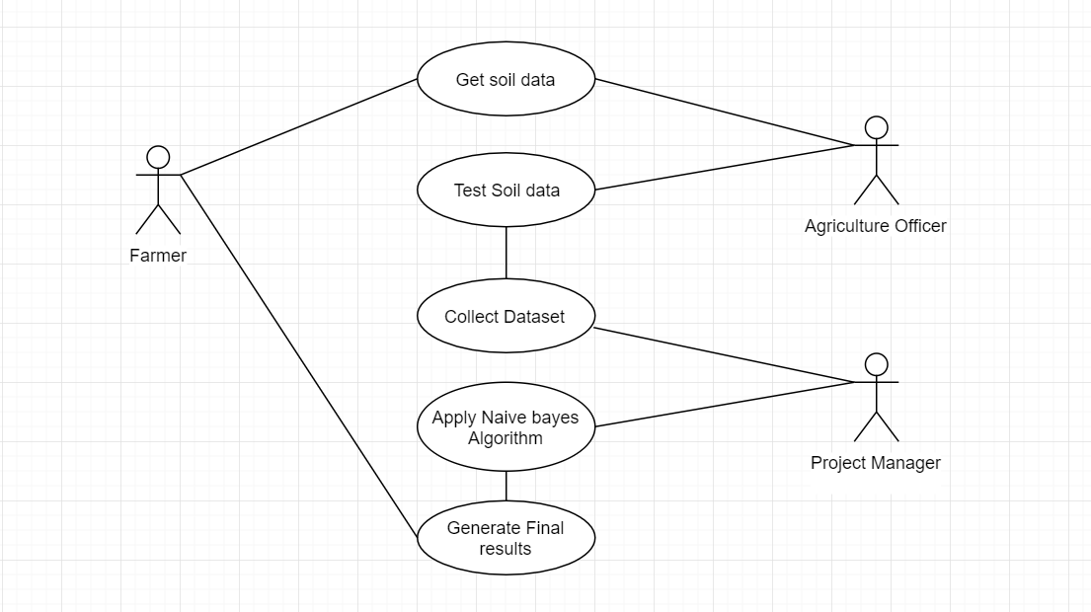
UML DIAGRAMS
1. USE CASE DIAGRAM

Slide 9
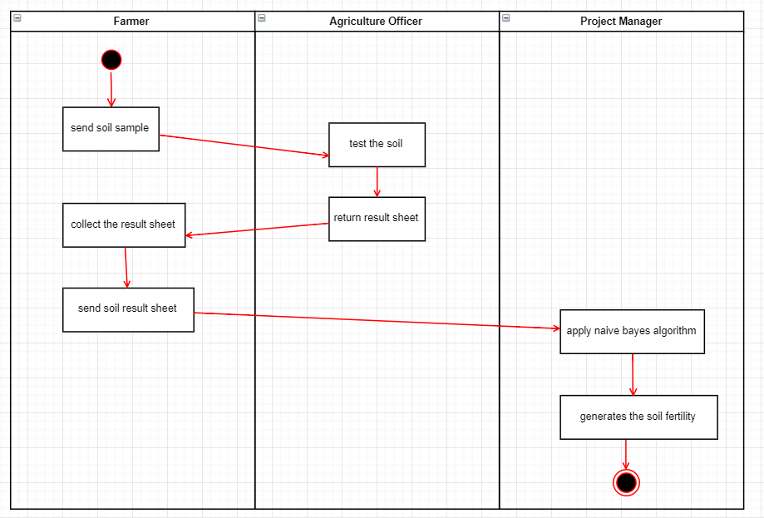
2. ACTIVITY DIAGRAM

Slide 10
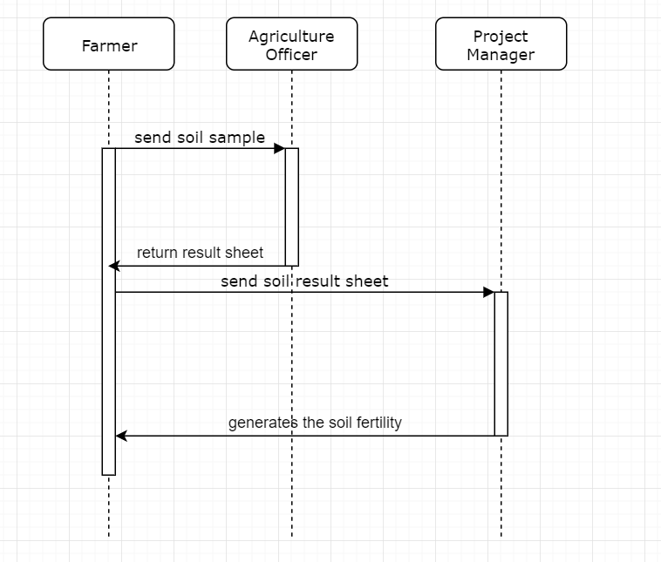
3. SEQUENCE DIAGRAM

Slide 11
Abstract
Introduction
Problem Statement
Existing System
Proposed System
Software/Hardware Requirements
References
References
“Naïve Bayes”, Wikipedia, February 2012
”C4.5 (J48)”, Wikipedia, February 2012
R. Vamanan& K. Ramar, (2011), “Classification Of Agricultural Land Soils A Data Mining Approach”, International Journal on Computer Science and Engineering, ISSN: 0975-3397, Vol.3

Slide 12
Q and A?
?

