Slide 1




Breast Cancer Diagnosis Prediction
Using MLP

Slide 2

Outline
Problem Statement
Findings
Proposed Solution
Code Walkthrough
Current Limitations
References
Notes:
When conducting research, it is easy to go to one source: Wikipedia. However, you need to include a variety of sources in your research. Consider the following sources:
Who can I interview to get more information on the topic?
Is the topic current and will it be relevant to my audience?
What articles, blogs, and magazines may have something related to my topic?
Is there a YouTube video on the topic? If so, what is it about?
What images can I find related to the topic?

Slide 3

Problem Statement
Breast cancer is the most common cancer amongst women in the world. It accounts for 25% of all cancer cases and affected over 2.1 Million people in 2015 alone. It starts when cells in the breast begin to grow out of control. These cells usually form tumors that can be seen via X-ray or felt as lumps in the breast area.
The key challenges against it’s detection is how to classify tumors into malignant (cancerous) or benign(non cancerous).
Notes:
After consulting a variety of sources, you will need to narrow your topic. For example, the topic of internet safety is huge, but you could narrow that topic to include internet safety in regards to social media apps that teenagers are using heavily. A topic like that is more specific and will be relevant to your peers. Some questions to think about to help you narrow your topic:
What topics of the research interest me the most?
What topics of the research will interest my audience the most?
What topics will the audience find more engaging? Shocking? Inspiring?

Slide 4
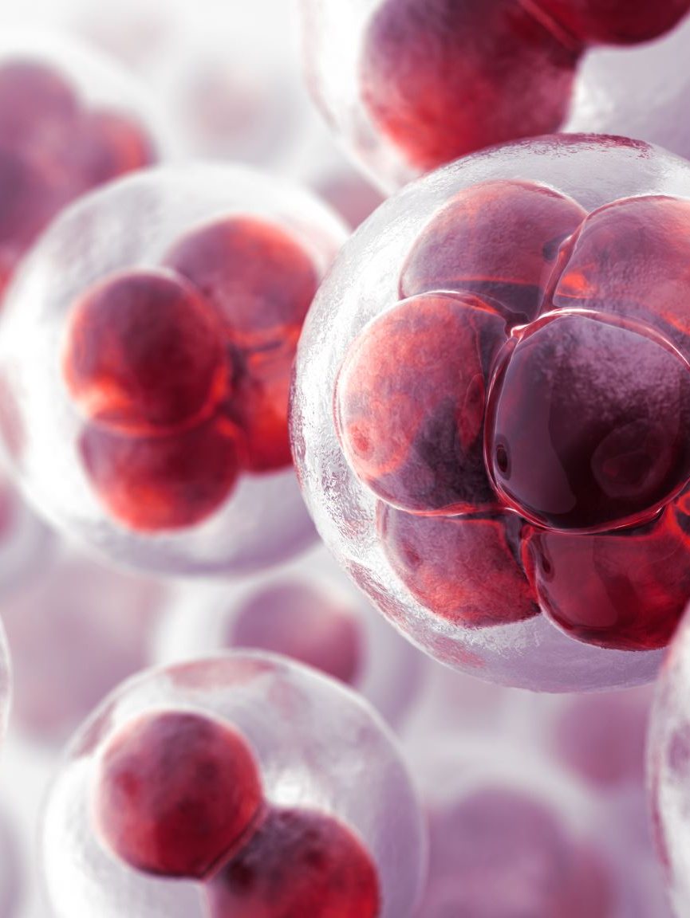
Dataset
Source : Kaggle
Data Count : 569 rows and 32 columns
Description: The dataset includes various features, such as measurements related to cell radius, texture, perimeter, area, smoothness, compactness, concavity, symmetry, fractal dimension, and more. The 'diagnosis' column indicates the diagnosis of breast cancer, with 'M' representing malignant cases and 'B' representing benign cases. This dataset is used for classification tasks, particularly for predicting whether a breast tumor is malignant or benign based on the provided features. Machine learning and data analysis techniques can be applied to develop models for breast cancer diagnosis using this dataset.
Notes:
Once you find your sources, you will want to evaluate your sources using the following questions:
Author:
Who is the author?
Why should I believe what he or she has to say on the topic?
Is the author seen as an expert on the topic? How do you know?
Current:
How current is the information in the source?
When was the source published?
Is the information out-of-date?
Accuracy:
Is the content accurate?
Is the information presented objectively? Do they share the pros and cons?

Slide 5
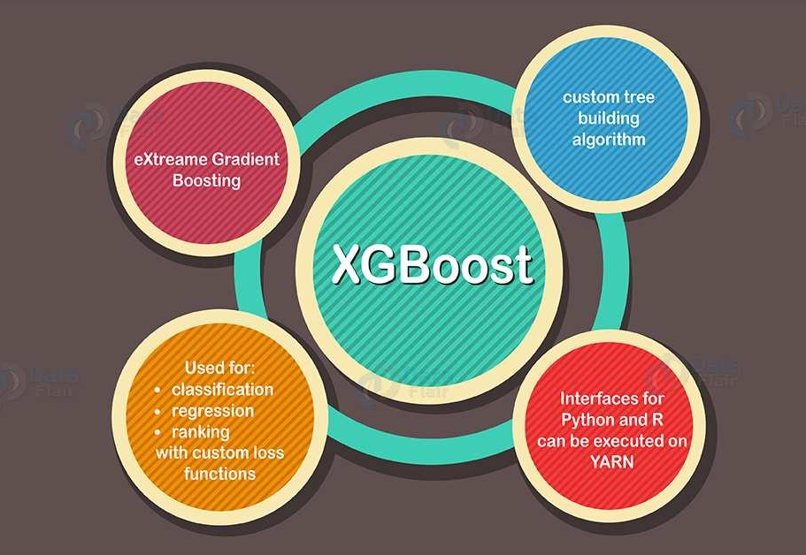

Traditional Models
And their Performances.
Notes:
You can use this slide as your opening or closing slide. Should you choose to use it as a closing, make sure you review the main points of your presentation. One creative way to do that is by adding animations to the various graphics on a slide. This slide has 4 different graphics, and, when you view the slideshow, you will see that you can click to reveal the next graphic. Similarly, as you review the main topics in your presentation, you may want each point to show up when you are addressing that topic.
Add animation to images and graphics:
Select your image or graphic.
Click on the Animations tab.
Choose from the options. The animation for this slide is “Split”. The drop-down menu in the Animation section gives even more animations you can use.
If you have multiple graphics or images, you will see a number appear next to it that notes the order of the animations.
Note: You will want to choose the animations carefully. You do not want to make your audience dizzy from your presentation.

Slide 6
XGBoost
XGBoost (Extreme Gradient Boosting) is an ensemble machine learning algorithm that's based on decision trees. It is known for its high performance, efficiency, and flexibility in a wide range of machine learning tasks.
XGBoost often achieves high accuracy on this dataset due to its ability to capture complex relationships between features and the target variable. XGBoost provides information about feature importance, helping to identify which features contribute most to the classification. This is valuable for understanding the factors that influence breast cancer diagnosis.
XGBoost is robust to noisy data and outliers, which is important in medical datasets where data quality can vary.

Slide 7
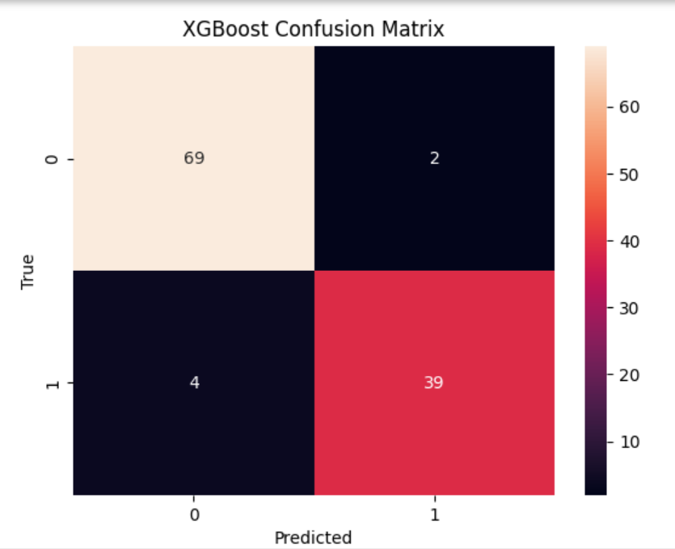
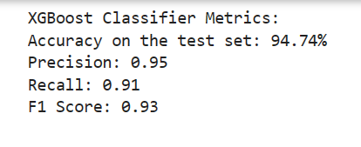
Performance

Slide 8
Random Forest
It is one of the most powerful and widely used machine learning algorithms for classification and regression tasks. Random Forest combines multiple decision trees to make predictions.
The dataset has a relatively high number of features (30 features). Random Forest can effectively handle high-dimensional data and select the most important features during the tree-building process.
Random Forest is robust to noisy data and can handle datasets with missing values or outliers, which is common in medical datasets. And the ensemble nature of Random Forest helps reduce overfitting, making it more robust to variations in the data.

Slide 9
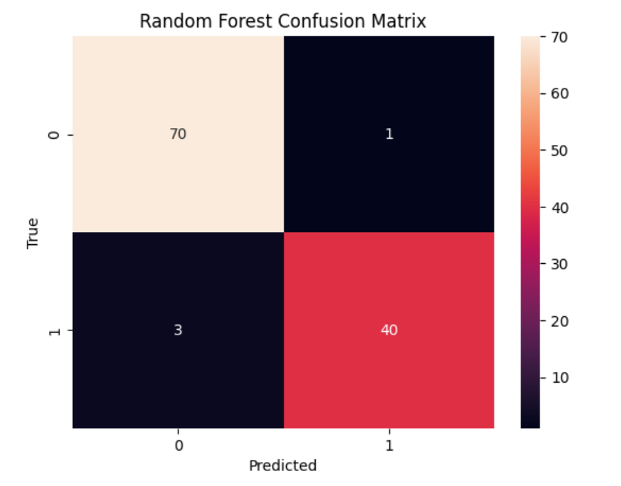
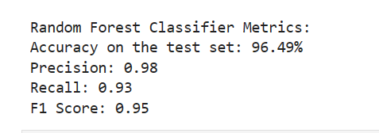
Performance

Slide 10

Performances
Factors | XGBoost | Random Forest
Accuracy | 94.74% | 96.49%
Precision | 95% | 98%
Recall | 91% | 93%
F1-Score | 93% | 95%
Notes:
Now, that you have narrowed your topic, you will want to organize your research in a structure that works. There are some common organizational patterns based on the kind of research you are doing.
Organizational Structures:
Cause and Effect- this kind of structure is great for explaining the causes and effects of a topic
Compare and Contrast- in this pattern you highlight the similarities and differences of the topic
Explain process- this structure is great for outlining a series of steps to follow;
Definition- if you want to make sure your audience understands what something is using illustrations, meanings, clarifying misconceptions, you may want to use this structure
Classification- a common organizational structure is grouping like topics or facts from the research together. For instance, in the internet safety about social media apps, you may organize the research where you look at each social media app one at a time

Slide 11

Limitations of the Existing Models
Limited Feature Engineering: XGBoost and Random Forests do not perform feature selection or extraction. If feature engineering is required, it needs to be done separately, which can be time-consuming.
Non-linear Relationships : Both algorithms struggle to capture extremely complex non-linear relationships in the data.
Interpretability: XGBoost can be more challenging to interpret due to its complex ensemble nature. Understanding why a specific prediction was made can be difficult.
Notes:
After you’ve done your research, it’s time to put your presentation together. The first step in the process is to introduce the topic. This is a great time to connect your topic to something that your audience can relate. In other words, why should they listen to all the information you will be sharing in your research presentation? What is in it for them? You may also want to include a graphic or image to grab their attention.
Feel free to duplicate this slide by right-clicking on this slide in the slides pane to the left and select Duplicate Slide.
The next step in your presentation is to state your claim or topic clearly. Your teacher may even call this your thesis. As you state your thesis, you may find that this layout is not the best layout for your claim or topic. You can change the layout by clicking the drop-down menu next to the Layout in the Slides menu section. You can choose Two Content, Comparison, or Picture with Caption. Note: A different layout might change the look of the icons on this page.
You will also want to state your facts. You have done the research now share some of the interesting facts with your audience. Facts do not have to be boring; you can communicate facts in a variety of ways by going to the Insert Tab. In the Insert tab you can:
Insert pictures from your computer or online.
Add a chart
Create some SmartArt
Insert a variety of icons to help your facts come to life. Note: You can change the color of the icons by selecting the icon and then click on the Format tab and then Graphics Fill. From there, you will choose a color from the list or choose More Fill Colors to give you more options.
Since this research presentation is a result of your hard work and searching, you want to make sure you support the claims or points in your presentation with facts from your research findings. Make sure you give the author proper credit for helping you share your ideas. If one of your sources has a video that is relevant to your topic, you can add the video as added support. Keep in mind the length of the video and the amount of time you have for your presentation. For a 5 minute speech, the video should be no longer than 30 seconds.
Questions to consider:
How will you state the author of the source?
Will you need to cite the source on the slide?
What are some ways you can engage your audience so they feel like they are a part of the presentation? Some ideas to consider is by taking a quick poll like: by a show of hands, how many of you think school uniforms are a way to cut down on bullying? Another suggestion is to have them hold up a certain number of fingers to see if they agree or disagree. Finally, you can share a story that the audience can relate to that makes them laugh.
After all the applause, your audience may have some questions. Be prepared to answer some of their questions by making a list of questions you think they might ask. You may also want to share the presentation with them by providing the link to your presentation, if they want more information.

Slide 12
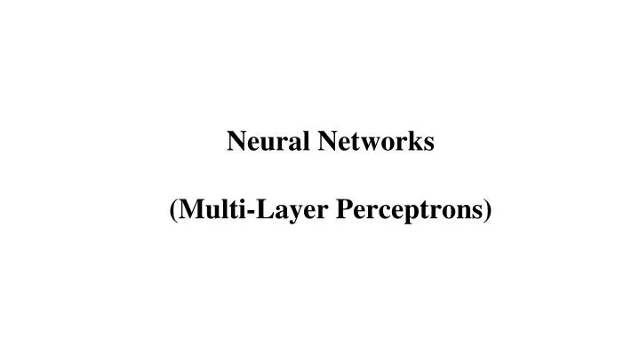
Proposed Solution
And its Performance.
Notes:
You can use this slide as your opening or closing slide. Should you choose to use it as a closing, make sure you review the main points of your presentation. One creative way to do that is by adding animations to the various graphics on a slide. This slide has 4 different graphics, and, when you view the slideshow, you will see that you can click to reveal the next graphic. Similarly, as you review the main topics in your presentation, you may want each point to show up when you are addressing that topic.
Add animation to images and graphics:
Select your image or graphic.
Click on the Animations tab.
Choose from the options. The animation for this slide is “Split”. The drop-down menu in the Animation section gives even more animations you can use.
If you have multiple graphics or images, you will see a number appear next to it that notes the order of the animations.
Note: You will want to choose the animations carefully. You do not want to make your audience dizzy from your presentation.

Slide 13
Why MLP?
Complexity of the Problem: The diagnosis of breast cancer is a complex medical task that requires the classification of tumors into malignant (M) or benign (B). MLPs are versatile and capable of learning complex, non-linear patterns in data, which can be important for distinguishing between cancer types.
Feature Extraction: MLPs can automatically extract relevant features from raw data. In medical datasets like this one, where the relationships between variables may not be straightforward, the ability to learn intricate feature representations is advantageous.
Deep Learning: MLPs are a type of deep learning model. Deep learning models excel at capturing hierarchical representations, making them suitable for datasets with intricate relationships and hidden patterns. They can identify complex, abstract features that may be indicative of cancer.

Slide 14
What is MLP?
Multi-Layer Perceptrons (MLPs) are a type of deep learning models.
Deep learning models like MLPs are known for their ability to learn hierarchical representations of data, allowing them to capture complex and abstract features and patterns. The depth of the network enables it to automatically extract relevant features from raw data, which is particularly valuable in tasks such as image and speech recognition, natural language processing, and many other complex machine learning problems.
MLPs are known for their ability to model complex, non-linear relationships in data and are widely used in a variety of machine learning tasks, including image and speech recognition, natural language processing, and classification and regression problems.
Notes:
After you’ve done your research, it’s time to put your presentation together. The first step in the process is to introduce the topic. This is a great time to connect your topic to something that your audience can relate. In other words, why should they listen to all the information you will be sharing in your research presentation? What is in it for them? You may also want to include a graphic or image to grab their attention.
Feel free to duplicate this slide by right-clicking on this slide in the slides pane to the left and select Duplicate Slide.
The next step in your presentation is to state your claim or topic clearly. Your teacher may even call this your thesis. As you state your thesis, you may find that this layout is not the best layout for your claim or topic. You can change the layout by clicking the drop-down menu next to the Layout in the Slides menu section. You can choose Two Content, Comparison, or Picture with Caption. Note: A different layout might change the look of the icons on this page.
You will also want to state your facts. You have done the research now share some of the interesting facts with your audience. Facts do not have to be boring; you can communicate facts in a variety of ways by going to the Insert Tab. In the Insert tab you can:
Insert pictures from your computer or online.
Add a chart
Create some SmartArt
Insert a variety of icons to help your facts come to life. Note: You can change the color of the icons by selecting the icon and then click on the Format tab and then Graphics Fill. From there, you will choose a color from the list or choose More Fill Colors to give you more options.
Since this research presentation is a result of your hard work and searching, you want to make sure you support the claims or points in your presentation with facts from your research findings. Make sure you give the author proper credit for helping you share your ideas. If one of your sources has a video that is relevant to your topic, you can add the video as added support. Keep in mind the length of the video and the amount of time you have for your presentation. For a 5 minute speech, the video should be no longer than 30 seconds.
Questions to consider:
How will you state the author of the source?
Will you need to cite the source on the slide?
What are some ways you can engage your audience so they feel like they are a part of the presentation? Some ideas to consider is by taking a quick poll like: by a show of hands, how many of you think school uniforms are a way to cut down on bullying? Another suggestion is to have them hold up a certain number of fingers to see if they agree or disagree. Finally, you can share a story that the audience can relate to that makes them laugh.
After all the applause, your audience may have some questions. Be prepared to answer some of their questions by making a list of questions you think they might ask. You may also want to share the presentation with them by providing the link to your presentation, if they want more information.

Slide 15
Ensemble
Ensembling machine learning and deep learning models is advantageous because it:
Improves Predictive Performance: By combining diverse models, it often leads to better overall predictive accuracy and robustness.
Mitigates Overfitting: Ensembling helps reduce overfitting by averaging out errors and noise from individual models.
Enhances Robustness: The ensemble is more resilient to outliers and variations in the data, making it a more reliable predictor.

Slide 16
Code Walkthrough

Slide 17
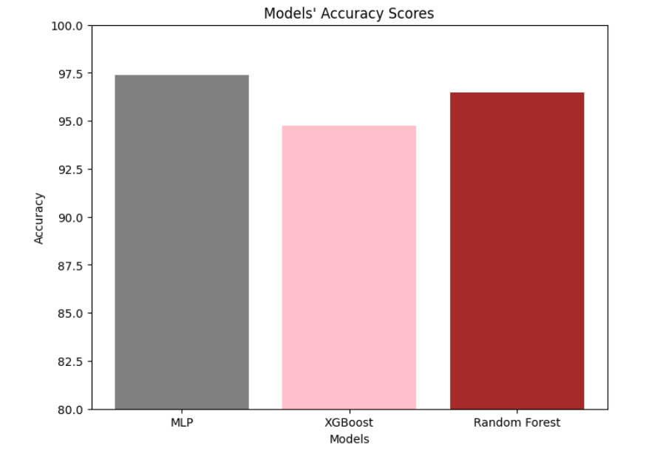
Findings

Slide 18
Current Limitations
Training Complexity: Training MLPs requires more data and computational resources, leading to longer training times.
Sensitivity to Hyperparameters: Proper hyperparameter tuning is essential to achieve good results.

Slide 19
References:
https://www.kaggle.com/datasets/yasserh/breast-cancer-dataset/
https://www.kaggle.com/search?q=Breast+Cancer+Prediction
https://www.geeksforgeeks.org/ml-cancer-cell-classification-using-scikit-learn/

Slide 20

Questions?

Slide 21

Thank You

