Slide 1
The Cognitive and Emotion Regulation Effort Discounting Paradigm (CERED)
Christoph & Josephine
Kolloquium 07.12.2021

Slide 2
Outline
Quick recap of COG-ED by Westbrook et al. (2013)
Changes from COG-ED to CERED
Paradigm
Computation
The study
Structure
Results of the pilot session 1
Results of the pilot session 2
Discussion

Slide 3
Quick recap of COG-ED by Westbrook et al. (2013)
The COG-ED paradigm
People need higher monetary incentives for higher levels
H-NFCs are less dependent on monetary incentives

Slide 4
Changes from COG-ED to CERED

Slide 5
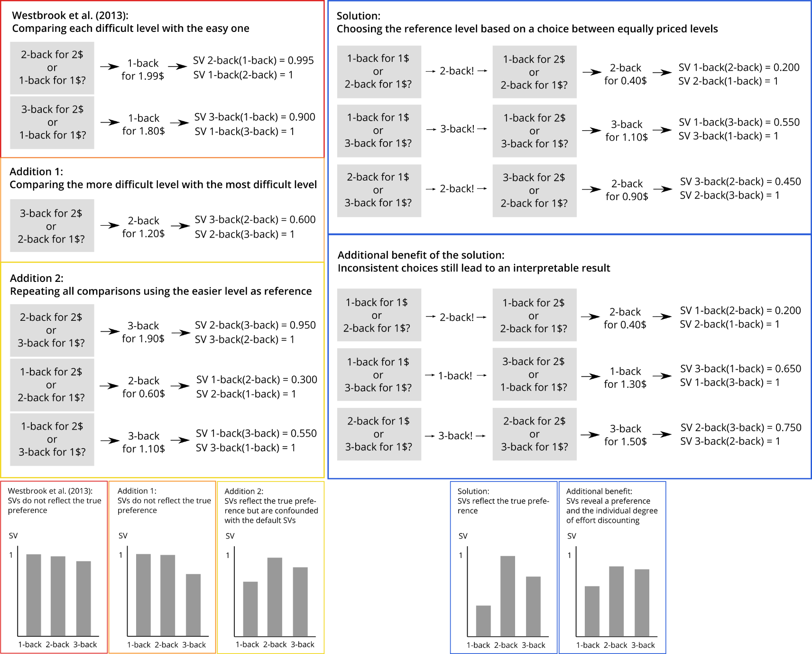
2. Changes from COG-ED to CERED: Paradigm

Slide 6
2. Changes from COG-ED to CERED: Computation
Problem 1: Westbrook’s “Area Under The Curve” is not a real AUC

Slide 7
2. Changes from COG-ED to CERED: Computation
Problem 2: Even a real AUC is not a good measure for effort discounting
→ Sum_{A}xAUC
Avoids effort
1
1
Avoids effort
Strong preference
Weak preference
Subjective value
Subjective value
Prefers easy level
Prefers easy level
1 2 3 4
1 2 3 4
n-back levels
n-back levels
Seeks effort
1
1
Seeks effort
Strong preference
Weak preference
Subjective value
Subjective value
Prefers hard level
Prefers easy level
1 2 3 4
1 2 3 4

Slide 8
2. Changes from COG-ED to CERED: Computation
Problem 3: Large number of df in reaction time analysis
Dimension
Across subjects
across levels
Across subjects
within levels
Within subjects
within levels
Within subjects
across levels
Transformation of the data
Raw
Raw
Log
Inverse
Square root
Outlier exclusion
None
2SD
3SD
200 ms
100 ms
Exclusion of post-error trials
Yes
Yes
No
Specification Curve Analysis with 92 pipelines

Slide 9
The Study

Slide 10
3. The study: Structure
T1: Lab session with n-back
1-back, 2-back, 3-back, and 4-back with 2 runs each
NASA-TLX after each level
ED paradigm
One run of a randomly chosen n-back level
T2: Lab session with ER task
ER training
ER paradigm with EMG on corrugator & levator
ED paradigm
ER choice block
Online: NFC, WHO-5, ERQ, FlexER, BIS-11, BSCS, SRS, ACS, CD-RISC, Lay Beliefs

Slide 11
3. The study: Results of the pilot session 1
Objective task load:
d’ did not increase between 2- and 4-back
RTs increased from 2- to 3-back (not between 2- & 4-back or 3- & 4-back)
Subjective task load:
All NASA-TLX subscales increased between at least two n-back levels
Subjective values differed between most n-back levels, but not between 1- & 2-back!
Association of NFC and task load:
Sum_{A}xAUC of the subjective values did not predict NFC
Higher NASA-TLX scores predicted lower NFC

Slide 12
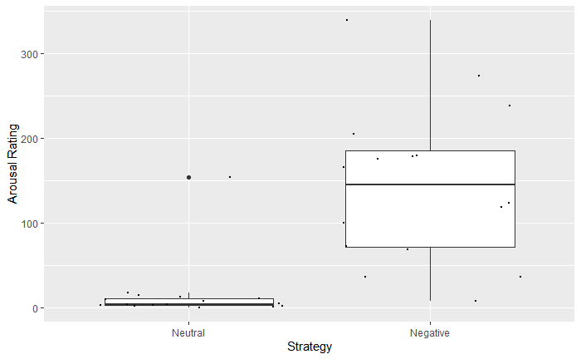
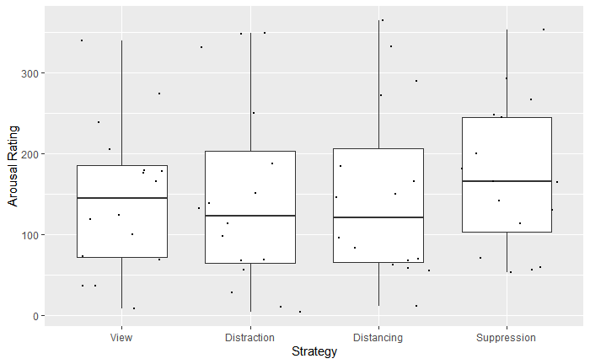
3. The study: Results of the pilot session 2
ER: Arousal

Slide 13
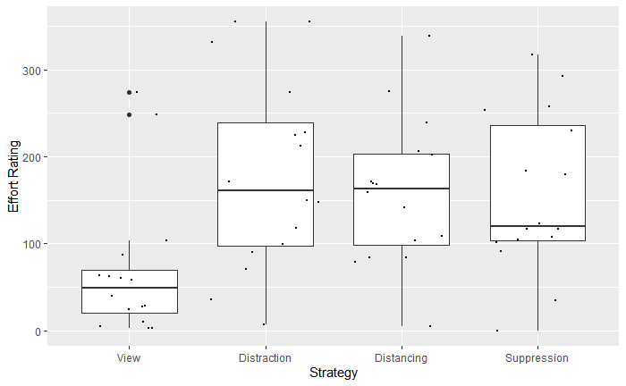
3. The study: Results of the pilot session 2
ER: Effort
Anwendung aller drei Regulationsstrategien anstrengender, als das Anschauen der Bilder
ER Choice:
Distraction: 3 von 16
Distancing: 6 von 16
Suppression: 7 von 16
Gründe: 13 von 16 gaben an, dass die gewählte Strategie leichter war

Slide 14
3. The study: Results of the pilot session 2
Was fehlt noch?
Statistik:
EMG Ergebnisse (Corrugator und Levator)
Systematik in Subjektive Werte bringen
Vorhersage Subjektiver Werte:
Multiples lineares Modell mit den Prädiktoren:
Subjektives Arousal-Rating
EMG Aktivität
subjektives Effort-Rating
Registered Report:
Ergebnisse der Pilotuntersuchung
Auswahl eines Journals

Slide 15
Discussion

