Slide 1




GEETHANJALI COLLEGE OF ENGINEERING AND TECHNOLOGY
DADO for Efficient Data Migration in Cloud Instances

Slide 2
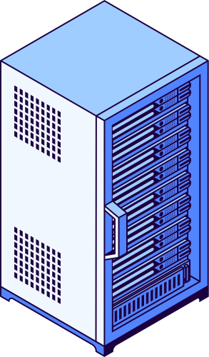




Under The Guidance Of
S. Durgaprasad
Done By
Ch Sricharan (21R11A05B7)
Satyam Das (21R11A05E5)

Slide 3

01
02
03
04
05
06
Introduction
Related Work
Methodology
Modules
Results
Conclusion
Table of Contents

Slide 4
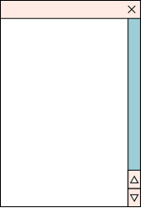

Introduction
DADO stands for Deep Adaptive Dragonfly Optimization algorithm. It optimizes container-level resource allocation across virtual machines (VMs) using a hybrid approach of the Dragonfly Algorithm, Levy Flight, and Actor-Critic Neural Networks. It dynamically adjusts CPU, memory, and network usage to minimize energy consumption, cost, and migration latency. The system processes real-time workloads, analyzes resource allocation, and visualizes the results for better decision-making.

Slide 5

Related Work ft. Literature Survey

Slide 6
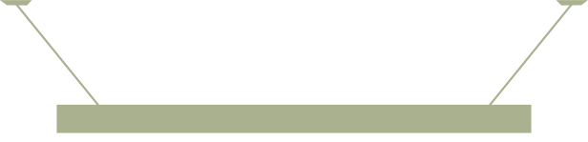
S.No | Author | Paper | Parameters
1 | Mohammad Al Shinwan,Lalith Abualigah,Mohammad Shehab | Dragonfly algorithm: a comprehensive survey of its results, variants, and applications | Optimization Local search Population search
2 | Tej.C. Hiremath, K.S. Rekha | Energy Efficient Data Migration Concerning Interoperability Using Optimized Deep Learning in Container-Based Heterogeneous Cloud Computing | Containers ACNN Load Resource capacity Energy consumption

Slide 7
S.No | Author | Paper | Parameters
3 | Chnoor M Rahman, Tarik A Rashid | Dragonfly Algorithm and Its Applications in Applied Science Survey | Static swarming Dynamic swarming
4 | Cigdem Aci, Hakan Gülcan | A Modified Dragonfly Optimization Algorithm for Single- and Multiobjective Problems Using Brownian Motion | Levy Flight Mecahnism(LFM)

Slide 8
S.No | Author | Paper | Parameters
5 | Neeraj Kumar, and G. Ram Mohana Reddy | Multi-Objective Energy Efficient Virtual Machines Allocation at the Cloud Data Center | HGAPSO

Slide 9


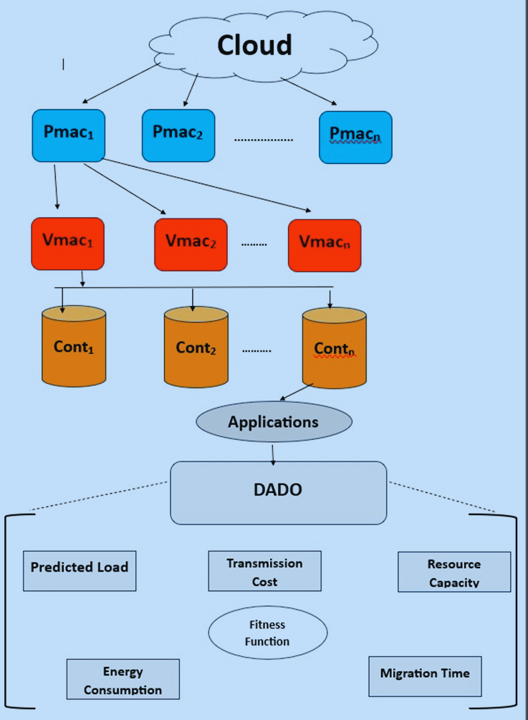

Methodology

Slide 10

Module One:Dataset Generation (VMs & Containers)
This module is responsible for creating synthetic data that represents the resource usage of multiple containers running on virtual machines (VMs).
The dataset includes metrics such as:
CPU Usage
Memory Utilization
Network Traffic
Energy Consumption
Migration Time
Uses NumPy and Pandas to generate a dataset of 15 containers spread across 3 virtual machines.

Slide 11
Module Two:Actor-Critic Neural Network
ACTOR NETWORK
CRITIC NEtwork
Chooses actions using neural networks and reward signals.
Evaluates actions using value function for policy improvement.
This module implements Deep Reinforcement Learning using an Actor-Critic model. The goal of this model is to predict the resource demand of containers and evaluate their performance.
TRAINING PROCESS
Learns by minimizing loss; critic refines actor’s decisions.

Slide 12
STEP 1: INITIALIZE POPULATION
STEP 2: LEVY FLIGHT MECHANISM
Module Three:Dragonfly Algorithm Optimization
The Levy Flight function adds randomness to avoid getting stuck in local optima.
It helps dragonflies explore different possible allocations.
The algorithm starts with a random set of solutions (resource allocation strategies).

Slide 13
STEP 3: ATTRACTION & REPULSION BEHAVIOR
STEP 4: FITNESS FUNCTION
Dragonflies are either attracted to promising solutions or repelled from bad ones.
This mimics real dragonfly behavior in nature.
The best allocation strategy is selected based on:
Energy Consumption
Migration Cost
Transmission Delay
Container Load Balancing
Module Three:Dragonfly Algorithm Optimization

Slide 14
KEY ANALYSIS:
Best VM and Container:
Identifies which VM has the least load.
Determines the best container to migrate to balance the workload.
Energy & Cost Optimization Metrics:
Computes how much energy is saved compared to random allocation.
Measures cost savings in terms of resource utilization.
Migration Analysis:
Calculates the total migration time required for reallocation.
Ensures migrations are efficient and cost-effective.
Module 4:Results Analysis

Slide 15

Results

Slide 16
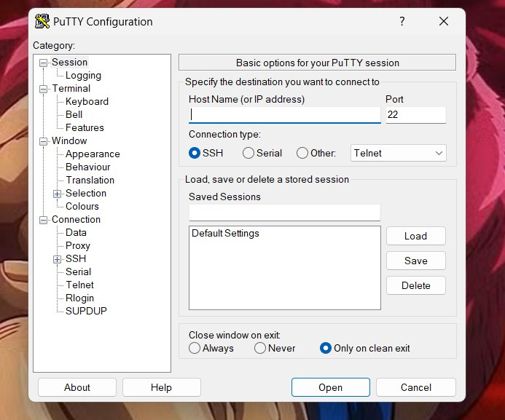
PUTTY CONFIGURATION FOR SSH CONNECTION SETUP

Slide 17
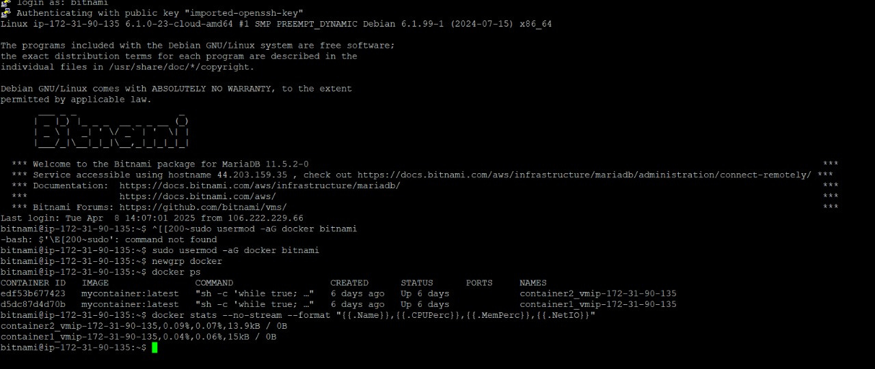
SSH Authentication and Container Monitoring on Bitnami Debian Instance

Slide 18
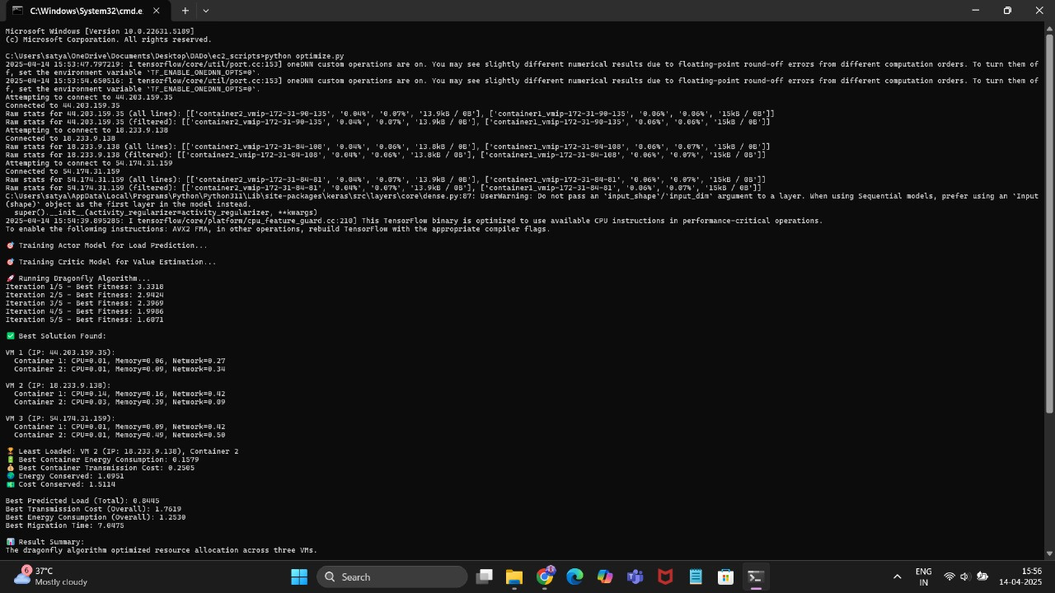
Dragonfly Algorithm Optimization for VM Resource Allocation

Slide 19
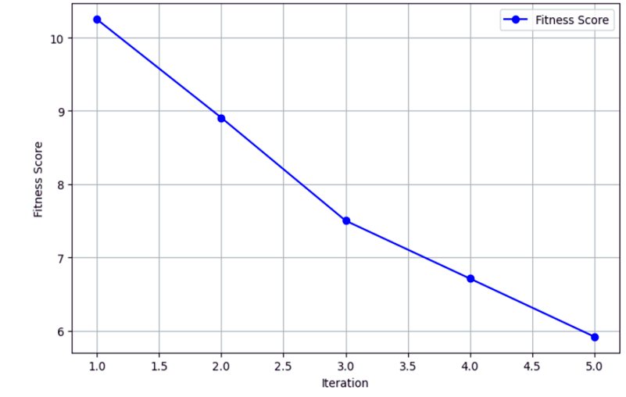
Fitness Score over Iterations

Slide 20
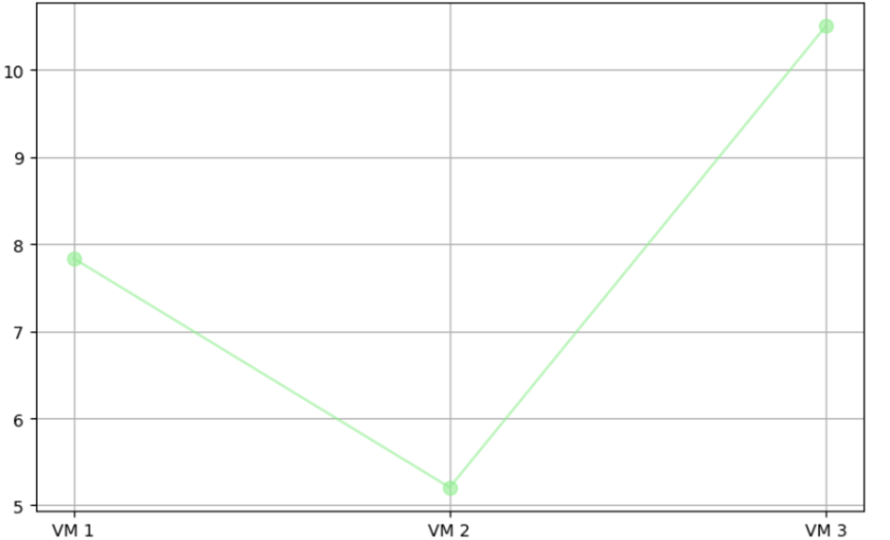
Energy Consumption vs VMs

Slide 21
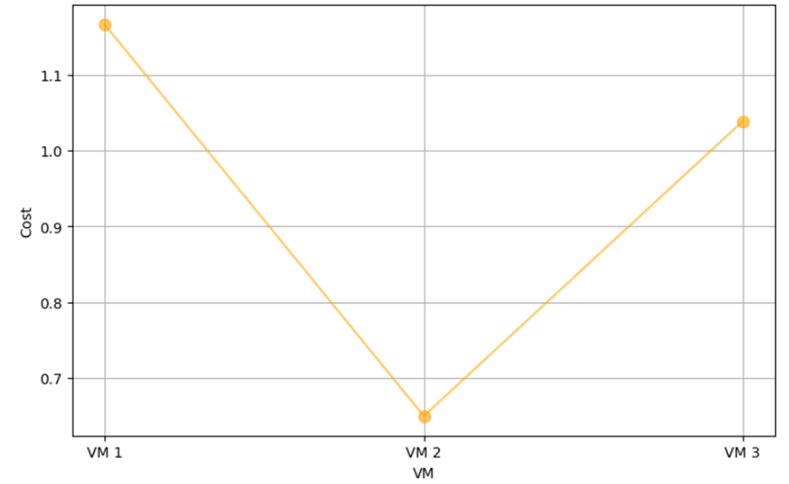
Cost vs VMs

Slide 22
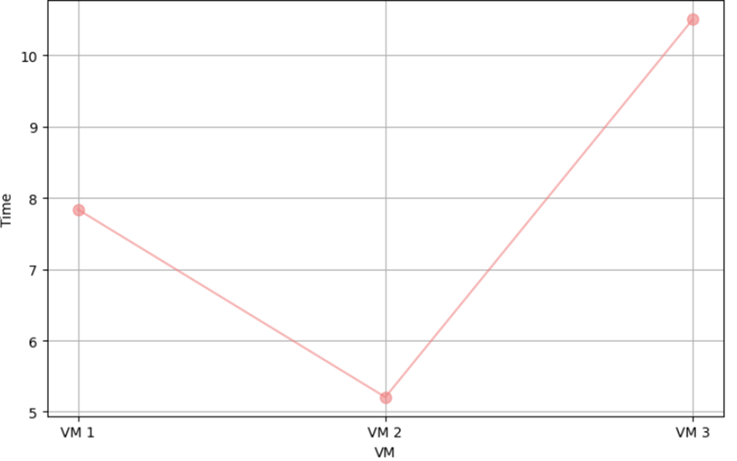
Time vs VMs

Slide 23
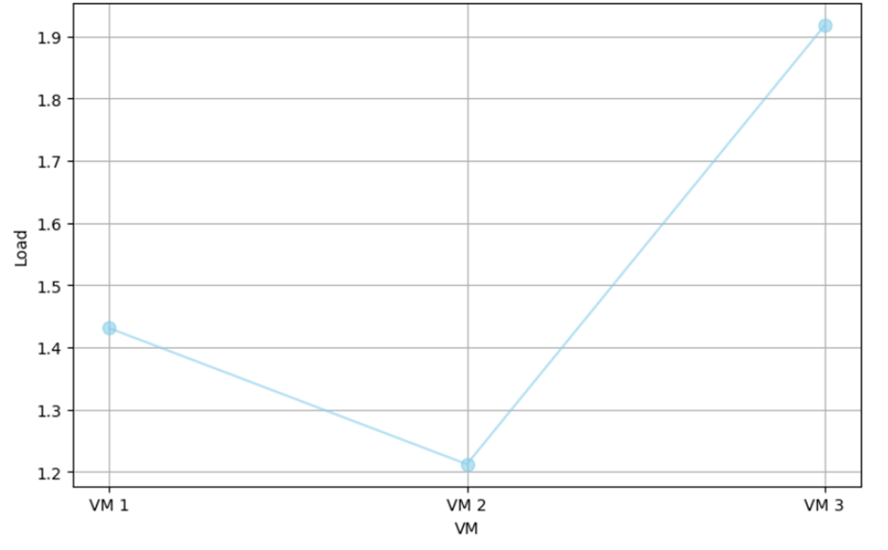
Load vs VMs

Slide 24
Conclusion
The project optimizes container resource allocation across virtual machines using the Dragonfly Algorithm and an Actor-Critic Neural Network. By predicting container loads and minimizing transmission cost, energy consumption, and migration time, the model improves overall efficiency. The least loaded VM and container are identified, ensuring balanced resource utilization. Energy and cost savings are achieved through intelligent allocation. Visualization of fitness scores and resource metrics demonstrates performance improvements. Future enhancements could include real-world workload integration and scalability for larger cloud environments.

Slide 25



Any Queries?
Thank You!
Type a message...

