Slide 1

Database Project: Rental Property Company “Miller Farm”
Yuliia Chernysheva
James Bell
Database Management
2 August 2025

Slide 2

This project is about creating a database to help manage a rental property business. It will help keep track of things like tenants, rent payments, leases, and maintenance

Slide 3

TENANTS (TenantID, FirstName, LastName, Phone, SSN, DrvrLicense, BankName, BankAccount, FamilyIncome, CarLcnPlate, Under18) PROPERTY_DETAILS (PropertyID, Address, QntRoom, QntBaths, SquareFoot, FloorNumber, isGarage, isBasement, isBalcony, StndPrice, StndMaintenance) LEASES (LeaseID, TenantID, PropertyID, StartDate, EndDate, OutofContract, EarnestMoney) FK TenantID -> TENANTS FK PropertyID -> PROPERTY_DETAILS PAYMENTS (PaymentID, PropertyID, PmntConfirm, PmntMonth, PmntYear, PmntPrice) FK PropertyID -> PROPERTY_DETAILS TECH_ISSUES (IssueID, PropertyID, Description, RequestDate, Status, CompleteDate, CostExpences) FK PropertyID -> PROPERTY_DETAILS FK Status -> STATUSES STATUSES (Status)
Tables in DBDL format
Notes:
Well-structured tables keep tenant, property, lease, payments, and maintenance data organized and connected.

Slide 4

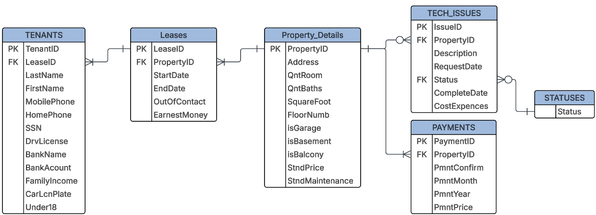
Initial Entity Relationship Diagram (ERD)

Slide 5

Data Integrity
✔️ Primary & Foreign Keys
Each table has a Primary Key to uniquely identify every record:
Tenants: TenantID
Leases: LeaseID
Property_Details: PropertyID
Tech_Issues: IssueID
Payments: PaymentID
Foreign Keys create reliable connections:
LeaseID links Tenants and Leases.
PropertyID links Leases, Tech_Issues, and Payments with Property_Details.
Status links Tech_Issues with Statuses.
✔️ Consistency & Accuracy
Keys enforce valid links between records.
Prevent orphan records and maintain reliable
relationships.
Notes:
Primary and foreign keys protect data accuracy and enforce reliable connections.

Slide 6
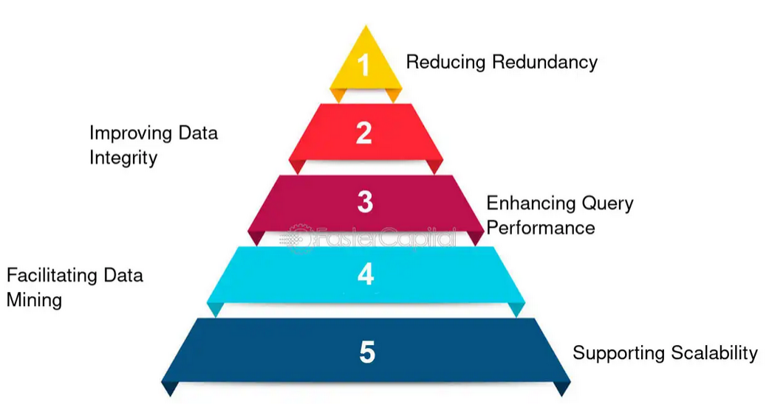
Normalization
✔️ Organized, Efficient Tables
Related data is split into separate tables:
Tenants store tenant details.
Leases hold lease info.
Payments and Tech_Issues handle transactions and requests.
✔️ Reduced Redundancy
No duplicate data — updates happen in one place only.
For example: tenant details are not repeated in the lease or payments tables.
✔️ Easier Maintenance & Scaling
Changes or new features don’t break the structure.
Makes future expansion or reporting easier.
Notes:
Normalization reduces duplication, keeps data clean, and makes maintenance easier.

Slide 7
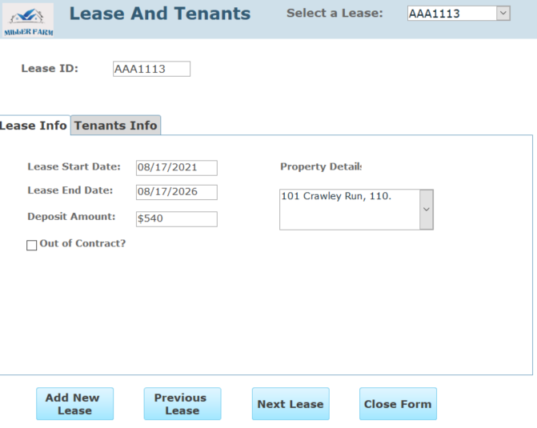
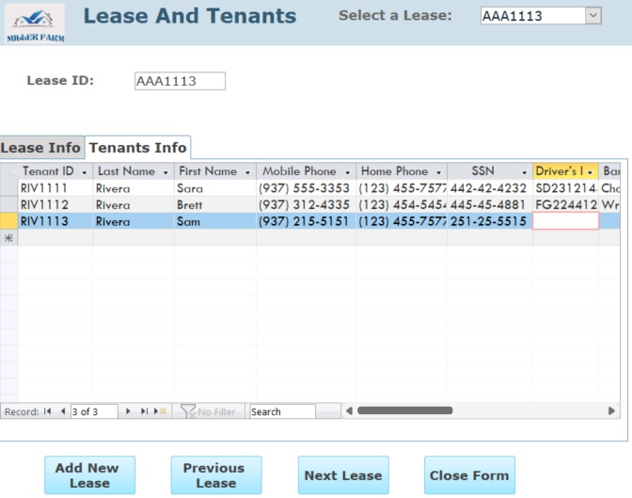
Lease & Tenants Form
Create New Lease: Enter tenant info, lease dates, property, and earnest money.
Edit Lease: Update or remove lease details as needed.
Navigation Tools: Move to previous or next lease record easily.
Search: Find leases by ID, or property.
Why It Matters:
Central place for managing tenant and lease data together.
Makes lease creation accurate and quick.
Notes:
One form to handle all lease and tenant details in one place.

Slide 8
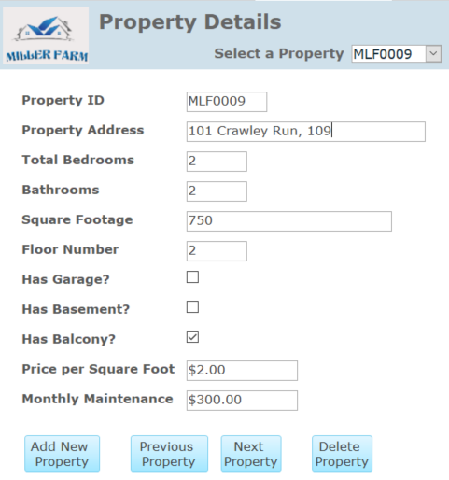
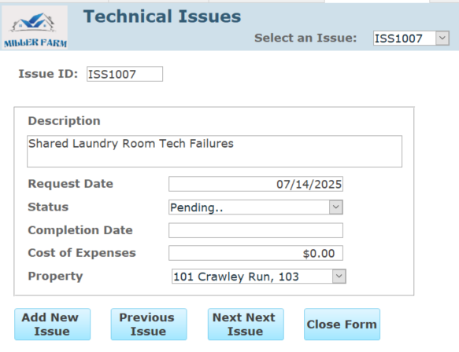
Property & Technical Issues Forms
Property Details:
Add, delete, navigate, and search for properties.
Keep information like size, rooms, and features up to date.
Technical Issues:
Log new repair requests and update statuses.
Find issues by property or status.
Navigate easily between requests.
Why It Matters:
Keeps properties well-documented.
Ensures maintenance issues don’t get overlooked.
Notes:
Manage properties and handle repairs efficiently.

Slide 9
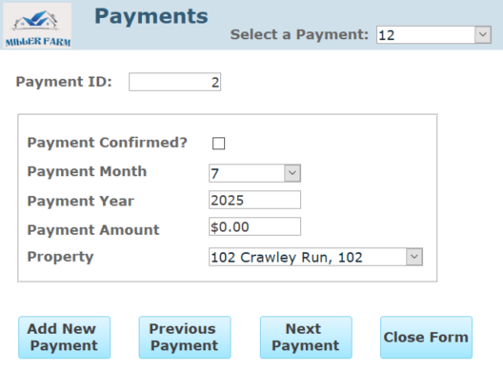
Payments Form
Key Features:
Add new payments for rent or services.
Delete or correct payments if needed.
Navigate between payment records.
Search payments by tenant, property, month, or year.
Why It Matters:
Supports accurate rent tracking.
Keeps financial records clear for reporting and profitability analysis.
Notes:
Accurate payment records keep income flowing smoothly.

Slide 10

Project Queries Summary
qryAppendMonthlyPayments: Adds new monthly payment records to track rent income.
qryAvailableProperty: Shows which properties are currently vacant and ready to rent.
qryLatePayments: Identifies tenants with overdue payments for follow-up.
qryOpenTechIssues: Lists unresolved maintenance or technical issues.
qryProfitability: Calculates overall profit by comparing income and expenses.
qryProfitPerMonth: Breaks down profit figures month by month for trend analysis.
qryIncreaseOldCharges: Updates older charges to reflect new rates or fees.
Notes:
Queries automate tracking, updates, and key financial insights.

Slide 11
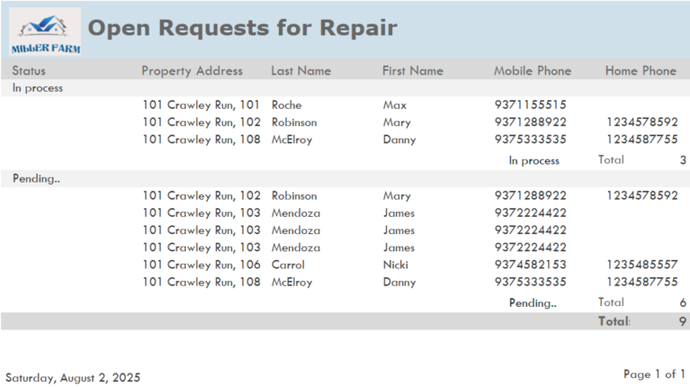

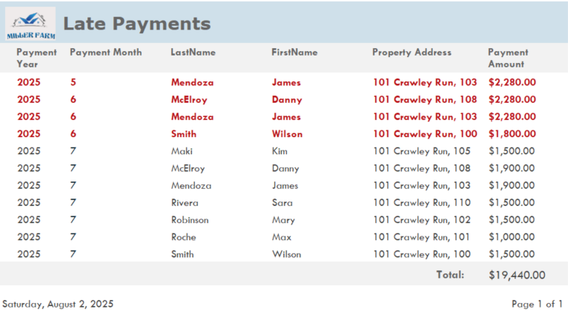
Project Reports
Late Payments Report:
Identifies tenants who are behind on rent
Shows amount overdue and due dates
Helps prioritize follow-up actions
Open Repair Requests Report
Lists current maintenance issues
Tracks status: open, in progress, or resolved
Supports timely repairs and better tenant satisfaction

Slide 12
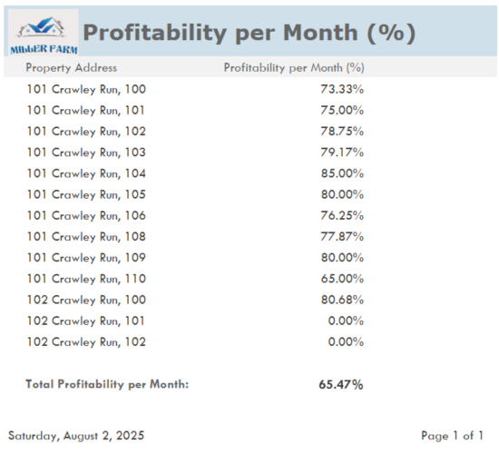
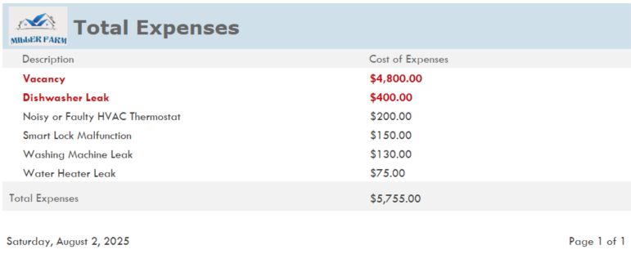
Project Reports
Total Expenses Report:
Shows all costs related to the properties
Categories: repairs, utilities, management fees, etc.
Supports budgeting and cost control
Profitability Report (Monthly)
Calculates monthly income vs. expenses
Visualizes profit trends over time
Helps evaluate financial performance
Why These Reports Are Useful:
Improve rent collection and cash flow
Ensure timely maintenance
Keep organized tenant records
Control costs and plan budgets
Make better business decisions with clear profit data

Slide 13

Skills I Gained
Understanding DBMS Basics: Defined what a database is and explained how DBMS differs from traditional file systems.
Relational Model Knowledge: Applied concepts like normalization, dependencies, integrity rules, and constraints.
Database Functions: Learned about recovery, security, administration, and basic data warehousing.
SQL & QBE: Wrote SQL and QBE commands to define, query, and manipulate data
Database Design & Development: Designed, built, and used relational databases to solve real business problems.

Slide 14

Understanding the textbook: I wasn’t sure if I needed to complete all the practice tasks included in each chapter.
Assignments: The textbook doesn’t have page numbers, but the assignments referred to pages (I found out how to search by page later).
Database design: Normalization was the most challenging aspect for me to understand.

Slide 15

Big thanks to the teacher for the timely responses and well-structured course, even during a shortened semester. It made this achievable!

