Slide 1
CSE 140L
Combinational circuits
Arvind
Computer Science & Artificial Intelligence Lab.
Massachusetts Institute of Technology
Visiting Scholar UCSD
January 9, 2017

Slide 2
Combinational circuit
f
A combinational circuit is a pure function, e.g., +, min, max,
It has no memory or state, i.e., given the same input it produces the same output
Thus, a counter is not a combinational circuit
Inputs and outputs are binary – either 0 or 1

Slide 3
Truth Table
The functionality of a combinational circuit can be defined using a Truth Table
It lists all possible combinations of values for inputs and specifies the output for each input
For every Truth Table there is a corresponding combinational circuit
a
s1
b
f
s2
c
a | b | c | s1 | s2
0 | 0 | 0 | 1 | 0
0 | 0 | 1 | 0 | 0
0 | 1 | 0 | 0 | 0
0 | 1 | 1 | 0 | 1
1 | 0 | 0 | 1 | 1
1 | 0 | 1 | 1 | 0
1 | 1 | 0 | 0 | 1
1 | 1 | 1 | 0 | 0
What is the size of a truth table?

Slide 4
Three simple combinational circuits
NOT
AND
OR
a | s
0 | 1
1 | 0
s
a
s = ~a
a | b | s
0 | 0 | 0
0 | 1 | 0
1 | 0 | 0
1 | 1 | 1
a
s
b
s = a∙b
a | b | s
0 | 0 | 0
0 | 1 | 1
1 | 0 | 1
1 | 1 | 1
a
s
b
s = a+b
Any combinational ckt can be built using these three gates

Slide 5
Some other famous gates
NAND
NOR
a | b | s
0 | 0 | 1
0 | 1 | 1
1 | 0 | 1
1 | 1 | 0
a
s
b
s = ~(a∙b)
a
s
b
a | b | s
0 | 0 | 1
0 | 1 | 0
1 | 0 | 0
1 | 1 | 0
a
s
b
s = ~(a+b)
a
s
Can you express these gates using NOT, AND, and OR gates?
b

Slide 6
Exclusive OR (XOR): another famous gate
XOR
From the Truth Table XOR produces a 1 when either (a=0) AND (b=1) or (a=1) AND (b=0). Hence, a ⊕ b = ~a.b + a.~b
a | b | s
0 | 0 | 0
0 | 1 | 1
1 | 0 | 1
1 | 1 | 0
a
s
b
s = a ⊕ b
Can you express XOR using NOT, AND, and OR gates?
a
b
s

Slide 7
Nomenclature
We use the words in each of the following categories interchangeably
combinational circuits, Boolean expressions, Boolean circuits
gate, Boolean operator
We use variables to name wires in a combinational circuit

Slide 8
Describing Complex Combinational ckts
A combinational ckt with n input variables and m outputs has 2^{n} rows and m columns in its Truth Table representation
Truth Tables are not a practical representation for circuits with large number of inputs
Circuit diagrams are even more tedious and impractical
Both representations are useless when we want computers to simulate the behavior of a circuit, i.e., determine the output given an input
We will use a programming language called Bluespec System Verilog (BSV) to express all ckts

Slide 9
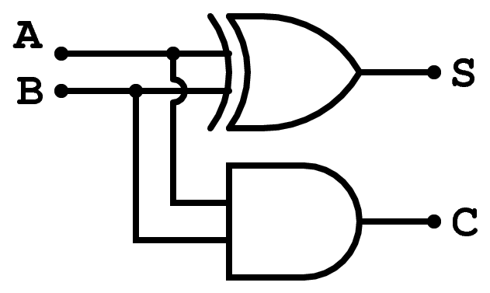
Half Adder
A | B | S | C
0 | 0 | 0 | 0
0 | 1 | 1 | 0
1 | 0 | 1 | 0
1 | 1 | 0 | 1
Boolean equations
s = (~a∙b) + (a∙~b)
c = a∙b
“Optimized”
s = a ⊕ b

Slide 10
Half Adder
OR
function ha(a, b);
s = (!a & b) | (a & !b);
c = a & b;
return {c,s};
endfunction
AND
NOT
“Structural” code – only specifies interconnection between boxes
-- order of statements does not matter.
Boolean equations
s = (~a∙b) + (a∙~b)
c = a∙b
Not quite correct –needs type annotations

Slide 11
Half Adder corrected
function Bit#(2) ha(Bit#(1) a, Bit#(1) b);
Bit#(1) s = (!a & b) | (a & !b);
Bit#(1) c = (a & b);
return {c,s};
endfunction
“Bit#(1) a” type declaration says that a is one bit wide
{c,s} represents bit concatenation
How big is {c,s}?
2 bits

Slide 12
“Optimized” Half Adder
function Bit#(2) ha(Bit#(1) a, Bit#(1) b);
Bit#(1) s = a ^ b;
Bit#(1) c = a & b;
return {c,s};
endfunction
XOR
“Optimized” (~a∙b) + (a∙~b) = a ⊕ b

Slide 13
BSV notes
function Bit#(2) ha(Bit#(1) a, Bit#(1) b);
Bit#(1) s = a ^ b;
Bit#(1) c = a & b;
return {c,s};
endfunction
Suppose we write t = ha(a,b) then t is a two-bit quantity representing c and s values
We can recover c and s values from t by writing t[0] and t[1], respectively.

Slide 14
Types
A type is a grouping of values:
Integer: 1, 2, 3, …
Bool: True, False
Bit: 0,1
A pair of Integers: Tuple2#(Integer, Integer)
A function fname from Integers to Integers:
function Integer fname (Integer arg)
Every expression in a BSV program has a type; sometimes it is specified explicitly and sometimes it is deduced by the compiler
Thus we say an expression has a type or belongs to a type
The type of each expression is unique

Slide 15
Parameterized types: #
A type declaration itself can be parameterized by other types
Parameters are indicated by using the syntax ‘#’
For example Bit#(n) represents n bits and can be instantiated by specifying a value of n
Bit#(1), Bit#(32), Bit#(8), …

Slide 16
Type synonyms
typedef bit [7:0] Byte;
typedef Bit#(8) Byte;
typedef Bit#(32) Word;
typedef Tuple2#(a,a) Pair#(type a);
typedef Int#(n) MyInt#(type n);
typedef Int#(n) MyInt#(numeric type n);
The same
The same

Slide 17
Selecting a wire: x[i]
assume x is 4 bits wide
Constant Selector: e.g., x[2]
Dynamic selector: x[i]
x0
x0
no hardware; x[2] is just the name of a wire
x1
[2]
x1
x2
x2
x3
x3
i
i
x0
x0
4-way mux
x1
x1
x2
[i]
x2
x3
x3

Slide 18
A 2-way multiplexer
A
A
B
B
S
S
(s==0)? A : B
Gate-level implementation
A mux is simple conditional expression

Slide 19
A 4-way multiplexer
A
case {s1,s0} matches
0: A;
1: B;
2: C;
3: D;
endcase
B
s0
C
s1
D
s0

Slide 20
Today’s Takeaways
“Combinational Circuits” are a form of “Digital Hardware”
These circuits have no state, and thus, are pure functions
Common way to describe them is by Truth Tables or Circuit Diagrams but both have limitations (Why?)
Modern programming languages can make it easy to describe (complex) combinational circuits as an acyclic graph of gates, and allow us to simulate their behavior
We will use Bluespec System Verilog (BSV) in this class
BSV is a high-level typed language where types can be parameterized, including for the number of inputs and outputs
Every expression has a (unique) type in BSV.
Type checking helps in avoiding many silly mistakes

