Slide 1
CSE 140L
Arithmetic circuits
Arvind
Computer Science & Artificial Intelligence Lab.
Massachusetts Institute of Technology
Visiting Scholar UCSD
January 18, 2017

Slide 2
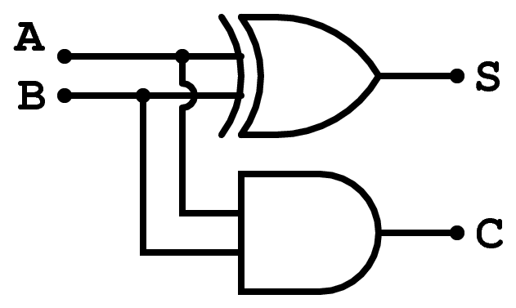
Half Adder
A | B | S | C
0 | 0 | 0 | 0
0 | 1 | 1 | 0
1 | 0 | 1 | 0
1 | 1 | 0 | 1
Boolean equations
s = a ⊕ b c = a∙b
function Bit#(2) ha(Bit#(1) a, Bit#(1) b);
Bit#(1) s = a ^ b;
Bit#(1) c = a & b;
return {c,s};
endfunction
ha can be used as a black-box as long as we understand its type signature
a
ha
s
b
c

Slide 3
BSV notes
function Bit#(2) ha(Bit#(1) a, Bit#(1) b);
Bit#(1) s = a ^ b;
Bit#(1) c = a & b;
return {c,s};
endfunction
Suppose we write t = ha(a,b) then t is a two bit quantity representing c and s values
We can recover c and s values from t by writing t[1] and t[0], respectively

Slide 4
Full Adder: 1-bit adder with a carry-in input
function Bit#(2) fa(Bit#(1) a,
Bit#(1) b,
Bit#(1) c_in);
a
b
fa
c_out
c_in
s
Full adders can be cascaded together to build n-bit adders
a[0]
b[0]
a[1]
b[1]
fa
fa
c_in
c_out …
s[0]
s[1]

Slide 5
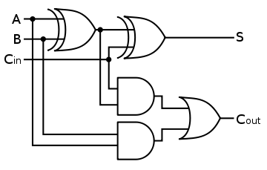
Full Adder
a
fa
s
b
c_out
c_in
A | B | C_{in} | S | C_{out}
0 | 0 | 0 | 0 | 0
0 | 0 | 1 | 1 | 0
0 | 1 | 0 | 1 | 0
0 | 1 | 1
1 | 0 | 0 | 1 | 0
1 | 0 | 1 | 0 | 1
1 | 1 | 0 | 0 | 1
1 | 1 | 1 | 1 | 1
t
0
1
It is easier to build a full adder using two half adders
Boolean equations
s = (~a∙~b∙c_{in})+(~a∙b∙~c_{in})+(a∙~b∙~c_{in})+(a∙b∙c_{in})
c_{out} = (~a∙b∙c_{in}) +(a∙~b∙c_{in}) +(a∙b∙~c_{in}) +(a∙b∙c_{in})
“Optimized”
t = a⊕b s = t⊕c_{in} c_{out} = a∙b + c_{in}∙t

Slide 6
Full Adder: built using half adders
fa
s
ha
a
ha
b
c_out
c_in
function Bit#(2) fa(Bit#(1) a, Bit#(1) b,
Bit#(1) c_in);
Bit#(2) ab = ha(a, b);
Bit#(2) abc = ha(ab[0], c_in);
Bit#(1) c_out = ab[1] | abc[1];
return {c_out, abc[0]};
endfunction
Extracts the sum bit
Extracts the carry bit
ha is being used as a black-box

Slide 7
The “let” syntax
fa
s
ha
a
ha
b
c_out
c_in
No need to write the type if the compiler can deduce it:
function Bit#(2) fa(Bit#(1) a, Bit#(1) b,
Bit#(1) c_in);
let ab = ha(a, b);
let abc = ha(ab[1], c_in);
let s = ab[0] & abc[0];
return {abc[1],s};
endfunction

Slide 8
Type declaration versus deduction
The programmer writes down types of some expressions in a program and the compiler deduces the types of the rest of expressions
If the type deduction cannot be performed or the type declarations are inconsistent then the compiler complains
function Bit#(3) fa(Bit#(1) a, Bit#(1) b,
Bit#(1) c_in);
Bit#(2) ab = ha(a, b);
Bit#(2) abc = ha(ab[1], c_in);
Bit#(2) s = ab[0] & abc[0];
return {abc[1],s};
endfunction
type error
Type checking prevents lots of silly mistakes

Slide 9
2-bit Ripple-Carry Adder
x[0]
y[0]
x[1]
y[1]
Now fa can be used as a black-box
fa
c[1]
fa
c[0]
c[2]
s[0]
s[1]
function Bit#(3) add(Bit#(2) x, Bit#(2) y,
Bit#(1) c0);
Bit#(2) s = 0; Bit#(3) c=0; c[0] = c0;
let cs0 = fa(x[0], y[0], c[0]);
c[1] = cs0[1]; s[0] = cs0[0];
let cs1 = fa(x[1], y[1], c[1]);
c[2] = cs1[1]; s[1] = cs1[0];
return {c[2],s};
endfunction
Initially s and c wires are zero

Slide 10
Assigning to Vector elements
Bit#(3) c=0;
Means c is three bits wide and each element is set to zero
Element 0 of c is connected to c0 but the value of the rest of the elements is not affected
Initial value of a vector must be set; we use “?” if we don’t know the initial value
c[0] = c0;

Slide 11
An w-bit Ripple-Carry Adder
Unless we know the value of w we cannot write a straight-line program as we did for 2-bit adder
Use loops!
function Bit#(w+1) addN(Bit#(w) x, Bit#(w) y,
Bit#(1) c0);
Bit#(w) s; Bit#(w+1) c=0; c[0] = c0;
for(Integer i=0; i<w; i=i+1)
begin
let cs = fa(x[i],y[i],c[i]);
c[i+1] = cs[1]; s[i] = cs[0];
end
return {c[w],s};
endfunction
There are some subtle type errors in this program but before we fix them, you may wonder what is the meaning of a loop in terms of gates?

Slide 12
All loops are unfolded by the compiler!
for(Integer i=0; i<w; i=i+1)
begin
let cs = fa(x[i],y[i],c[i]);
c[i+1] = cs[1]; s[i] = cs[0];
end
Can be done only when the value of w is known
cs0 = fa(x[0], y[0], c[0]); c[1]=cs0[1]; s[0]=cs0[0];
cs1 = fa(x[1], y[1], c[1]); c[2]=cs1[1]; s[1]=cs1[0];
…
csw = fa(x[valw-1], y[valw-1], c[valw-1]);
c[valw] = csw[1]; s[valw-1] = csw[0];

Slide 13
Loops to gates
x[0]
y[0]
x[1]
y[1]
x[w-1]
y[w-1]
fa
c[1]
fa
c[2]
c[w-1]
fa
c[w]
c[0]
cs
…
s[0]
s[1]
s[w-1]
cs0 = fa(x[0], y[0], c[0]); c[1]=cs0[1]; s[0]=cs0[0];
cs1 = fa(x[1], y[1], c[1]); c[2]=cs1[1]; s[1]=cs1[0];
…
csw = fa(x[valw-1], y[valw-1], c[valw-1]);
c[valw] = csw[1]; s[valw-1] = csw[0];
Unfolded loop defines an acyclic wiring diagram

Slide 14
Instantiating the parametric Adder
function Bit#(w+1) addN(Bit#(w) x, Bit#(w) y,
Bit#(1) c0);
How do we define a add32, add3 … using addN ?
// concrete instances of addN!
function Bit#(33) add32(Bit#(32) x, Bit#(32) y,
Bit#(1) c0) =
addN(x,y,c0);
The numeric type w on the RHS implicitly gets instantiated to 32 because of the LHS declaration
function Bit#(4) add3(Bit#(3) x, Bit#(3) y,
Bit#(1) c0) = addN(x,y,c0);

Slide 15
Fixing the type errors valueOf(w) versus w
Each expression has a type and a value and these come from two entirely disjoint worlds
w in Bit#(w) resides in the types world
Sometimes we need to use values from the types world into actual computation. The function valueOf allows us to do that
Thus
i<w is not type correct
i<valueOf(w)is type correct

Slide 16
Fixing the type errors TAdd#(w,1) versus w+1
Sometimes we need to perform operations in the types world that are very similar to the operations in the value world
Examples: Add, Mul, Log
We define a few special operators in the types world for such operations
Examples: TAdd#(m,n), TMul#(m,n), …

Slide 17
Fixing the type errors Integer versus Int#(32)
In mathematics integers are unbounded but in computer systems integers always have a fixed size
BSV allows us to express both types of integers, though unbounded integers are used only as a programming convenience
for(Integer i=0; i<valw; i=i+1)
begin
let cs = fa(x[i],y[i],c[i]);
c[i+1] = cs[1]; s[i] = cs[0];
end
integer

Slide 18
A w-bit Ripple-Carry Adder corrected
function Bit#(TAdd#(w,1)) addN(Bit#(w) x, Bit#(w) y,
Bit#(1) c0);
Bit#(w) s; Bit#(TAdd#(w,1)) c; c[0] = c0;
let valw = valueOf(w);
for(Integer i=0; i<valw; i=i+1)
begin
let cs = fa(x[i],y[i],c[i]);
c[i+1] = cs[1]; s[i] = cs[0];
end
return {c[valw],s};
endfunction
types world
equivalent of w+1
Lifting a type into the value world
Structural interpretation of a loop – unfold it to generate an acyclic graph

Slide 19
BSV Compiling phases
Type checking: Ensures that type of each expression can be determined uniquely; Otherwise the program is rejected
Static elaboration: Compiler eliminates all constructs which have no direct hardware meaning
Loops are unfolded
Functions are in-lined; even recursive functions can be used as long as all the recursion can be gotten rid of at compile time
After this stage the program does not contain any Integers because Integers are unbounded in BSV
Gates are generated (actually Verilog)

Slide 20
Takeaway
Once we define a combinational ckt, we can use it repeatedly to build larger ckts
The BSV compiler, because of the type signatures of functions, prevents us from connecting them in obviously illegal ways
We can write parameterized ckts in BSV, for example an n-bit adder. Once n is specified, the correct ckt is automatically generated
Even though we use loop constructs and functions to express combinational ckts, all loops are unfolded and functions are inlined during the compilation phase

