Slide 1
MIA – FINAL PROJECT
Breast Lesion Segmentation
Deanna Hood
Gerard Bahi
Chalikonda Prabhu Kumar

Slide 2
Objective
Algorithm
Fast: low computation time
Automatic: same parameters for all
Effective: High Dice/Jaccard indexes
Notes:
Goal: to develop a fast, automatic segmentation algorithm for detecting breast lesions in ultrasound images.

Slide 3
Pipeline of the algorithm
Oversegmentation
Feature extraction
Training and classification
Evaluation
Post-processing
Notes:
Oversegment images into superpixels, extract features from superpixels for training/classification, apply some post-processing to improve results, and evaluate results if ground truth is available.

Slide 4
Oversegmentation: Superpixels
SLIC
Quick Shift
Notes:
SLIC enforces regularly-sized and shaped superpixels which wasn’t effective for the ultrasounds, so Quick Shift was used instead which fit well to the lesion edges and, for some images, produced a result that could have just been thresholded straight away for the segmentation. In order to appropriately segment all images, however, we used machine learning to train a classifier.

Slide 5
Classifiers
SVM
Random Forests
Classification
Probability
Classification
Probability
KNN
Classification
Notes:
Different classifiers were trained with supervised machine learning, passing the ground truth of the superpixels as the classes to be learned. Some of the classifiers were K nearest neighbours, support vector machine with RBF filters, and random forests. We eventually decided on Random Forests as it was giving the best results, provided a continuous probability of being in either the lesion or background class rather than just the classification itself, and it could be trained in different parts and the trees concatenated.

Slide 6
Features used
Superpixel (mean, median, std. deviation)
Normalized distance from the center
SIFT on superpixel centroid
Distance to Cluster Histograms
Texture features (GLCM)
Notes:
The same features were extracted from the superpixels for training the classifier as testing on images to be segmented. Intensity, spatial, and texture features were calculated.

Slide 7
Features – Histogram Clustering
Compute histogram of all super pixels
Chi squared distance of histograms
Cluster distances
Compute mean histogram of clusters
Features: Distance to cluster histograms
Notes:
K-means clustering to get 50 representative histograms, the distance to which were used as features.

Slide 8
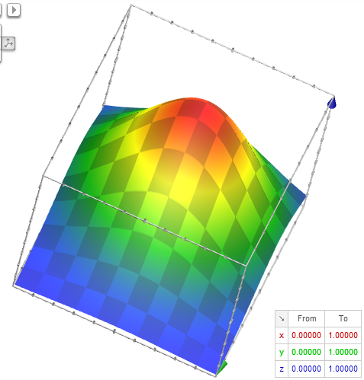
Postprocessing
Bell-curve around likely lesion area [x_{0,}y₀]
Penalise by
min[ exp(-|x-x₀|²/2σ_{x}²),
exp(-|y-y₀|²/2σ_{y}²) ]
  Lesion center of [0.5, 0.35]
  Sigmas of [0.3, 0.25]
Notes:
False positives around edges of image. The likely lesion center was learned and superpixels far from this distance had their probabilities reduced.
Thresholding then gave final segmentation.

Slide 9
Parameter Selection
Simulated Annealing on evaluation measure of training set
Convergence to global maximum
Notes:
Difficult to determine optimum set of algorithm parameters when balancing segmentation of multiple images. Simulated Annealing optimiser used to determine the best parameters (likely lesion center, threshold etc) to give a good objective function. Objective function used: average dice coefficient in leave-one-out training. Discontinuous and non-convex, yet global convergence obtained.

Slide 10
Results
Notes:
Superpixels fit edge of lesion and segment well.

Slide 11
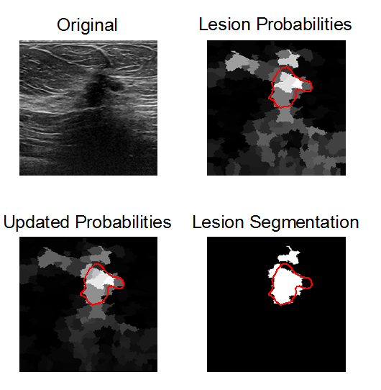
Results
Notes:
Shadow from lesion gives false positives at bottom of image. After post-processing, probabilities reduced and so thresholding can successfully segment lesion.

Slide 12
Results
Notes:
Lung gives false positives at bottom of image where texture is similar to lesion. Post-processing proves very successful at allowing thresholding to segment the lesion.

Slide 13
Results: Leave-one-out
14 images
Max: 0.94
Mean: 0.59
Median: 0.57
Computationally fast
Dice Coefficients
Notes:
Majority of Dice coefficients about 0.57; a quarter about 0.87. Approximately 5 minutes to segment Challenge dataset.

Slide 14
Future Work
Investigate more post-processing techniques
Use only low-correlated data for training
Run optimiser for feature combinations
Convex objective function
Notes:
In a large training data set it may be advantageous to reduce training data by keeping only representative subset.
Features only added if were seen to increase result, but a better combination might be able to be found with optimiser.
A convex objective function would allow for better convergence.

Slide 15
Conclusions
Quick Shift performs better than SLIC in US images
Lesions do not have a default model (shape, texture)
Optimizer is a useful tool for choosing the right parameters for thresholding
FPs from shadows and lungs can be overcome with spatial information
Notes:
No particular shape/texture of lesions, but by combining combination of features can be detected.
Difficult to determine parameters when trade-offs are involved, but optimiser can choose optimum ones.

