Slide 1
Quantitative Researcher
Tsung Yu Chen
Quantitative Researcher
Tsung Yu Chen

Slide 2
Quantitative Researcher
Tsung Yu Chen

Slide 3
Table of Content
01. Intro
02. Research Topic
2.1 Time Invariant Feature
2.2 Information Entropy
03. WorldQuant Experience
04. What Can I do in VICI Holdings?

Slide 4
01.
About Me

Slide 5

Education
M.S./ B.S in NTHU Physics
Theoretical Condensed Matter Physics Labs
Work Experience
Skymirror: Quantitative researcher in RL/ DL
Cinnamon AI: AI researcher Intern in NLP
Achievement
WorldQuant Global Alphathon (National) 3rd prize
Publication is pursuing PRB as 1st author
Hobbits & Interest
Photography, Volleyball, Basketball
A strong passion for research and exploring new ideas.

Slide 6
02.
Research Topic
Time Invariant Feature
If alpha is time invariant, so should the given feature

Slide 7
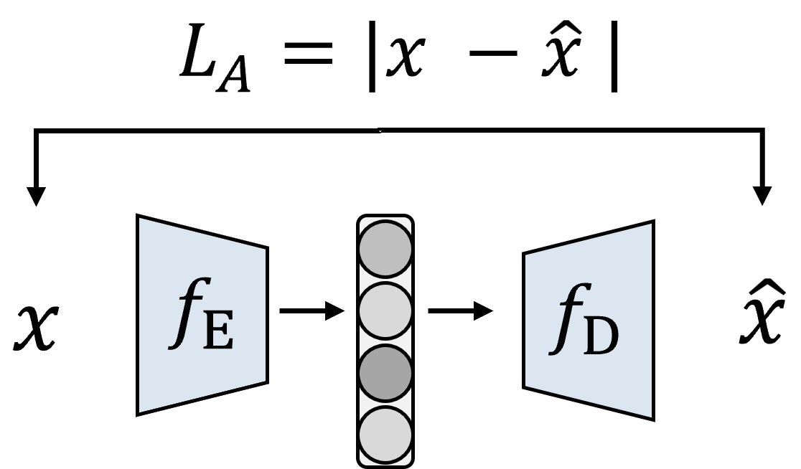
After a classifier
Year Precision
2017 0.72
0.58
0.56
0.56
0.57
0.60
*Note: data start from 2017.06
Under this approach, the hidden features is distinguishable for every year from 2017 to 2022. And two bull years 2018, 2022 are more outstanding than the other years

Slide 8








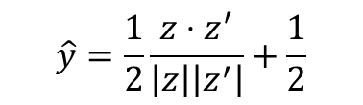





$$L= L_{A}\left(x\right)+L_{A}\left(x^{′}\right)+L_{D}$$
After a classifier
$$L_{A}=|x −\hat{x} |$$
Year Precision
2017 0.58
0.51
0.43
0.45
0.46
0.54
$$x$$
$$f_{E}$$
$$f_{D}$$
$$\hat{x}$$
$$x^{′}$$
$$f_{E}$$
$$f_{D}$$
$${\hat{x}}^{′}$$
$$z$$
$$z^{′}$$
*Note: data start from 2017.06
$$\hat{y}=\frac{1}{2}\frac{z⋅z^{′}}{\left|z\right|\left|z^{′}\right|}+\frac{1}{2}$$
We successfully find a better hidden space for time-invariant feature.
$$L_{D}=y \log{\hat{y}}+\left(1−y\right)\log{(1−\hat{y})}$$

Slide 9








$$L_{A}=|x −\hat{x} |$$
After a classifier
Year Precision
2017 0.00
0.22
0.00
0.19
0.19
0.31
$$x$$
$$f_{E}$$
$$f_{D}$$
$$\hat{x}$$
$$L= L_{A} −L_{D}$$
$$g_{D}$$
2017
2018
2019
2020
2021
2022
*Note: data start from 2017.06
$$L_{D}=∑y_{n} \log{y_{n}}$$
With GAN-like approach, we state that we can pure the hidden time-invariant features from a time-dependent feautres.

Slide 10
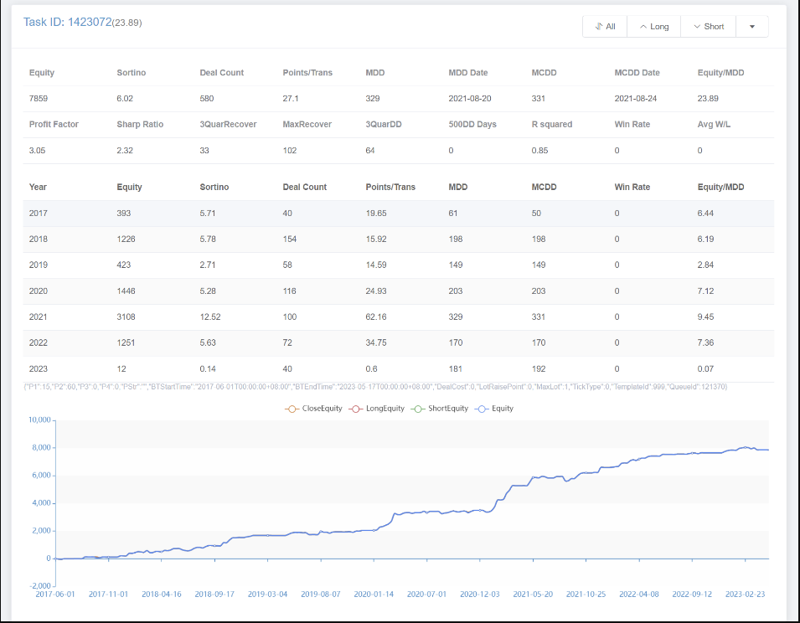
Long
* Note that all of them are test set

Slide 11
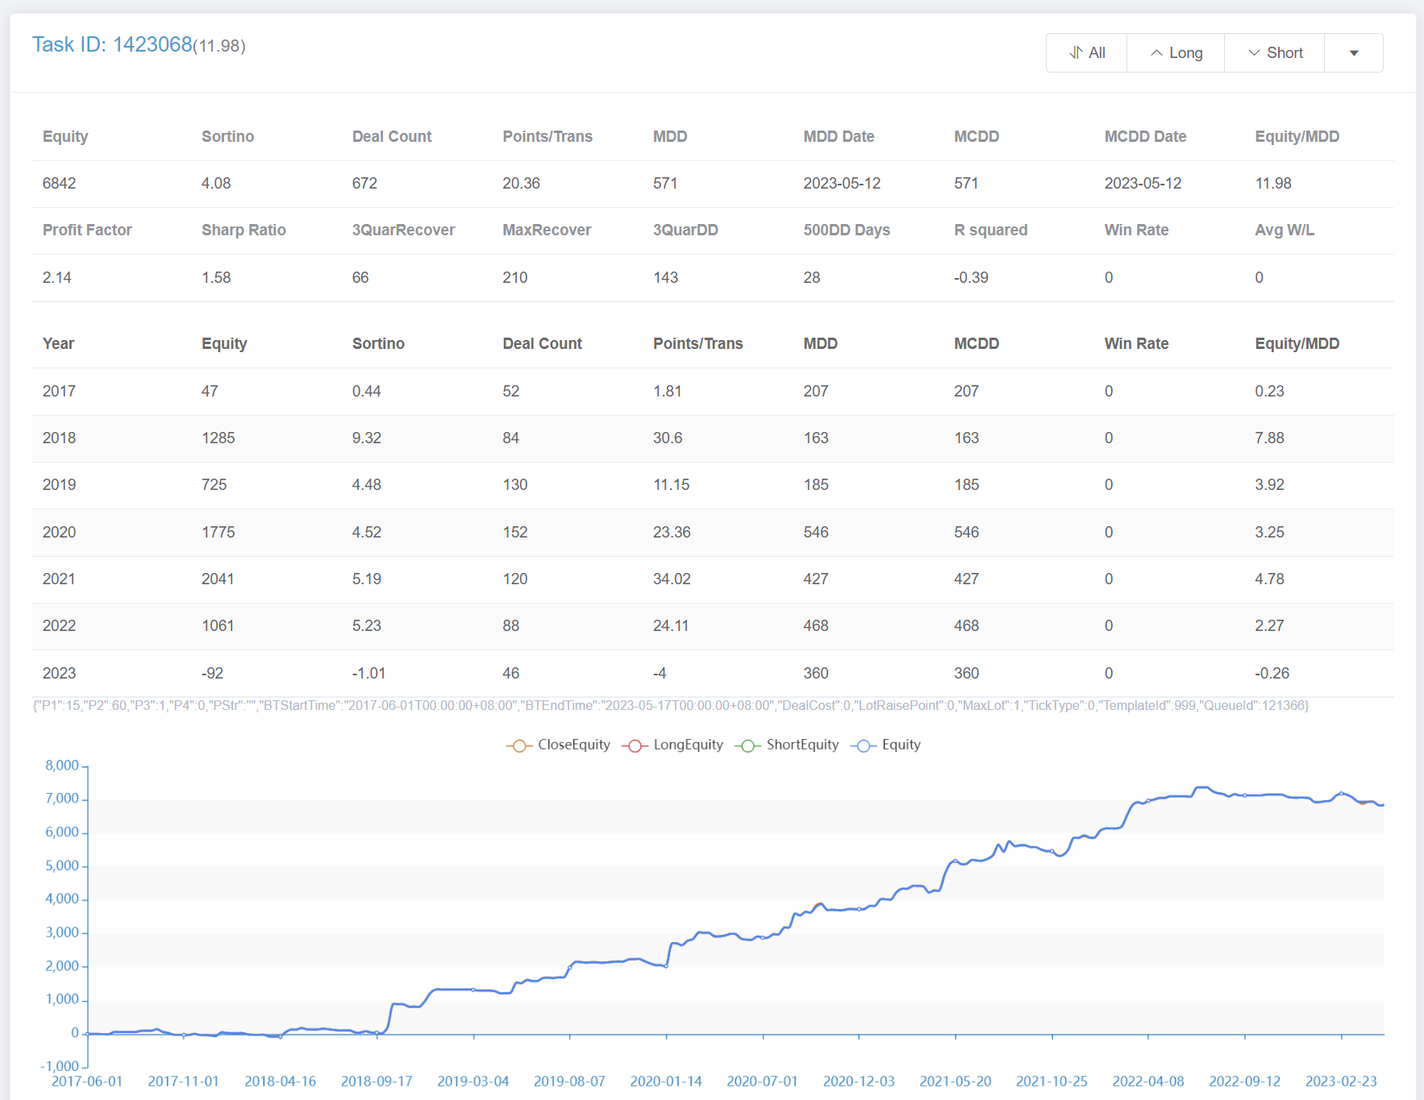
Short
* Note that all of them are test set

Slide 12
02.
Research Topic
RL

Slide 13
Build a gym env for trading ( the observations are the combination of indicators, action is discrete -> [0, 1] for 1 is to long/short the derivatives ).
Try different algo (PPO, A2C, DDQN, DQN) for the env
Try the densed reward for the Algo -> testset overfitting (time series testing)

Slide 14
02.
Research Topic
Information Entropy
How can we know if the market is messing up now?

Slide 15
Hypothesis :
A mean reversion’s another interpretation is that the system will always be messed up.
Thus,
If the entropy of the market decreases, then it is more likely that the system will attempt to maximize the entropy.

Slide 16
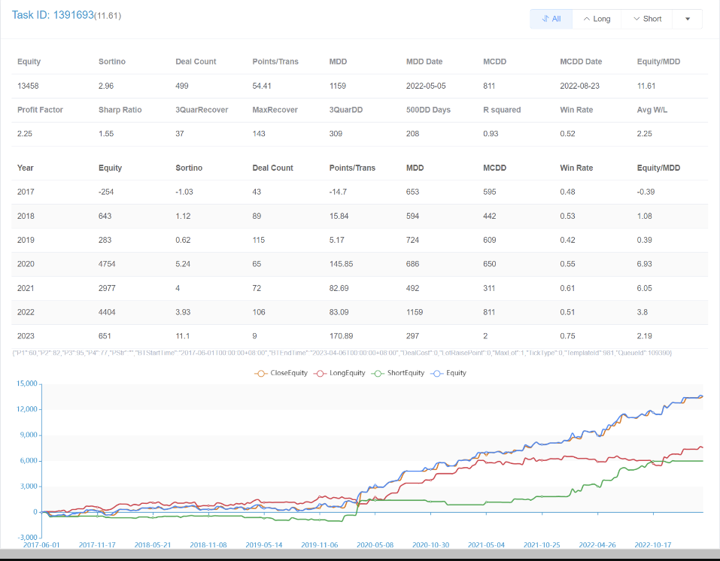

Slide 17
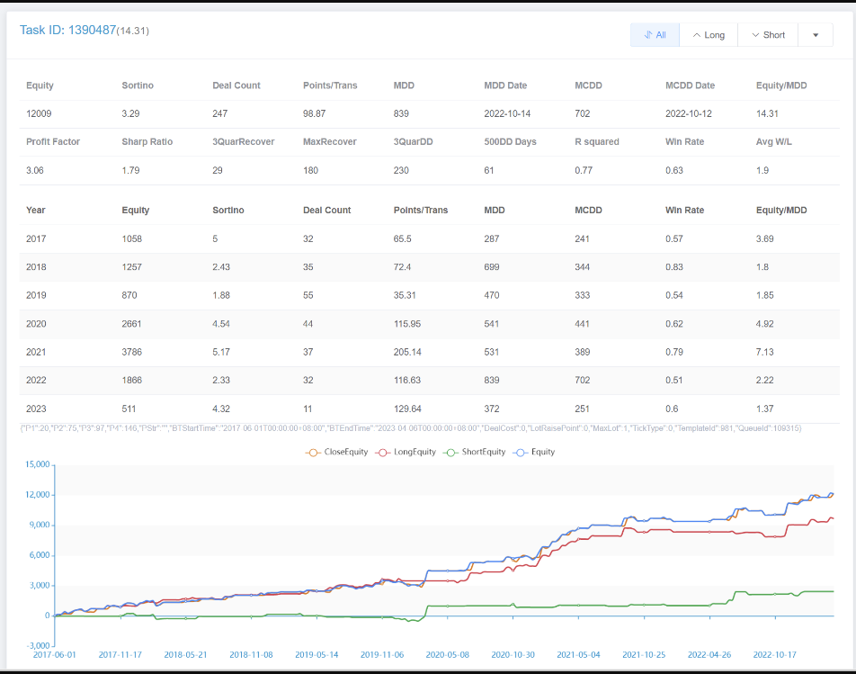

Slide 18
03.
WorldQuant Experience

Slide 19
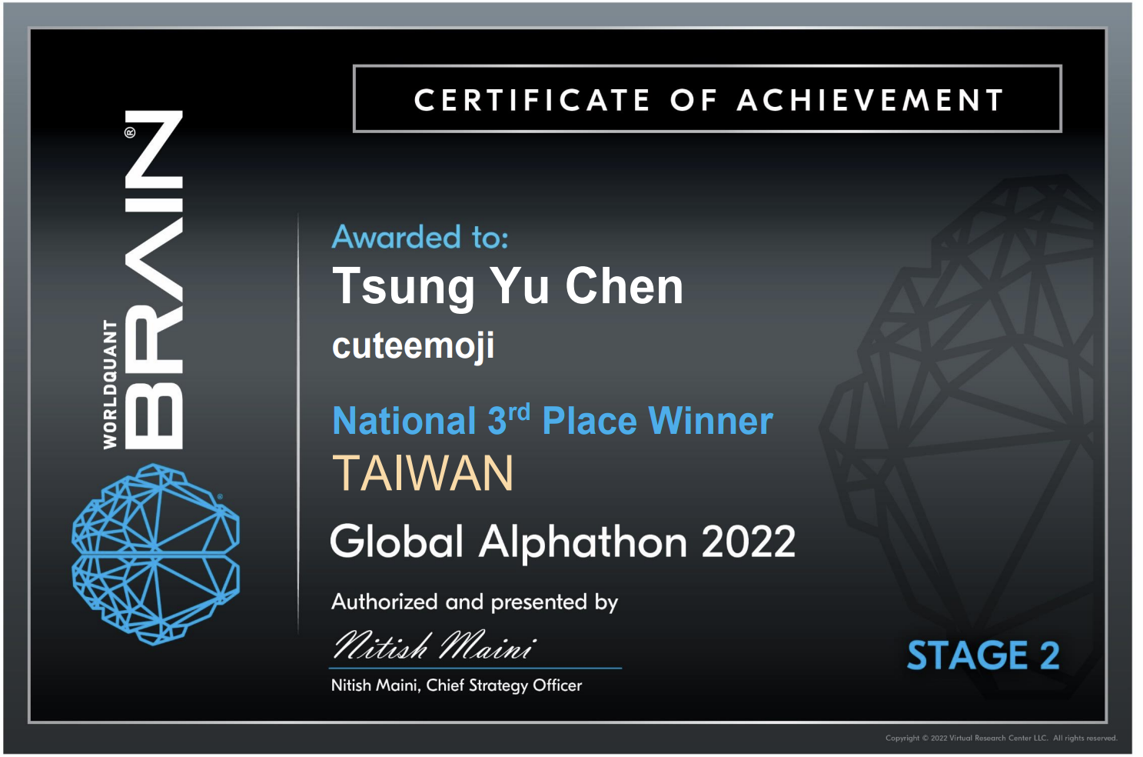

Slide 20
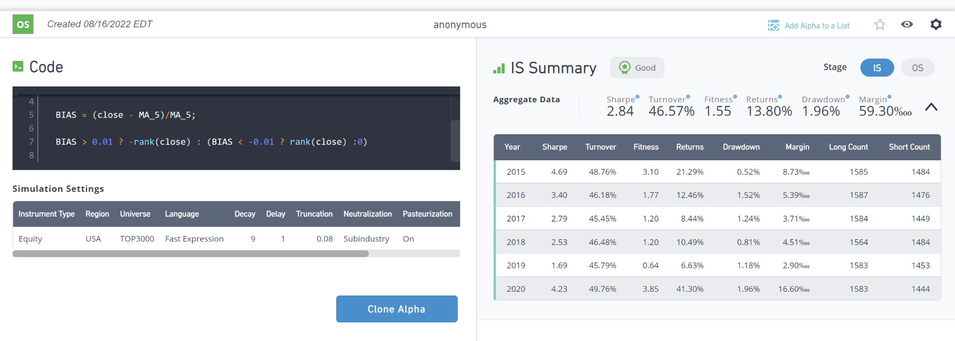

Slide 21
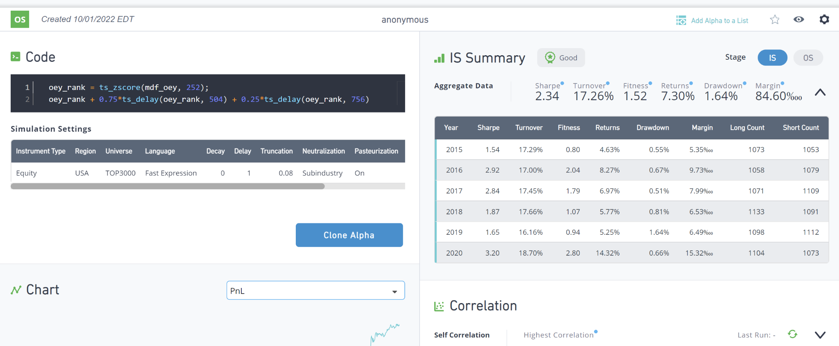
* OEY: Operation Earning Yield

Slide 22
04.
What Can I bring to VICI Holdings

Slide 23
Energy
Energetic Researcher with some crazy ideas
Self Motivated and eager to learn
Skill of ML/DL/RL
I have the ability to execute and deliver individual projects by leveraging the above skills
Potential Research Topic
Meta Learning across different derivatives
Hedge Crypto Strategies

