Slide 1

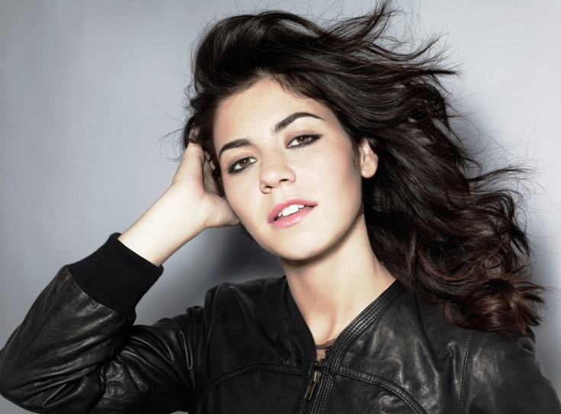
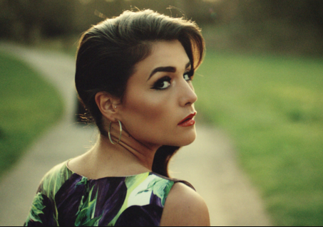
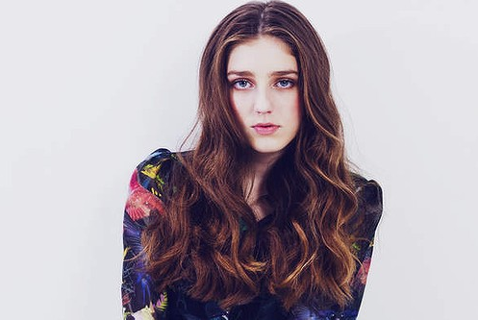
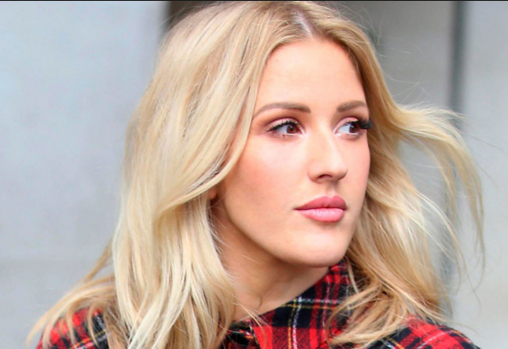




This Is The Theme of This News
This is the content of this news . Blabla Blabla Blabla Blabla Blabla Blabla Blabla Blabla Blabla Blabla
Down to here …
READ MORE
Jessie Ware - You & I
Birdy - Wild Horses
Ellie Goulding - On My Mind
Zayn Malik – Pillow Talk
Copyright 2016

