Slide 1



Business Insights-360
View in Power BI
Last data refresh:
01-02-2024 11:17:47 UTC
Downloaded at:
01-02-2024 11:22:33 UTC

Slide 2
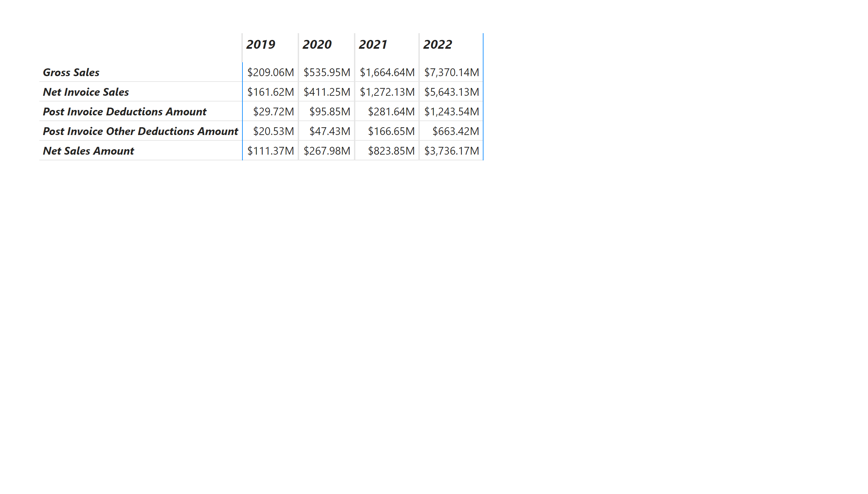
P&L Check
Notes:
pivotTable
No alt text provided

Slide 3
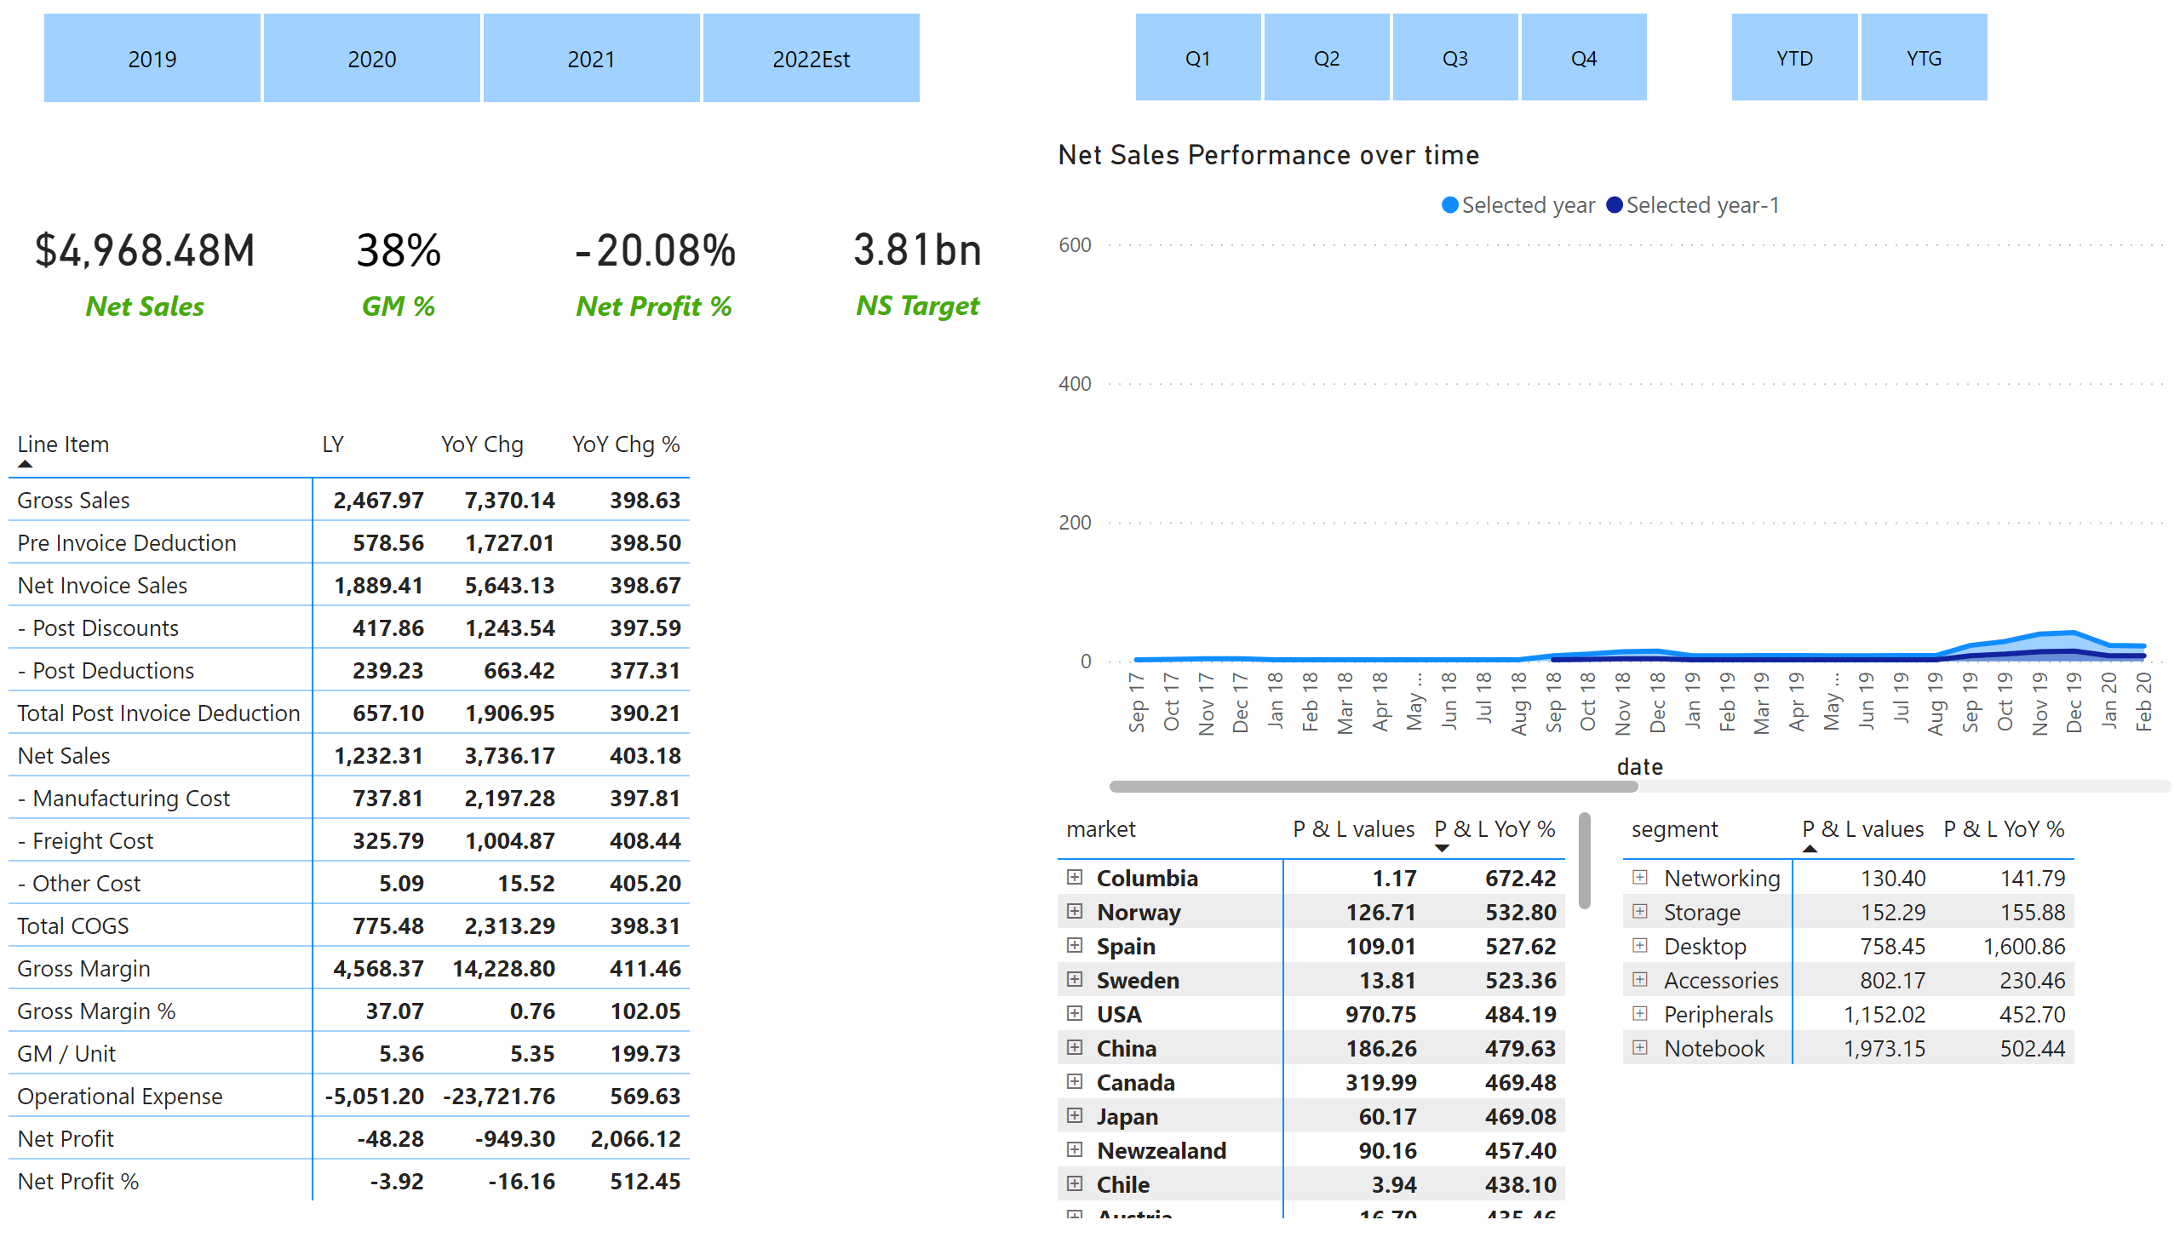
Finance view
Notes:
pivotTable
No alt text provided
slicer
No alt text provided
slicer
No alt text provided
Net Sales Performance over time
No alt text provided
pivotTable
No alt text provided
pivotTable
No alt text provided
slicer
No alt text provided
card
No alt text provided
card
No alt text provided
card
No alt text provided
card
No alt text provided

Slide 4
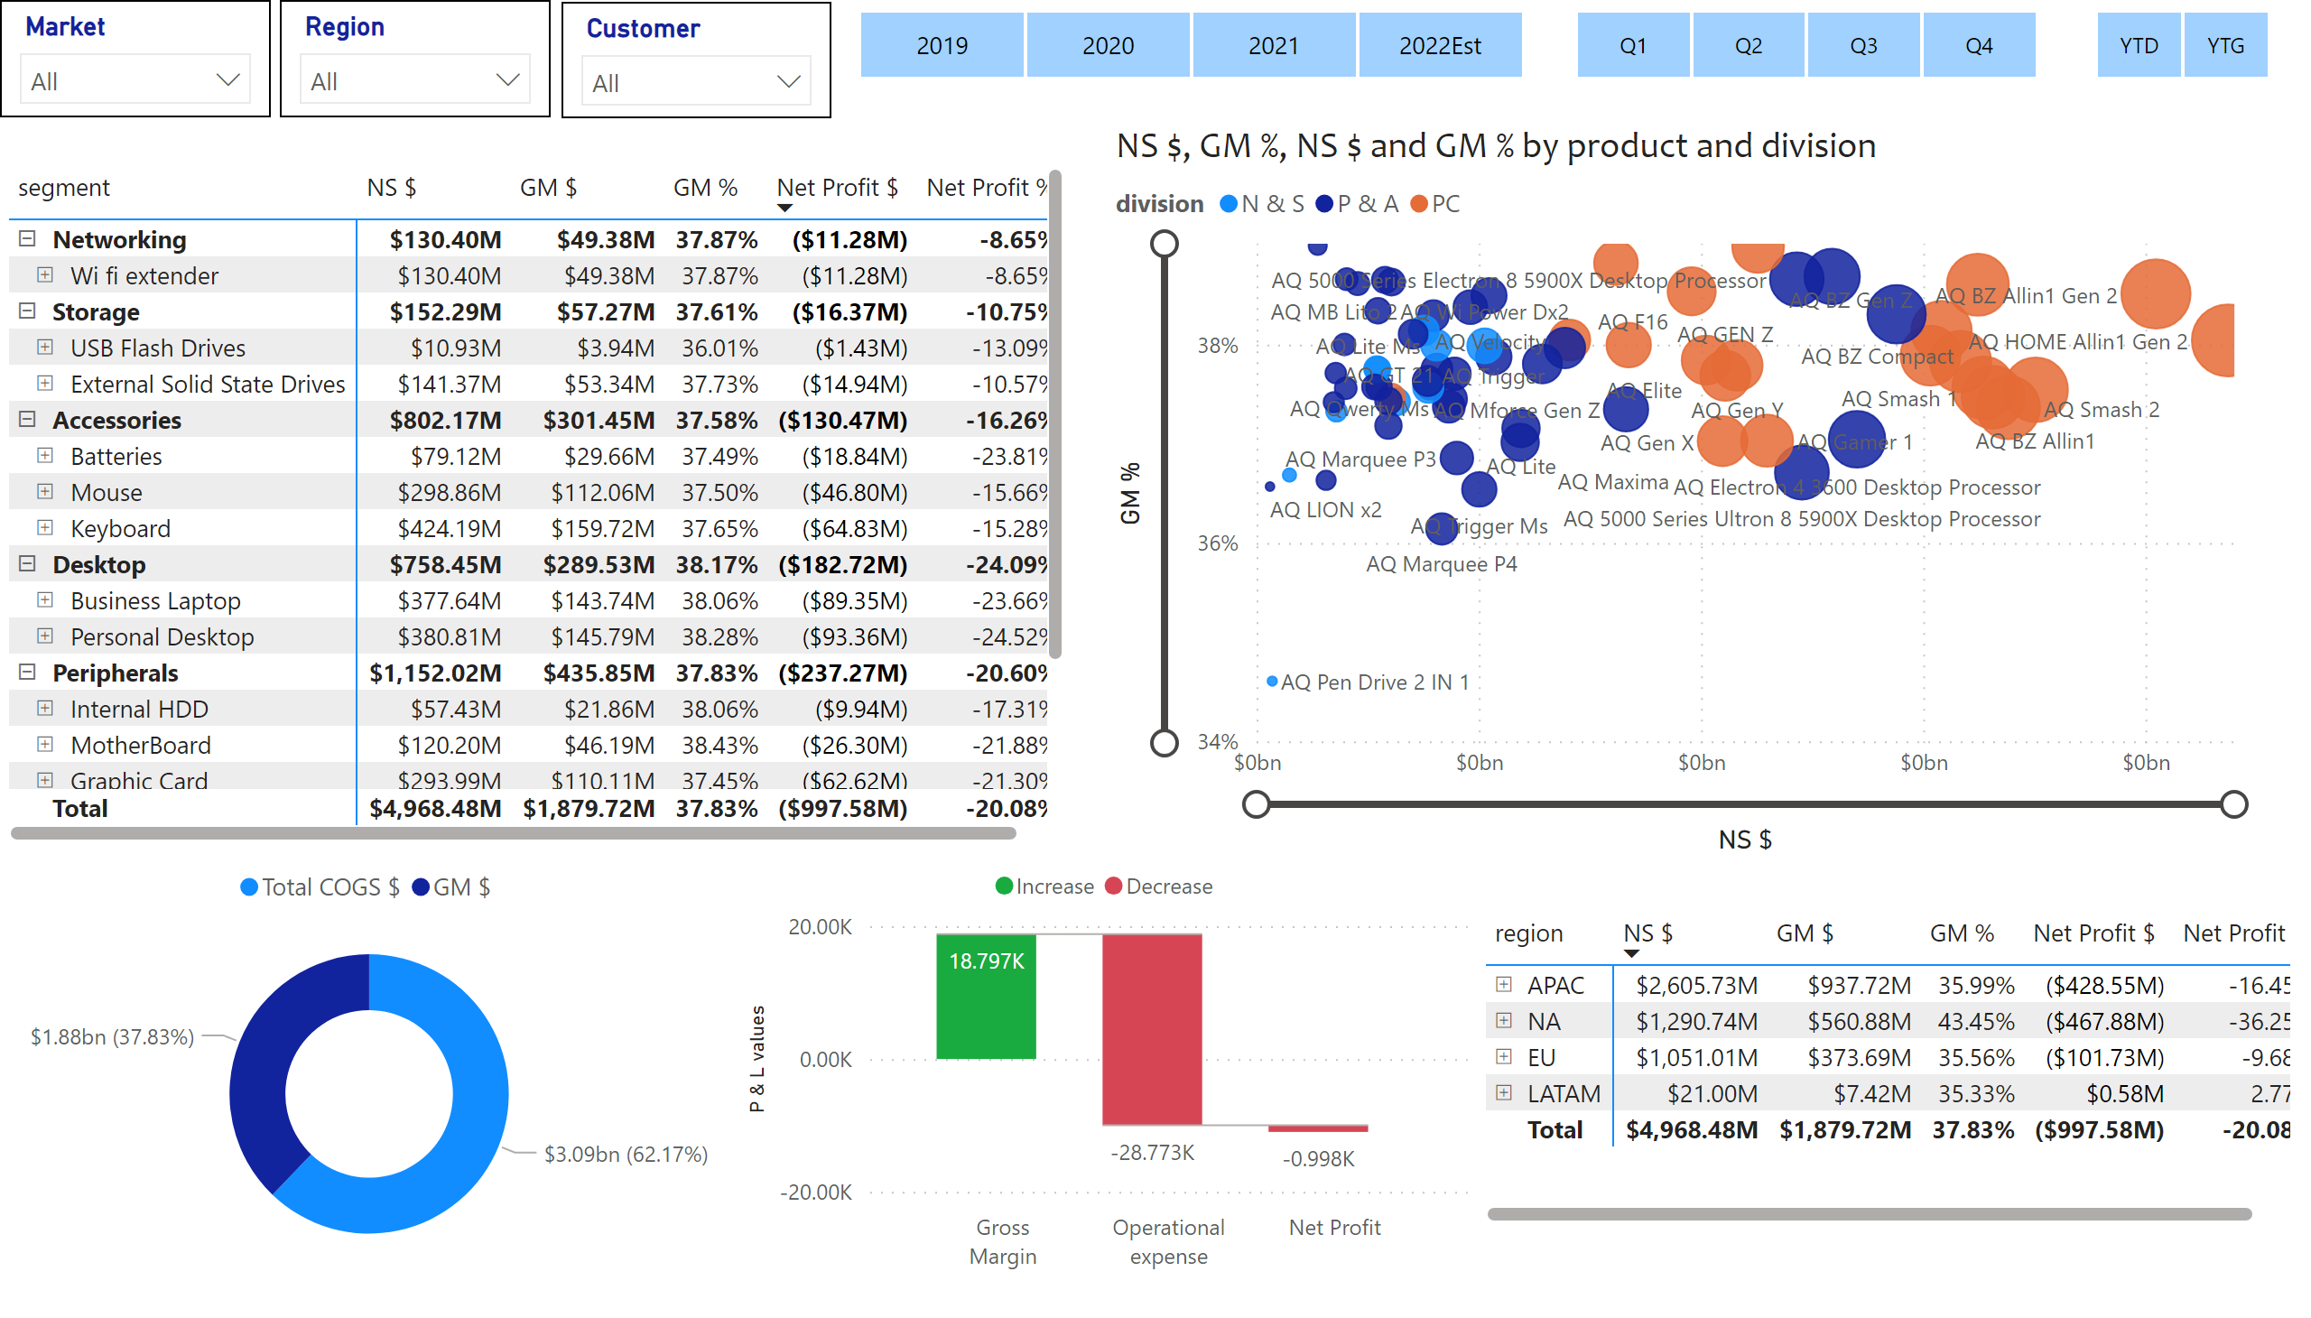
Marketing View
Notes:
scatterChart
No alt text provided
slicer
No alt text provided
slicer
No alt text provided
slicer
No alt text provided
pivotTable
No alt text provided
donutChart
No alt text provided
waterfallChart
No alt text provided
pivotTable
No alt text provided
slicer
No alt text provided
slicer
No alt text provided
slicer
No alt text provided

Slide 5
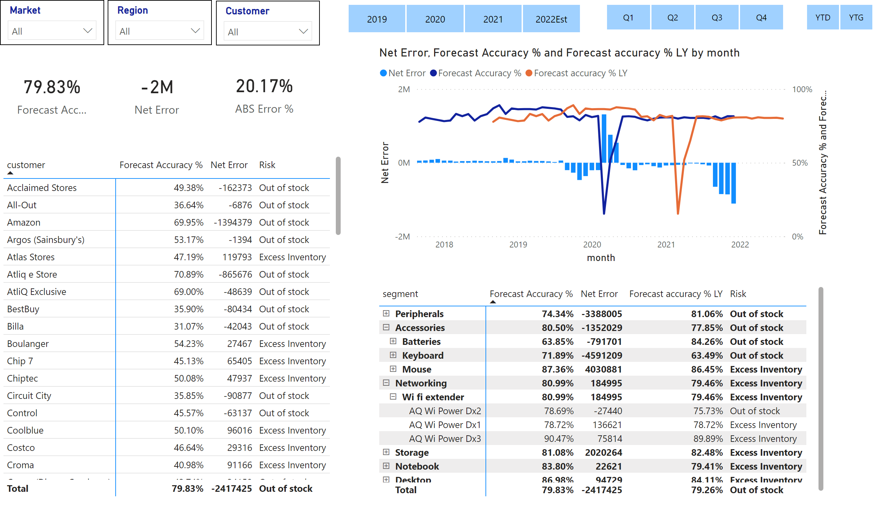
Supply Chain View
Notes:
slicer
No alt text provided
slicer
No alt text provided
slicer
No alt text provided
card
No alt text provided
card
No alt text provided
card
No alt text provided
pivotTable
No alt text provided
pivotTable
No alt text provided
lineClusteredColumnComboChart
No alt text provided
slicer
No alt text provided
slicer
No alt text provided
slicer
No alt text provided

Slide 6
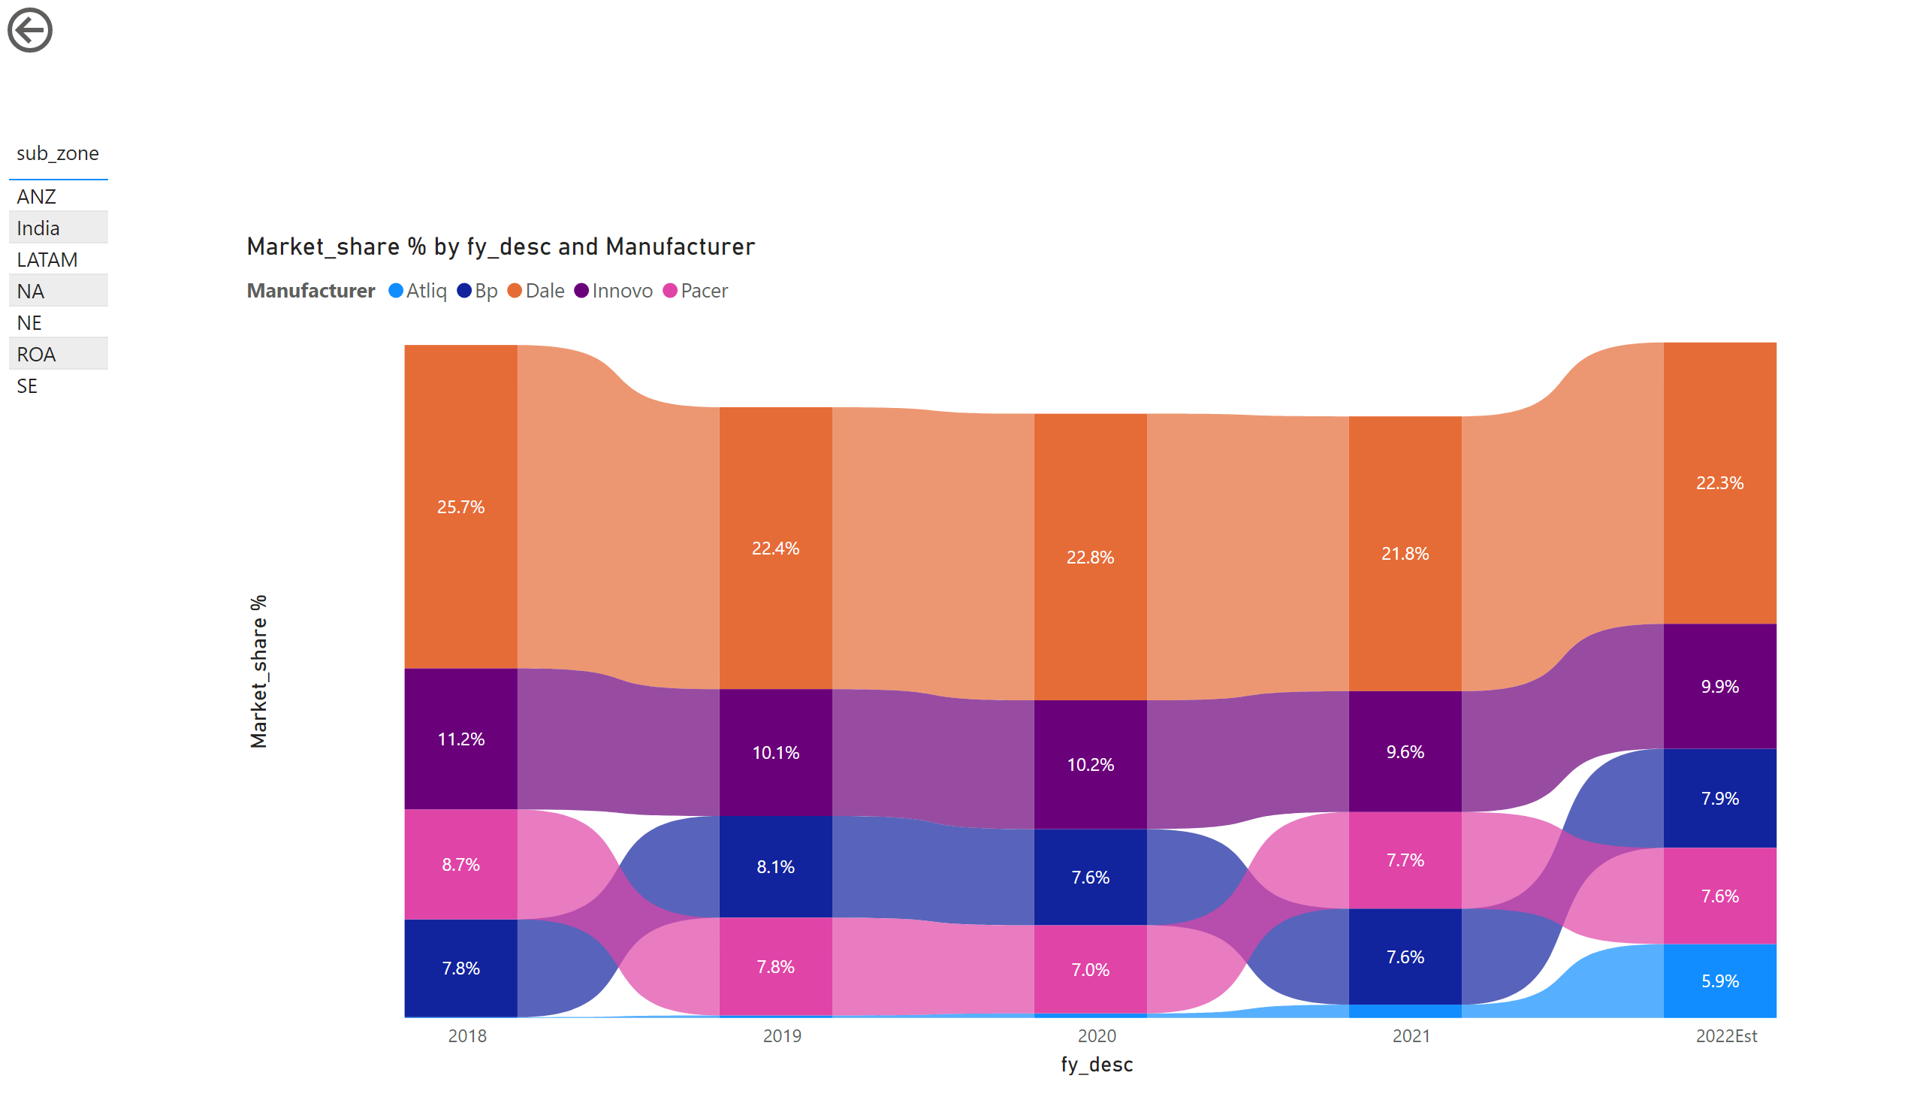
Market share
Notes:
ribbonChart
No alt text provided
actionButton
No alt text provided
tableEx
No alt text provided

