Slide 1
Illumina Amplicon Sequencing for Insecticide Resistance Surveillance
Sanjay C Nagi

Slide 2
Why Genomic Surveillance of Mosquitoes?
Insecticide-based interventions are crucial for malaria control
Emergence and spread of insecticide resistance challenges control efforts
Genomic surveillance helps:
Identify resistance-conferring mutations early
Implement proactive interventions
Understand resistance mechanisms
Devise effective mitigation strategies

Slide 3
Why Amplicon Sequencing?
Whole genome sequencing is costly for routine surveillance
Amplicon sequencing targets specific genomic regions of interest
Benefits:
Cost-effective
Focuses on known resistance loci
Allows high-throughput analysis
Provides detailed information on resistance mechanisms

Slide 4
Technology Used in Illumina Amplicon Sequencing
Based on sequencing-by-synthesis technology
Key components:
DNA polymerase
Fluorescently labeled nucleotides
High-resolution cameras
Process:
Amplification of target regions
Bridge amplification to create clusters
Sequencing using fluorescent nucleotides
Image capture and base calling

Slide 5
Illumina Adaptors and Barcodes
Adaptors: Short DNA sequences added to amplicons
Allow binding to flow cell
Facilitate bridge amplification
Barcodes (Indexes):
Unique sequences for sample identification
Enable multiplexing (multiple samples in one run)
Ag-vAMP-IR panel uses:
96 custom i7 adaptors
16 i5 adaptors
Allows multiplexing of up to 1536 samples per run

Slide 6
Brief Overview of the Lab Method
DNA extraction from mosquito samples
PCR1 amplification of target regions (multiplex)
Uses primers with Illumina adaptor sequences
PCR2 Addition of index sequences
Pooling of samples
QC and quantification
Loading onto Illumina sequencer
Run!

Slide 7
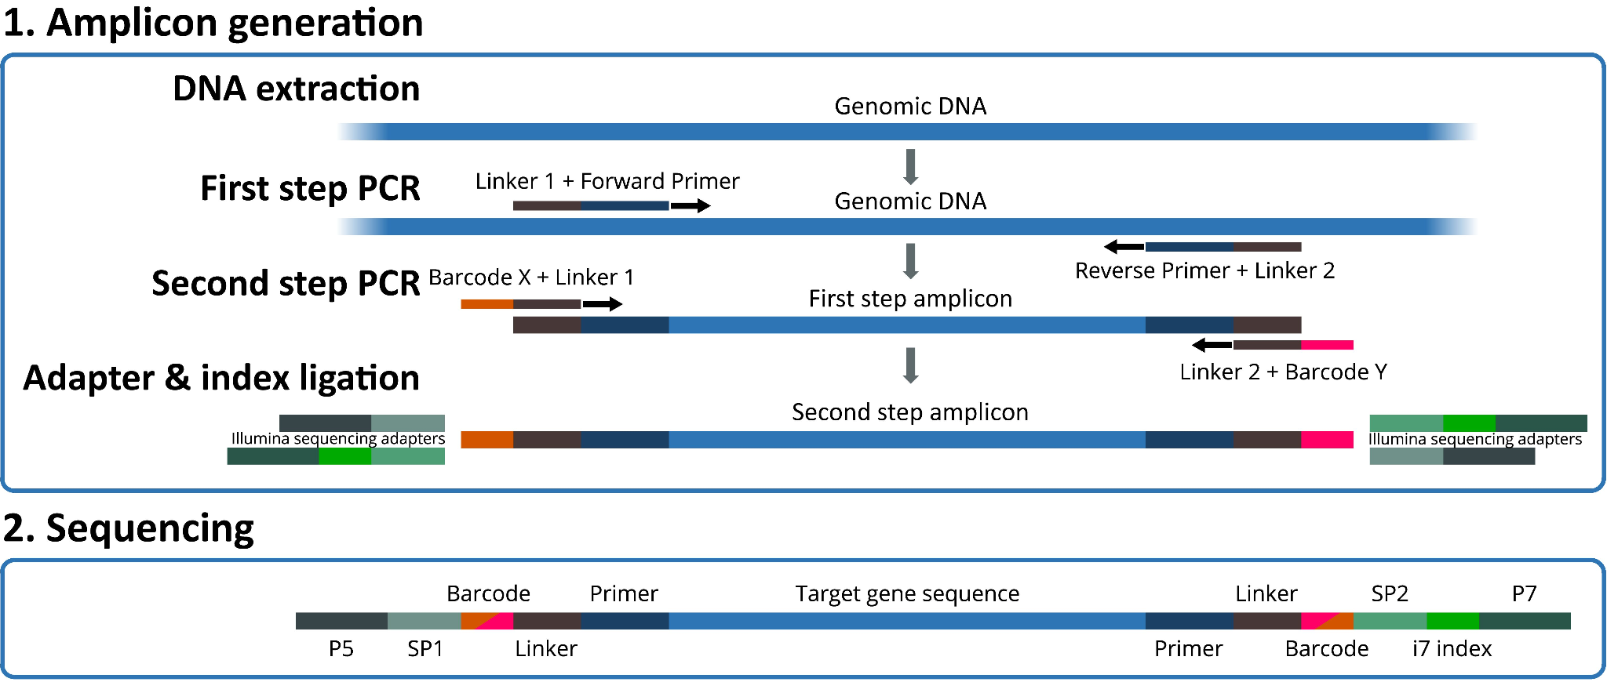

Slide 8
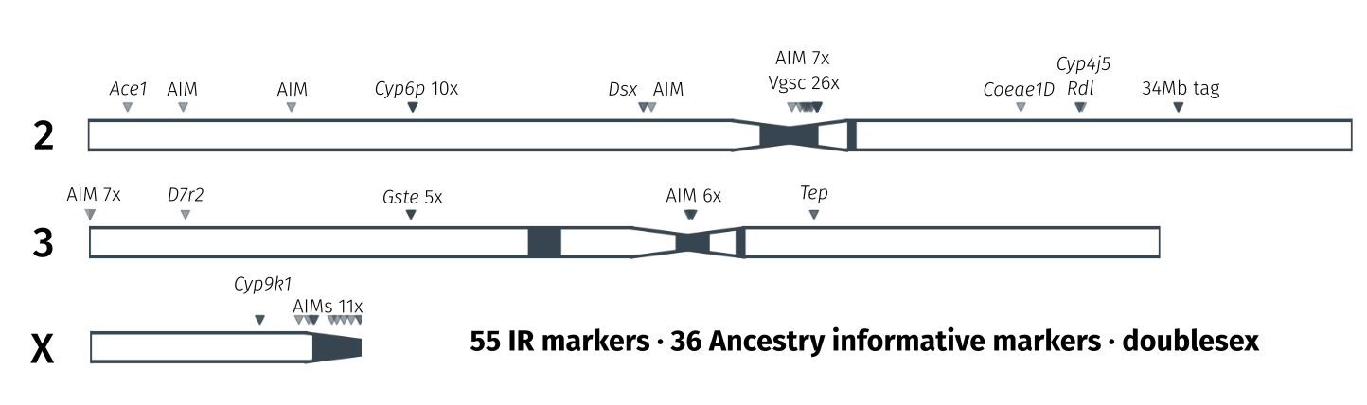
ag-vampIR

Slide 9

Analyzing the Data with AmpSeeker
Open-source Snakemake workflow for amplicon data analysis
Key features:
Automated end-to-end analysis
Modular architecture
Generates local webpage for result exploration

Slide 10
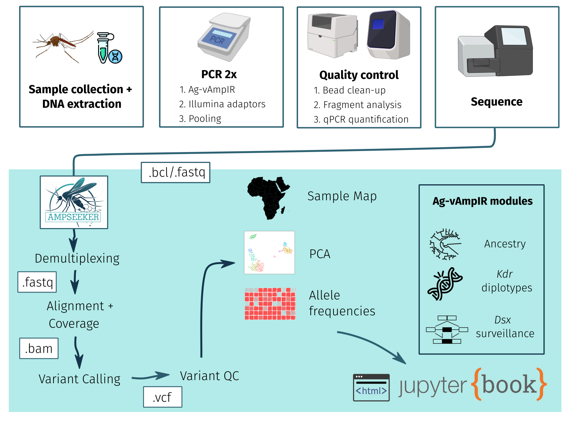
Analyzing the Data with AmpSeeker

Slide 11
Conclusion
Illumina amplicon sequencing is a powerful tool for insecticide resistance surveillance
Combines targeted approach with high-throughput capabilities
AmpSeeker pipeline streamlines data analysis and interpretation
Enhances our ability to monitor and respond to insecticide resistance in malaria vectors

