Slide 1
Super Quick Architecture Review

Slide 2
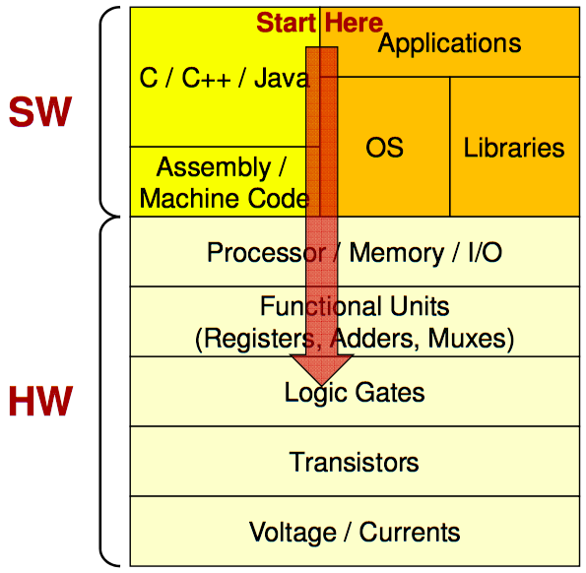
Software-Hardware stack
Credit:: Mark Redekopp, USC

Slide 3
Process vs Thread
Source: https://www.cs.uic.edu/~jbell/CourseNotes/OperatingSystems/4_Threads.html

Slide 4
ISA example - MIPS R-format Instructions
op
rs
rt
rd
shamt
funct
6 bits
5 bits
5 bits
5 bits
5 bits
6 bits
Instruction fields
op: operation code (opcode)
rs: first source register number
rt: second source register number
rd: destination register number
shamt: shift amount (00000 for now)
funct: function code (extends opcode)
Used only for ALU instructions

Slide 5
R-format Example
op
rs
rt
rd
shamt
funct
6 bits
5 bits
5 bits
5 bits
5 bits
6 bits
add $r8, $r17, $r18
special
$r17
$r18
$r8
0
add
0
17
18
8
0
32
000000
10001
10010
01000
00000
100000
00000010001100100100000000100000₂ = 02324020₁₆

Slide 6
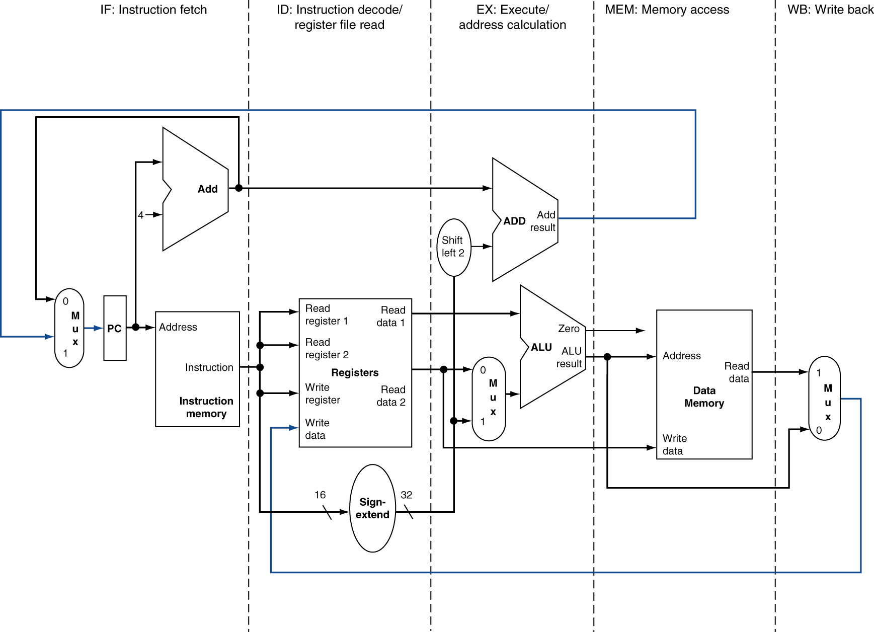
5-stage pipeline

Slide 7
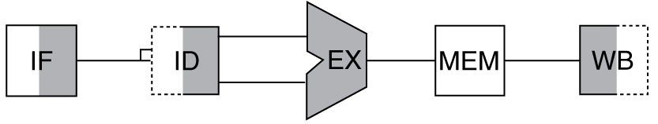
Abstracted CPU
Memory (Off-chip DRAM)
L3 Data Cache
L2 Data Cache
Core
Core
Core
I-$
RF
D-$
RF
. . .
Instr. Cache
Register File
L1 Data Cache
Data Path
Core
Core

Slide 8
Memory Hierarchy

