Slide 1
CUDA Parallelism Model
Slide credit: Slides adapted from
© David Kirk/NVIDIA and Wen-mei W. Hwu, 2007-2016

Slide 2
Objective
To learn the basic concepts involved in a simple CUDA kernel function
Declaration
Built-in variables
Thread index to data index mapping
2

Slide 3
Example: Vector Addition Kernel
Device Code
// Compute vector sum C = A + B
// Each thread performs one pair-wise addition
__global__
void vecAddKernel(float* A, float* B, float* C, int n)
{
int i = threadIdx.x+blockDim.x*blockIdx.x;
if(i<n) C[i] = A[i] + B[i];
}

Slide 4
Example: Vector Addition Kernel Launch (Host Code)
Host Code
void vecAdd(float* h_A, float* h_B, float* h_C, int n)
{
// d_A, d_B, d_C allocations and copies omitted
// Run ceil(n/256.0) blocks of 256 threads each
vecAddKernel<<<ceil(n/256.0),256>>>(d_A, d_B, d_C, n);
}
The ceiling function makes sure that there are enough threads to cover all elements.
4

Slide 5
More on Kernel Launch (Host Code)
Host Code
void vecAdd(float* h_A, float* h_B, float* h_C, int n)
{
dim3 DimGrid((n-1)/256 + 1, 1, 1);
dim3 DimBlock(256, 1, 1);
vecAddKernel<<<DimGrid,DimBlock>>>(d_A, d_B, d_C, n);
}
This is an equivalent way to express the ceiling function.

Slide 6
Kernel execution in a nutshell
__host__
void vecAdd(…)
{
dim3 DimGrid(ceil(n/256.0),1,1);
dim3 DimBlock(256,1,1);
vecAddKernel<<<DimGrid,DimBlock>>>(d_A,d_B,d_C,n);
}
__global__
void vecAddKernel(float *A,
float *B, float *C, int n)
{
int i = blockIdx.x * blockDim.x
+ threadIdx.x;
if( i<n ) C[i] = A[i]+B[i];
}
Blk 0
Grid
Blk N-1
• • •
GPU
M0
• • •
Mk
RAM

Slide 7
More on CUDA Function Declarations
Executed on the:
Only callable from the:
__device__ float DeviceFunc()‏
device
device
__global__ void KernelFunc()‏
device
host
__host__ float HostFunc()‏
host
host
__global__ defines a kernel function
Each “__” consists of two underscore characters
A kernel function must return void
__device__ and __host__ can be used together
__host__ is optional if used alone

Slide 8
Compiling A CUDA Program
Integrated C programs with CUDA extensions
NVCC Compiler
Device Code (PTX)
Host Code
Host C Compiler/ Linker
Device Just-in-Time Compiler
Heterogeneous Computing Platform with
CPUs, GPUs, etc.

Slide 9
Multi-dimensional Kernel Configuration

Slide 10
A Multi-Dimensional Grid Example
host
device
Grid 1
Block (0, 0)
Block (0, 1)
Kernel 1
Block (1, 0)
Block (1, 1)
Block (1,0)
Grid 2
(1,0,0)
(1,0,1)
(1,0,2)
(1,0,3)
Thread
(0,0,0)
Thread
(0,0,1)
Thread
(0,0,2)
Thread
(0,0,3)
Thread
(0,0,0)
Thread
(0,1,3)
Thread
(0,1,0)
Thread
(0,1,1)
Thread
(0,1,2)
10

Slide 11



Slide 12
Row-Major Layout in C/C++
M
Row*Width+Col = 2*4+1 = 9
M₀
M₁
M₂
M₃
M₄
M₅
M₆
M₇
M₈
M₉
M₁₀
M₁₁
M₁₂
M₁₃
M₁₄
M₁₅
M
M_{0,0}
M_{0,1}
M_{0,2}
M_{0,3}
M_{1,0}
M_{1,1}
M_{1,2}
M_{1,3}
M_{2,0}
M_{2,1}
M_{2,2}
M_{2,3}
M_{3,0}
M_{3,1}
M_{3,2}
M_{3,3}
M_{0,0}
M_{0,1}
M_{0,2}
M_{0,3}
M_{1,0}
M_{1,1}
M_{1,2}
M_{1,3}
M_{2,0}
M_{2,1}
M_{2,2}
M_{2,3}
M_{3,0}
M_{3,1}
M_{3,2}
M_{3,3}

Slide 13
Source Code of a PictureKernel
__global__ void PictureKernel(float* d_Pin, float* d_Pout,
int height, int width)
{
// Calculate the row # of the d_Pin and d_Pout element
int Row = blockIdx.y*blockDim.y + threadIdx.y;
// Calculate the column # of the d_Pin and d_Pout element
int Col = blockIdx.x*blockDim.x + threadIdx.x;
// each thread computes one element of d_Pout if in range
if ((Row < height) && (Col < width)) {
d_Pout[Row*width+Col] = 2.0*d_Pin[Row*width+Col];
}
}
Scale every pixel value by 2.0

Slide 14
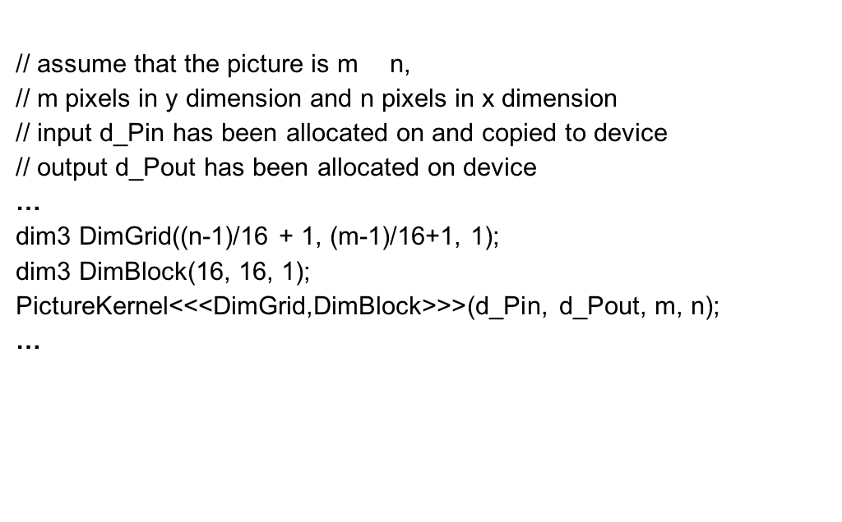
Host Code for Launching PictureKernel
// assume that the picture is m$×$n,
// m pixels in y dimension and n pixels in x dimension
// input d_Pin has been allocated on and copied to device
// output d_Pout has been allocated on device
…
dim3 DimGrid((n-1)/16 + 1, (m-1)/16+1, 1);
dim3 DimBlock(16, 16, 1);
PictureKernel<<<DimGrid,DimBlock>>>(d_Pin, d_Pout, m, n);
…

Slide 15
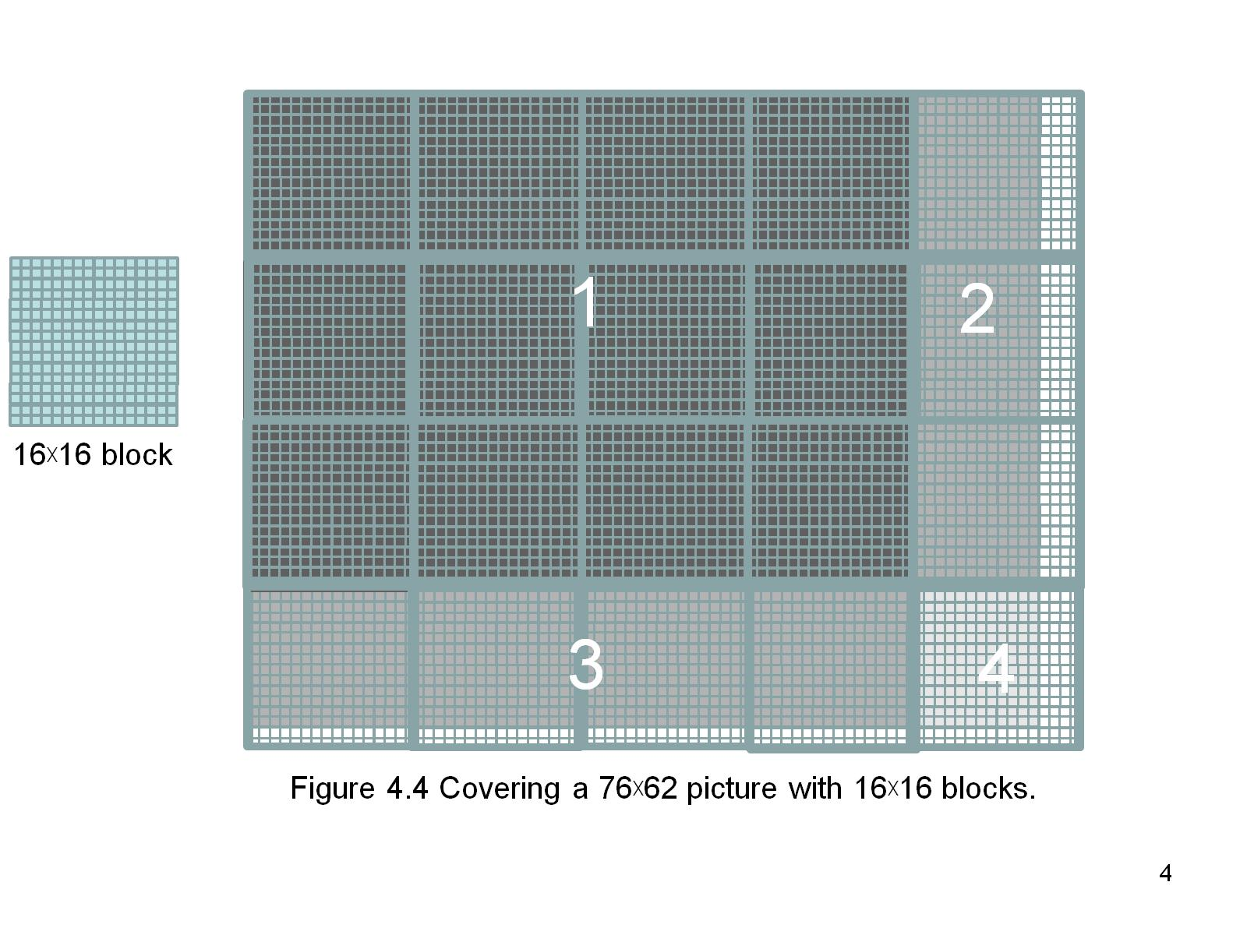

Covering a 62$×$76 Picture with 16$×$16 Blocks
Not all threads in a Block will follow the same control flow path.

Slide 16
Color-to-Grayscale Image Processing Example

Slide 17
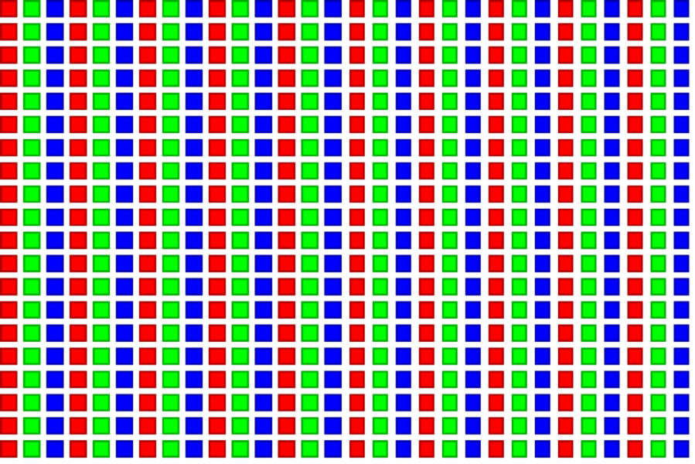
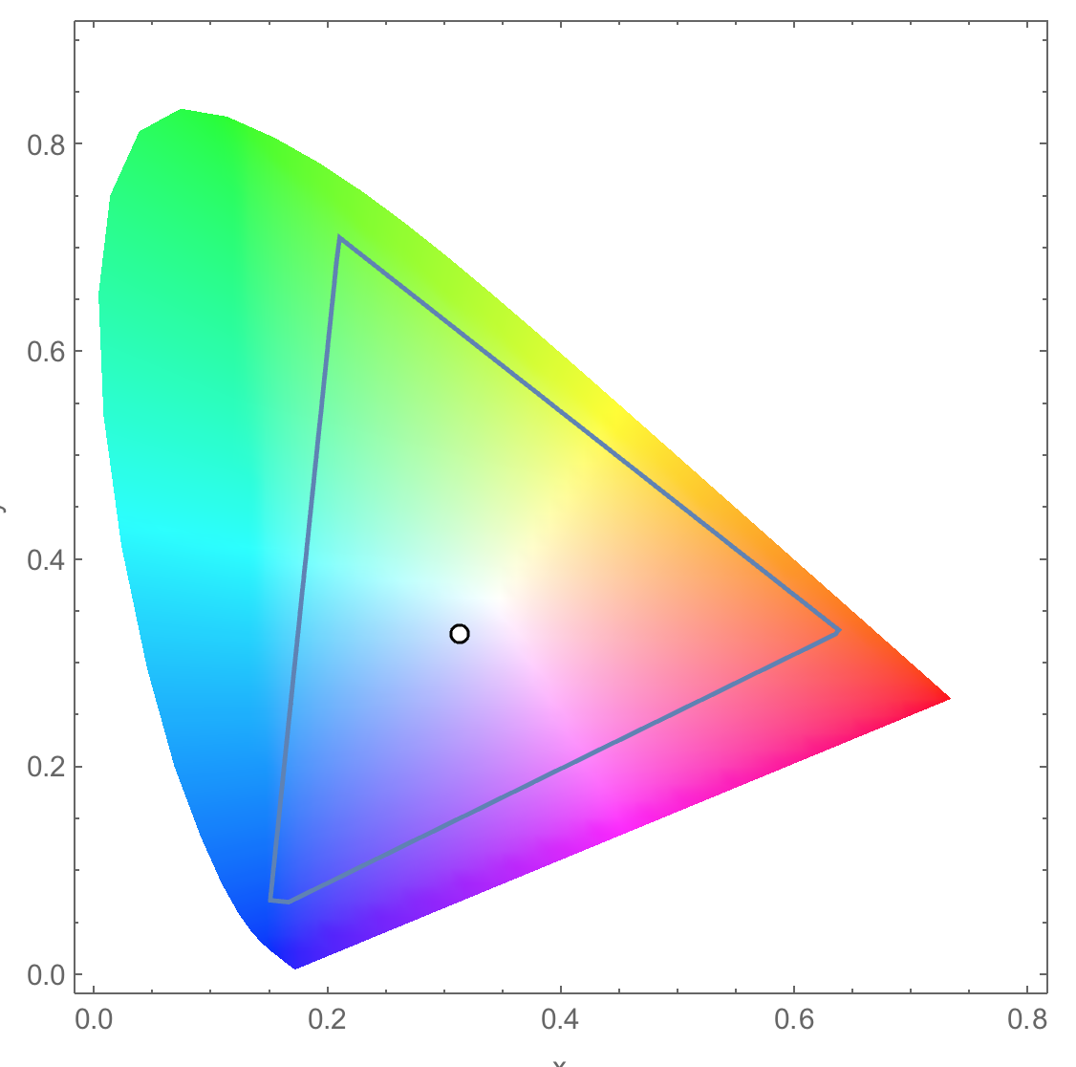
RGB Color Image Representation
Each pixel in an image is an RGB value
The format of an image’s row is (r g b) (r g b) … (r g b)
RGB ranges are not distributed uniformly
Many different color spaces, here we show the constants to convert to AdbobeRGB color space
The vertical axis (y value) and horizontal axis (x value) show the fraction of the pixel intensity that should be allocated to G and B. The remaining fraction (1-y–x) of the pixel intensity that should be assigned to R
The triangle contains all the representable colors in this color space

Slide 18


RGB to Grayscale Conversion
A grayscale digital image is an image in which the value of each pixel carries only intensity information.

Slide 19
Color Calculating Formula
For each pixel (r g b) at (I, J) do: grayPixel[I,J] = 0.21*r + 0.71*g + 0.07*b
This is just a dot product <[r,g,b],[0.21,0.71,0.07]> with the constants being specific to input RGB space
0.71
0.21
0.07

Slide 20
RGB to Grayscale Conversion Code
#define CHANNELS 3 // we have 3 channels corresponding to RGB
// The input image is encoded as unsigned characters [0, 255]
__global__ void colorConvert(unsigned char * grayImage,
unsigned char * rgbImage,
int width, int height) {
int x = threadIdx.x + blockIdx.x * blockDim.x;
int y = threadIdx.y + blockIdx.y * blockDim.y;
if (x < width && y < height) {
// get 1D coordinate for the grayscale image
int grayOffset = y*width + x;
// one can think of the RGB image having
// CHANNEL times columns than the gray scale image
int rgbOffset = grayOffset*CHANNELS;
unsigned char r = rgbImage[rgbOffset ]; // red value for pixel
unsigned char g = rgbImage[rgbOffset + 1]; // green value for pixel
unsigned char b = rgbImage[rgbOffset + 2]; // blue value for pixel
// perform the rescaling and store it
// We multiply by floating point constants
grayImage[grayOffset] = 0.21f*r + 0.71f*g + 0.07f*b;
}
}

Slide 21
Thread scheduling

Slide 22
Objective
To learn how a CUDA kernel utilizes hardware execution resources
Assigning thread blocks to execution resources
Capacity constrains of execution resources
Zero-overhead thread scheduling

Slide 23
Transparent Scalability
Device
Device
Thread grid
Block 0
Block 1
Block 2
Block 3
Block 0
Block 1
Block 2
Block 3
Block 0
Block 1
time
Block 4
Block 5
Block 2
Block 3
Block 6
Block 7
Block 4
Block 5
Block 6
Block 7
Block 4
Block 5
Block 6
Block 7
Each block can execute in any order relative to others.
Hardware is free to assign blocks to any processor at any time
A kernel scales to any number of parallel processors

Slide 24
Example: Executing Thread Blocks
SM
t0 t1 t2 … tm
Threads are assigned to Streaming Multiprocessors (SM) in block granularity
Up to 8 blocks to each SM as resource allows
Fermi SM can take up to 1536 threads
Could be 256 (threads/block) * 6 blocks
Or 512 (threads/block) * 3 blocks, etc.
SM maintains thread/block idx #s
SM manages/schedules thread execution
SP
Blocks
Shared
Memory

Slide 25
What Block Size Should I Use??
For 2D algorithms using multiple blocks, should I use 8X8, 16X16 or 32X32 blocks for Fermi?
For 8X8, we have 64 threads per Block. Since each SM can take up to 1536 threads, which translates to 24 Blocks. However, each SM can only take up to 8 Blocks, only 512 threads will go into each SM!
For 16X16, we have 256 threads per Block. Since each SM can take up to 1536 threads, it can take up to 6 Blocks and achieve full capacity unless other resource considerations overrule.
For 32X32, we would have 1024 threads per Block. Only one block can fit into an SM for Fermi. Using only 2/3 of the thread capacity of an SM.

Slide 26
The Von-Neumann Model
Memory
I/O
Processing Unit
Reg
File
ALU
Control Unit
PC
IR
Notes:
Insert von-neumann schematic here

Slide 27
The Von-Neumann Model with SIMD units
Memory
I/O
Processing Unit
Reg
File
ALU
Control Unit
PC
IR
Single Instruction Multiple Data
(SIMD)
Single Instruction Multiple Data
(SIMD)
Notes:
Insert von-neumann schematic here

Slide 28
Warp Example
If 3 blocks are assigned to an SM and each block has 256 threads, how many Warps are there in an SM?
Each Block is divided into 256/32 = 8 Warps
There are 8 * 3 = 24 Warps
…
Block 0 Warps
…
Block 1 Warps
…
…
…
Block 2 Warps
…
t0 t1 t2 … t31
t0 t1 t2 … t31
t0 t1 t2 … t31
Register File
L1
Shared Memory

Slide 29
Warps as Scheduling Units
Each block is divided into 32-thread warps
An implementation technique, not part of the CUDA programming model
Warps are scheduling units in SM
Threads in a warp execute in Single Instruction Multiple Data (SIMD) manner
The number of threads in a warp may vary in future generations
Block 1 Warps
Block 2 Warps
Block 3 Warps
…
…
…
…
…
…
t0 t1 t2 … t31
t0 t1 t2 … t31
t0 t1 t2 … t31

Slide 30
Blocks are partitioned after linearization
Linearized thread blocks are partitioned
Thread indices within a warp are consecutive and increasing
Warp 0 starts with Thread 0
Partitioning scheme is consistent across devices
Thus you can use this knowledge in control flow
However, the exact size of warps may change from generation to generation
DO NOT rely on any ordering within or between warps
If there are any dependencies between threads, you must __syncthreads() to get correct results (more later).

Slide 31
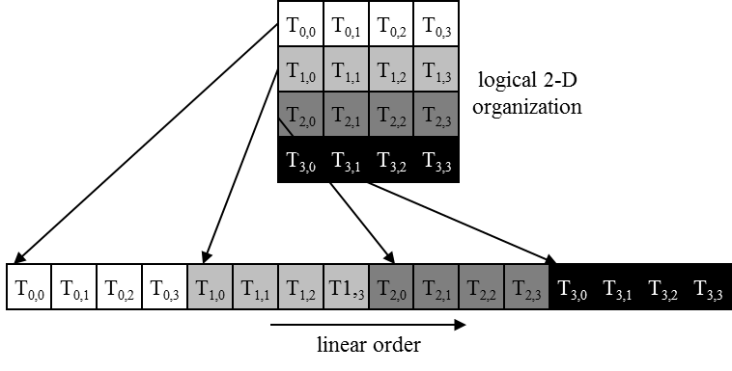
Warps in Multi-dimensional Thread Blocks
The thread blocks are first linearized into 1D in row major order
In x-dimension first, y-dimension next, and z-dimension last
Figure 6.1: Placing 2D threads into linear order

Slide 32
Warp divergence

Slide 33
SMs are SIMD Processors
Control unit for instruction fetch, decode, and control is shared among multiple processing units
Control overhead is minimized
Memory
I/O
Processing Unit
Shared Memory
Register
File
ALU
Control Unit
PC
IR
Processor (SM)
Notes:
Insert von-neumann schematic here

Slide 34
SIMD Execution Among Threads in a Warp
All threads in a warp must execute the same instruction at any point in time
Also called SIMT execution model
This works efficiently if all threads follow the same control flow path
All if-then-else statements make the same decision
All loops iterate the same number of times
Notes:
WARP_SIZE

Slide 35
Control Divergence
Control divergence occurs when threads in a warp take different control flow paths by making different control decisions
Some take the then-path and others take the else-path of an if-statement
Some threads take different number of loop iterations than others
The execution of threads taking different paths are serialized in current GPUs
The control paths taken by the threads in a warp are traversed one at a time until there is no more.
During the execution of each path, all threads taking that path will be executed in parallel
The number of different paths can be large when considering nested control flow statements
Notes:
WARP_SIZE

Slide 36
Control Divergence Examples
Divergence can arise when branch or loop condition is a function of thread indices
Example kernel statement with divergence:
if (threadIdx.x > 2) { }
This creates two different control paths for threads in a block
Decision granularity < warp size; threads 0, 1 and 2 follow different path than the rest of the threads in the first warp
Example without divergence:
If (blockIdx.x > 2) { }
Decision granularity is a multiple of blocks size; all threads in any given warp follow the same path

Slide 37
Example: Vector Addition Kernel
// Compute vector sum C = A + B
// Each thread performs one pair-wise addition
__global__
void vecAddKernel(float* A, float* B, float* C, int n)
{
int i = threadIdx.x + blockDim.x * blockIdx.x;
if(i<n) C[i] = A[i] + B[i];
}
Device Code

Slide 38
Analysis for vector size of 1,000 elements
Assume that block size is 256 threads
8 warps in each block
All threads in Blocks 0, 1, and 2 are within valid range
i values from 0 to 767
There are 24 warps in these three blocks, none will have control divergence
Most warps in Block 3 will not control divergence
Threads in the warps 0-6 are all within valid range, thus no control divergence
One warp in Block 3 will have control divergence
Threads with i values 992-999 will all be within valid range
Threads with i values of 1000-1023 will be outside valid range
Effect of serialization on control divergence will be small
1 out of 32 warps has control divergence
The impact on performance will likely be less than 3%

