Slide 1
Parallel Computation Patterns (Reduction)
Slide credit: Slides adapted from
© David Kirk/NVIDIA and Wen-mei W. Hwu, 2007-2016

Slide 2
CUDA Memories

Slide 3
Hardware View of CUDA Memories
Notes:
Insert von-neumann schematic here

Slide 4
Programmer View of CUDA Memories
Grid
Block (0, 0)
Block (1, 0)
Shared Memory
Shared Memory
Registers
Registers
Registers
Registers
Thread (0, 0)
Thread (1, 0)
Thread (0, 0)
Thread (1, 0)
Host
Global Memory
Constant Memory
Notes:
Global, constant, and texture memory contents are persistent across kernels called by the same application.
Each thread uses a number of registers.
Each block allocates a certain amount of Shared Memory that is accessible to all threads in the block.

Slide 5
Declaring CUDA Variables
Variable declaration | Memory | Scope | Lifetime
int LocalVar; | register | thread | thread
__device__ __shared__ int SharedVar; | shared | block | block
__device__ int GlobalVar; | global | grid | application
__device__ __constant__ int ConstantVar; | constant | grid | application
__device__ is optional when used with __shared__, or __constant__
Automatic variables reside in a register
Except per-thread arrays that reside in global memory

Slide 6
Example: Shared Memory Variable Declaration
void blurKernel(unsigned char * in, unsigned char * out, int w, int h)
{
__shared__ float ds_in[TILE_WIDTH][TILE_WIDTH];
…
}

Slide 7
Where to Declare Variables?
Can host access it?
Outside of any Function
In the kernel
global
constant
register
shared

Slide 8
Shared Memory in CUDA
A special type of memory whose contents are explicitly defined and used in the kernel source code
One in each SM
Accessed at much higher speed (in both latency and throughput) than global memory
Scope of access and sharing - thread blocks
Lifetime – thread block, contents will disappear after the corresponding thread finishes terminates execution
Accessed by memory load/store instructions
A form of scratchpad memory in computer architecture

Slide 9
Global Memory Access Pattern of the Basic Matrix Multiplication Kernel
Global Memory
…
Thread 1
Thread 2
Notes:
In Matrix multiplication, each thread accesses global memory in the for loop.

Slide 10
Tiling/Blocking - Basic Idea
Global Memory
On-chip Memory
…
Thread 1
Thread 2
Divide the global memory content into tiles
Focus the computation of threads on one or a small number of tiles at each point in time

Slide 11
Tiling/Blocking - Basic Idea
Global Memory
On-chip Memory
…
Thread 1
Thread 2

Slide 12
Parallel Computation Patterns - Reduction

Slide 13
“Partition and Summarize”
A commonly used strategy for processing large input data sets
There is no required order of processing elements in a data set (associative and commutative)
Partition the data set into smaller chunks
Have each thread to process a chunk
Use a reduction tree to summarize the results from each chunk into the final answer
E.G., Google and Hadoop MapReduce frameworks support this strategy
We will focus on the reduction tree step for now

Slide 14
Reduction enables other techniques
Reduction is also needed to clean up after some commonly used parallelizing transformations
Privatization
Multiple threads write into an output location
Replicate the output location so that each thread has a private output location (privatization)
Use a reduction tree to combine the values of private locations into the original output location

Slide 15
What is a reduction computation?
Summarize a set of input values into one value using a “reduction operation”
Max
Min
Sum
Product
Often used with a user defined reduction operation function as long as the operation
Is associative and commutative
Has a well-defined identity value (e.g., 0 for sum)
For example, the user may supply a custom “max” function for 3D coordinate data sets where the magnitude for the each coordinate data tuple is the distance from the origin.
An example of “collective operation”

Slide 16
An Efficient Sequential Reduction O(N)
Initialize the result as an identity value for the reduction operation
Smallest possible value for max reduction
Largest possible value for min reduction
0 for sum reduction
1 for product reduction
Iterate through the input and perform the reduction operation between the result value and the current input value
N reduction operations performed for N input values
Each input value is only visited once – an O(N) algorithm
This is a computationally efficient algorithm.

Slide 17
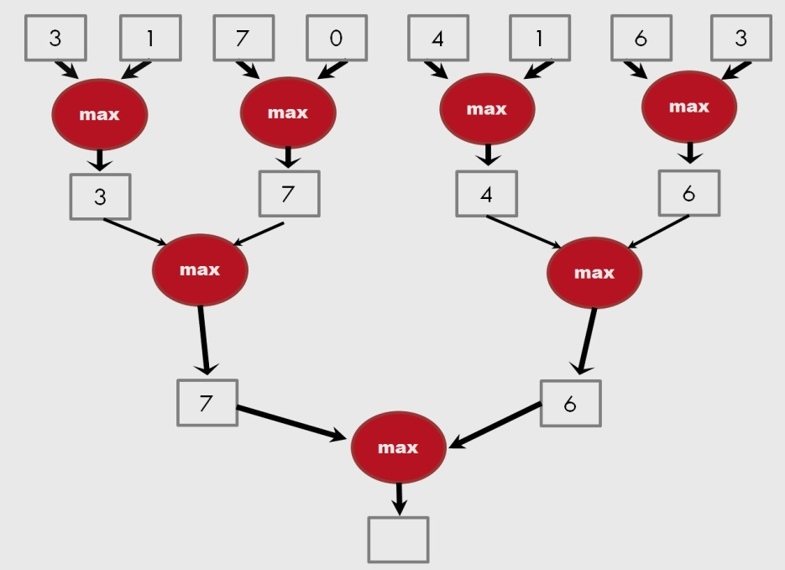
A parallel reduction tree algorithm performs N-1 operations in log(N) steps
13

Slide 18
Work Efficiency Analysis
For N input values, the reduction tree performs
(1/2)N + (1/4)N + (1/8)N + … (1)N = (1- (1/N))N = N-1 operations
In Log (N) steps – 1,000,000 input values take 20 steps
Assuming that we have enough execution resources
Average Parallelism (N-1)/Log(N))
For N = 1,000,000, average parallelism is 50,000
However, peak resource requirement is 500,000
This is not resource efficient
This is a work-efficient parallel algorithm
The amount of work done is comparable to the an efficient sequential algorithm
Many parallel algorithms are not work efficient

Slide 19
Basic reduction kernel

Slide 20
Parallel Sum Reduction
Parallel implementation
Each thread adds two values in each step
Recursively halve # of threads
Takes log(n) steps for n elements, requires n/2 threads

Slide 21
Parallel Sum Reduction
Assume an in-place reduction using shared memory
The original vector is in device global memory
The shared memory is used to hold a partial sum vector
Initially, the partial sum vector is simply the original vector
Each step brings the partial sum vector closer to the sum
The final sum will be in element 0 of the partial sum vector
Reduces global memory traffic due to reading and writing partial sum values
Thread block size limits n to be less than or equal to 2,048

Slide 22
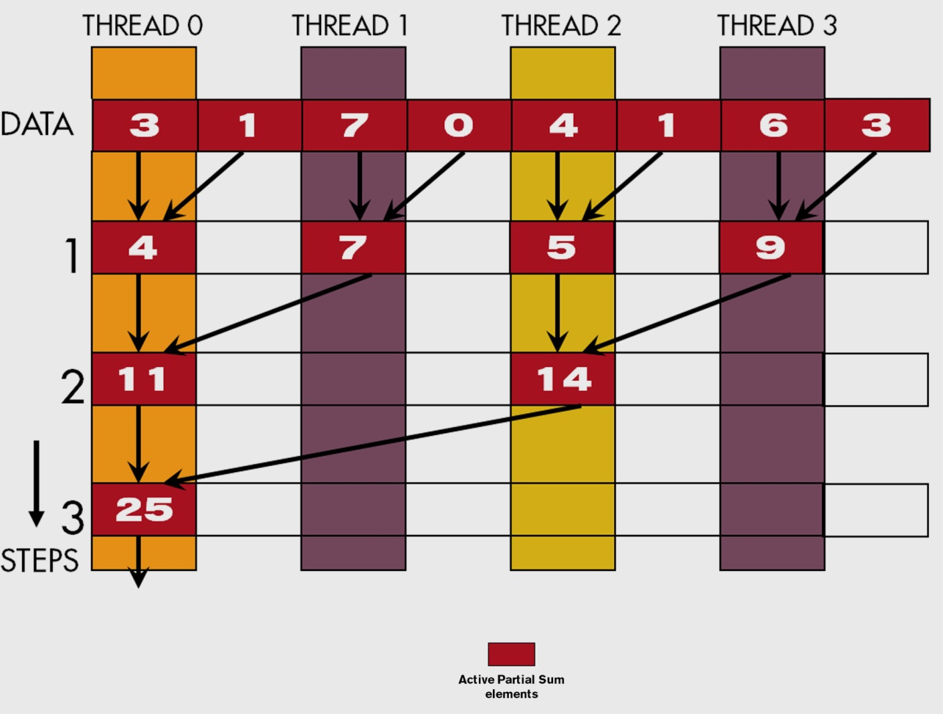
A Parallel Sum Reduction Example

Slide 23
A Naive Thread to Data Mapping
Each thread is responsible for an even-index location of the partial sum vector (location of responsibility)
After each step, half of the threads are no longer needed
One of the inputs is always from the location of responsibility
In each step, one of the inputs comes from an increasing distance away

Slide 24
A Simple Thread Block Design
Each thread block takes 2*BlockDim.x input elements
Each thread loads 2 elements into shared memory
__shared__ float partialSum[2*BLOCK_SIZE];
unsigned int t = threadIdx.x;
unsigned int start = 2*blockIdx.x*blockDim.x;
partialSum[t] = input[start + t];
partialSum[blockDim+t] = input[start + blockDim.x+t];

Slide 25
The Reduction Steps
for (unsigned int stride = 1;
stride <= blockDim.x; stride *= 2)
{
__syncthreads();
if (t % stride == 0)
partialSum[2*t]+= partialSum[2*t+stride];
}
Why do we need __syncthreads()?

Slide 26
Barrier Synchronization
__syncthreads() is needed to ensure that all elements of each version of partial sums have been generated before we proceed to the next step
__syncthreads() synchronizes all threads within the block

Slide 27
Barrier Synchronization
Thread 0
Time
Thread 1
Thread 2
Thread 3
Thread 4
…
…
Thread N-3
Thread N-2
Thread N-1

Slide 28
Back to the Global Picture
At the end of the kernel, Thread 0 in each block writes the sum of the thread block in partialSum[0] into a vector indexed by the blockIdx.x
There can be a large number of such sums if the original vector is very large
The host code may iterate and launch another kernel
If there are only a small number of sums, the host can simply transfer the data back and add them together
Alternatively, Thread 0 of each block could use atomic operations to accumulate into a global sum variable.

Slide 30
A better reduction model

Slide 31
Some Observations on the naïve reduction kernel
In each iteration, two control flow paths will be sequentially traversed for each warp
Threads that perform addition and threads that do not
Threads that do not perform addition still consume execution resources
Half or fewer of threads will be executing after the first step
All odd-index threads are disabled after first step
After the 5th step, entire warps in each block will fail the if test, poor resource utilization but no divergence
This can go on for a while, up to 6 more steps (stride = 32, 64, 128, 256, 512, 1024), where each active warp only has one productive thread until all warps in a block retire

Slide 32
Thread Index Usage Matters
In some algorithms, one can shift the index usage to improve the divergence behavior
Commutative and associative operators
Keep the active threads consecutive
Always compact the partial sums into the front locations in the partialSum[ ] array

Slide 33
An Example of 4 threads
Thread 0
Thread 1
Thread 2
Thread 3
3
1
7
0
4
1
6
3
7
2
13
3
20
5
25

Slide 34
A Quick Analysis
For a 1024 thread block
No divergence in the first 5 steps
1024, 512, 256, 128, 64, 32 consecutive threads are active in each step
All threads in each warp either all active or all inactive
The final 5 steps will still have divergence

