Slide 1
Matirx Multiply (Memory and Data Locality)
Slide credit: Slides adapted from
© David Kirk/NVIDIA and Wen-mei W. Hwu, 2007-2016

Slide 2
Example – Matrix Multiplication
N
WIDTH
M
P
BLOCK_WIDTHE
Row
WIDTH
BLOCK_WIDTH
WIDTH
WIDTH
Col

Slide 3
A Basic Matrix Multiplication
__global__ void MatrixMulKernel(float* M, float* N, float* P, int Width) {
// Calculate the row index of the P element and M
int Row = blockIdx.y*blockDim.y+threadIdx.y;
// Calculate the column index of P and N
int Col = blockIdx.x*blockDim.x+threadIdx.x;
if ((Row < Width) && (Col < Width)) {
float Pvalue = 0;
// each thread computes one element of the block sub-matrix
for (int k = 0; k < Width; ++k) {
Pvalue += M[Row*Width+k]*N[k*Width+Col];
}
P[Row*Width+Col] = Pvalue;
}
}

Slide 4
Example – Matrix Multiplication
__global__ void MatrixMulKernel(float* M, float* N, float* P, int Width) {
// Calculate the row index of the P element and M
int Row = blockIdx.y*blockDim.y+threadIdx.y;
// Calculate the column index of P and N
int Col = blockIdx.x*blockDim.x+threadIdx.x;
if ((Row < Width) && (Col < Width)) {
float Pvalue = 0;
// each thread computes one element of the block sub-matrix
for (int k = 0; k < Width; ++k) {
Pvalue += M[Row*Width+k]*N[k*Width+Col];
}
P[Row*Width+Col] = Pvalue;
}
}

Slide 5
A Toy Example: Thread to P Data Mapping
Block(0,0)
Block(0,1)
Thread(0,1)
Thread(0,0)
P_{0,0}
P_{0,1}
P_{0,2}
P_{0,3}
BLOCK_WIDTH = 2
Thread(1,0)
P_{1,0}
P_{1,1}
P_{1,2}
P_{1,3}
Thread(1,1)
P_{2,0}
P_{2,1}
P_{2,2}
P_{2,3}
P_{3,0}
P_{3,1}
P_{3,2}
P_{3,3}
Block(1,0)
Block(1,1)

Slide 6
Calculation of P_{0,0} and P_{0,1}
N_{0,0}
N_{0,1}
N_{1,0}
N_{1,1}
N_{2,0}
N_{2,1}
N_{3,0}
N_{3,1}
M_{0,0}
M_{0,1}
M_{0,2}
M_{0,3}
P_{0,0}
P_{0,1}
P_{0,1}
M_{1,0}
M_{1,1}
M_{1,2}
M_{1,3}
P_{1,0}
P_{1,1}

Slide 7
Tiled parallel algorithms

Slide 8
Global Memory Access Pattern of the Basic Matrix Multiplication Kernel
Global Memory
…
Thread 1
Thread 2
Notes:
In Matrix multiplication, each thread accesses global memory in the for loop.

Slide 9
Tiling/Blocking - Basic Idea
Global Memory
On-chip Memory
…
Thread 1
Thread 2
Divide the global memory content into tiles
Focus the computation of threads on one or a small number of tiles at each point in time

Slide 10
Tiling/Blocking - Basic Idea
Global Memory
On-chip Memory
…
Thread 1
Thread 2

Slide 11
Tiling needs synchronization
Good: when threads have similar access timing
Bad: when threads have very different timing
Thread 1
Time
…
Thread 2
Thread 1
Time
Thread 2

Slide 12
Barrier Synchronization for Tiling
Thread 0
Time
Thread 1
Thread 2
Thread 3
Thread 4
…
…
Thread N-3
Thread N-2
Thread N-1

Slide 13
Outline of Tiling Technique
Identify a tile of global memory contents that are accessed by multiple threads
Load the tile from global memory into on-chip memory
Use barrier synchronization to make sure that all threads are ready to start the phase
Have the multiple threads to access their data from the on-chip memory
Use barrier synchronization to make sure that all threads have completed the current phase
Move on to the next tile

Slide 14
Tiled matrix multiplication

Slide 15
Objective
To understand the design of a tiled parallel algorithm for matrix multiplication
Loading a tile
Phased execution
Barrier Synchronization

Slide 16
Matrix Multiplication
Data access pattern
Each thread - a row of M and a column of N
Each thread block – a strip of M and a strip of N
N
WIDTH
M
P
BLOCK_WIDTHE
Row
WIDTH
BLOCK_WIDTH
WIDTH
WIDTH
Col

Slide 17
Tiled Matrix Multiplication
Break up the execution of each thread into phases
so that the data accesses by the thread block in each phase are focused on one tile of M and one tile of N
The tile is of BLOCK_SIZE elements in each dimension
N
WIDTH
M
P
BLOCK_WIDTHE
Row
WIDTH
BLOCK_WIDTH
WIDTH
WIDTH
Col

Slide 18
Loading a Tile
All threads in a block participate
Each thread loads one M element and one N element in tiled code

Slide 19
Phase 0 Load for Block (0,0)
N_{0,0}
N_{0,1}
N_{0,2}
N_{0,3}
N_{0,0}
N_{0,1}
Shared Memory
N_{1,0}
N_{1,1}
N_{1,2}
N_{1,3}
N_{1,0}
N_{1,1}
N_{2,0}
N_{2,1}
N_{2,2}
N_{2,3}
N_{3,0}
N_{3,1}
N_{3,2}
N_{3,3}
Shared Memory
M_{0,0}
M_{0,1}
M_{0,2}
M_{0,3}
M_{0,0}
M_{0,1}
P_{0,0}
P_{0,1}
P_{0,2}
P_{0,3}
M_{1,0}
M_{1,1}
M_{1,2}
M_{1,3}
M_{1,0}
M_{1,1}
P_{1,0}
P_{1,1}
P_{1,2}
P_{1,3}
M_{2,0}
M_{2,1}
M_{2,2}
M_{2,3}
P_{2,0}
P_{2,1}
P_{2,2}
P_{2,3}
M_{3,0}
M_{3,1}
M_{3,2}
M_{3,3}
P_{3,0}
P_{3,1}
P_{3,2}
P_{3,3}

Slide 20
Phase 0 Use for Block (0,0) (iteration 0)
N_{0,0}
N_{0,1}
N_{0,2}
N_{0,3}
N_{0,0}
N_{0,1}
Shared Memory
N_{1,0}
N_{1,1}
N_{1,2}
N_{1,3}
N_{1,0}
N_{1,1}
N_{2,0}
N_{2,1}
N_{2,2}
N_{2,3}
N_{3,0}
N_{3,1}
N_{3,2}
N_{3,3}
Shared Memory
M_{0,0}
M_{0,1}
M_{0,2}
M_{0,3}
M_{0,0}
M_{0,1}
P_{0,0}
P_{0,1}
P_{0,2}
P_{0,3}
M_{1,0}
M_{1,1}
M_{1,2}
M_{1,3}
M_{1,0}
M_{1,1}
P_{1,0}
P_{1,1}
P_{1,2}
P_{1,3}
M_{2,0}
M_{2,1}
M_{2,2}
M_{2,3}
P_{2,0}
P_{2,1}
P_{2,2}
P_{2,3}
M_{3,0}
M_{3,1}
M_{3,2}
M_{3,3}
P_{3,0}
P_{3,1}
P_{3,2}
P_{3,3}

Slide 21
Phase 0 Use for Block (0,0) (iteration 1)
N_{0,0}
N_{0,1}
N_{0,2}
N_{0,3}
N_{0,0}
N_{0,1}
Shared Memory
N_{1,0}
N_{1,1}
N_{1,2}
N_{1,3}
N_{1,0}
N_{1,1}
N_{2,0}
N_{2,1}
N_{2,2}
N_{2,3}
N_{3,0}
N_{3,1}
N_{3,2}
N_{3,3}
Shared Memory
M_{0,0}
M_{0,1}
M_{0,2}
M_{0,3}
M_{0,0}
M_{0,1}
P_{0,0}
P_{0,1}
P_{0,2}
P_{0,3}
M_{1,0}
M_{1,1}
M_{1,2}
M_{1,3}
M_{1,0}
M_{1,1}
P_{1,0}
P_{1,1}
P_{1,2}
P_{1,3}
M_{2,0}
M_{2,1}
M_{2,2}
M_{2,3}
P_{2,0}
P_{2,1}
P_{2,2}
P_{2,3}
M_{3,0}
M_{3,1}
M_{3,2}
M_{3,3}
P_{3,0}
P_{3,1}
P_{3,2}
P_{3,3}

Slide 22
Phase 1 Load for Block (0,0)
N_{0,0}
N_{0,1}
N_{0,2}
N_{0,3}
N_{1,0}
N_{1,1}
N_{1,2}
N_{1,3}
N_{2,0}
N_{2,1}
N_{2,2}
N_{2,3}
N_{2,0}
N_{2,1}
Shared Memory
N_{3,0}
N_{3,1}
N_{3,2}
N_{3,3}
N_{3,0}
N_{3,1}
Shared Memory
M_{0,0}
M_{0,1}
M_{0,2}
M_{0,3}
M_{0,2}
M_{0,3}
P_{0,0}
P_{0,1}
P_{0,2}
P_{0,3}
M_{1,0}
M_{1,1}
M_{1,2}
M_{1,3}
M_{1,2}
M_{1,3}
P_{1,0}
P_{1,1}
P_{1,2}
P_{1,3}
M_{2,0}
M_{2,1}
M_{2,2}
M_{2,3}
P_{2,0}
P_{2,1}
P_{2,2}
P_{2,3}
M_{3,0}
M_{3,1}
M_{3,2}
M_{3,3}
P_{3,0}
P_{3,1}
P_{3,2}
P_{3,3}

Slide 23
Phase 1 Use for Block (0,0) (iteration 0)
N_{0,0}
N_{0,1}
N_{0,2}
N_{0,3}
N_{1,0}
N_{1,1}
N_{1,2}
N_{1,3}
N_{2,0}
N_{2,1}
N_{2,2}
N_{2,3}
N_{2,0}
N_{2,1}
Shared Memory
N_{3,0}
N_{3,1}
N_{3,2}
N_{3,3}
N_{3,0}
N_{3,1}
Shared Memory
M_{0,0}
M_{0,1}
M_{0,2}
M_{0,3}
M_{0,2}
M_{0,3}
P_{0,0}
P_{0,1}
P_{0,2}
P_{0,3}
M_{1,0}
M_{1,1}
M_{1,2}
M_{1,3}
M_{1,2}
M_{1,3}
P_{1,0}
P_{1,1}
P_{1,2}
P_{1,3}
M_{2,0}
M_{2,1}
M_{2,2}
M_{2,3}
P_{2,0}
P_{2,1}
P_{2,2}
P_{2,3}
M_{3,0}
M_{3,1}
M_{3,2}
M_{3,3}
P_{3,0}
P_{3,1}
P_{3,2}
P_{3,3}

Slide 24
Phase 1 Use for Block (0,0) (iteration 1)
N_{0,0}
N_{0,1}
N_{0,2}
N_{0,3}
N_{1,0}
N_{1,1}
N_{1,2}
N_{1,3}
N_{2,0}
N_{2,1}
N_{2,2}
N_{2,3}
N_{2,0}
N_{2,1}
Shared Memory
N_{3,0}
N_{3,1}
N_{3,2}
N_{3,3}
N_{3,0}
N_{3,1}
Shared Memory
M_{0,0}
M_{0,1}
M_{0,2}
M_{0,3}
M_{0,2}
M_{0,3}
P_{0,0}
P_{0,1}
P_{0,2}
P_{0,3}
M_{1,0}
M_{1,1}
M_{1,2}
M_{1,3}
M_{1,2}
M_{1,3}
P_{1,0}
P_{1,1}
P_{1,2}
P_{1,3}
M_{2,0}
M_{2,1}
M_{2,2}
M_{2,3}
P_{2,0}
P_{2,1}
P_{2,2}
P_{2,3}
M_{3,0}
M_{3,1}
M_{3,2}
M_{3,3}
P_{3,0}
P_{3,1}
P_{3,2}
P_{3,3}

Slide 25
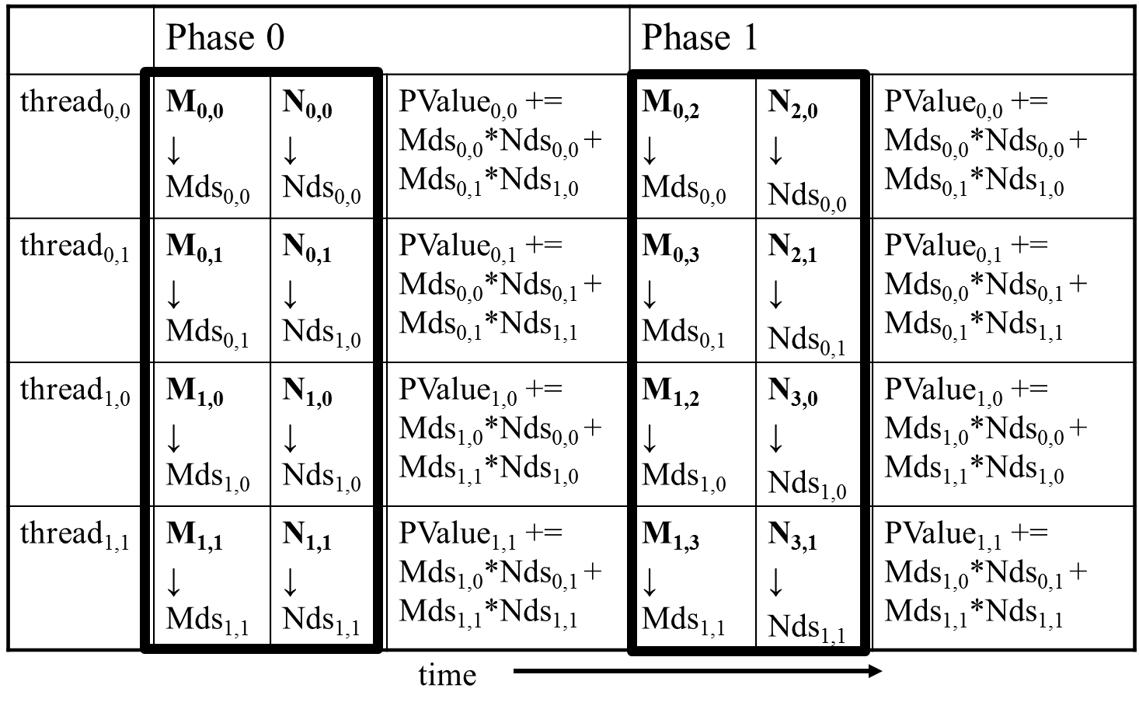
Execution Phases of Toy Example

Slide 26
Execution Phases of Toy Example (cont.)
Shared memory allows each value to be accessed by multiple threads

Slide 27
Barrier Synchronization
Synchronize all threads in a block
__syncthreads()
All threads in the same block must reach the __syncthreads() before any of the them can move on
Best used to coordinate the phased execution tiled algorithms
To ensure that all elements of a tile are loaded at the beginning of a phase
To ensure that all elements of a tile are consumed at the end of a phase

Slide 28
Tiled matrix multiplication kernel

Slide 29
Objective
To learn to write a tiled matrix-multiplication kernel
Loading and using tiles for matrix multiplication
Barrier synchronization, shared memory
Resource Considerations
Assume that Width is a multiple of tile size for simplicity
2

Slide 30
Loading Input Tile 0 of M (Phase 0)
Have each thread load an M element and an N element at the same relative position as its P element.
N
int Row = by * blockDim.y + ty;
int Col = bx * blockDim.x + tx;
2D indexing for accessing Tile 0:
M[Row][tx]
N[ty][Col]
WIDTH
M
P
Row
TILE_WIDTH
WIDTH
TILE_WIDTH
WIDTH
WIDTH
Col

Slide 31
Loading Input Tile 0 of N (Phase 0)
Have each thread load an M element and an N element at the same relative position as its P element.
N
int Row = by * blockDim.y + ty;
int Col = bx * blockDim.x + tx;
2D indexing for accessing Tile 0:
M[Row][tx]
N[ty][Col]
WIDTH
M
P
BLOCK_WIDTH
Row
WIDTH
BLOCK_WIDTH
WIDTH
WIDTH
Col

Slide 32
Loading Input Tile 1 of M (Phase 1)
N
2D indexing for accessing Tile 1:
M[Row][1*TILE_WIDTH + tx]
N[1*TILE*WIDTH + ty][Col]
WIDTH
M
P
BLOCK_WIDTH
Row
WIDTH
BLOCK_WIDTH
WIDTH
WIDTH
Col

Slide 33
Loading Input Tile 1 of N (Phase 1)
N
2D indexing for accessing Tile 1:
M[Row][1*TILE_WIDTH + tx]
N[1*TILE*WIDTH + ty][Col]
WIDTH
M
P
BLOCK_WIDTH
Row
WIDTH
BLOCK_WIDTH
WIDTH
WIDTH
Col

Slide 34
M and N are dynamically allocated - use 1D indexing
M[Row][p*TILE_WIDTH+tx]
M[Row*Width + p*TILE_WIDTH + tx]
N[p*TILE_WIDTH+ty][Col]
N[(p*TILE_WIDTH+ty)*Width + Col]
where p is the sequence number of the current phase

Slide 35
Tiled Matrix Multiplication Kernel
__global__ void MatrixMulKernel(float* M, float* N, float* P, Int Width)
{
__shared__ float ds_M[TILE_WIDTH][TILE_WIDTH];
__shared__ float ds_N[TILE_WIDTH][TILE_WIDTH];
int bx = blockIdx.x; int by = blockIdx.y;
int tx = threadIdx.x; int ty = threadIdx.y;
int Row = by * blockDim.y + ty;
int Col = bx * blockDim.x + tx;
float Pvalue = 0;
// Loop over the M and N tiles required to compute the P element
for (int p = 0; p < n/TILE_WIDTH; ++p) {
// Collaborative loading of M and N tiles into shared memory
ds_M[ty][tx] = M[Row*Width + p*TILE_WIDTH+tx];
ds_N[ty][tx] = N[(t*TILE_WIDTH+ty)*Width + Col];
__syncthreads();
for (int i = 0; i < TILE_WIDTH; ++i)Pvalue += ds_M[ty][i] * ds_N[i][tx];
__synchthreads();
}
P[Row*Width+Col] = Pvalue;
}

Slide 36
Tiled Matrix Multiplication Kernel
__global__ void MatrixMulKernel(float* M, float* N, float* P, Int Width)
{
__shared__ float ds_M[TILE_WIDTH][TILE_WIDTH];
__shared__ float ds_N[TILE_WIDTH][TILE_WIDTH];
int bx = blockIdx.x; int by = blockIdx.y;
int tx = threadIdx.x; int ty = threadIdx.y;
int Row = by * blockDim.y + ty;
int Col = bx * blockDim.x + tx;
float Pvalue = 0;
// Loop over the M and N tiles required to compute the P element
for (int p = 0; p < n/TILE_WIDTH; ++p) {
// Collaborative loading of M and N tiles into shared memory
ds_M[ty][tx] = M[Row*Width + p*TILE_WIDTH+tx];
ds_N[ty][tx] = N[(t*TILE_WIDTH+ty)*Width + Col];
__syncthreads();
for (int i = 0; i < TILE_WIDTH; ++i)Pvalue += ds_M[ty][i] * ds_N[i][tx];
__synchthreads();
}
P[Row*Width+Col] = Pvalue;
}

Slide 37
Tiled Matrix Multiplication Kernel
__global__ void MatrixMulKernel(float* M, float* N, float* P, Int Width)
{
__shared__ float ds_M[TILE_WIDTH][TILE_WIDTH];
__shared__ float ds_N[TILE_WIDTH][TILE_WIDTH];
int bx = blockIdx.x; int by = blockIdx.y;
int tx = threadIdx.x; int ty = threadIdx.y;
int Row = by * blockDim.y + ty;
int Col = bx * blockDim.x + tx;
float Pvalue = 0;
// Loop over the M and N tiles required to compute the P element
for (int p = 0; p < n/TILE_WIDTH; ++p) {
// Collaborative loading of M and N tiles into shared memory
ds_M[ty][tx] = M[Row*Width + p*TILE_WIDTH+tx];
ds_N[ty][tx] = N[(t*TILE_WIDTH+ty)*Width + Col];
__syncthreads();
for (int i = 0; i < TILE_WIDTH; ++i)Pvalue += ds_M[ty][i] * ds_N[i][tx];
__synchthreads();
}
P[Row*Width+Col] = Pvalue;
}

Slide 38
Tile (Thread Block) Size Considerations
Each thread block should have many threads
TILE_WIDTH of 16 gives 16*16 = 256 threads
TILE_WIDTH of 32 gives 32*32 = 1024 threads
For 16, in each phase, each block performs 2*256 = 512 float loads from global memory for 256 * (2*16) = 8,192 mul/add operations. (16 floating-point operations for each memory load)
For 32, in each phase, each block performs 2*1024 = 2048 float loads from global memory for 1024 * (2*32) = 65,536 mul/add operations. (32 floating-point operation for each memory load)

Slide 39
Shared Memory and Threading
For an SM with 16KB shared memory
Shared memory size is implementation dependent!
For TILE_WIDTH = 16, each thread block uses 2*256*4B = 2KB of shared memory.
For 16KB shared memory, one can potentially have up to 8 thread blocks executing
This allows up to 8*512 = 4,096 pending loads. (2 per thread, 256 threads per block)
The next TILE_WIDTH 32 would lead to 2*32*32*4 Byte= 8K Byte shared memory usage per thread block, allowing 2 thread blocks active at the same time
However, in a GPU where the thread count is limited to 1536 threads per SM, the number of blocks per SM is reduced to one!
Each __syncthread() can reduce the number of active threads for a block
More thread blocks can be advantageous

Slide 40
Handling arbitrary matrix sizes in tiled algorithms

Slide 41
Objective
To learn to handle arbitrary matrix sizes in tiled matrix multiplication
Boundary condition checking
Regularizing tile contents
Rectangular matrices

Slide 42
Handling Matrix of Arbitrary Size
The tiled matrix multiplication kernel we presented so far can handle only square matrices whose dimensions (Width) are multiples of the tile width (TILE_WIDTH)
However, real applications need to handle arbitrary sized matrices.
One could pad (add elements to) the rows and columns into multiples of the tile size, but would have significant space and data transfer time overhead.
We will take a different approach.

Slide 43
Phase 1 Loads for Block (0,0) for a 3x3 Example
Threads (1,0) and (1,1) need special treatment in loading N tile
N_{0,0}
N_{0,1}
N_{0,2}
N_{1,0}
N_{1,1}
N_{1,2}
N_{2,0}
N_{2,1}
N_{2,2}
N_{2,0}
N_{2,1}
Shared Memory
Shared Memory
M_{0,0}
M_{0,1}
M_{0,2}
M_{0,2}
P_{0,0}
P_{0,1}
P_{0,2}
M_{1,0}
M_{1,1}
M_{1,2}
M_{1,2}
P_{1,0}
P_{1,1}
P_{1,2}
M_{2,0}
M_{2,1}
M_{2,2}
P_{2,0}
P_{2,1}
P_{2,2}
Threads (0,1) and (1,1) need special treatment in loading M tile

Slide 44
Phase 1 Use for Block (0,0) (iteration 0)
N_{0,0}
N_{0,1}
N_{0,2}
N_{1,0}
N_{1,1}
N_{1,2}
N_{2,0}
N_{2,1}
N_{2,2}
N_{2,0}
N_{2,1}
Shared Memory
Shared Memory
M_{0,0}
M_{0,1}
M_{0,2}
M_{0,2}
P_{0,0}
P_{0,1}
P_{0,2}
M_{1,0}
M_{1,1}
M_{1,2}
M_{1,2}
P_{1,0}
P_{1,1}
P_{1,2}
M_{2,0}
M_{2,1}
M_{2,2}
P_{2,0}
P_{2,1}
P_{2,2}

Slide 45
Phase 1 Use for Block (0,0) (iteration 1)
N_{0,0}
N_{0,1}
N_{0,2}
N_{1,0}
N_{1,1}
N_{1,2}
N_{2,0}
N_{2,1}
N_{2,2}
N_{2,0}
N_{2,1}
Shared Memory
Shared Memory
M_{0,0}
M_{0,1}
M_{0,2}
M_{0,2}
P_{0,0}
P_{0,1}
P_{0,2}
M_{1,0}
M_{1,1}
M_{1,2}
M_{1,2}
P_{1,0}
P_{1,1}
P_{1,2}
M_{2,0}
M_{2,1}
M_{2,2}
P_{2,0}
P_{2,1}
P_{2,2}
All Threads need special treatment. None of them should introduce invalidate contributions to their P elements.

Slide 46
Phase 0 Loads for Block (1,1) for a 3x3 Example
Threads (0,1) and (1,1) need special treatment in loading N tile
Threads (0,1) and (1,1) need special treatment in loading N tile
N_{0,0}
N_{0,1}
N_{0,2}
N_{0,2}
Shared Memory
N_{1,0}
N_{1,1}
N_{1,2}
N_{1,2}
N_{2,0}
N_{2,1}
N_{2,2}
M_{0,0}
M_{0,1}
M_{0,2}
P_{0,0}
P_{0,1}
P_{0,2}
M_{1,0}
M_{1,1}
M_{1,2}
Shared Memory
P_{1,0}
P_{1,1}
P_{1,2}
M_{2,0}
M_{2,1}
M_{2,2}
M_{2,0}
M_{2,1}
P_{2,0}
P_{2,1}
P_{2,2}
Threads (1,0) and (1,1) need special treatment in loading M tile

Slide 47
Major Cases in Toy Example
Threads that do not calculate valid P elements but still need to participate in loading the input tiles
Phase 0 of Block(1,1), Thread(1,0), assigned to calculate non-existent P[3,2] but need to participate in loading tile element N[1,2]
Threads that calculate valid P elements may attempt to load non-existing input elements when loading input tiles
Phase 0 of Block(0,0), Thread(1,0), assigned to calculate valid P[1,0] but attempts to load non-existing N[3,0]

Slide 48
A “Simple” Solution
When a thread is to load any input element, test if it is in the valid index range
If valid, proceed to load
Else, do not load, just write a 0
Rationale: a 0 value will ensure that that the multiply-add step does not affect the final value of the output element
The condition tested for loading input elements is different from the test for calculating output P element
A thread that does not calculate valid P element can still participate in loading input tile elements

Slide 49
Phase 1 Use for Block (0,0) (iteration 1)
N_{0,0}
N_{0,1}
N_{0,2}
N_{1,0}
N_{1,1}
N_{1,2}
N_{2,0}
N_{2,1}
N_{2,2}
N_{2,0}
N_{2,1}
Shared Memory
0
0
Shared Memory
M_{0,0}
M_{0,1}
M_{0,2}
M_{0,2}
0
P_{0,0}
P_{0,1}
P_{0,2}
M_{1,0}
M_{1,1}
M_{1,2}
M_{1,2}
0
P_{1,0}
P_{1,1}
P_{1,2}
M_{2,0}
M_{2,1}
M_{2,2}
P_{2,0}
P_{2,1}
P_{2,2}

Slide 50
Boundary Condition for Input M Tile
Each thread loads
M[Row][p*TILE_WIDTH+tx]
M[Row*Width + p*TILE_WIDTH+tx]
Need to test
(Row < Width) && (p*TILE_WIDTH+tx < Width)
If true, load M element
Else , load 0
M
TILE_WIDTH
TILE_WIDTH

Slide 51
Boundary Condition for Input N Tile
Each thread loads
N[p*TILE_WIDTH+ty][Col]
N[(p*TILE_WIDTH+ty)*Width+ Col]
Need to test
(p*TILE_WIDTH+ty < Width) && (Col< Width)
If true, load N element
Else , load 0
N
TILE_WIDTH
TILE_WIDTH

Slide 52
Loading Elements – with boundary check
8 for (int p = 0; p < (Width-1) / TILE_WIDTH + 1; ++p) {
++ if(Row < Width && t * TILE_WIDTH+tx < Width) {
9 ds_M[ty][tx] = M[Row * Width + p * TILE_WIDTH + tx];
++ } else {
++ ds_M[ty][tx] = 0.0;
++ }
++ if (p*TILE_WIDTH+ty < Width && Col < Width) {
10 ds_N[ty][tx] = N[(p*TILE_WIDTH + ty) * Width + Col];
++ } else {
++ ds_N[ty][tx] = 0.0;
++ }
11 __syncthreads();

Slide 53
Inner Product – Before and After
++ if(Row < Width && Col < Width) {
12 for (int i = 0; i < TILE_WIDTH; ++i) {
13 Pvalue += ds_M[ty][i] * ds_N[i][tx];
}
14 __syncthreads();
15 } /* end of outer for loop */
++ if (Row < Width && Col < Width)
16 P[Row*Width + Col] = Pvalue;
} /* end of kernel */

Slide 54
Some Important Points
For each thread the conditions are different for
Loading M element
Loading N element
Calculating and storing output elements
The effect of control divergence should be small for large matrices

Slide 55
Handling General Rectangular Matrices
In general, the matrix multiplication is defined in terms of rectangular matrices
j x k M matrix multiplied with a k x l N matrix results in a j x l P matrix
We have presented square matrix multiplication, a special case
The kernel function needs to be generalized to handle general rectangular matrices
The Width argument is replaced by three arguments: j, k, l
When Width is used to refer to the height of M or height of P, replace it with j
When Width is used to refer to the width of M or height of N, replace it with k
When Width is used to refer to the width of N or width of P, replace it with l

Slide 56
Tiled Matrix multiply control divergence

Slide 57
Performance Impact of Control Divergence
Boundary condition checks are vital for complete functionality and robustness of parallel code
The tiled matrix multiplication kernel has many boundary condition checks
The concern is that these checks may cause significant performance degradation
For example, see the tile loading code below:
if(Row < Width && t * TILE_WIDTH+tx < Width) {
ds_M[ty][tx] = M[Row * Width + p * TILE_WIDTH + tx];
} else {
ds_M[ty][tx] = 0.0;
}
if (p*TILE_WIDTH+ty < Width && Col < Width) {
ds_N[ty][tx] = N[(p*TILE_WIDTH + ty) * Width + Col];
} else {
ds_N[ty][tx] = 0.0;
}

Slide 58
Two types of blocks in loading M Tiles
1. Blocks whose tiles are all within valid range until the last phase.
2. Blocks whose tiles are partially outside the valid range all the way
M
Type 1
TILE_WIDTH
Type 2

Slide 59
Analysis of Control Divergence Impact
Assume 16x16 tiles and thread blocks
Each thread block has 8 warps (256/32)
Assume square matrices of 100x100
Each thread will go through 7 phases (ceiling of 100/16)
There are 49 thread blocks (7 in each dimension)

Slide 60
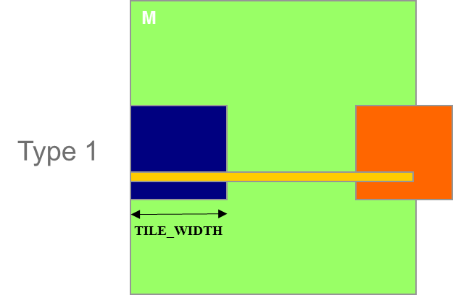
Control Divergence in Loading M Tiles
Assume 16x16 tiles and thread blocks
Each thread block has 8 warps (256/32)
Assume square matrices of 100x100
Each warp will go through 7 phases (ceiling of 100/16)
There are 42 (6*7) Type 1 blocks, with a total of 336 (8*42) warps
They all have 7 phases, so there are 2,352 (336*7) warp-phases
The warps have control divergence only in their last phase
336 warp-phases have control divergence

Slide 61
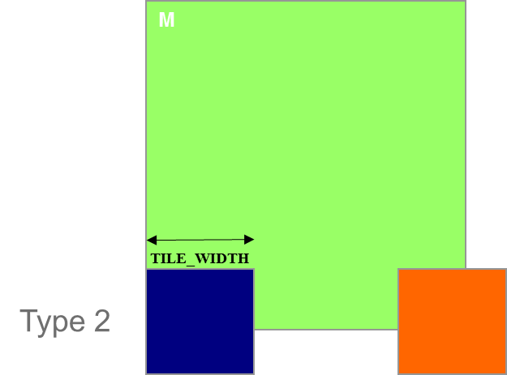
Control Divergence in Loading M Tiles (Type 2)
Type 2: the 7 block assigned to load the bottom tiles, with a total of 56 (8*7) warps
They all have 7 phases, so there are 392 (56*7) warp-phases
The first 2 warps in each Type 2 block will stay within the valid range until the last phase
The 6 remaining warps stay outside the valid range
So, only 14 (2*7) warp-phases have control divergence

Slide 62
Overall Impact of Control Divergence
Type 1 Blocks: 336 out of 2,352 warp-phases have control divergence
Type 2 Blocks: 14 out of 392 warp-phases have control divergence
The performance impact is expected to be less than 12% (350/2,944 or (336+14)/(2352+14))
M
Type 1
TILE_WIDTH
Type 2

Slide 63
Additional Comments
The calculation of impact of control divergence in loading N tiles is somewhat different and is left as an exercise
The estimated performance impact is data dependent.
For larger matrices, the impact will be significantly smaller
In general, the impact of control divergence for boundary condition checking for large input data sets should be insignificant
One should not hesitate to use boundary checks to ensure full functionality
The fact that a kernel is full of control flow constructs does not mean that there will be heavy occurrence of control divergence
We will cover some algorithm patterns that naturally incur control divergence (such as parallel reduction) in the Parallel Algorithm Patterns modules

