Slide 1
CUDA Streams
Slide credit: Slides adapted from
© David Kirk/NVIDIA and Wen-mei W. Hwu, 2007-2016

Slide 2
Pinned host memory

Slide 3
CPU-GPU Data Transfer using DMA
DMA (Direct Memory Access) hardware is used by cudaMemcpy() for better efficiency
Frees CPU for other tasks
Hardware unit specialized to transfer a number of bytes requested by OS
Between physical memory address space regions (some can be mapped I/O memory locations)
Uses system interconnect, typically PCIe in today’s systems
CPU Main Memory (DRAM)
PCIe
GPU card
(or other I/O cards)
Global Memory
DMA

Slide 4
Virtual Memory Management
Modern computers use virtual memory management
Many virtual memory spaces mapped into a single physical memory
Virtual addresses (pointer values) are translated into physical addresses
Not all variables and data structures are always in the physical memory
Each virtual address space is divided into pages that are mapped into and out of the physical memory
Virtual memory pages can be mapped out of the physical memory (page-out) to make room
Whether or not a variable is in the physical memory is checked at address translation time

Slide 5
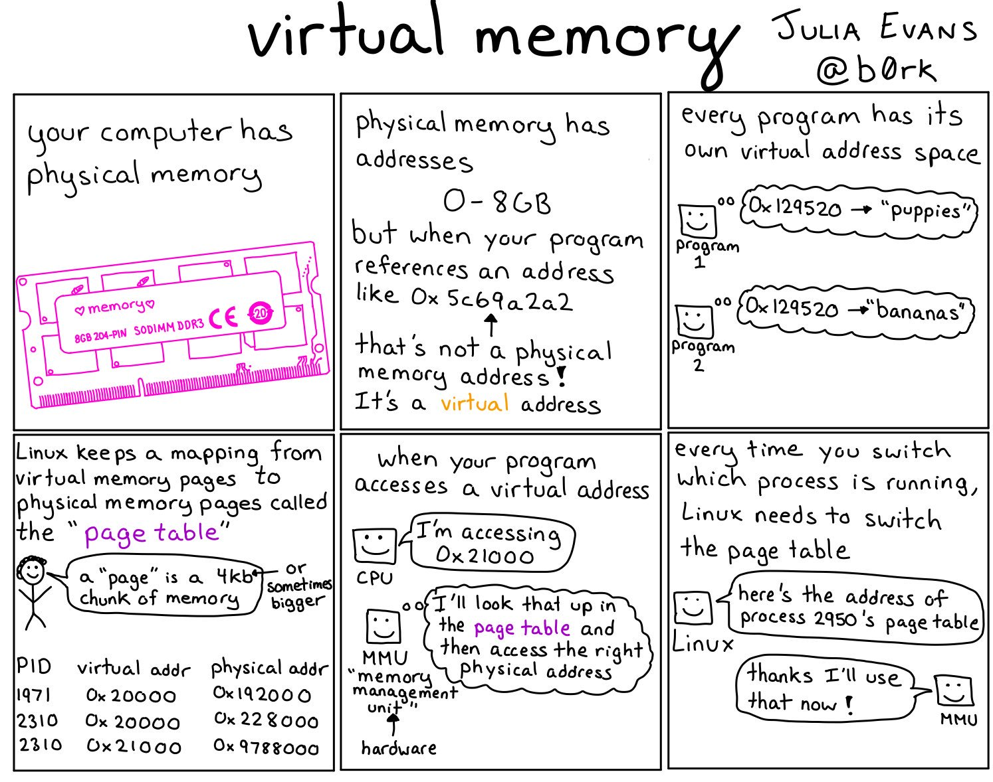

Slide 6


Slide 7
Data Transfer and Virtual Memory
DMA uses physical addresses
When cudaMemcpy() copies an array, it is implemented as one or more DMA transfers
Address is translated and page presence checked for the entire source and destination regions at the beginning of each DMA transfer
No address translation for the rest of the same DMA transfer so that high efficiency can be achieved
The OS could accidentally page-out the data that is being read or written by a DMA and page-in another virtual page into the same physical location

Slide 8
Pinned Memory and DMA Data Transfer
Pinned memory are virtual memory pages that are specially marked so that they cannot be paged out
Allocated with a special system API function call
a.k.a. Page Locked Memory, Locked Pages, etc.
CPU memory that serve as the source or destination of a DMA transfer must be allocated as pinned memory

Slide 9
CUDA data transfer uses pinned memory.
The DMA used by cudaMemcpy() requires that any source or destination in the host memory is allocated as pinned memory
If a source or destination of a cudaMemcpy() in the host memory is not allocated in pinned memory, it needs to be first copied to a pinned memory – extra overhead
cudaMemcpy() is faster if the host memory source or destination is allocated in pinned memory since no extra copy is needed

Slide 10
Allocate/Free Pinned Memory
cudaHostAlloc(), three parameters
Address of pointer to the allocated memory
Size of the allocated memory in bytes
Option – use cudaHostAllocDefault for now
cudaFreeHost(), one parameter
Pointer to the memory to be freed

Slide 11
Using Pinned Memory in CUDA
Use the allocated pinned memory and its pointer the same way as those returned by malloc();
The only difference is that the allocated memory cannot be paged by the OS
The cudaMemcpy() function should be about 2X faster with pinned memory
Pinned memory is a limited resource
over-subscription can have serious consequences

Slide 12
Putting It Together - Vector Addition Host Code Example
int main()
{
float *h_A, *h_B, *h_C;
…
cudaHostAlloc((void **) &h_A, N* sizeof(float),
cudaHostAllocDefault);
cudaHostAlloc((void **) &h_B, N* sizeof(float),
cudaHostAllocDefault);
cudaHostAlloc((void **) &h_C, N* sizeof(float),
cudaHostAllocDefault);
…
// cudaMemcpy() runs 2X faster
}

Slide 13
Cuda streams

Slide 14
Serialized Data Transfer and Computation
So far, the way we use cudaMemcpy serializes data transfer and GPU computation for VecAddKernel()
Trans. A
Trans. B
Comp
Trans. C
time
Only use one direction, GPU idle
PCIe Idle
Only use one direction, GPU idle

Slide 15
Device Overlap
Some CUDA devices support device overlap
Simultaneously execute a kernel while copying data between device and host memory
int dev_count;
cudaDeviceProp prop;
cudaGetDeviceCount( &dev_count);
for (int i = 0; i < dev_count; i++) {
cudaGetDeviceProperties(&prop, i);
if (prop.deviceOverlap) …

Slide 16
Ideal, Pipelined Timing
Divide large vectors into segments
Overlap transfer and compute of adjacent segments
Trans A.0
Trans B.0
Comp
C.0 = A.0 + B.0
Trans C.0
Trans A.1
Trans B.1
Comp
C.1 = A.1 + B.1
Trans C.1
Trans A.2
Trans B.2
Comp
C.2 = A.2 + B.2
Trans A.3
Trans B.3

Slide 17
CUDA Streams
CUDA supports parallel execution of kernels and cudaMemcpy() with “Streams”
Each stream is a queue of operations (kernel launches and cudaMemcpy()calls)
Operations (tasks) in different streams can go in parallel
“Task parallelism”

Slide 18
Streams
Requests made from the host code are put into First-In-First-Out queues
Queues are read and processed asynchronously by the driver and device
Driver ensures that commands in a queue are processed in sequence. E.g., Memory copies end before kernel launch, etc.
host thread
cudaMemcpy()
kernel launch
device sync
cudaMemcpy()
FIFO
device driver

Slide 19
Streams cont.
To allow concurrent copying and kernel execution, use multiple queues, called “streams”
CUDA “events” allow the host thread to query and synchronize with individual queues (i.e. streams).
host thread
Stream 0
Stream 1
Event
device driver
device driver

Slide 20
Conceptual View of Streams
PCIe up
PCIe down
Copy Engine
Kernel Engine
MemCpy A.0
MemCpy A.1
MemCpy B.0
MemCpy B.1
Kernel 0
Kernel 1
MemCpy C.0
MemCpy C.1
Stream 0
Stream 1
Operations (Kernel launches, cudaMemcpy() calls)

Slide 21
Overlapping data transfer w/ computation

Slide 22
Simple Multi-Stream Host Code
cudaStream_t stream0, stream1;
cudaStreamCreate(&stream0);
cudaStreamCreate(&stream1);
float *d_A0, *d_B0, *d_C0; // device memory for stream 0
float *d_A1, *d_B1, *d_C1; // device memory for stream 1
// cudaMalloc() calls for d_A0, d_B0, d_C0, d_A1, d_B1, d_C1 go here

Slide 23
Simple Multi-Stream Host Code (Cont.)
for (int i=0; i<n; i+=SegSize*2) {
cudaMemcpyAsync(d_A0, h_A+i, SegSize*sizeof(float),…, stream0);
cudaMemcpyAsync(d_B0, h_B+i, SegSize*sizeof(float),…, stream0);
vecAdd<<<SegSize/256, 256, 0, stream0>>>(d_A0, d_B0,…);
cudaMemcpyAsync(h_C+i, d_C0, SegSize*sizeof(float),…, stream0);
cudaMemcpyAsync(d_A1, h_A+i+SegSize, SegSize*sizeof(float),…, stream1);
cudaMemcpyAsync(d_B1, h_B+i+SegSize, SegSize*sizeof(float),…, stream1);
vecAdd<<<SegSize/256, 256, 0, stream1>>>(d_A1, d_B1, …);
cudaMemcpyAsync(d_C1, h_C+i+SegSize, SegSize*sizeof(float),…, stream1);
}

Slide 24
A View Closer to Reality in Previous GPUs
PCIe up
PCIe down
Copy
Engine
Kernel Engine
MemCpy A.0
Kernel 0
MemCpy B.0
Kernel 1
MemCpy C.0
MemCpy A.1
MemCpy B.1
MemCpy C.1
Stream 0
Stream 1
Operations (Kernel launches, cudaMemcpy() calls)

Slide 25
Not quite the overlap we want in some GPUs
C.0 blocks A.1 and B.1 in the copy engine queue
Trans A.0
Trans B.0
Comp
C.0 = A.0 + B.0
Trans C.0
Trans
A.1
Trans
B.1
Comp
C.1= A.1 + B.1
Trans C.1

Slide 26
Better Multi-Stream Host Code
for (int i=0; i<n; i+=SegSize*2) {
cudaMemcpyAsync(d_A0, h_A+i, SegSize*sizeof(float),…, stream0);
cudaMemcpyAsync(d_B0, h_B+i, SegSize*sizeof(float),…, stream0);
cudaMemcpyAsync(d_A1, h_A+i+SegSize, SegSize*sizeof(float),…, stream1);
cudaMemcpyAsync(d_B1, h_B+i+SegSize, SegSize*sizeof(float),…, stream1);
vecAdd<<<SegSize/256, 256, 0, stream0>>>(d_A0, d_B0, …);
vecAdd<<<SegSize/256, 256, 0, stream1>>>(d_A1, d_B1, …);
cudaMemcpyAsync(h_C+i, d_C0, SegSize*sizeof(float),…, stream0);
cudaMemcpyAsync(h_C+i+SegSize, d_C1, SegSize*sizeof(float),…, stream1);
}

Slide 27
C.0 no longer blocks A.1 and B.1
PCIe up
PCIe down
Copy
Engine
Kernel Engine
MemCpy A.0
Kernel 0
MemCpy B.0
Kernel 1
MemCpy A.1
MemCpy B.1
MemCpy C.0
MemCpy C.1
Stream 0
Stream 1
Operations (Kernel launches, cudaMemcpy() calls)

Slide 28
Better, not quite the best overlap
C.1 blocks next iteration A.0 and B.0 in the copy engine queue
Trans A.0
Trans B.0
Comp
C.0 = A.0 + B.0
Trans C.0
Iteration n
Trans
A.1
Trans
B.1
Comp
C.1= A.1 + B.1
Trans C.1
Trans A.2
Trans B.2
Comp
C.2 = A.2 +
Iteration n+1
Trans
A.2

Slide 29
Ideal, Pipelined Timing
Will need at least three buffers for each original A, B, and C, code is more complicated
Trans A.0
Trans B.0
Comp
C.0 = A.0 + B.0
Trans C.0
Trans A.1
Trans B.1
Comp
C.1 = A.1 + B.1
Trans C.1
Trans A.2
Trans B.2
Comp
C.2 = A.2 + B.2
Trans A.3
Trans B.3

Slide 30
Wait until all tasks have completed
cudaStreamSynchronize(stream_id)
Used in host code
Takes one parameter – stream identifier
Wait until all tasks in a stream have completed
E.g., cudaStreamSynchronize(stream0)in host code ensures that all tasks in the queues of stream0 have completed
This is different from cudaDeviceSynchronize()
Also used in host code
No parameter
cudaDeviceSynchronize() waits until all tasks in all streams have completed for the current device

