Slide 1
The Physics-informed AI Climate Model Agent Neuro-symbolic Simulator (PACMANS) for Tipping Point Discovery Workgroup Presentation March 9, 2022
Jennifer Sleeman, Ph.D.
Jay Brett, Ph.D.
Marisa Hughes, Ph.D.
Anand Gnanadesikan, Ph.D.
Yannis Kevrekidis, Ph.D.
DISTRIBUTION STATEMENT A: Approved for public release: distribution unlimited.

Slide 2
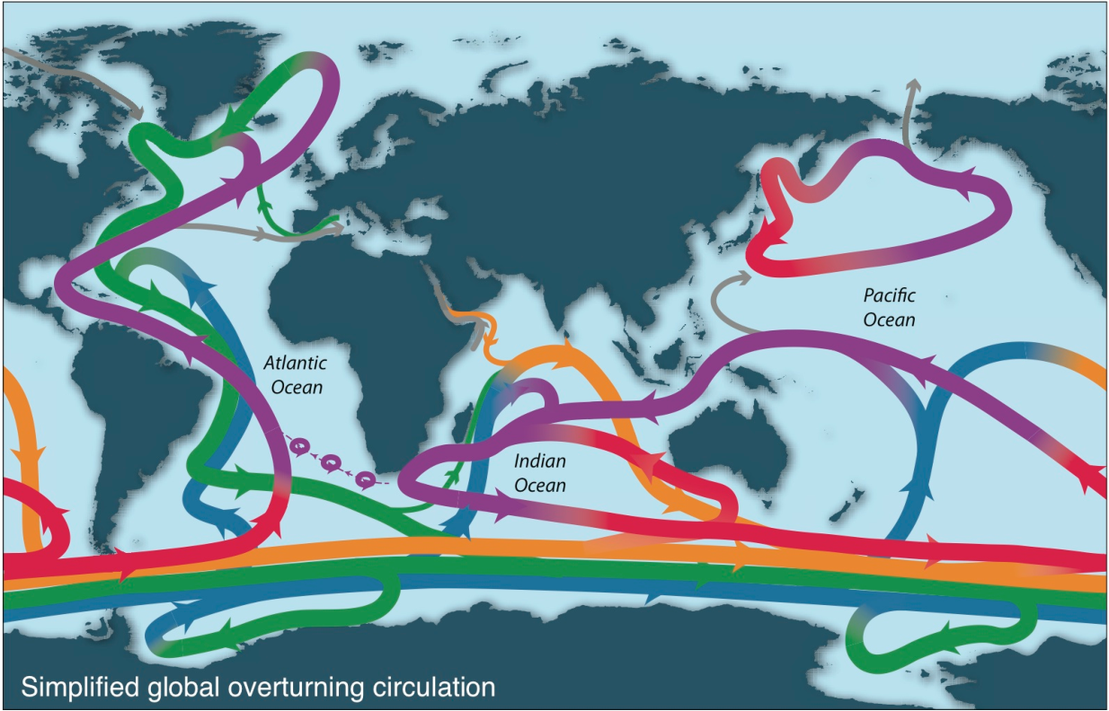
Introduction
Schematic of overturning (Talley, 2013)
Exploring instability of the Atlantic Meridional Overturning Circulation (AMOC)
Deep circulation (green/dark blue) driven by very small regions! But has major impact on heat, carbon, and oxygen.

Slide 3
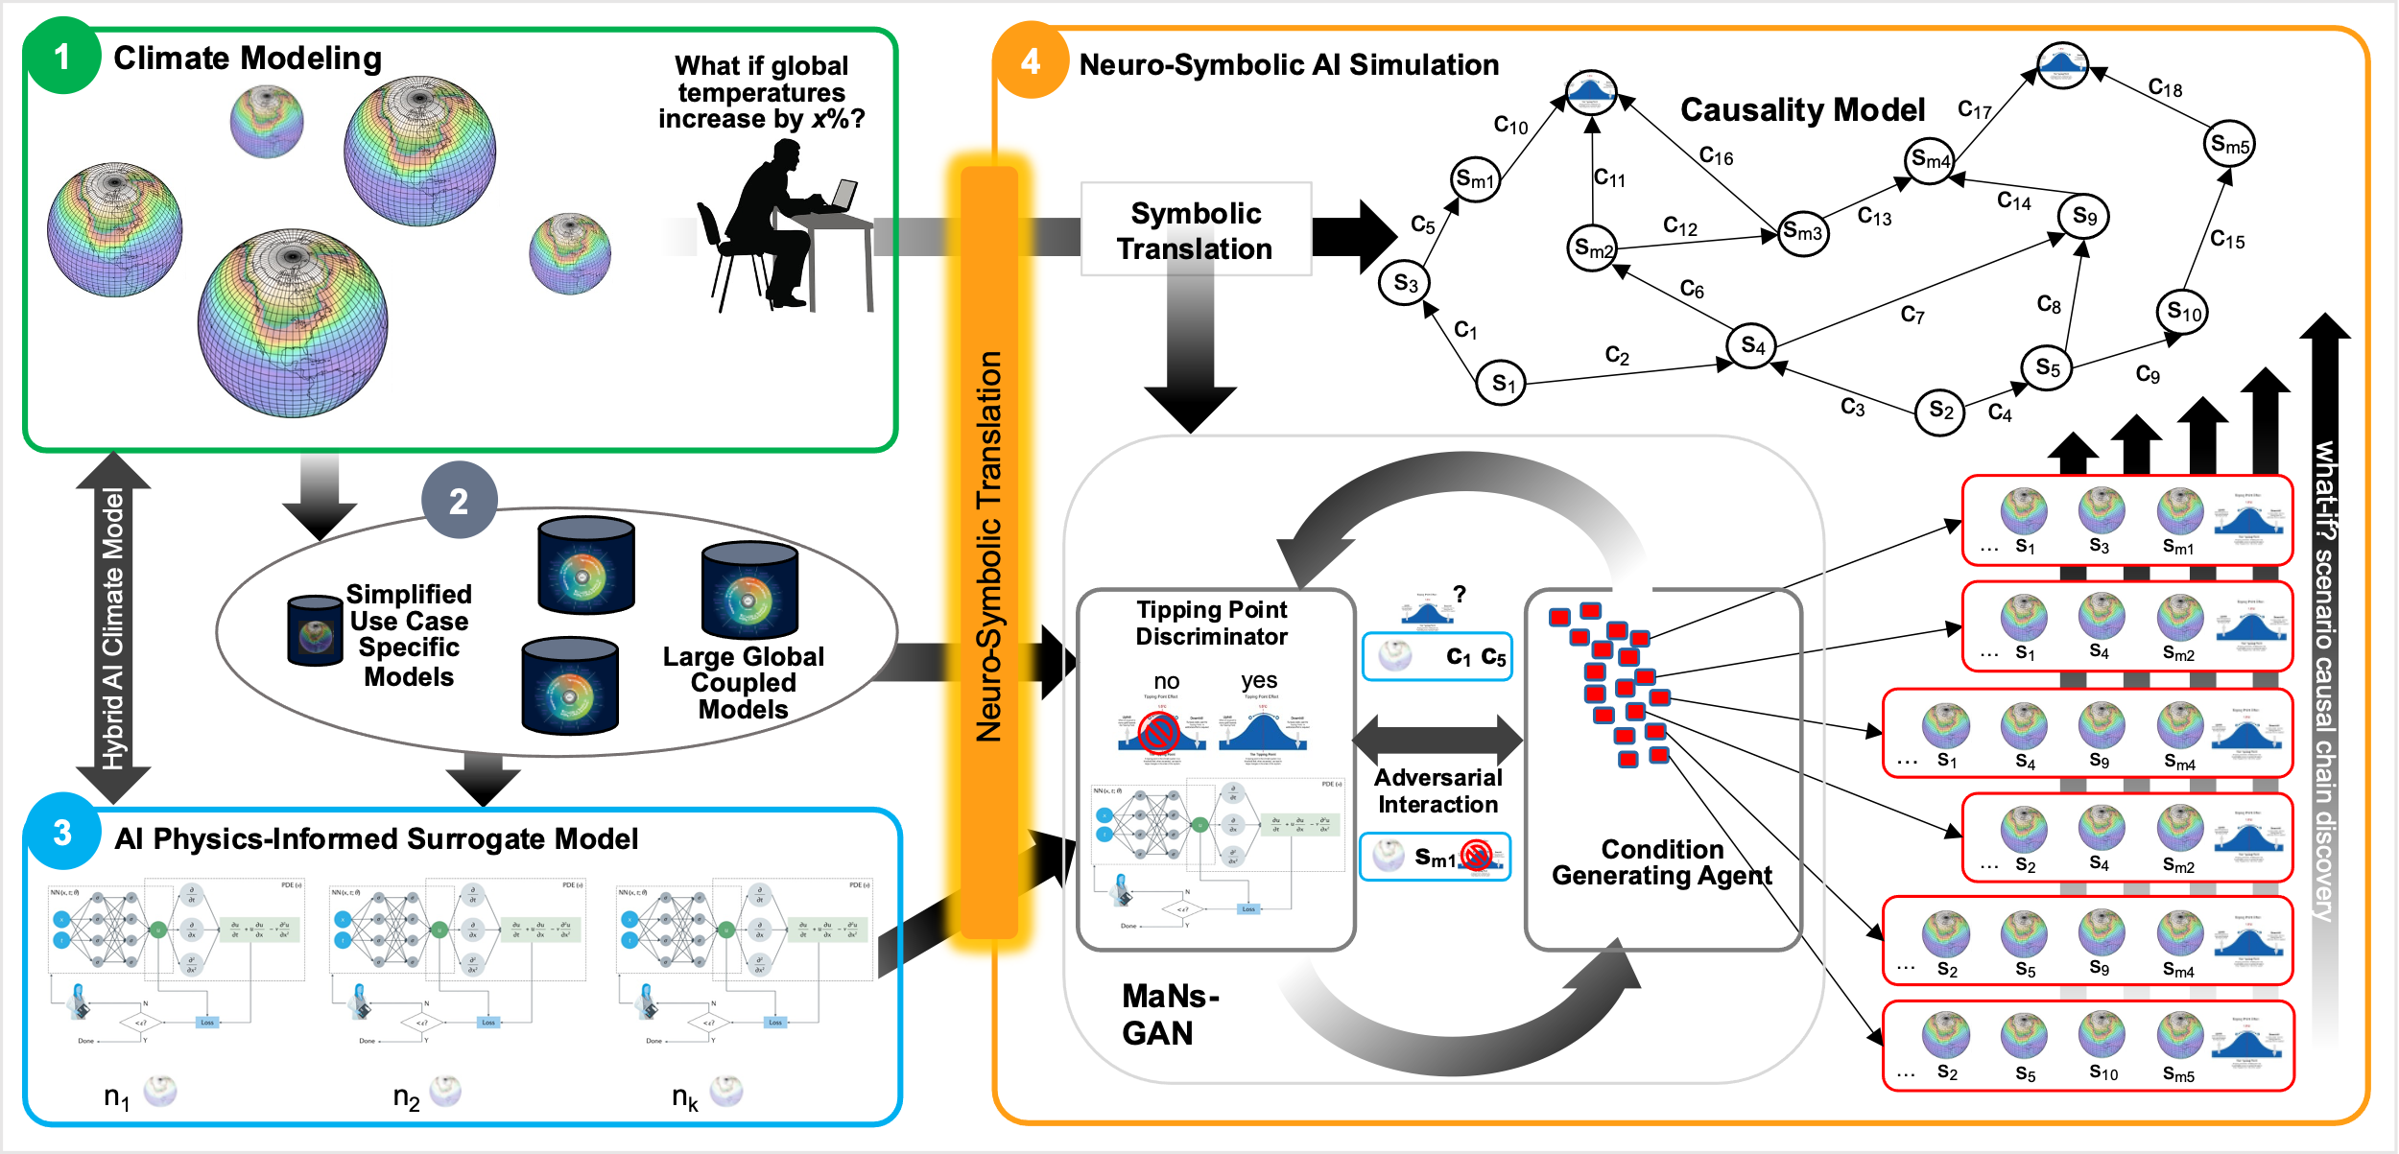
Introduction - PACMANs
The Physics-informed AI Climate Model Agent Neuro-symbolic Simulator (PACMANS) for Tipping Point Discovery Framework.

Slide 4
Overview
Data Generation – labeled
Prototype Multi-Generator GAN
Bifurcation Method
Graph representations of the box model

Slide 5
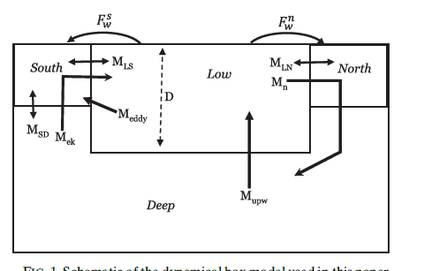
Surrogate Climate Models for Evaluation
On long time scales, Atlantic overturning can often be described by simple box model…
… which exhibits tipping points.
But work needs to be done to
Extend to include Pacific Basin
Calibrate model against specific climate models (NCAR+CMIP6) using preindustrial and historical simulations.
Show that model can capture both mean state and variability
Use surrogate model to project tipping points, examine for accuracy of prediction.
Gnanadesikan, 1999; Gnanadesikan, Kelson and Sten, J. Climate 2018
March 9, 2022

Slide 6
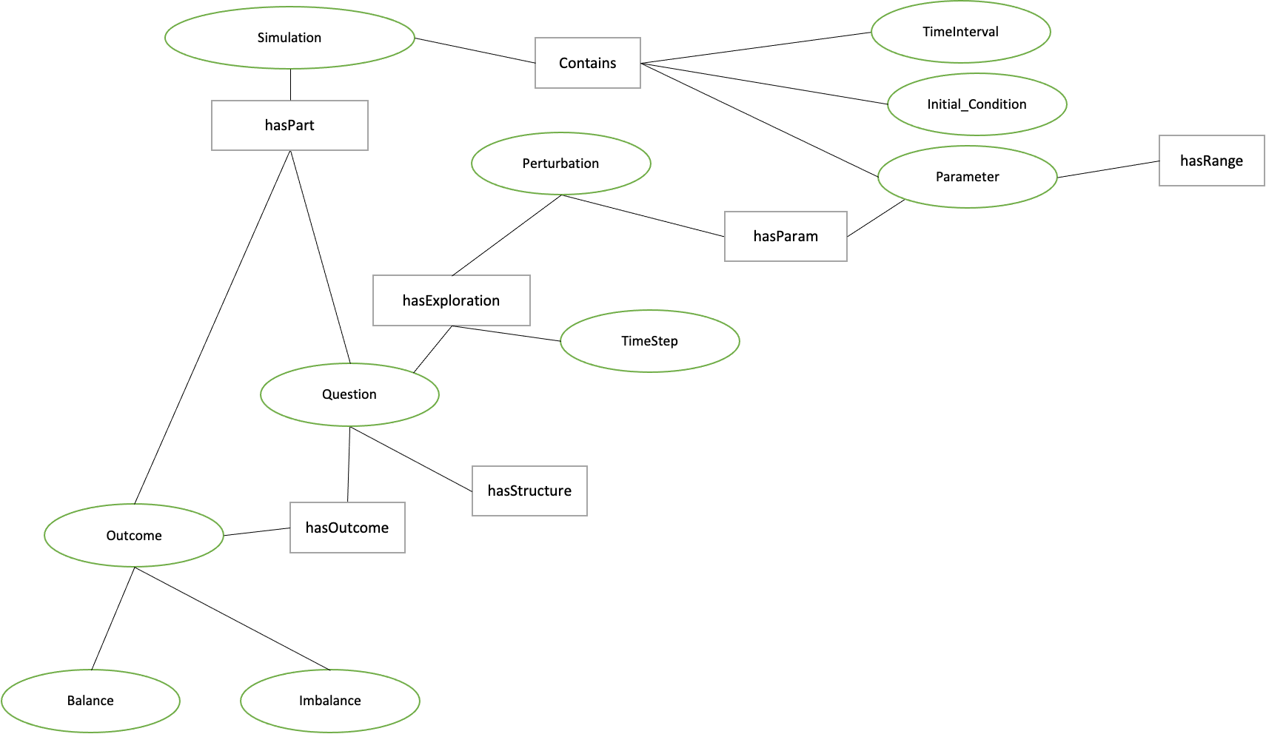
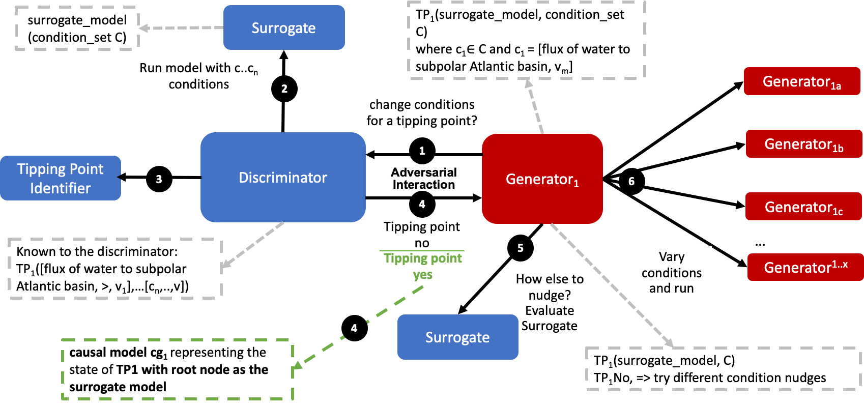
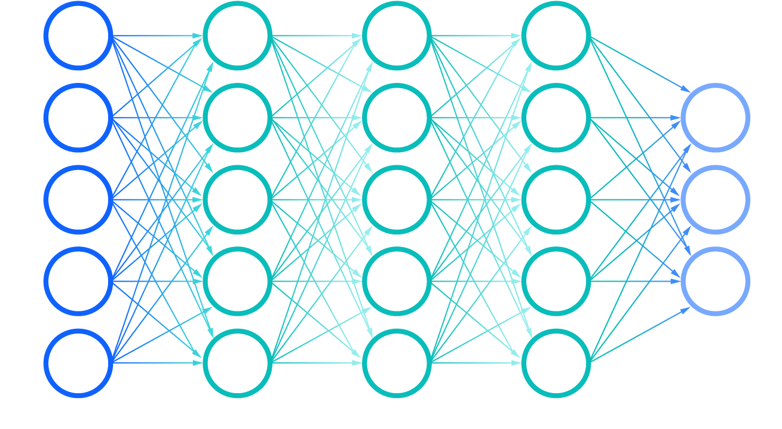
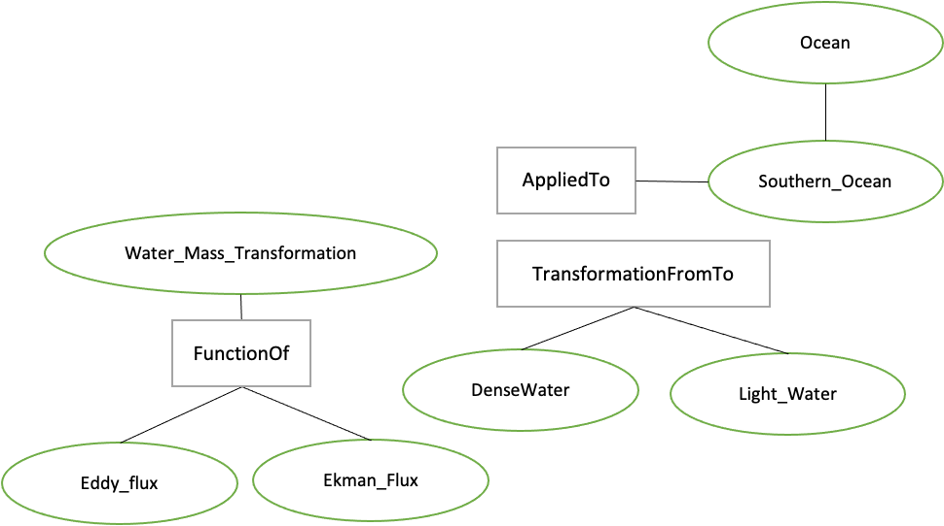
From Neuro-Symbolic to Deep Learning
A priori graph
structure of box model constituents
Experimental exploration structurally represented
Deep network for low dimensional structure embeddings
Adversarial
Game
Does the stability of the overturning depend on the pathways and sensitivities of water mass transformation in the Southern Ocean?
From Models to Language to Adversarial Learning – A depiction of how we will incorporate the explorations of the box model with a neuro-symbolic language, represented as graphs for low-dimensional embeddings used for learning. Graph representations used for representing modeling (far left), defining exploration problems in terms of graphs (mid-left), producing low dimensional embeddings of graphs (mid-right), and using the low dimensional embedding for adversarial learning (far right).

Slide 7
Updates for Working Group
Data Generation – labeled
Prototype Multi-Generator GAN
Bifurcation Method
Graph representations of the box model
This material is based upon work supported by the Defense Advanced Research Projects Agency (DARPA) under Agreement No. HR00112290032.

