Slide 1
Distribution-free Uncertainty Quantification for Deep Learning
Zhen Lin
zhenlin4@illinois.edu
Advisor: Jimeng Sun
Committee: Jim Rehg, Hanghang Tong, Yaniv Romano, Jimeng Sun
03/19/2024
Notes:
Hello everyone, thank you for coming to my PhD defense today.
Today I will present my research on Distribution-free UQ for DL.

Slide 2
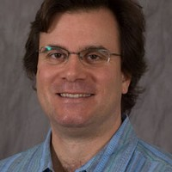
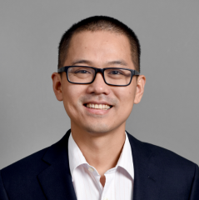
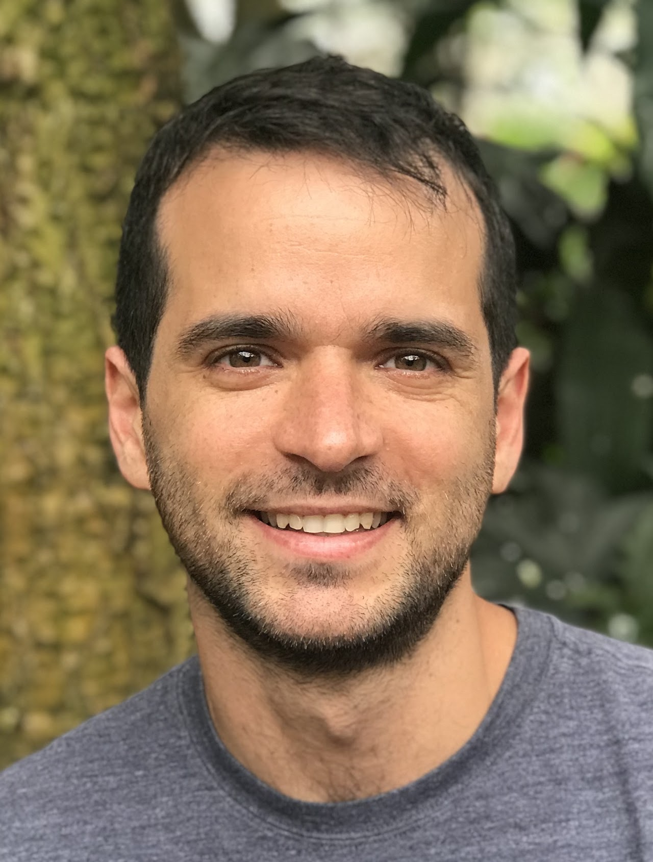
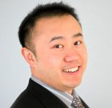
Committee Members
Prof. Jim Rehg
University of Illinois Urbana-Champaign
Prof. Hanghang Tong
University of Illinois Urbana-Champaign
Prof. Yaniv Romano
Technion—Israel Institute of Technology
Prof. Jimeng Sun
University of Illinois Urbana-Champaign
(Chair & Director of Research)
Notes:
First of all, I’d like to introduce my committee members online today.
Professor Jim Rehg from UIUC (computer vision and machine learning, and work in a number of inter’disciplinary areas: developmental and social psychology, autism research, mobile health, and robotics)
Hanghang Tong: large scale data mining and machine learning, especially for graph and multimedia data with applications to social networks analysis, healthcare, cyber-security and e-commerce
Yaniv Romano: Prediction with Confidence, uncertainty estimation, reproducibility in science, theory and practice of neural nets, inverse problems and so on.
Jimeng Sun: AI for healthcare, clinical trials, drug discovery, predictive modeling, tensor factorization, and generative models
It’s my great honor to have them on my PhD committee, and I really appreciate their time and feedbacks in this process.\

Slide 3
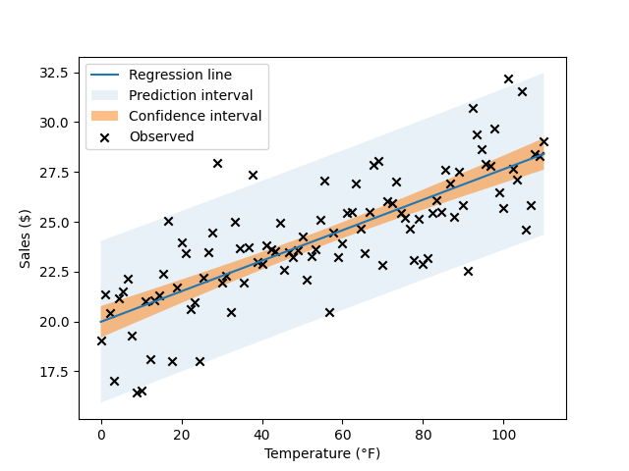
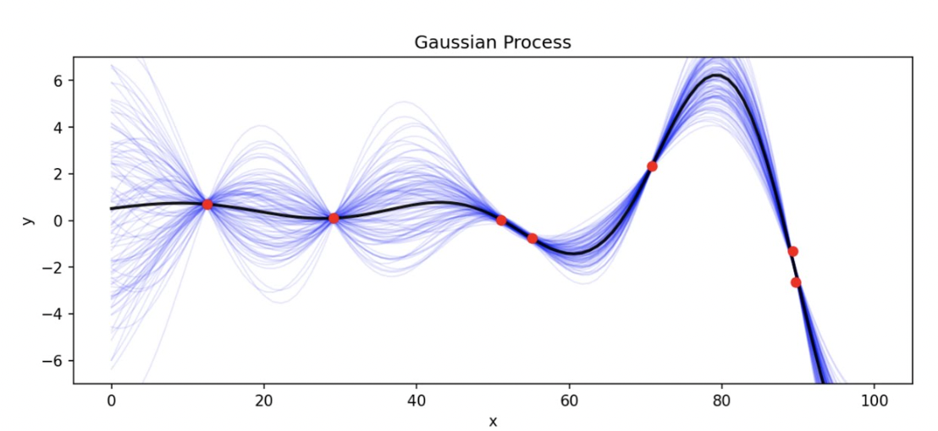

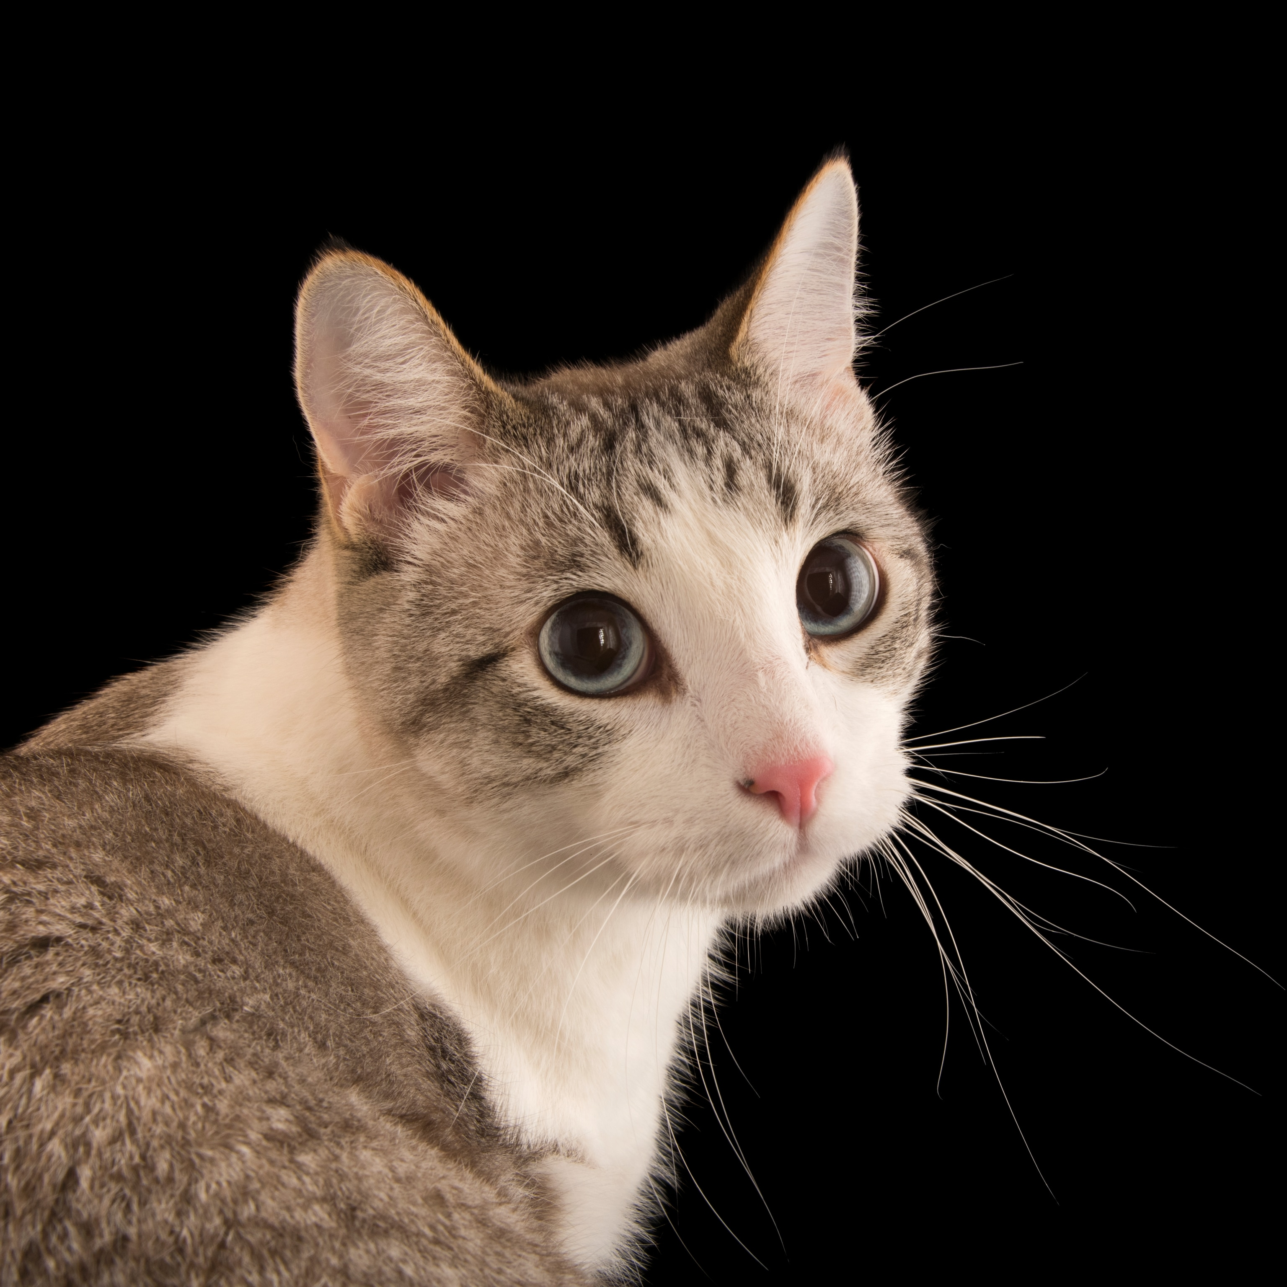
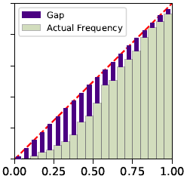
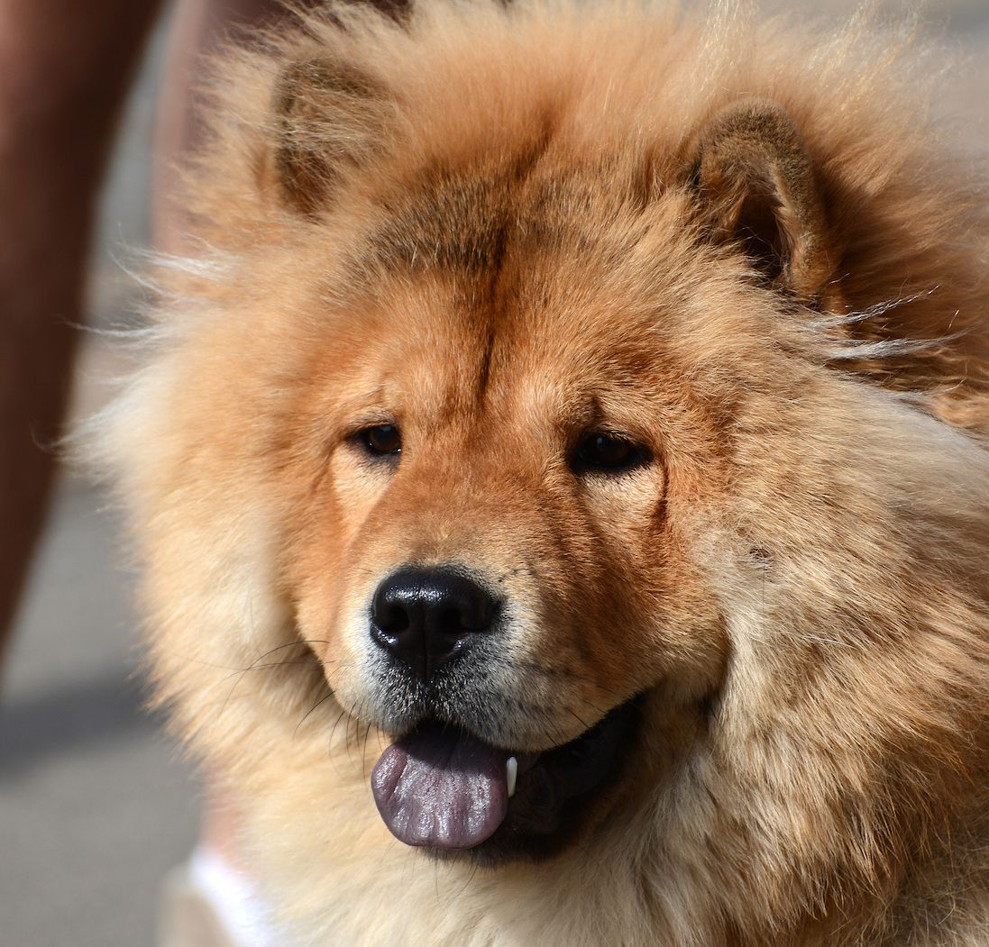
Research Overview
Hello World
Distribution-Free UQ
Conformal Prediction
LVD (NeurIPS’21)
TQA (NeurIPS’22)
CPTD (TMLR’22)
Gaussian Process
Monte-Carlo Dropout
Bayesian NN
…
Model Calibration
KCal (ICLR’23)
UQ for Natural Language Generation (preprint)
Uncertainty Quantification (UQ)
{cat}
Risk-Controlling Prediction Set
SCRIB (AAAI’22)
FavMac (ICML’23)
{dog, bear}
Notes:
The title is DFUQ, but I’d like to first explain that is a non-DF UQ.
Non-DF UQ: UQ comes from assuming the underlying model/distribution
DFUQ: do not make assumptions about the form of the underlying distribution

Slide 4
Conformal Prediction – Prediction Intervals
Distribution-Free UQ
Conformal Prediction
LVD (NeurIPS’21)
TQA (NeurIPS’22)
CPTD (TMLR’22)
Model Calibration
KCal (ICLR’23)
UQ for Natural Language Generation (preprint)
Uncertainty Quantification (UQ)
Risk-Controlling Prediction Set
SCRIB (AAAI’22)
FavMac (ICML’23)
Notes:
6:38 (20:00 remain)
9:43

Slide 5

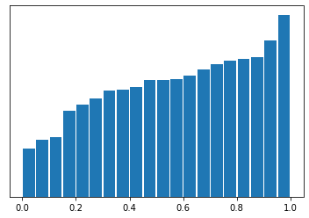






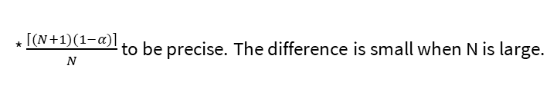

Prediction Set and Interval Construction
Conformal Prediction
Goal: Build valid prediction set/interval $C(X_{N+1})$for test data $Y_{N+1}$
Coverage guarantee: $ℙ\left\{Y_{N+1}∈C\left(X_{N+1}\right)\right\}≥1−α$ (e.g. 0.9)
Simplest Example (Split conformal) Assuming the DNN is trained:
Fix a non-conformity score function: $s_{i}=s\left(x_{i},y_{i}\right)$; compute them on the calibration dataset.
Construct $C\left(x\right)=\{y:s\left(x,y\right)≤\hat{q}\}$. $\hat{q}$ is the $1−α \text{quantile}\text{∗ }\text{of} \text{the} \text{scores} [s_{1},…,s_{N}]$
Assuming $\left(x_{1},y_{1}\right),…,(x_{N+1},y_{N+1})$ are exchangeable (or iid), $C(X_{N+1})$has the coverage guarantee
Why? Rank of $s_{N+1}$ among $[s_{1},…,s_{N+1}]$ is Uniform[0,1].
Proper training
Data
$$\hat{f}$$
$s(⋅,⋅)$(e.g. $|y−\hat{f}(x)|)$
$$s_{1},…,s_{N}$$
Calibration
$$\hat{q}$$
$$C\left(x_{N+1}\right)=\{y:s\left(x_{N+1},y\right)≤\hat{q}\}$$
$$X_{N+1}$$
* $\frac{\left.\left\lceil (N+1)(1−α)\right.\right\rceil }{N}$ to be precise. The difference is small when N is large.
Model Calibration
Conformal Prediction Interval:
LVD(NeurIPS’21), TQA (NeurIPS’22), CPTD (TMLR’22)
Risk-Controlling Prediction Set
UQ for NLG

Slide 6
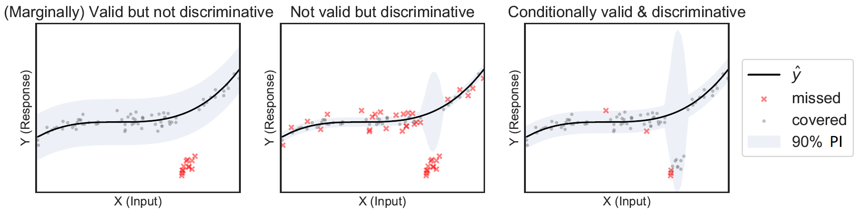



Conditional Validity and Discriminativeness
The previous PI
guarantee holds for a random $X_{N+1}$ (marginally valid)
has constant-width (not discriminative)
e.g. minority patients
Model Calibration
Conformal Prediction Interval:
LVD(NeurIPS’21), TQA (NeurIPS’22), CPTD (TMLR’22)
Risk-Controlling Prediction Set
UQ for NLG

Slide 7
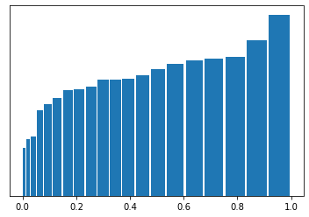




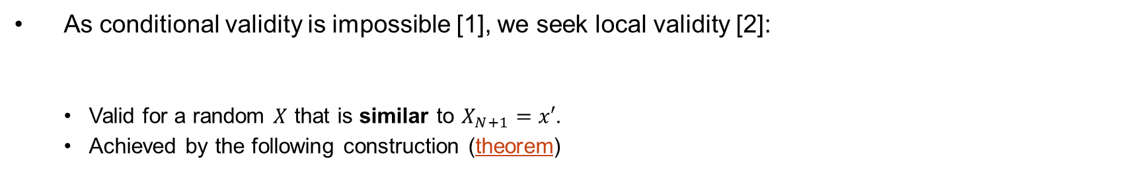
Locally Valid and Discriminative PI (LVD)
As conditional validity is impossible [1], we seek local validity [2]:
Valid for a random $X$ that is similar to $X_{N+1}=x′$.
Achieved by the following construction (theorem)
Trained kernel $K_{f}$ $w_{i}=K_{f}(x^{′},x_{i})$
Proper training
$$\hat{f}$$
$s(⋅,⋅)$(e.g. $|y−\hat{f}(x)|)$
$$s_{1},…,s_{N}$$
$$w_{1},…,w_{N}$$
$$s_{1},…,s_{N}$$
Calibration
Weighted ${\hat{q}}_{w}$
$$C(X_{N+1})$$
$$X_{N+1}$$
[1] Vovk, Vladimir. "Conditional validity of inductive conformal predictors." In Asian conference on machine learning, pp. 475-490. PMLR, 2012.
[2] Guan, Leying. "Conformal prediction with localization." arXiv preprint arXiv:1908.08558 (2019).
Model Calibration
Conformal Prediction Interval:
LVD(NeurIPS’21), TQA (NeurIPS’22), CPTD (TMLR’22)
Risk-Controlling Prediction Set
UQ for NLG
Notes:
For any distribution P, for almost all x aside from the atoms of P_X, E[leb(C(x))] = \infty
CI need to be conditionally valid for Q as well.

Slide 8
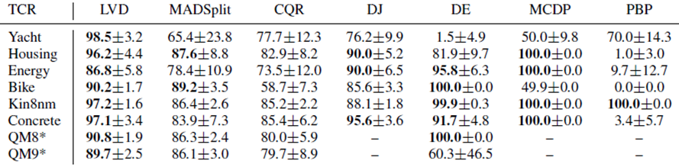
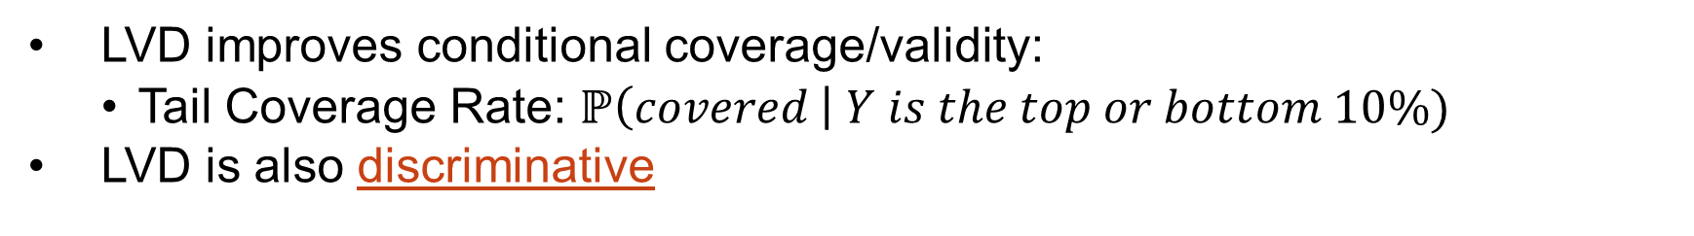
LVD Experiment Results
LVD improves conditional coverage/validity:
Tail Coverage Rate: $ℙ\left(covered \right| Y is the top or bottom 10\%)$
LVD is also discriminative
Model Calibration
Conformal Prediction Interval:
LVD(NeurIPS’21), TQA (NeurIPS’22), CPTD (TMLR’22)
Risk-Controlling Prediction Set
UQ for NLG
Notes:
Split it to two slides (use previous example)

Slide 9
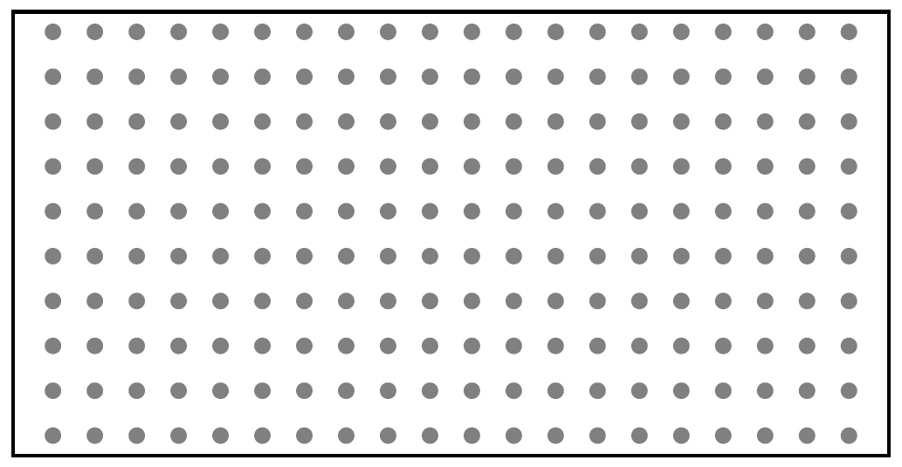



PI for Cross-sectional Time Series
Given i.i.d. training data ${\{S_{i}\}}_{i=1}^{N}$ where each $S_{i}=$ is a (temporally correlated) time series (TS)
Task: Given a new TS $S_{N+1}$, at time $t$, construct a PI for $Y_{N+1, t+1}$, denoted as ${\hat{C}}_{N+1,t+1}$
$t$ (e.g. days in hospital)
patient
$$S_{i}$$
Patient Data
Model Calibration
Conformal Prediction Interval:
LVD(NeurIPS’21), TQA (NeurIPS’22), CPTD (TMLR’22)
Risk-Controlling Prediction Set
UQ for NLG
Notes:
18:03

Slide 10
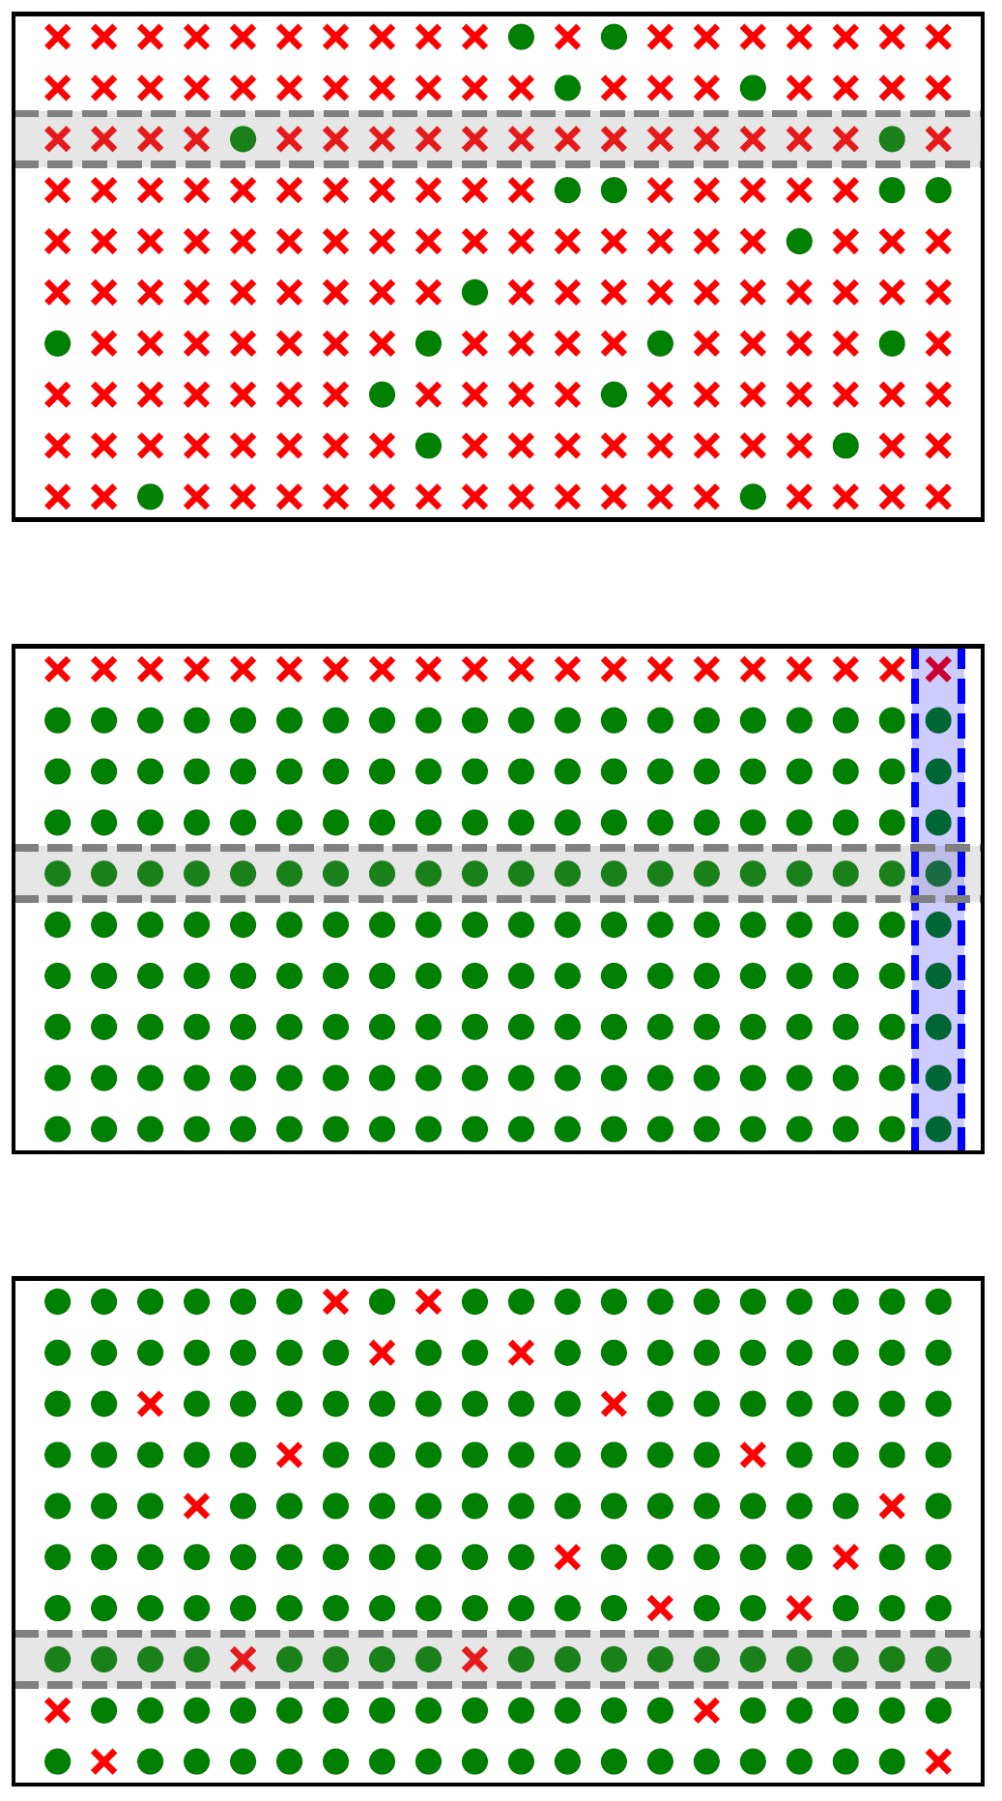
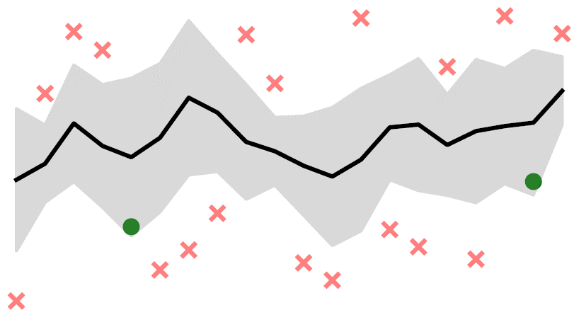
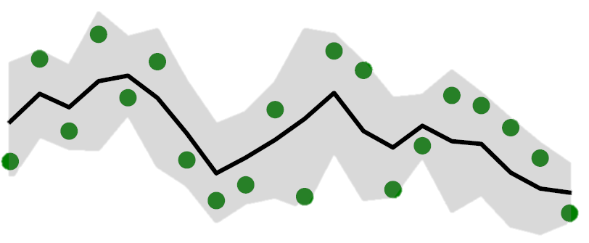
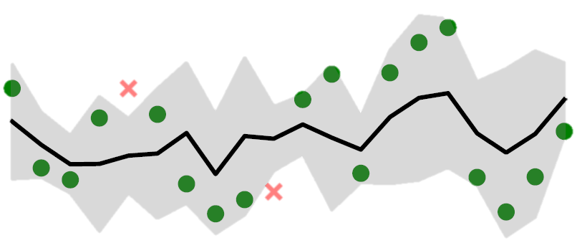
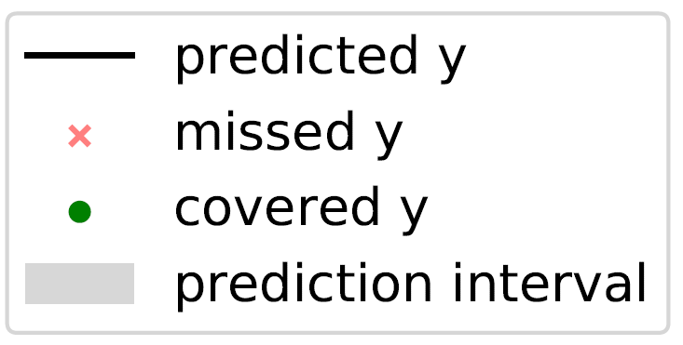
Cross-sectional vs Longitudinal Validity
Formal definitions in the appendix
Longitudinal validity is impossible to achieve in the same sense as conditional validity (theorem)
$t$ (e.g. days in hospital)
Potential issue of split conformal
patient
(A): Cross-sectionally Invalid, Longitudinally Invalid
(B): Cross-sectionally Valid, Longitudinally Invalid
Patient Data
(C) Cross-sectionally Valid, Longitudinally Valid
Model Calibration
Conformal Prediction Interval:
LVD(NeurIPS’21), TQA (NeurIPS’22), CPTD (TMLR’22)
Risk-Controlling Prediction Set
UQ for NLG

Slide 11
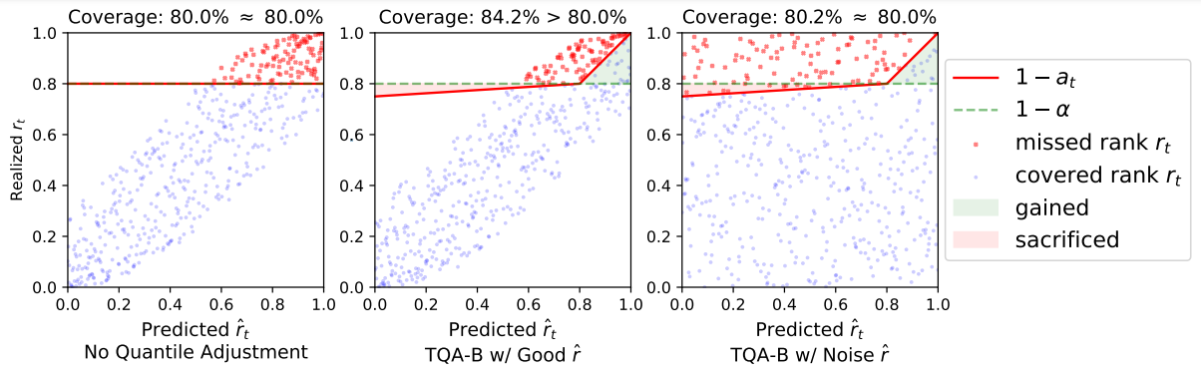


Temporal Quantile Adjustments
Quantile Budgeting (TQA-B)
Construct $C\left(x\right)=\{y:s\left(x,y\right)≤\hat{q}\}$. $\hat{q}$ is the $1−α$ quantile of the scores $[s_{1,t+1},…,s_{N+1,t+1}]$
If we have reasons to believe that ${\hat{y}}_{N+1, t+1}$ is likely quite hard (or easy) to predict, we could change the quantile to query $1−a_{i,t+1}$
Step 1: Predict ${\hat{r}}_{i,t+1}$, rank of $s_{i,t+1}$ among $[s_{1,t+1},…,s_{N+1,t+1}]$
Step 2: Using predicted ${\hat{r}}_{i,t+1}$ to adjust $1−a_{i,t+1}$
Theoretical guarantees
$$1−a_{i,t+1}$$
Model Calibration
Conformal Prediction Interval:
LVD(NeurIPS’21), TQA (NeurIPS’22), CPTD (TMLR’22)
Risk-Controlling Prediction Set
UQ for NLG
Notes:
It’s like a “damping” effect – a patient previously tend to have high coverage (whose rhat is left-leaning) is lowered, and vice versa
21’

Slide 12
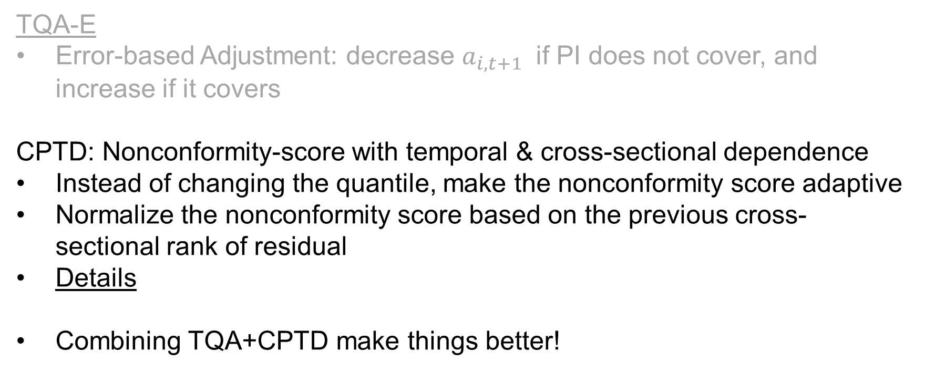
Other Solutions
TQA-E
Error-based Adjustment: decrease $a_{i,t+1}$ if PI does not cover, and increase if it covers
CPTD: Nonconformity-score with temporal & cross-sectional dependence
Instead of changing the quantile, make the nonconformity score adaptive
Normalize the nonconformity score based on the previous cross-sectional rank of residual
Details
Combining TQA+CPTD make things better!
Model Calibration
Conformal Prediction Interval:
LVD(NeurIPS’21), TQA (NeurIPS’22), CPTD (TMLR’22)
Risk-Controlling Prediction Set
UQ for NLG
Notes:
Don’t need to say details are skipped.
24’

Slide 13
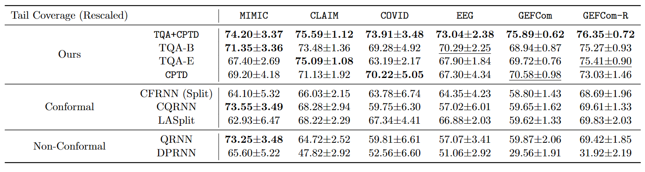
Experiment Results
Tail Coverage (Rescaled): Coverage for the 10% least-covered TS, rescaled to the same width
Target: 90%
Model Calibration
Conformal Prediction Interval:
LVD(NeurIPS’21), TQA (NeurIPS’22), CPTD (TMLR’22)
Risk-Controlling Prediction Set
UQ for NLG
Notes:
Don’t mention re-scale

Slide 14
Risk-Controlling Prediction Set
Distribution-Free UQ
Conformal Prediction
LVD (NeurIPS’21)
TQA (NeurIPS’22)
CPTD (TMLR’22)
Model Calibration
KCal (ICLR’23)
UQ for Natural Language Generation (preprint)
Uncertainty Quantification (UQ)
Risk-Controlling Prediction Set
SCRIB (AAAI’22)
FavMac (ICML’23)
Notes:
18:46 (8:00 remain)
24:18
I will mainly focus on the FavMac, our ICML’23 paper.
#If time permits we can go over the other paper in the Appendix as well.

Slide 15
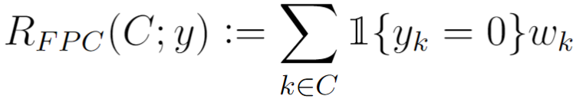

Prediction Set Motivated by Diagnoses Prediction
Code assignment to patient health records (prediction set $C$)
maximize the correct predictions (value $V$)
control the errors (risk $R$)
Truth: {CHF, SHA,D}
Incorrect Codes: {ARF,MCAL,…}
Example Prediction | Risk | Value
{D,ARF} | 0.48 | 0.11
{CHF,D,ARF,MCAL} | 0.48+2.48=2.96 | 0.11+0.37=0.48
{CHF,D,SHA,ARF} | 0.48 | 0.11+0.37+0.30=0.78
Model Calibration
Conformal Prediction Interval
Risk-Controlling Prediction Set:
FavMac (ICML’23), SCRIB (AAAI’22)
UQ for NLG

Slide 16
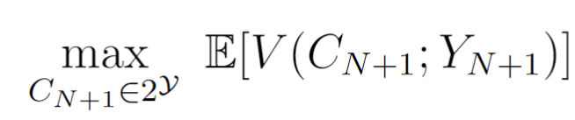



Problem Formulation
Online setting
Goal: Find prediction set $C_{N+1}$ with high value and risk control guarantee
Details
Expected Risk Control Violation Control
Model Calibration
Conformal Prediction Interval
Risk-Controlling Prediction Set:
FavMac (ICML’23), SCRIB (AAAI’22)
UQ for NLG

Slide 17
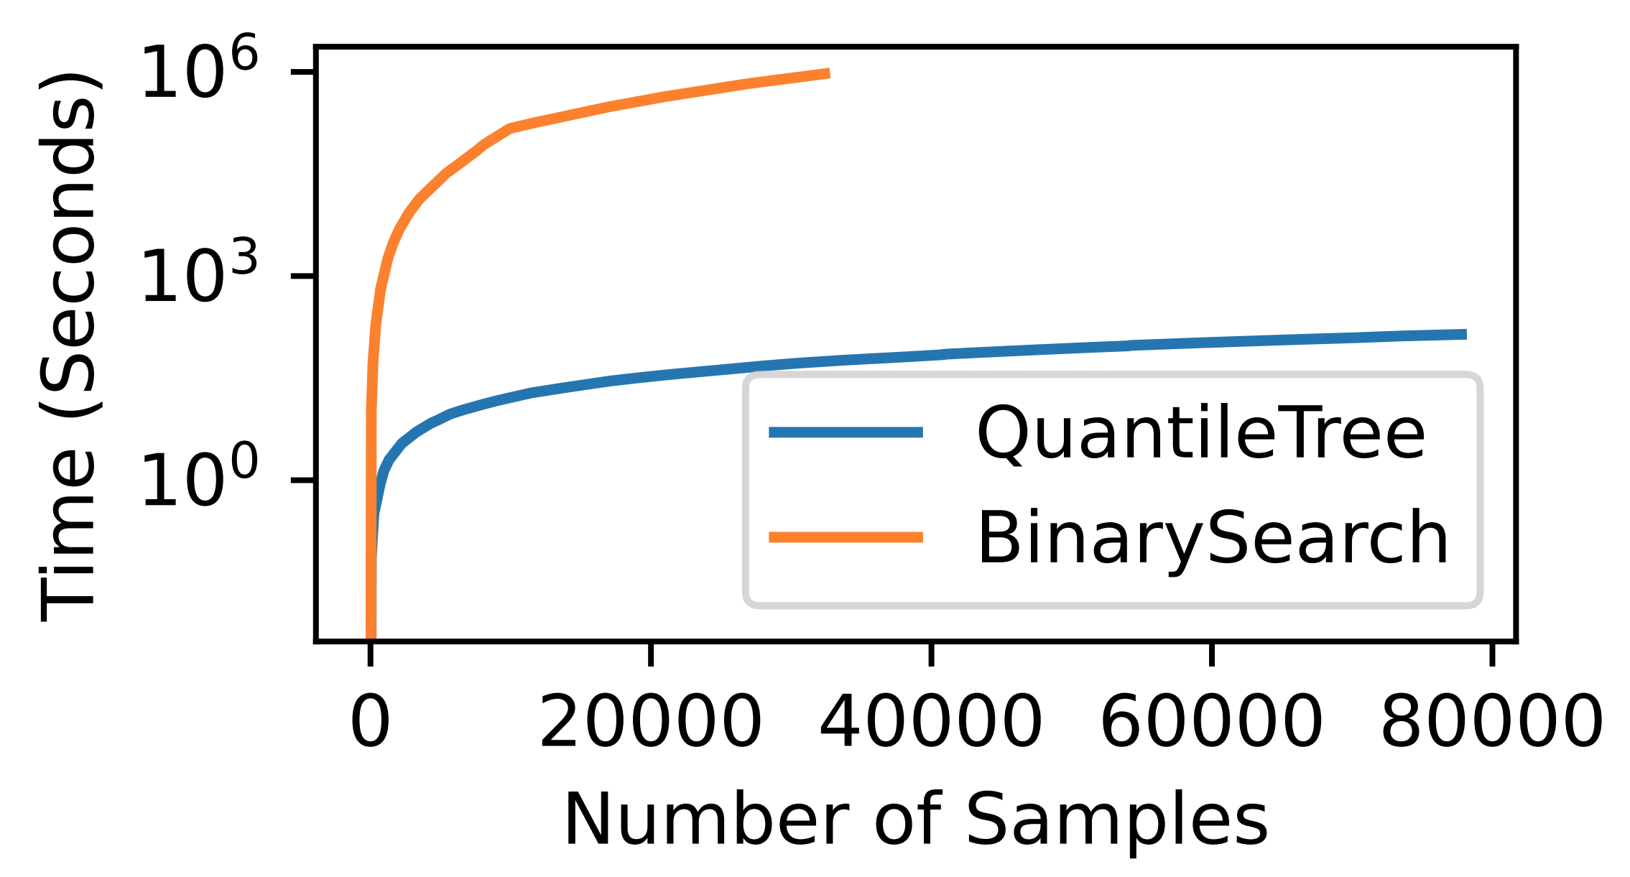
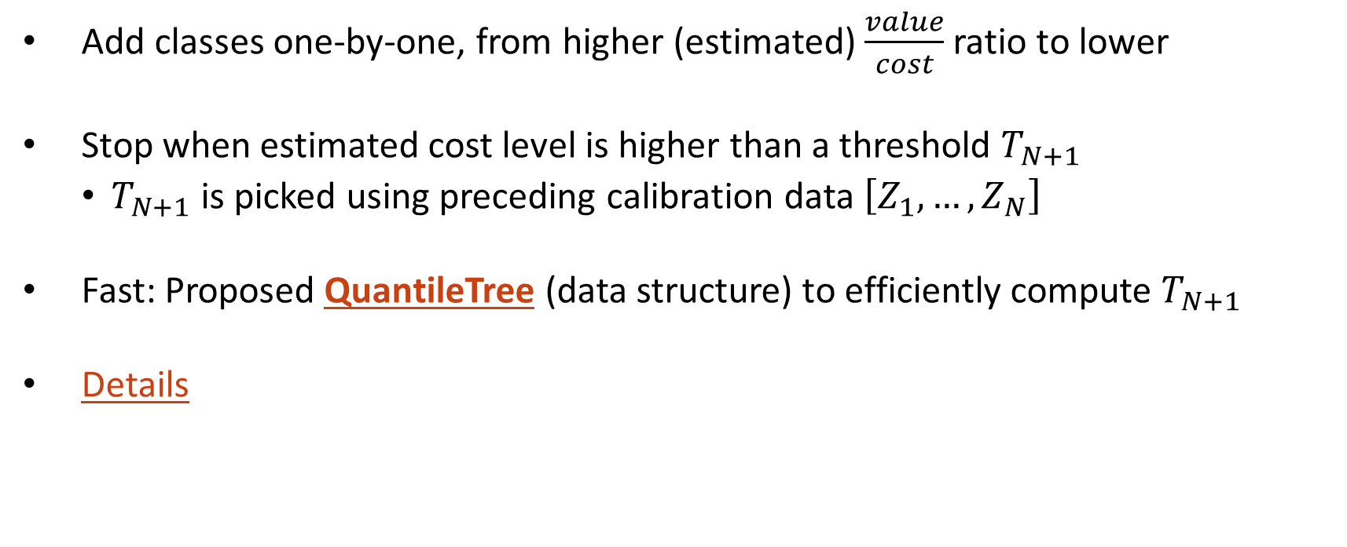
FavMac: Fast Value-maximizing Prediction Set with Conformal Cost (Risk) Control
Add classes one-by-one, from higher (estimated) $\frac{value}{cost}$ ratio to lower
Stop when estimated cost level is higher than a threshold $T_{N+1}$
$T_{N+1}$ is picked using preceding calibration data $\left[Z_{1},…,Z_{N}\right]$
Fast: Proposed QuantileTree (data structure) to efficiently compute $T_{N+1}$
Details
Model Calibration
Conformal Prediction Interval
Risk-Controlling Prediction Set:
FavMac (ICML’23), SCRIB (AAAI’22)
UQ for NLG
Notes:
Binary Search: NlogN, because evaluating a threshold is O(N)

Slide 18
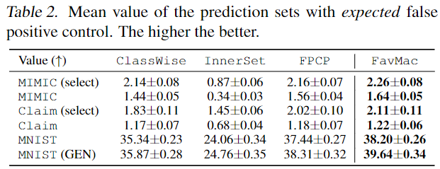
Experiments
False Positive Control (Expectation)
FavMac (ours) achieves the highest value
Model Calibration
Conformal Prediction Interval
Risk-Controlling Prediction Set:
FavMac (ICML’23), SCRIB (AAAI’22)
UQ for NLG

Slide 19
UQ for Natural Language Generation
Distribution-Free UQ
Conformal Prediction
LVD (NeurIPS’21)
TQA (NeurIPS’22)
CPTD (TMLR’22)
Model Calibration
KCal (ICLR’23)
UQ for Natural Language Generation (preprint)
Uncertainty Quantification (UQ)
Risk-Controlling Prediction Set
SCRIB (AAAI’22)
FavMac (ICML’23)
Notes:
22:46 (4:00 remain)
30:05, 28:42

Slide 20
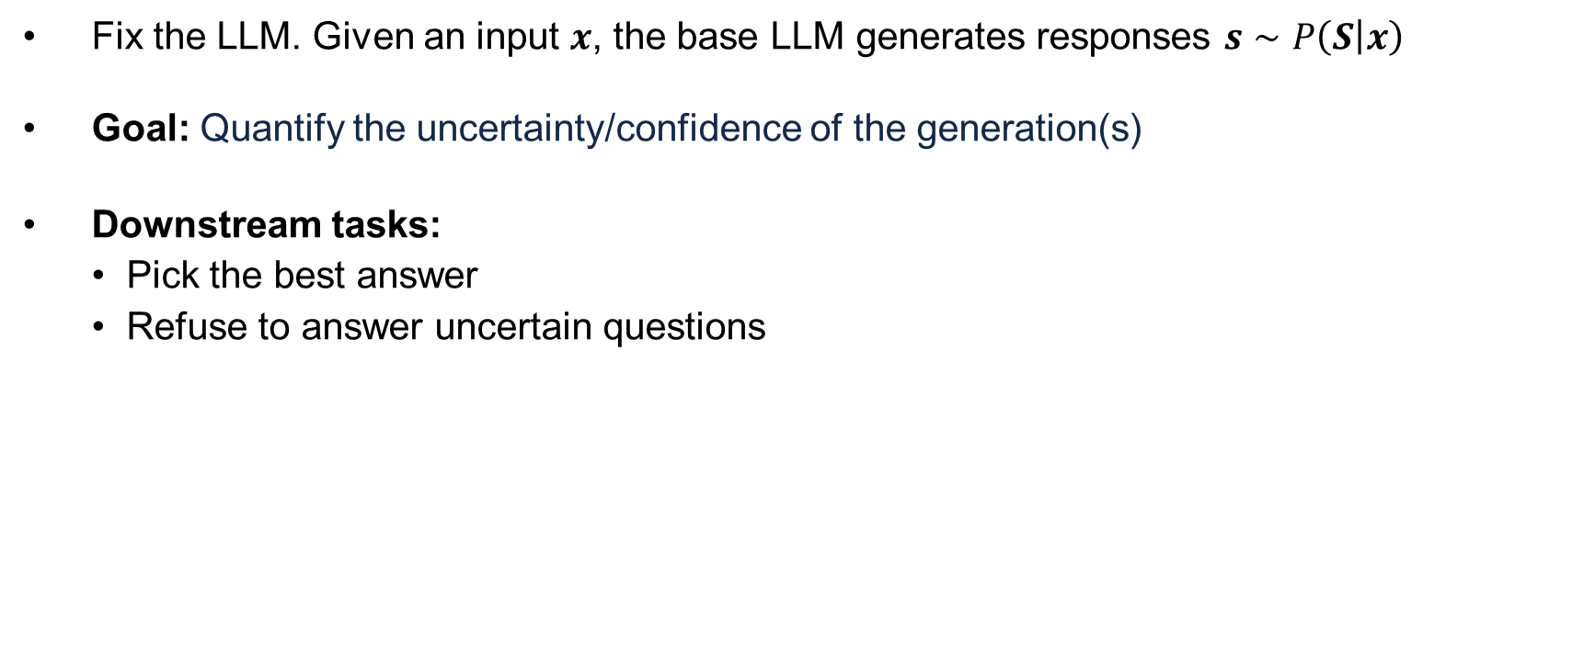
Uncertainty Estimation in Natural Language Generation
Fix the LLM. Given an input $x$, the base LLM generates responses $s∼P\left(S | x\right)$
Goal: Quantify the uncertainty/confidence of the generation(s)
Downstream tasks:
Pick the best answer
Refuse to answer uncertain questions
There’s no cure
Why was the plague that struck Athens so devastating?
A large flock of birds
It was so short and caused so much quaratic
It happened just as farming season began
input $x$ Base LLM response(s) $s$
Model Calibration
Conformal Prediction Interval
Risk-Controlling Prediction Set
UQ for Natural Language Generation

Slide 21
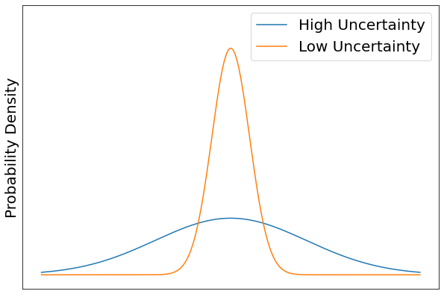
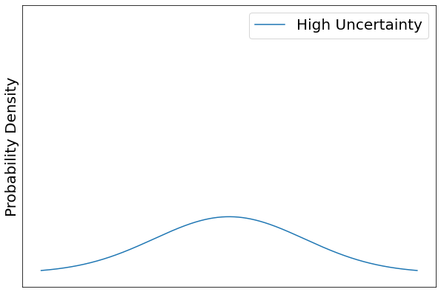

Uncertainty vs Confidence
Uncertainty measure is a property of the perceived predictive distribution
Takes the form of $U(x)$
“Dispersion” or “Variance” of the predictive distribution
There’s no cure
Why was the plague that struck Athens so devastating?
A large flock of birds
It was so short and caused so much quaratic
It happened just as farming season began
By foot
How was he traveling then?
Walking
Walked
On foot
Model Calibration
Conformal Prediction Interval
Risk-Controlling Prediction Set
UQ for Natural Language Generation

Slide 22
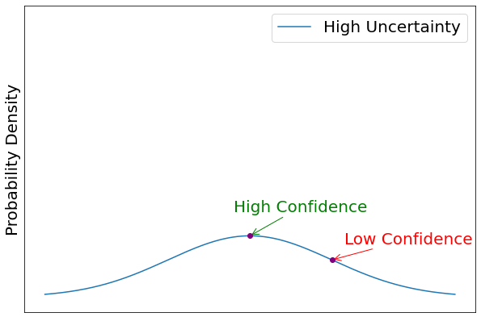

Uncertainty vs Confidence
Confidence measure depends on both the predictive distribution and the answer
Takes the form of $C(s|x)$
Should correlate to $P(correct)$ perceived by the model itself
There’s no cure
Why was the plague that struck Athens so devastating?
A large flock of birds
It was so short and caused so much quaratic
It happened just as farming season began
Model Calibration
Conformal Prediction Interval
Risk-Controlling Prediction Set
UQ for Natural Language Generation

Slide 23

Black-box Uncertainty Estimation for LLM
Main steps:
Sample multiple responses $s_{1},…,s_{m}$
Compute similarity matrix $W (m×m)$ of the responses
Compute uncertainty $U(x)$ or confidence $C(s|x)$
Model Calibration
Conformal Prediction Interval
Risk-Controlling Prediction Set
UQ for Natural Language Generation
Notes:
34:40

Slide 24



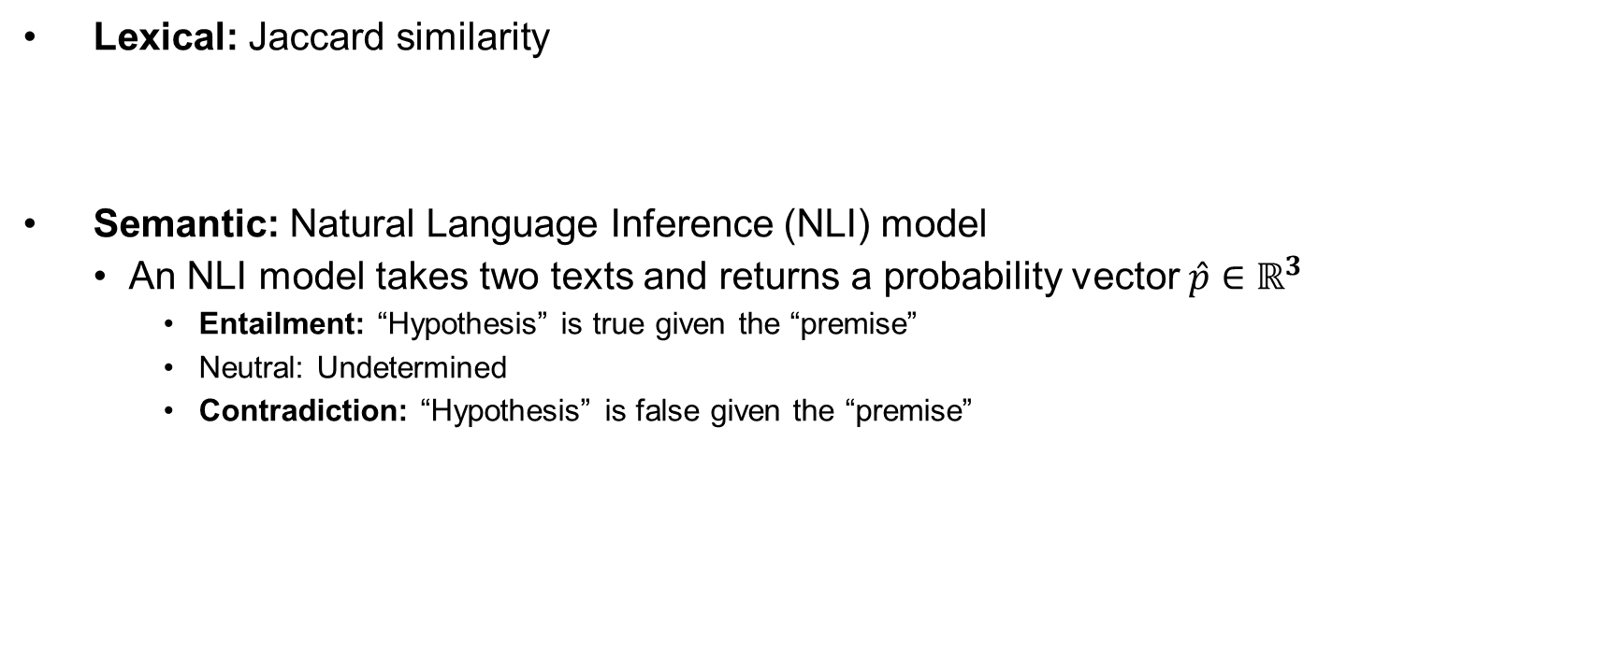
Similarity Matrix
Lexical: Jaccard similarity
Semantic: Natural Language Inference (NLI) model
An NLI model takes two texts and returns a probability vector $\hat{p}∈ℝ^{3}$
Entailment: “Hypothesis” is true given the “premise”
Neutral: Undetermined
Contradiction: “Hypothesis” is false given the “premise”
Model Calibration
Conformal Prediction Interval
Risk-Controlling Prediction Set
UQ for Natural Language Generation
Notes:
We will focus on entailment in the experiments

Slide 25
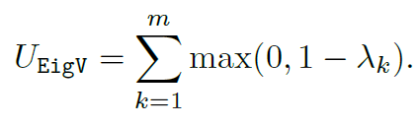

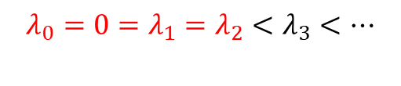
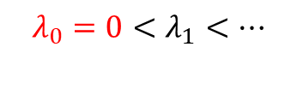
Uncertainty/Confidence from Similarities
Idea 1: Eigen Value
Use the eigen-values $λ$ of the graph Laplacian
$λ_{1}≤⋯≤λ_{k}≤⋯≤λ_{m}$
Consider graphs with only {1,0} as edge weights
$$λ_{0}=0<λ_{1}<…$$
$$λ_{0}=0=λ_{1}=λ_{2}<λ_{3}<…$$
Model Calibration
Conformal Prediction Interval
Risk-Controlling Prediction Set
UQ for Natural Language Generation

Slide 26
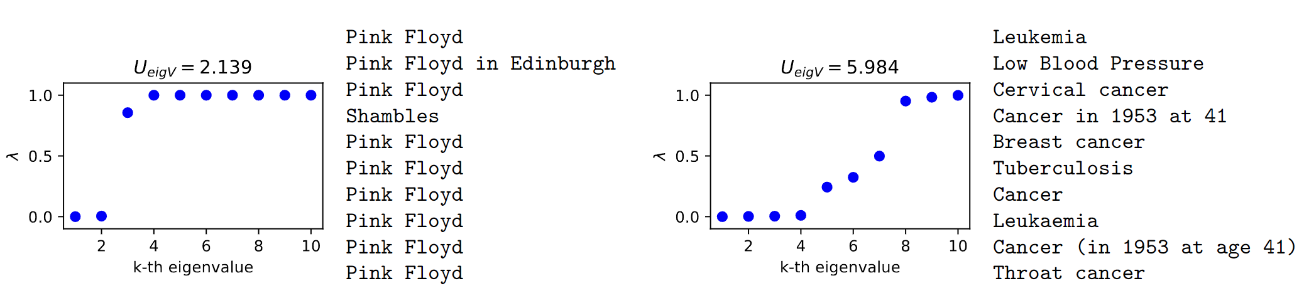

Uncertainty/Confidence from Similarities
Idea 1: Eigen Value
Use the eigen-values $λ$ of the graph Laplacian
$λ_{1}≤⋯≤λ_{k}≤⋯≤λ_{m}$
Sum of (one minus) the eigen-value of the graph Laplacian.
Left: Q: Dave Gilmore and Roger Waters were in which rock group? A: Pink Floyd
Right: Q: What claimed the life of singer Kathleen Ferrier? A: Cancer
Model Calibration
Conformal Prediction Interval
Risk-Controlling Prediction Set
UQ for Natural Language Generation

Slide 27

Uncertainty/Confidence from Similarities
Idea 2: Degree Matrix
$U_{EigV}$ cannot tell us confidence.
For confidence, use degree matrix $D$ ($D_{i,i}=\sum_{j}{w_{i,j}}$)
High degree -> well-connected node -> similar to many other responses
Model Calibration
Conformal Prediction Interval
Risk-Controlling Prediction Set
UQ for Natural Language Generation

Slide 28


Uncertainty/Confidence from Similarities
Idea 3: Eccentricity
Use spectral clustering to generate embedding $v_{i}$ for response $s_{i}$
${v′}_{i}$ denotes the de-meaned embedding
UMAP of the embeddings for
“Q: What is the bakery’s name
A: The Dominique Ansel Bakery”
Model Calibration
Conformal Prediction Interval
Risk-Controlling Prediction Set
UQ for Natural Language Generation
Notes:
(the embedding before we run the k-means in spectral clustering
u_1,..u_k: eigen-vectors of the smallest k eigen-values.
v_j = [u_{1,j}, …, u{k,j}] is a meaningful embedding

Slide 29

Experiments
Accuracy-Rejection Curve: Use uncertainty to predict the expected accuracy
Expected Accuracy: Average accuracy of all (20) responses, auto-evaluated by GPT3.5
Oracle: Rejection based on expected accuracy (cheating)
(E) means Entailment similarity from the NLI model (deberta-large-mnli)
Model Calibration
Conformal Prediction Interval
Risk-Controlling Prediction Set
UQ for Natural Language Generation

Slide 30

Experiments
AU-ARC: Uncertainty to predict the expected accuracy
Proposed methods perform similarly, consistently outperforming baselines
Model Calibration
Conformal Prediction Interval
Risk-Controlling Prediction Set
UQ for Natural Language Generation

Slide 31

Experiments
Uncertainty expected accuracy
AU-ARC: Confidence to predict the accuracy of individual responses
EigV is uncertainty-only (i.e. same value for all responses), so it usually perform a bit worse than Ecc or Deg
Model Calibration
Conformal Prediction Interval
Risk-Controlling Prediction Set
UQ for Natural Language Generation

Slide 32
Hallucination?
Uncertainty estimation does not solve the problem of hallucination
Not about overconfidence either, which however could easily be calibrated.
Why is it still important?
Good Uncertainty/Confidence measure requires:
Model’s predictive distribution faithfully reflects reality
We can quantify the U/C of this distribution (focus of this paper)
Both 1 and 2 are important
Model Calibration
Conformal Prediction Interval
Risk-Controlling Prediction Set
UQ for Natural Language Generation
Notes:
Skip “overconfidence” in talk

Slide 33
Future Works
UQ with Distribution Shifts
Estimate distribution shift with domain adaptation techniques (e.g. hospitals with many patients’ data)
Uncertainty Estimation for Long Text
Assigning uncertainty to each semantic segment
How to segment the long text
Evaluation (which could be costly)
Uncertainty Expression in NLG
Prediction set doesn’t just work for NLG, due to semantic invariance
What does an uncertainty of -0.3 mean? (Natural language expression like “I’m confident that” or use comparisons)

Slide 34
Acknowledgements
My Committee: Jim Rehg, Yaniv Romano, Jimeng Sun, Hanghang Tong
Sunlab: Chaoqi Yang, Siddhartha Laghuvarapu, Jintai Chen, Zhenbang Wu, Zifeng Wang, Benjamin Danek, Patrick Jiang, Junyi Gao, Andy Chufan Gao, Tianfan Fu, Dina Albassam, George Heintz, Hanyin Wang, Jathurshan Pradeepkumar, Jiacheng Lin, John Wu, Lang Cao, Mitchell Hermon, Namkyeong Lee, Shivam Kumar, Siddharth Biswal, Trisha Das, Xu Cao, Shenda Hong, Brandon Theodorou
MGH/Harvard: Jin Jing, Wendong Ge, M Brandon Westover
IQVIA: Cheng Qian, Lucas Glass
Nuro: Brian Yao, Aleksandr Petiushko, Albert Tseng, Kai-Siang Ang, Wei Liu
Friends & Coauthors: Shubhendu Trivedi, Camille Avestruz, Cao (Danica) Xiao, Brian Nord, Mintong Kang, Nicholas Huang, Risi Kondor, João Caldeira, W.L. Kimmy Wu, and friends from UChicago, AQR, and UIUC
My Family
Notes:
This is not a partition and some names should appear more than once if not for space

Slide 35


LVD Experiment Results
LVD is discriminative:
AUROC: Using the width of $\hat{C}(X_{i})$ to predict whether $r_{i}$ (residual) is big or small
(big=greater than the median of all $r_{i}$)
Model Calibration
Conformal Prediction Interval:
LVD(NeurIPS’21), TQA (NeurIPS’22), CPTD (TMLR’22)
Risk-Controlling Prediction Set
UQ for NLG
Notes:
Split it to two slides (use previous example)

Slide 36


TQA&CPTD
Cross-sectional and Longitudinal Validity Definitions
Cross-sectional validity
Longitudinal validity
Impossibility of longitudinal validity
Conformal Prediction with Temporal Quantile Adjustments (NeurIPS 2022)
Conformal Prediction Intervals with Temporal Dependence (TMLR Aug 2022)
Zhen Lin, Shubhendu Trivedi, Jimeng Sun
Notes:
We only present the reliability diagrams as they are more visually intuitive.
KCal has very consistent calibration quality across all classes.
More results are in our paper.

Slide 37

TQA
Theoretical Guarantees
If we have reasons to believe that ${\hat{y}}_{N+1, t+1}$ is likely quite hard (or easy) to predict, we could change the quantile to query:
$a_{i, t}≝α−{\hat{δ}}_{i,t}$
Intuitively, we increase (decrease) the adjustment amount ${\hat{δ}}_{i,t}$ if we suspect the nonconformity score is high (low)
Conformal Prediction with Temporal Quantile Adjustments (NeurIPS 2022)
Conformal Prediction Intervals with Temporal Dependence (TMLR Aug 2022)
Zhen Lin, Shubhendu Trivedi, Jimeng Sun
Notes:
We only present the reliability diagrams as they are more visually intuitive.
KCal has very consistent calibration quality across all classes.
More results are in our paper.

Slide 38


TQA
TQA-B Details
In this version of TQA, we perform “budgeting” on the adjustments ${\hat{δ}}_{i,t}$
We divide the process into 2 steps
Quantile Prediction:
Try to predict the rank of the nonconformity score for ${\hat{y}}_{i,t+1}$ as ${\hat{r}}_{i,t+1}$
Simply take the rank of the EQMA (exponentially weighted moving average) of the residual up to time t
Budgeting:
Conformal Prediction with Temporal Quantile Adjustments (NeurIPS 2022)
Conformal Prediction Intervals with Temporal Dependence (TMLR Aug 2022)
Zhen Lin, Shubhendu Trivedi, Jimeng Sun
Notes:
We only present the reliability diagrams as they are more visually intuitive.
KCal has very consistent calibration quality across all classes.
More results are in our paper.

Slide 39




TQA
TQA-E Details
In this version of TQA, we adjust ${\hat{δ}}_{t}$ without considering the cross-section, and allow for infinite PI
This is inspired by a recent work [1] on single time series (without the cross-section)
Define
Starting with ${\hat{δ}}_{0}=0$
Note that when ${\hat{δ}}_{0}≥α$, TQA-E leads to infinitely wide PI
Cross-sectional validity:
[1] Isaac Gibbs and Emmanuel Candes. Adaptive conformal inference under distribution shift. NeurIPS 2021
Conformal Prediction with Temporal Quantile Adjustments (NeurIPS 2022)
Conformal Prediction Intervals with Temporal Dependence (TMLR Aug 2022)
Zhen Lin, Shubhendu Trivedi, Jimeng Sun
Notes:
We only present the reliability diagrams as they are more visually intuitive.
KCal has very consistent calibration quality across all classes.
More results are in our paper.

Slide 40




CPTD
CPTD Details
To account for temporal dependency, we introduce a normalizing term ${\hat{m}}_{N+1,t+1}$
Denoting the absolute residual as $r_{i,s}=|y_{i,s}−{\hat{y}}_{i,s}|$
The quantile-to-query ${\hat{m}}_{i,t+1}$ is estimated by (past average rank)
Conformal Prediction with Temporal Quantile Adjustments (NeurIPS 2022)
Conformal Prediction Intervals with Temporal Dependence (TMLR Aug 2022)
Zhen Lin, Shubhendu Trivedi, Jimeng Sun
Notes:
We only present the reliability diagrams as they are more visually intuitive.
KCal has very consistent calibration quality across all classes.
More results are in our paper.

Slide 41



FavMac: Problem Formulation
We are given
a multilabel classifier
(online) calibration data ${\left\{z_{i}=\left(x_{i},y_{i}\right)\right\}}_{i=1}^{N}$, and a test sample $x_{N+1}$ (assume they are i.i.d.)
an arbitrary value function $V$ and a bounded cost function $C$
Goal: Find prediction set $S_{N+1}$ with high value and cost control guarantee (as specified below)
Expected Cost Control: Violation Control:
Fast Online Value-Maximizing Prediction Sets with Conformal Cost Control (ICML 2023)
Zhen Lin, Shubhendu Trivedi, Cao Xiao, Jimeng Sun

Slide 42


FavMac: Violation Control Pipeline
Choose appropriate proxy functions $\hat{C}$ and $\hat{V}$, for a target cost $c$:
Sort the classes
Find the threshold $t_{c,δ,i}$
Collect all calibration $t$
Pick the $T$ for the next datum
More details in Appendix Including Expectation Control
Model Calibration
Conformal Prediction Interval
Risk-Controlling Prediction Set:
FavMac (ICML’23), SCRIB (AAAI’22)
UQ for NLG

Slide 43







FavMac
Method Overview
Choose a “proxy” function $\hat{C}$ depending on the cost $C$ (similarly for value)
Choose thresholds $T$ (for proxy) basing on the calibration set
Define the prediction set ${\hat{S}}_{N+1}$as
$𝒰(X)$ is the “universe” from which we select prediction sets (e.g. $2^{𝒴}$)
The choice of $𝓤(X)$ is important to maximize value
(Efficiency) Custom data structure “QuantileTree”
Each update: $O\left(Nlog\left(N\right)\right)→O\left(log\left(N\right)\right)$
Fast Online Value-Maximizing Prediction Sets with Conformal Cost Control (ICML 2023)
Zhen Lin, Shubhendu Trivedi, Cao Xiao, Jimeng Sun
Notes:
We only present the reliability diagrams as they are more visually intuitive.
KCal has very consistent calibration quality across all classes.
More results are in our paper.

Slide 44



FavMac
Proxy Functions
Cost/Value functions take the form of $C(S;y)$ or $V(S;y)$
We don’t know Y, so can only use proxy functions $\hat{C}\left(S;x\right)$
For additive functions, such as
We can use
In general, one could use Monte-Carlo for general functions, or directly train a model as proxy
Fast Online Value-Maximizing Prediction Sets with Conformal Cost Control (ICML 2023)
Zhen Lin, Shubhendu Trivedi, Cao Xiao, Jimeng Sun

Slide 45



FavMac
(Expected) Cost Control
For any threshold $t$, define
“Max cost given threshold $t$” – is increasing in $t$
Now, we choose the (random) threshold
$C_{max}$ is the upper bound of cost $C$
We then use the value proxy to pick the final prediction set, as long as its cost proxy is below $T_{c}$
Violation control is very similar, except for a different threshold.
Fast Online Value-Maximizing Prediction Sets with Conformal Cost Control (ICML 2023)
Zhen Lin, Shubhendu Trivedi, Cao Xiao, Jimeng Sun

Slide 46


FavMac
Choice of Universe $𝒰$
The performance of FavMac significantly depends on $𝒰$
The Full Universe:
$$𝒰\left(X\right)=2^{𝒴}$$
This is not necessarily ideal, because we control the *max* cost within the universe, so a very big universe can lead to conservative $\hat{S}$ (with very low cost)
The Greedy Sequence:
Starting with $S_{\left(0\right)}(x)=∅$, for $j=0,…,K−1$, we gradually add the class with the largest probability
Mathematically, this means (with $σ\left(j\right)$ denoting the j-th element in a permutation $σ$):
$S_{(j+1)}\left(x\right)=S_{(j)}\left(x\right)∪\{σ_{Prob}(j+1;x)\}$ where $σ_{Prob}\left(x\right)=argsort(−\hat{p}\left(x\right))$
The Greedy Ratio Sequence:
Add the class that maximizes the value/cost ratio (instead of max probability)
Fast Online Value-Maximizing Prediction Sets with Conformal Cost Control (ICML 2023)
Zhen Lin, Shubhendu Trivedi, Cao Xiao, Jimeng Sun
Notes:
We only present the reliability diagrams as they are more visually intuitive.
KCal has very consistent calibration quality across all classes.
More results are in our paper.

Slide 47


FavMac
Theoretical Guarantee
We briefly present the theoretical guarantees
Roughly speaking, if our calibration data is i.i.d. with the test data, we satisfy the expected cost control or violation control constraint.
Fast Online Value-Maximizing Prediction Sets with Conformal Cost Control (ICML 2023)
Zhen Lin, Shubhendu Trivedi, Cao Xiao, Jimeng Sun
Notes:
We only present the reliability diagrams as they are more visually intuitive.
KCal has very consistent calibration quality across all classes.
More results are in our paper.

Slide 48




Efficient Online Update with Quantile Tree
Thresholds are essentially weighted quantiles
We propose QuantileTree, which queries/updates weighted CDF and inverse CDF in $O\left(logN\right)$ time
QuantileTree
Red-Black Tree Segmentation Tree
Model Calibration
Conformal Prediction Interval
Risk-Controlling Prediction Set:
FavMac (ICML’23), SCRIB (AAAI’22)
UQ for NLG
Notes:
One sentence (put this in appendix)

Slide 49



SCRIB: Set-classifier with Class-specific Risk Bound
Predicted probabilities
$$m(x)$$
Base Classifier
SCRIB
Predict: {Wake}
Reject (unsure):
Likely: {N1,N2}
Model Calibration
Conformal Prediction Interval
Risk-Controlling Prediction Set:
FavMac (ICML’23), SCRIB (AAAI’22)
UQ for NLG

Slide 50

Motivation
Existing Classification with Rejection Methods Control Overall Risk
Huge decrease for N1 risk
Qualitative assessment:
Realized class-specific risks On SleepEDF. Overall risk for SGR/LABEL/SCRIB are 4.5%/6.8%/4.4%.
Model Calibration
Conformal Prediction Interval
Risk-Controlling Prediction Set:
FavMac (ICML’23), SCRIB (AAAI’22)
UQ for NLG

Slide 51



Problem Formulation
Minimize the ambiguity of the prediction set $H$: $A\left(H\right)$
Size-ambiguity: $A_{S}\left(H\right)≝E\left[\left|H\left(X\right)\right|\right]$
Chance-ambiguity: $A_{C}\left(H\right)≝ℙ\{\left|H\left(X\right)\right|>1\}$
Or a weighted average of the two
Meanwhile, we want to limit the risk as well:
Overall risk: $r\left(H\right)≝$
Class-specific risk: $r_{k}\left(H\right)≝$
Model Calibration
Conformal Prediction Interval
Risk-Controlling Prediction Set:
FavMac (ICML’23), SCRIB (AAAI’22)
UQ for NLG

Slide 52




Method: SCRIB
SCRIB searches for $t$ to minimize the loss
$$L(t)≝A\left(H\right)+\sum_{k=1}^{K}{λ_{k}{{\left(r_{k}\left(H\right)−r_{k}^{∗}\right)}_{+}}^{2}}$$
QuickSearch (DP+Coordinate Descent)
Input:
a base classifier¹ $m$: $𝒳↦{\left[0,1\right]}^{K}$
a calibration set
risk targets $r_{k}^{∗}$ for $k∈[K]$
SCRIB
A set classifier $H\left(x;t\right):𝒳↦2^{𝒴}$
(low risk & ambiguity)
Thresholds: $t$
Model Calibration
Conformal Prediction Interval
Risk-Controlling Prediction Set:
FavMac (ICML’23), SCRIB (AAAI’22)
UQ for NLG

Slide 53


Experiment: Control Class-specific Risk
Evaluation Metric:
Excess class-specific risk
${\left(Δr_{k}\right)}_{+}≝max\{0,r_{k}\left(H\right)−r_{k}^{∗}\}$
Class-specific risks by SCRIB are concentrated below targets
Distribution of class-specific risks in 20 experiments. Red line marks 10% target (for any class). P-value=3e-8.
Model Calibration
Conformal Prediction Interval
Risk-Controlling Prediction Set:
FavMac (ICML’23), SCRIB (AAAI’22)
UQ for NLG
Notes:
SCRIB-: Using only one threshold instead class-specific thresholds
Blue line: median
More experiments and user study results could be found in our paper.

Slide 54


Appendix: QuickSearch
Model Calibration
Conformal Prediction Interval
Risk-Controlling Prediction Set:
FavMac (ICML’23), SCRIB (AAAI’22)
UQ for NLG
Notes:
SCRIB-: Using only one threshold instead class-specific thresholds
Blue line: median
More experiments and user study results could be found in our paper.

