Slide 1
SUPERSTORE SALES ANALYSIS
Turning Four Years of Retail Data into
Actionable Business Insights
AnalystLab Africa Internship Project | Chacha Marwa
Dataset: Kaggle — Superstore Dataset Final

Slide 2
THE DATASET
What I Analyzed
Source
Kaggle — Superstore Dataset Final, a US retail sales dataset (2014–2017) covering orders, customers, products, and profitability.
Grain
One row per order line item, with Sales, Profit, Discount, Quantity, Category, Sub-Category, Segment, Region/State, and Order Date.
Scope of this analysis
~5,009 orders across 4 years, built into a multi-page Power BI dashboard: Overview, Geography, Product Performance, Discount Impact, and Customer View.
2.30M
5,009
Total Sales
Total Orders
286.4K
3
Total Profit
Product Categories
Superstore Sales Analysis • 02

Slide 3
MEASUREMENT FRAMEWORK
KPIs I Tracked
Each dashboard page was built to answer a specific business question using these metrics.
1
Total Sales & Total Orders
2
Total Profit & Profit Margin
Overall revenue scale and order volume across the 4-year period.
Whether growth in sales is translating into healthy profitability.
3
Sales & Profit by Region/State
4
Sales & Profit by Category/Sub-Category
Where the business is strongest and where it's underperforming geographically.
Which product lines drive revenue vs which ones actually earn money.
5
Discount vs Profit relationship
6
Sales by Customer & Segment
Whether discounting is helping close sales or quietly eroding margin.
Who the highest-value customers and segments are.
Superstore Sales Analysis • 03

Slide 4
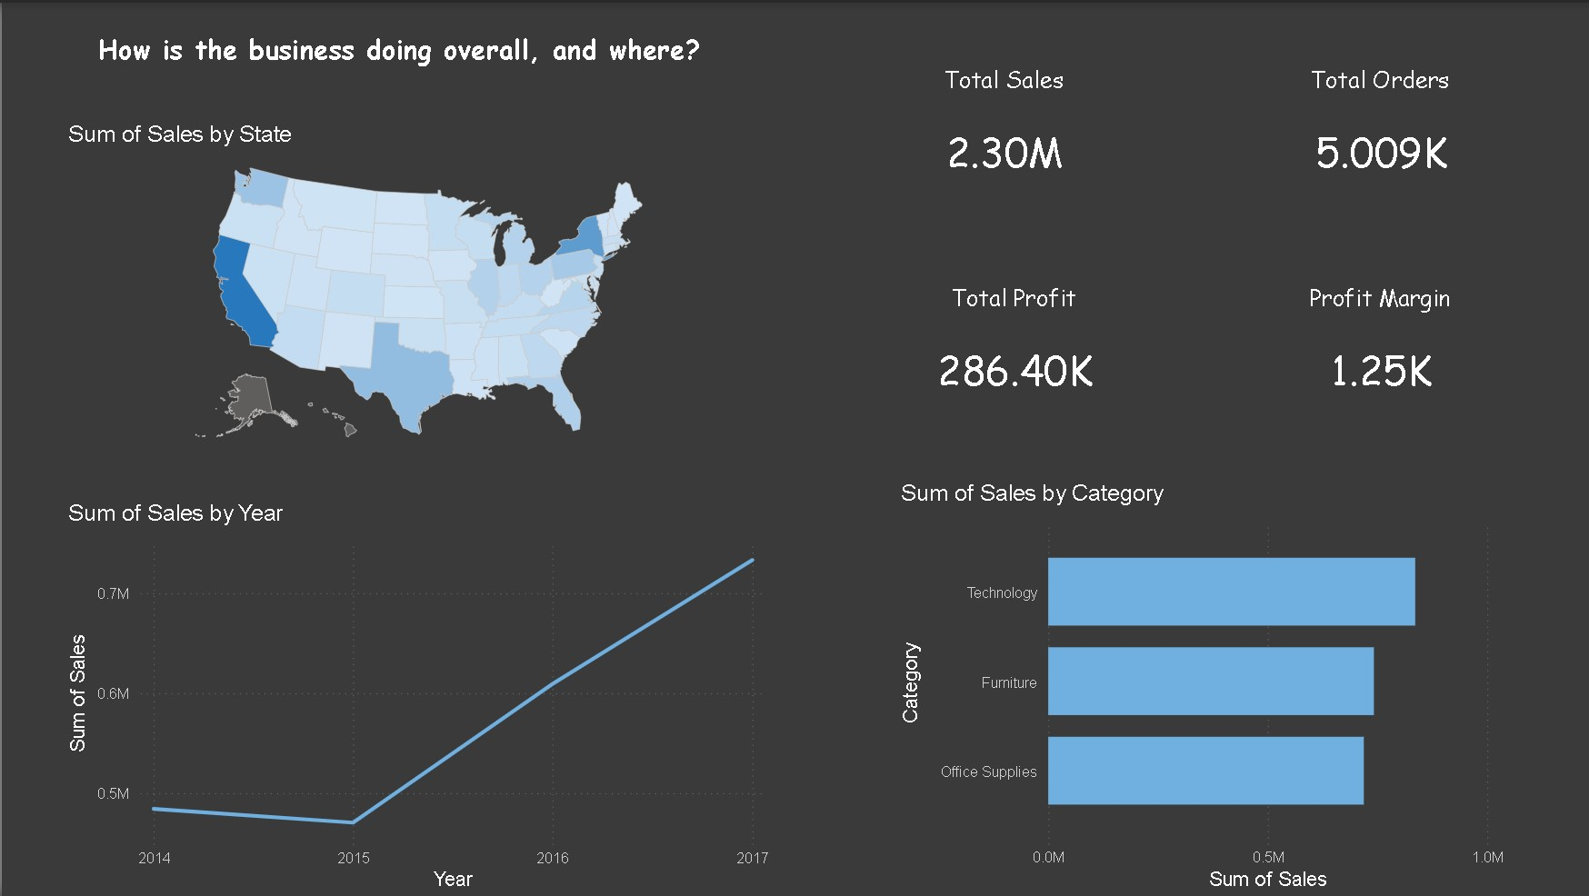
DASHBOARD PAGE 1
Overview — How Is the Business Doing?
Total sales, orders, profit and margin at a glance, with sales trend and category split.
Superstore Sales Analysis • 04
Sales climbed every year from 2014 to 2017, nearly doubling — Technology is the top revenue category.

Slide 5
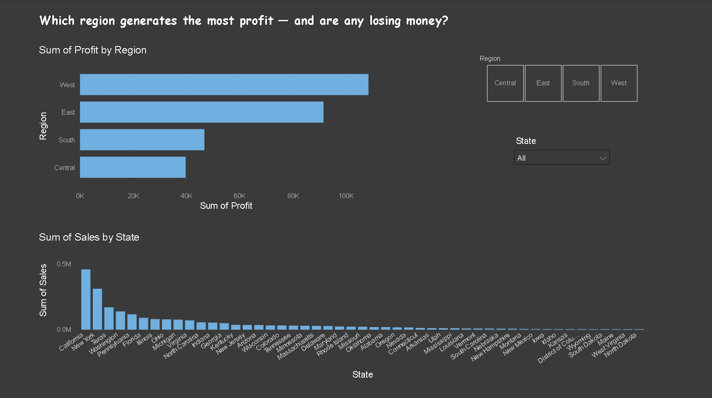
DASHBOARD PAGE 2
Geography — Where Is Profit Coming From?
Regional profit comparison plus state-level sales, with click-to-filter region buttons.
Superstore Sales Analysis • 05
West and East regions generate the bulk of profit; California and New York dominate state-level sales.

Slide 6
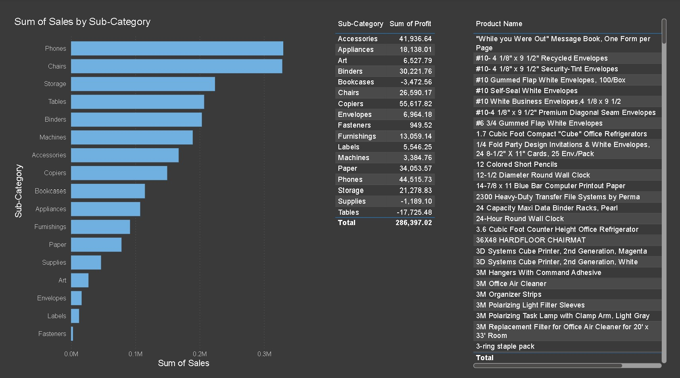
DASHBOARD PAGE 3
Product Performance — What's Selling, What's Earning
Sales by sub-category alongside a searchable profit table and full product list.
Superstore Sales Analysis • 06
Phones and Chairs lead sales, but Tables and Bookcases show negative total profit despite selling well.

Slide 7
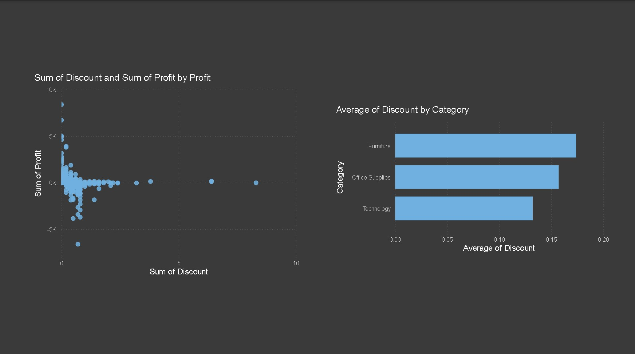
DASHBOARD PAGE 4
Discount Impact — Is Discounting Hurting Margin?
Discount vs profit scatter plot next to average discount rate by category.
Superstore Sales Analysis • 07
Profit drops toward zero (and negative) as discount rises — Furniture carries the highest average discount.

Slide 8
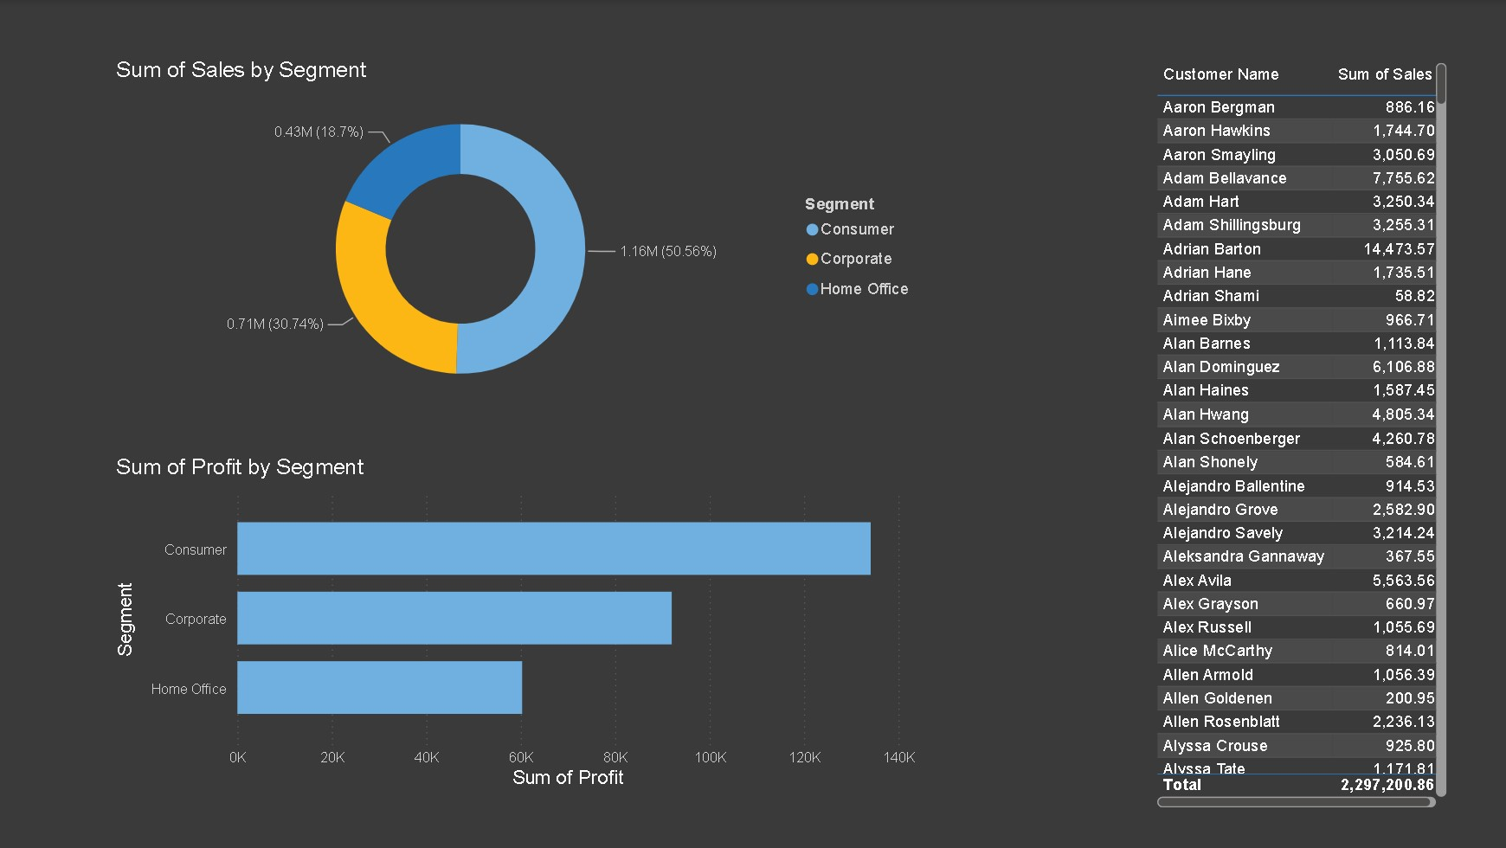
DASHBOARD PAGE 5
Customer View — Segment & Customer-Level Detail
Sales and profit by segment, with a searchable, sortable customer sales table.
Superstore Sales Analysis • 08
Consumer segment drives just over half of all sales, ahead of Corporate and Home Office.

Slide 9
WHAT THE DATA SHOWS
Key Insights
01
Discounts above ~20% erase profit entirely
The discount-vs-profit scatter shows profit clustering near zero or turning negative once discount rises past roughly 0.2, and Furniture — the category with the highest average discount (~0.17) — is also the most exposed to this effect.
02
Two sub-categories sell well but lose money
Tables (-$17.7K profit) and Bookcases (-$3.5K profit) both post meaningful sales volume yet finish in the red, while Copiers and Phones deliver strong profit relative to their sales — a profitability gap hidden by revenue alone.
03
Growth and geography are both concentrated
Sales nearly doubled from 2014 to 2017, but that growth — and profit overall — is concentrated in the West and East regions and in just two states, California and New York, which together dwarf the rest of the country.
Superstore Sales Analysis • 09

Slide 10
SO WHAT SHOULD CHANGE
Recommendations
1
2
Cap discounts on Furniture
Re-price or re-negotiate Tables & Bookcases
Set a discount ceiling (e.g. 15%) on Tables and Bookcases specifically, since these are the sub-categories most often sold at a loss.
Review supplier cost and list price for these two sub-categories before running any further promotions on them.
3
4
Double down on the West and East
Protect high-margin lines from blanket discounts
Prioritize marketing spend and inventory in the highest-profit regions and top states rather than spreading budget evenly nationwide.
Exclude Copiers and Phones from storewide discount campaigns, since they already convert sales into profit efficiently.
Superstore Sales Analysis • 10

Slide 11
REFLECTION
What I Learned & Struggled With
What I Learned
What I Struggled With
How to structure a multi-page Power BI dashboard around specific business questions rather than just charting everything available.
That discount and profit need to be viewed together — sales volume alone hides losing sub-categories.
How to use slicers and buttons (Region, State) to make a dashboard genuinely interactive rather than static.
The value of writing each page as a question (e.g. "Which region generates the most profit?") to keep the design focused.
Deciding which visuals belonged on which page without overcrowding a single dashboard view.
Getting the discount-vs-profit scatter plot to read clearly, since most points cluster tightly near zero discount.
Balancing detail (full customer/product tables) against readability for a quick executive glance.
Translating raw chart output into plain-English insights instead of just describing what each chart shows.
Superstore Sales Analysis • 11

