Slide 1
PITCH GA2
DANI 2
SVEN COLLINS, KLEST REBI,
JIAQI WANG & KYRA VAN SCHAIK

Slide 2
HYPOTHESIS
Windspeed has an inverse correlation with NO_x concentrations that is greater in Rotterdam than Heerlen.

Slide 3
HYPOTHESIS REFINEMENT
We chose to compare Rotterdam and Heerlen to look at the impact of the Port on the air quality in the cities and from our research we found that one of the major pollutants coming from ships was NO_x. Furthermore, we found the weather factor with the largest effect on NO_x was windspeed which also varies between Port and Portless cities.

Slide 4
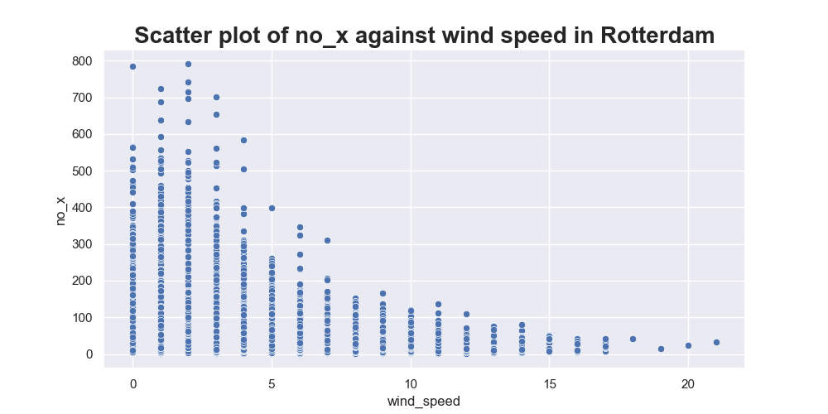
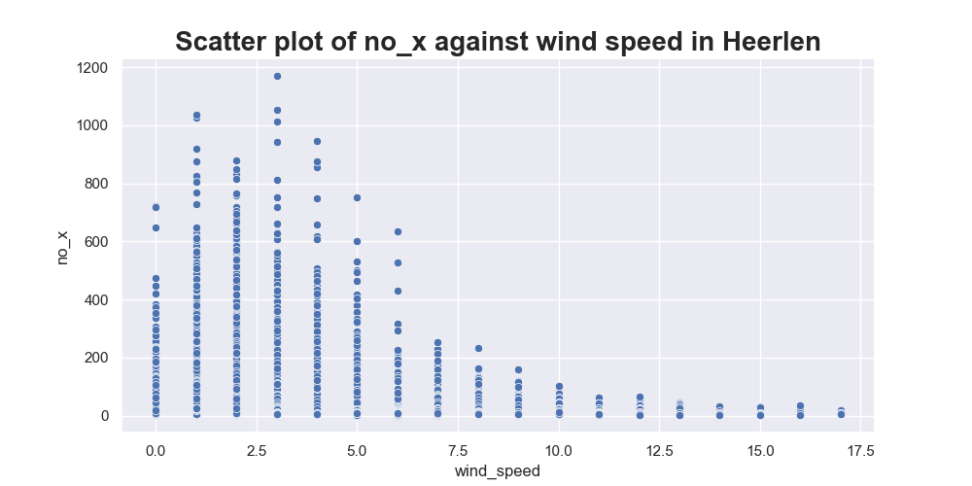
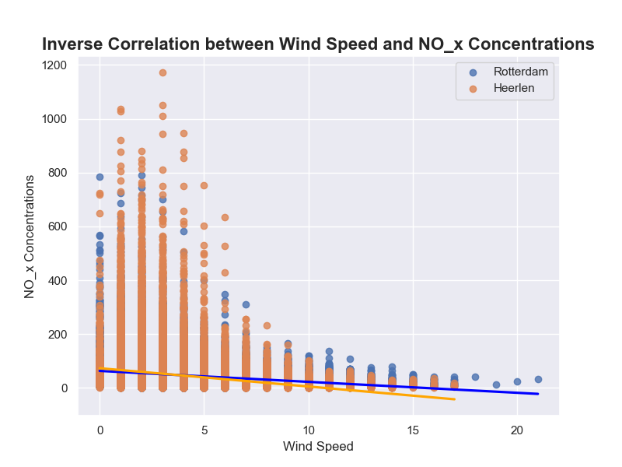
RESULTS
We could use more slides for this if necessary

Slide 5
CONCLUSION

