Slide 1

Guide to Network Defense and Countermeasures Third Edition
Chapter 3
Network Traffic Signatures

Slide 2
Objectives
Explain the Common Vulnerabilities and Exposures (CVE) standard
Describe the concepts of signature analysis
Detect normal and suspicious traffic signatures
Identify suspicious events

Slide 3
Examining the Common Vulnerabilities and Exposures Standard
To prevent attacks, make sure your security devices share information and coordinate with one another
Each device uses its own “language”
The way they interpret signatures might differ
Common Vulnerabilities and Exposures (CVE) standard
Enables devices to share information using the same standard

Slide 4
How the CVE Works
CVE enables hardware and security devices to draw from the same database of vulnerabilities
Benefits
Stronger security
Better performance
When purchasing an intrusion detection and prevention system (IDPS)
Make sure they support CVE

Slide 5
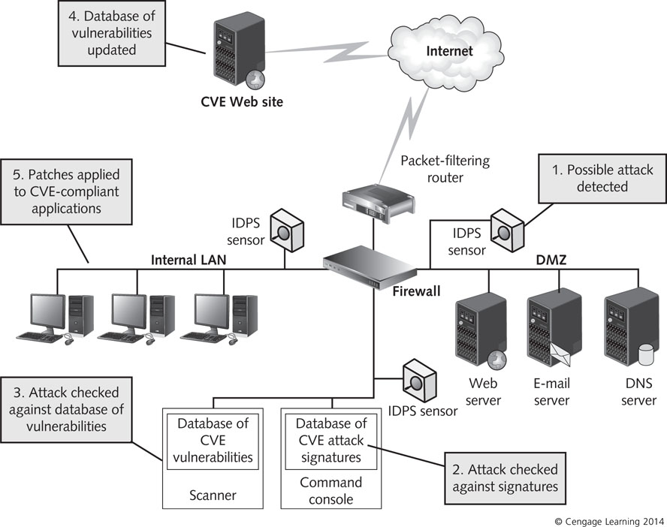
Figure 3-1 CVE enables multiple devices to work together to detect possible attacks

Slide 6
Scanning CVE Vulnerabilities Descriptions
View current CVE vulnerabilities online
List can be downloaded
The CVE list is not a vulnerability database that can be used to repair attacks on an IDPS
Information in a CVE reference
Name of the vulnerability
Short description
References to the event in other databases
Such as BUGTRAQ

Slide 7
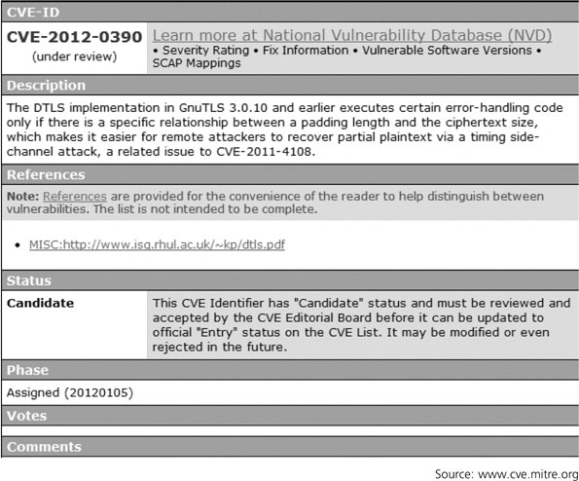
Figure 3-2 CVE candidate listing CVE-2012-0390

Slide 8
Understanding Signature Analysis
Signature – set of characteristics used to define a type of network activity
IP numbers and options, TCP flags, and port numbers are examples
Some intrusion-detection devices assemble databases of “normal” traffic signatures
Deviations from normal signatures trigger an alarm
Other devices refer to a database of well-known attack signatures
Traffic that matches stored signatures triggers an alarm

Slide 9
Understanding Signature Analysis
Signature analysis:
Practice of analyzing and understanding TCP/IP communications to determine whether they are legitimate or suspicious
Bad header information
Packets are often altered through header information
Suspicious signatures can include malformed
Source and destination IP address
Source and destination port number
IP options, protocol and checksums
IP fragmentation flags, offset, or identification

Slide 10
Understanding Signature Analysis
Bad header information
Checksum
Simple error-checking procedure
Determines whether a message has been damaged or tampered with while in transit
Uses a mathematical formula
Suspicious data payload
Payload
Actual data sent from an application on one computer to an application on another
Some IDPSs check for specific strings in the payload

Slide 11
Understanding Signature Analysis
Suspicious data payload (cont’d)
Remote-access Trojans (RATs):open back doors that give the remote attacker administrative rights
Unix Sendmail program is exploited by adding codes to packet contents
Single-Packet Attacks
Also called “atomic attacks”
Completed by sending a single network packet from client to host
Does not need a connection to be established
Changes to IP option settings can cause a server to freeze up

Slide 12
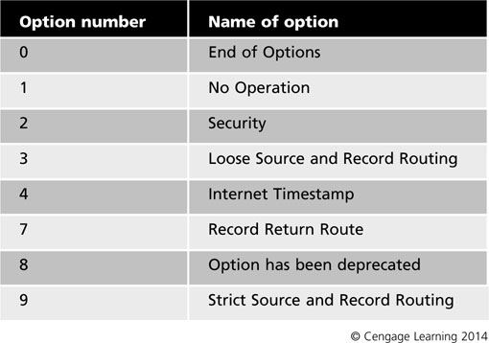
Table 3-1 IP options settings

Slide 13
Understanding Signature Analysis
Multiple-Packet Attacks
Also called “composite attacks”
Require a series of packets to be received and executed for the attack to be completed
Especially difficult to detect
Denial-of-service (DoS) attacks are obvious examples
ICMP flood: a type of DoS attack that occurs when multiple ICMP packets are sent to a single host on a network
Server becomes so busy responding to ICMP requests that it cannot process other traffic

Slide 14
Analyzing Packets
Packet sniffer
Captures information about each TCP/IP packet it detects
Capturing packets and studying them can help you better understand what makes up a signature
Example:
Wireshark
Be familiar with elements of TCP/IP packets discussed on pages 86-88 of textbook

Slide 15
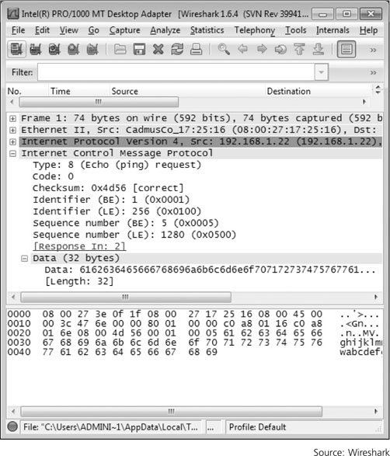
Figure 3-3 An ICMP echo request packet capture

Slide 16
Analyzing Traffic Signatures
Need to detect whether traffic is normal or suspicious
Network baselining
Process of determining what is normal for your network before you can identify anomalies

Slide 17
Examining Normal Network Traffic Signatures
Important TCP flags
SYN (0x2) – synchronize flag is sent when a connection is initiated
ACK (0x10) – acknowledgement flag is set to signal that the previous packet was received
PSH (0x8) – push flag indicates that immediate delivery is required
URG (0x20) – urgent flag is used when urgent data is being sent
RST (0x4) – reset flag is sent when one computer wants to stop and restart the connection in response to a problem

Slide 18
Examining Normal Network Traffic Signatures
Important TCP flags (cont’d)
FIN (0x1) – finished flag lets one computer know that the other is finished sending data
Placement and use of these flags are definite
Deviations from normal use mean that the communication is suspicious

Slide 19
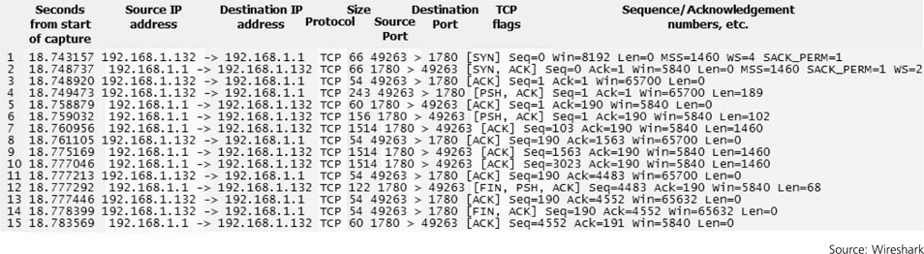
Figure 3-6 TShark capture of a TCP stream

Slide 20
Examining Normal Network Traffic Signatures
FTP Signatures
Organizations that operate a public FTP server should regularly review the signatures of packets that attempt to access that server
Normal connection signature includes a three-way handshake
The sequence of packets is shown in the next slides

Slide 21
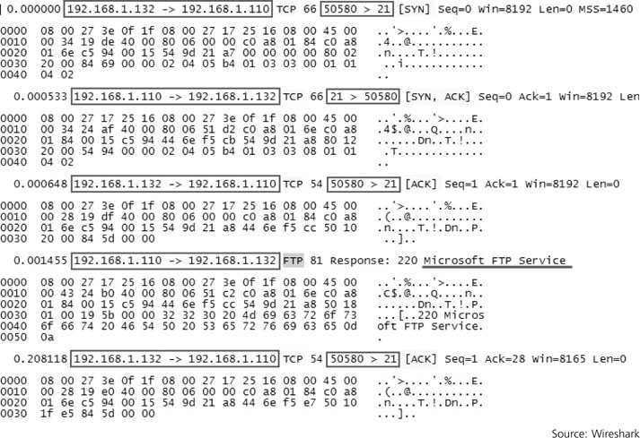
Figure 3-7 The beginning of an FTP session

Slide 22
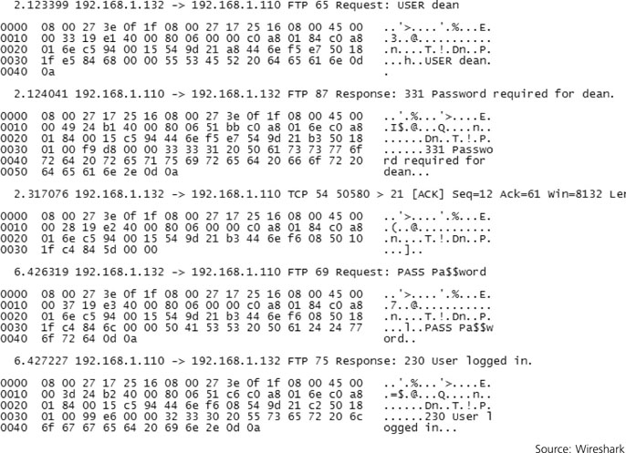
Figure 3-8 Continuation of an FTP session

Slide 23
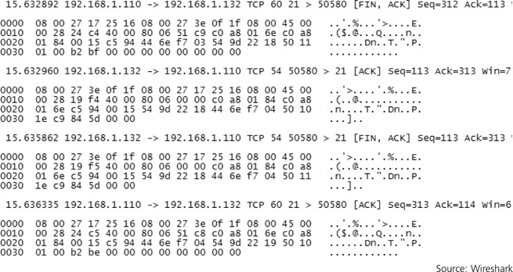
Figure 3-9 The teardown of an FTP data connection

Slide 24
Examining Normal Network Traffic Signatures
Web Signatures
Most of the signatures in log files are Web related
When a signature is Web-related:
It consists of packets sent back and forth from a Web browser to a Web server as a connection is made
Normal communication consists of a sequence of packets distinguished by their TCP flags

Slide 25
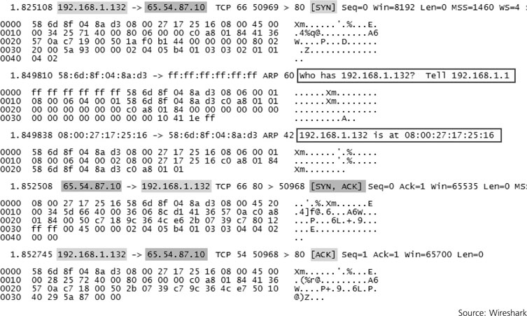
Figure 3-10 A normal exchange of packets between a Web browser and a Web server

Slide 26
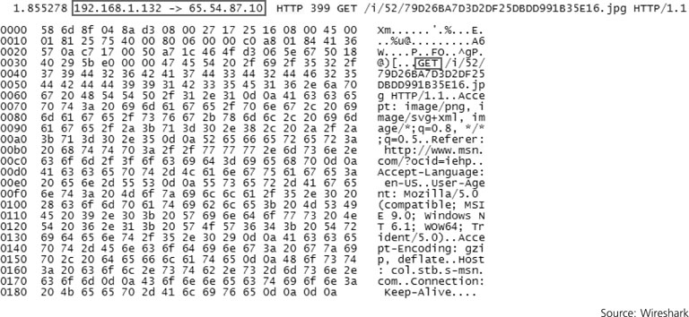
Examining Normal Network Traffic Signatures
Web Signatures (cont’d)
Once the handshake is complete:
Web browser sends a request to the Web server for Web page data (called an HTTP GET packet)
Figure 3-11 An HTTP GET packet

Slide 27
Examining Abnormal Network Traffic Signatures
Categories
Informational
Traffic might not be malicious but could be used to verify whether an attack has been successful
Reconnaissance
Attacker’s attempt to gain information
Unauthorized access
Traffic caused by someone who has gained unauthorized access
Denial of service
Traffic might be part of an attempt to slow or halt all connections on a network device

Slide 28
Examining Abnormal Network Traffic Signatures
Ping Sweeps
Also called an ICMP sweep
Used by attackers to determine the location of a host
Attacker sends a series of ICMP echo request packets in a range of IP addresses
Ping sweep alone does not cause harm
IP address used in the ping sweep should be noted in order to track further activity
AN IDPS could be configured to transmit an alarm and block transmissions if this IP address attempts to connect to a specific host on a network

Slide 29
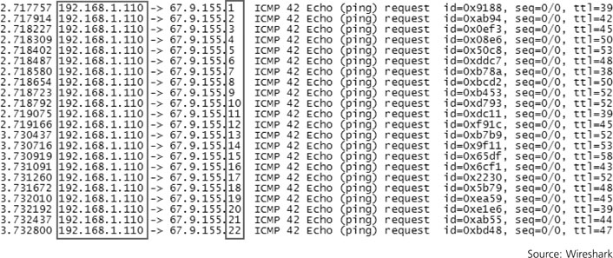
Figure 3-12 An automated ping sweep

Slide 30
Examining Abnormal Network Traffic Signatures
Port Scans
Attempt to connect to a computer’s ports to see whether any are active and listening
An attacker who finds an open port can exploit any known vulnerabilities associated with any service that runs on that port
Signature of a port scan typically includes a SYN packet sent to each port on an IP address

Slide 31
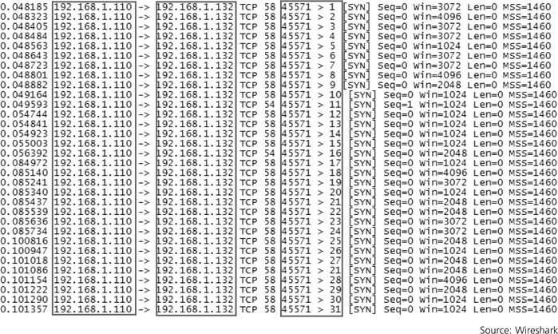
Figure 3-13 An automated port scan

Slide 32
Examining Abnormal Network Traffic Signatures
Random Back Door Scans
Back door – an undocumented or unauthorized hidden opening (such as a port) through which an attacker can access a computer, program, or other resource
Probes a computer to see if any ports are open and listening that are used by well-known Trojan programs
Trojan programs
Applications that seem to be harmless but can cause harm to a computer or its files

Slide 33
Examining Abnormal Network Traffic Signatures
Specific Trojan Scans
Vanilla scan – all ports from 0 to 65,535 are probed one after another
Strobe scan – scans only ports that are commonly used by specific programs
A common type of strobe scan searches IP addresses for the presence of a specific Trojan program
If a Trojan program has already operating, attackers save themselves the time of installing an new Trojan program

Slide 34
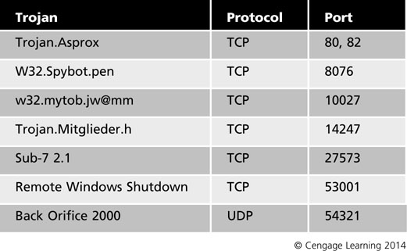
Table 3-2 Examples of Trojan programs and ports

Slide 35
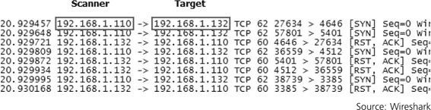
Figure 3-14 A scan of a single host for existing Trojans

Slide 36
Examining Abnormal Network Traffic Signatures
Nmap Scans
Network mapper (Nmap)
Popular software tool for scanning networks
Examples of Nmap scans
SYN scan – a progression of packets with only the SYN flag set
FIN scan –only packets with the FIN flag set
ACK scan –only packets with the ACK flag set
Null scan – sequence of packets that have no flags set
Xmas scan – sequence of packets that have the FIN PSH URG flags set

Slide 37
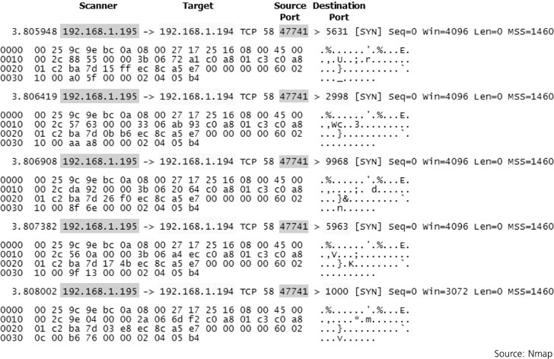
Figure 3-15 Nmap SYN scan

Slide 38
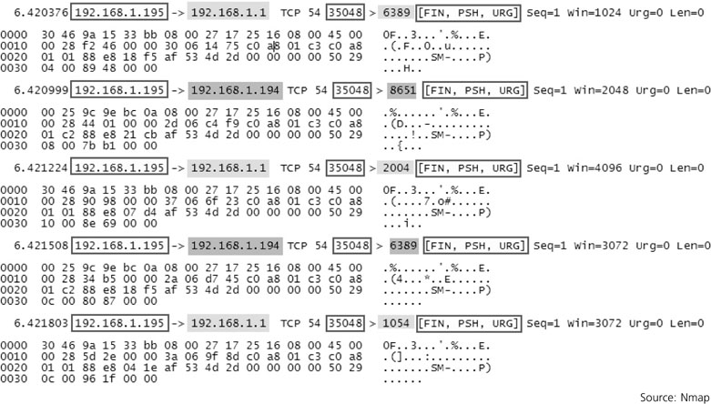
Figure 3-16 Nmap Xmas scan

Slide 39
Identifying Suspicious Events
Attackers often avoid launching well-known attacks
Use waiting intervals to fool detection systems
Scan throttling – often used by attackers to delay the progression of a scan over hours, days, or weeks
Reviewing log files manually can be overwhelming
Must check them and identify potential attacks
An IDPS can help you with this task
IDPSs depend on extensive databases of attack signatures

Slide 40
Packet Header Discrepancies
Falsified IP address
Attacker can insert a false address into the IP header
Make the packet more difficult to trace back
Also known as IP spoofing
A land attack is an example
Occurs when a detected IP packet the same source and destination IP address
Localhost source spoof is another example
If source address of 127.0.0.1 occurs in a packet
Falsified port number or protocol
Protocol numbers can also be altered
Port numbers should never be set to 0

Slide 41
Packet Header Discrepancies
Illegal TCP flags
Look at the TCP flags for violations of normal usage
Examples of SYN and FIN flags misuse
SYN/FIN flags should not exist in normal traffic
SYN/FIN/PSH,SYN/FIN/RST,SYN/FIN/RST/PSH
Use is sometimes called an Xmas attack
Packets should never contain a FIN flag by itself
A SYN-only packet should not contain any data

Slide 42
Packet Header Discrepancies
TCP or IP options
TCP options can alert you of an attack
Only one MSS or window option should appear in a packet
MSS, NOP, and SackOK should appear only in packets that have the SYN and/or ACK flag set
IP options
Originally intended as ways to insert special handling instructions into packets
Attackers mostly use IP options now for attack attempts
IPv6 removed options field and replaced it with extension headers

Slide 43
Packet Header Discrepancies
Fragmentation abuses
Maximum transmit unit (MTU)
Maximum packet size that can be transmitted over a network
Packets larger than the MTU must be fragmented
Broken into multiple segments small enough for the network to handle
An IDPS should be configured to send an alarm if it encounters a large number of fragmented packets

Slide 44
Packet Header Discrepancies
Fragmentation abuses (cont’d)
IPv4
Overlapping fragments – two fragments of the same packet have the same position within the packet
Fragments that are too large – IP packet can be no larger than 65,535 bytes
Fragments overwrite data – early fragments are transmitted along with random data and later fragments overwrite the random data
Fragments are too small – if any fragment (other than the final fragment) is less than 400 bytes, it has probably been crafted intentionally

Slide 45
Packet Header Discrepancies
Fragmentation abuses (cont’d)
IPv6
Fragments with a destination address of a network device – if a router, firewall, or other device is the destination of fragmented IPv6 packets, a DoS attack might be intended
Fragments are too small - if any fragment (other than the final fragment) is less than 1280 bytes, it has probably been crafted intentionally
Fragments that arrive too slowly – fragments that take more than 60 seconds to deliver should be dropped

Slide 46
Advanced Attacks
Advanced IDPS evasion techniques
Polymorphic buffer overflow attack
Uses a tool called ADMutate
Alters an attack’s shell code to differ from the known signature many IDPSs use
Once packets reach the target, they reassemble into original form
Path obfuscation
Directory path in payload is obfuscated by using multiple forward slashes

Slide 47
Advanced Attacks
Advanced IDPS evasion techniques (cont’d)
Common Gateway Interface (CGI) scripts
Scripts used to process data submitted over the Internet
Examples
Count.cgi
FormMail
AnyForm
Php.cgi
TextCounter
GuestBook

Slide 48
Advanced Attacks
Advanced IDPS evasion techniques (cont’d)
Packet injection
Attackers can craft packets that comply with protocols that can be inserted into network traffic
Tools such as Nemesis are supposed to be useful for testing IDPSs and firewalls
Can be used to disrupt communications, spoof a variety of systems, and carry out a number of attacks

Slide 49
Remote Procedure Calls
Remote Procedure Call (RPC)
Standard set of communication rules
Allows one computer to request a service from another computer on a network
Portmapper
Maintains a record of each remotely accessible program and the port it uses
Converts RPC program numbers into TCP/IP port numbers

Slide 50
Remote Procedure Calls
RPC-related events that should trigger IDPS alarms:
RPC dump
Targeted host receives an RPC dump request
RPC set spoof
Targeted host receives an RPC set request from a source IP address of 127.0.0.1
RPC NFS sweep
Targeted host receives series of requests for the Network File System (NFS) on different ports

Slide 51
Summary
Common Vulnerabilities and Exposures (CVE)
Enables security devices to share attack signatures and information about network vulnerabilities
Interpreting network traffic signatures can help prevent network intrusions
Analysis of traffic signatures is an integral aspect of intrusion prevention
Possible intrusions are marked by invalid settings
TCP flags are used in sequence to create a normal three-way handshake between two computers

Slide 52
Summary
Learn what normal traffic signatures look like
Help identify signatures of suspicious connection attempts
Suspicious network events
“Orphaned” packets
Land attacks
Localhost source spoof
Falsified protocol numbers
Illegal combinations of TCP flags

Slide 53
Summary
Advanced attacks
Difficult to detect without a database of intrusion signatures or user behaviors
Advanced attack methods include
Exploiting CGI vulnerabilities
Misusing Remote Procedure Calls

