Slide 1
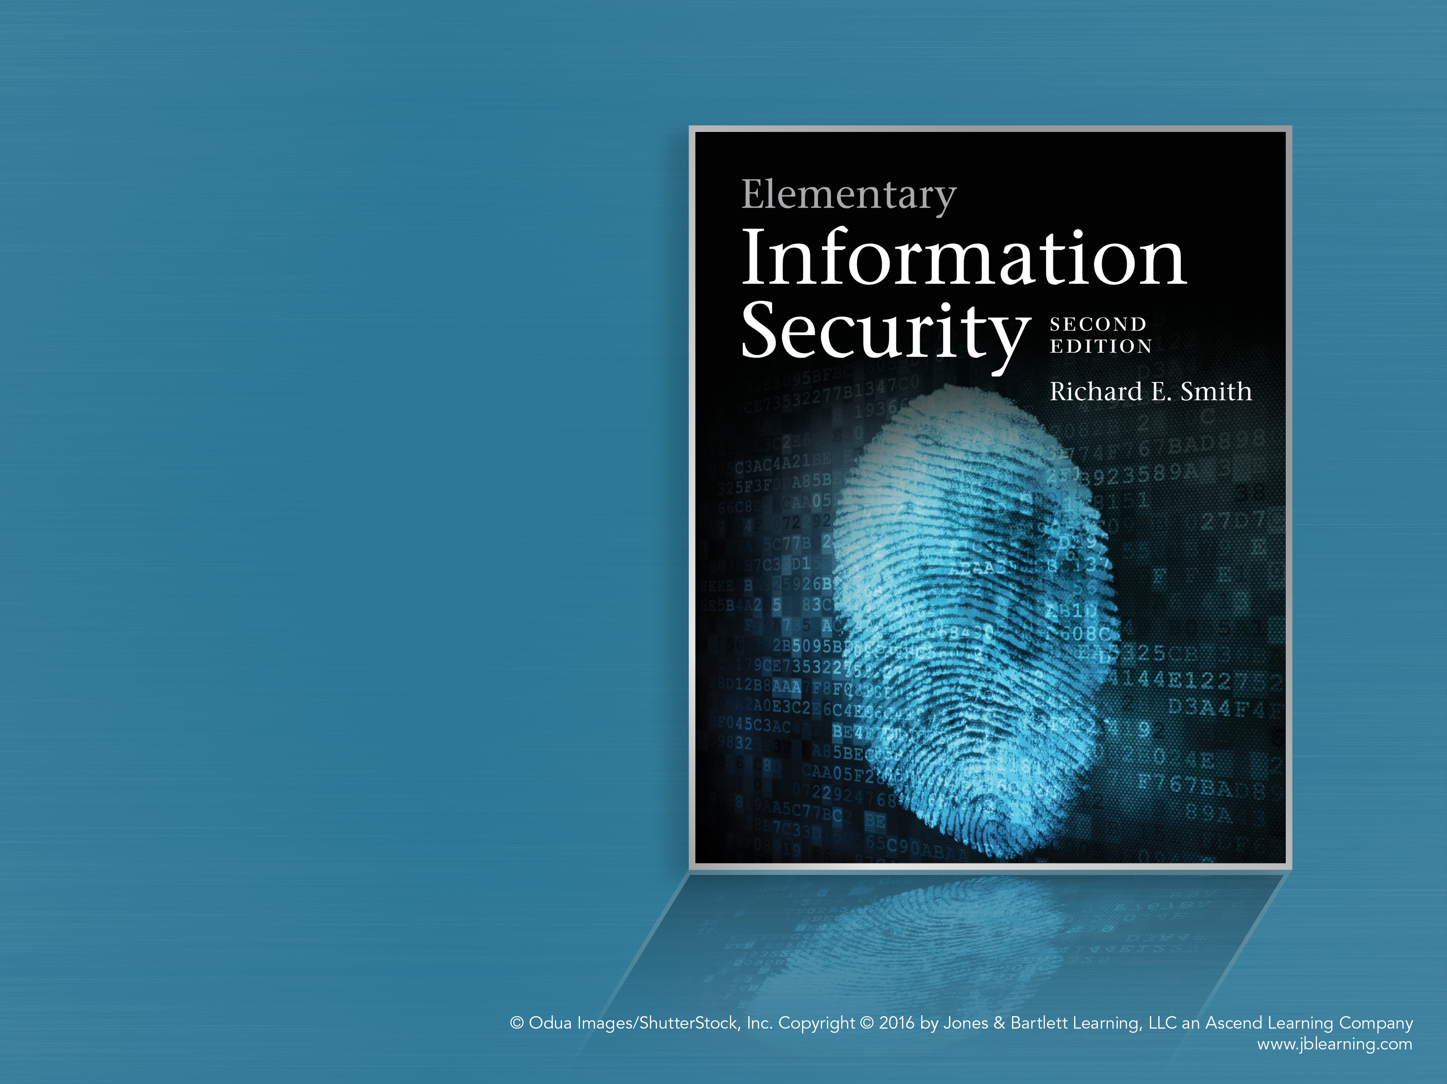
Chapter 1
Security From the Ground Up

Slide 2
Chapter Overview
Making Security Decisions
Risk Management Framework
  Example: Alice’s Arts
Assets and Threat Agents
Identifying Risks
Prioritizing Risks
Security Requirements and Policy
Monitoring Security
Ethical Issues

Slide 3
Making security decisions
Do you always lock:
  A car door
  A room door
  A house door
If not always, what decides?
  Rule-based decisions
    Example: we follow someone else’s rule
  Relativistic decisions
  Requirements-based decisions

Slide 4
Decision Making Strategies
Relativistic
  My friend does it, so I do, too.
  My neighbor has a fence and locks his front door. Me, too.
  We all use super-strong Kryptonite bike locks
    “Security Theater”, hunters’ dilemma
Requirements-based
  We look at the risks and choose security measures accordingly
  Reassess risks as part of the “life cycle” of the asset

Slide 5
Decision making in a life cycle
Identify your practical goals
  What “real” things do you want to accomplish?
Choose the security that fits
  What weaknesses exist?
  What security measures might work?
  What are the trade-offs against goals?
Measure success
  Monitor for attacks or other failures
  Recover from problems

Slide 6
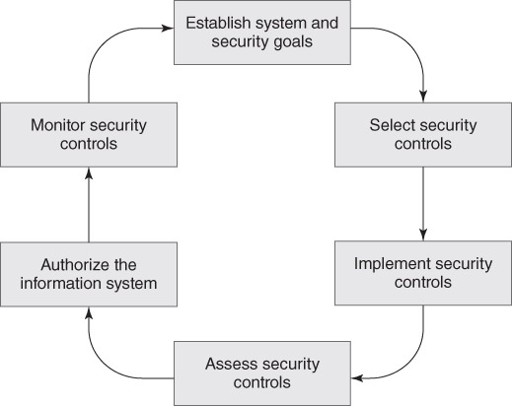
Risk Management Framework (RMF)
Notes:
1. Categorize the information system: identify its goals, security risks, and requirements
2. Select security controls: identify existing controls and additional ones required
3. Implement security controls: construct the system containing the controls
4. Assess security controls: verify that the controls work as required
5. Authorize the information system: approve the system for operation and deploy it
6. Monitor security controls: watch for security incidents and address them; also review
the environment for changes that affect security

Slide 7
RMF Risk Assessment
Rule-based
  US Federal standards and guidelines
Identify the RMF category
  Estimates the impact of cybersecurity failures
Impact in terms of CIA Properties
    Confidentiality, Integrity, Availability
Assess each in terms of impact:
  Not applicable, Low, Moderate, High
  Low = noticeable impact
  High = Major Damage

Slide 8
Example RMF categorizations
Web site to publish product information
  Confidentiality – not applicable
  Integrity – Low
  Availability – Low
Web site for online sales
  Confidentiality – Moderate
  Integrity – Moderate
  Availability – Moderate
Notes:
Amawig’s goal is to sell widgets. We assess two Amawig web sites.
The first web site contains nothing but public information
1. Confidentiality: Not applicable, since all information is public.
2. Integrity: Low, since a site outage will not prevent customer sales.
3. Availability: Also low, since a site outage doesn’t prevent customer sales.
The second web site
1. Confi dentiality: Moderate, since the website handles some electronic payment
information from customers.
2. Integrity: Moderate, since the website handles some electronic payment information
from customers, it specifi es product prices, and it directs product shipments.
3. Availability: Moderate, since an interruption would visibly affect sales, but would
not cause long-term damage to the company.

Slide 9
RMF uses rules to assign controls
Published rules recommend controls
  NIST Special Publication 800-53
  Add controls as impact increases
What about smaller environments?
Smaller impacts yield greater effects
  Large businesses absorb ‘noticeable’ events
  One such event could ruin a small company
RMF rules aren’t geared for smaller enterprises

Slide 10
Do all enterprises do all RMF steps?
Categorize – NO – smaller ones do it differently
  Identify risks, threats, and requirements
Select Controls – YES, but a small enterprise…
  Combines with the Implement step
Implement Controls – see above
Assess Controls – YES
  Determine if the controls really work
Authorize System – NO, not in small enterprises
Monitor Controls - YES

Slide 11
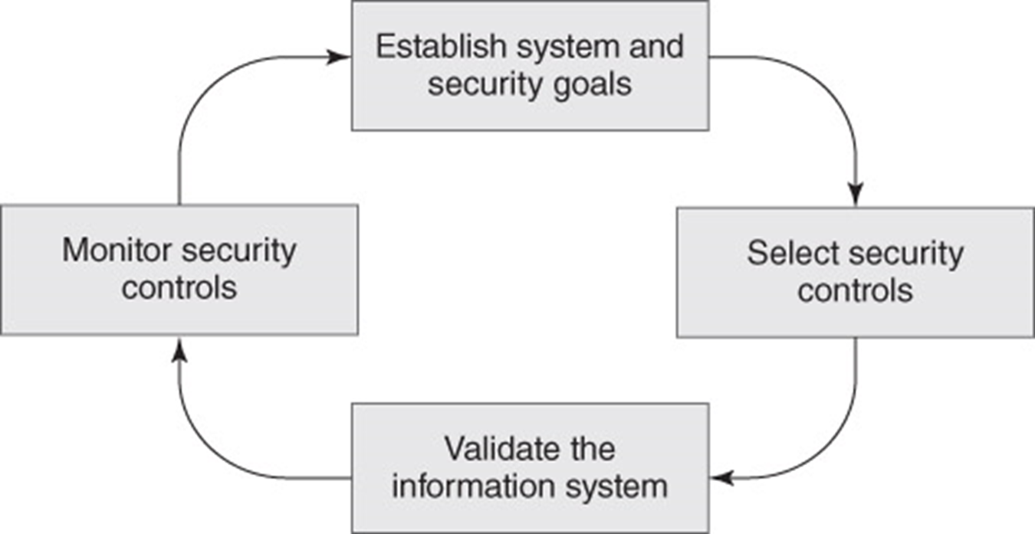
Proprietor’s RMF
Shorter, requirements-based assessment
Notes:
A. Establish system and security goals: identify the system’s goals, security risks,
and requirements. We perform a risk assessment and use it to produce a list of
security requirements.
B. Select security controls: identify existing controls and additional ones
required, and construct the system containing the controls. We use the security
requirements to identify the controls we require.
C. Validate the information system: verify that the controls work as required,
approve the system for operation, and deploy it. We test the system’s controls
against the security requirements to ensure that we address our risks.
D. Monitor security controls: watch for security incidents and address them; also
review the environment for changes that affect security. The system must contain
security controls that keep records of security-relevant operations and incidents

Slide 12
PRMF Risk Assessment
A more elaborate process
  Addresses the special cases of smaller enterprises and nongovernment organizations
PRMF Step A performs the assessment
Three major parts
  Identify Risks: assets, threat agents, attacks
  Prioritize risks: estimate relative impacts
  Establish requirements: identify security goals to address the highest-priority risks

Slide 13
Risk Assessment Detailed Steps
Identifying risks
  Step 1: Identify assets
  Step 2: Identify threat agents and attacks
Prioritizing risks
  Step 3: estimate the likelihood of attacks
  Step 4: estimate the impact of attacks
  Step 5: Calculate their relative significance
Establish requirements
  Step 6: Write requirements to address the highest-priority risks

Slide 14
Textbook Basic Principles
Basic Principles of Information Security
  Capitalized phrases in the book
  Illustrate general rules often followed by secure systems
Continuous Improvement – a basic principle
  We identify our basic goals
  We measure our success
  We adjust our work to better achieve our goals

Slide 15
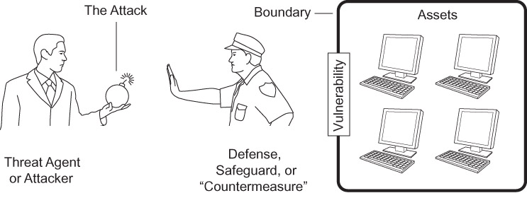
Assets and Risk Assessment

Slide 16
Terminology
Assets are protected by a boundary
Openings in the boundary are vulnerabilities
A threat agent or attacker tries to attack assets
A defense, safeguard, or countermeasure protects the assets
An attacked system that is unsafe to use is a Compromised system
A compromised systems on a network, all controlled by a single attacker is a Botnet

Slide 17
Assets: What Are We Protecting?
Identifying Goals
  What do we do that requires our computer?
  Focus on general, non-computing goals
    Making money, operating a store, etc.
    These lead to goals
      “I need to sell products to customers”
Identifying Assets
  What computer assets support these goals?
  Those are the important assets

Slide 18
Example: Alice’s Arts
A small retail store
Alice is the sole proprietor
Uses a laptop
  Track expenses, pay bills
  Manage bank account
  Order merchandise
  Advertising and social media
Point of Sale (POS) terminal
  Record sales

Slide 19
Alice’s Arts: Goals and Assets
Alice’s Goals: stay in business and offer appealing merchandise to customers
Alice’s Assets:
  Computer Hardware: laptop, POS, printer
  Purchased Software: OS install disk, office software, etc.
  Personal arrangement of files and contents
  Spreadsheets to track business
  Online accounts: banks, merchandise
  Social media accounts

Slide 20
Security Architecture and Boundaries
Room security = walls + doorways
How do we assess a boundary?
  Can a threat agent breach a wall?
  How do we control doorways?
  How can a threat agent pass through a doorway?
  How much do we trust those inside the boundary (i.e. the insider threat)

Slide 21
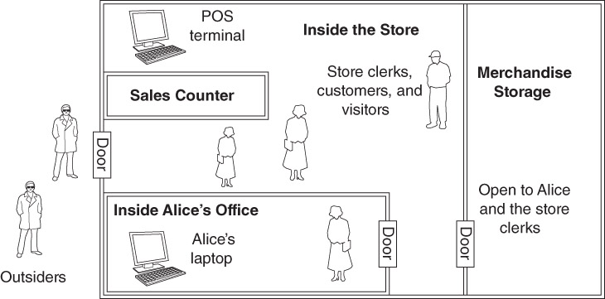
Least Privilege: A Basic Principle
Restrict what people may do to an asset
Provide the minimum privileges required
Example: key opens my store but not yours

Slide 22
Defense in Depth: Another Principle
We improve security by providing layers of defense
  Attackers must breach a series of defenses to reach our most valuable assets
Example: stealing Alice’s laptop off-hours
  Layer 1: Thief must first enter the outer door
    The door is locked when store is closed
  Layer 2: Thief must enter the office area
    Only Alice can unlock the office
Notes:
Defense in depth provides layers of separate defenses to protect important assets.
Alice often leaves her laptop in her office, and keeps the office locked.
When the store is closed, a thief must break through two door locks to get to her laptop.
There are many examples of layered defenses in commercial spaces and in academic institutions.

Slide 23
Threat Agents
Think about the people who actually perform attacks
We can use published information to produce written profiles of specific groups that represent threat agents
Spring 2015
Rick Smith - MSSE Program

Slide 24
Examples of specific threat agents
Cyber-criminals: Kevin Mitnick, Jerry Schneider
Criminal organizations
  Forums used in cyber crime activities
  Groups operating identified botnets
  Vendors of software used in cyber crime
Independent pressure groups
  Anonymous, Lulzsec
National Actors
Spring 2015
Rick Smith - MSSE Program

Slide 25
National actors
  Government intelligence agencies
    NSA
    GCHQ
    Other politically active countries
  Military cyber operations groups
  Quasi-governmental: Syrian Electronic Army

Slide 26
Profiling a Threat Agent
Goals
Typical mode of operation (MO)
Level of motivation
Capabilities and logistical constraints
References – reputable sources for the information
Spring 2015

Slide 27
Threat Agents – Typical Goals
  News coverage
  Financial gain
  Ideological victory
  Regime change?

Slide 28
Typical mode of operation (MO)
  How targets are selected
  How operations are organized
  Preference for broadly targeted attacks, or specific targets
  Individual versus multiple coordinated attacks
  Remote attacks, on-site attacks, insider attacks, social engineering

Slide 29
Level of Motivation
Unmotivated
Scant – will exploit minor vulnerabilities
Stealth – applies effort, but avoids social stigma
Low – causes harm and limited damage to assets
Moderate – cause significant damage to assets or some injury to persons, but not critical injury
High – will cause significant disruptions and/or critical injuries to people to achieve objectives
Spring 2015
Rick Smith - MSSE Program

Slide 30
Capabilities and logistical constraints
Size of team, financial resources, geographical limitations
Does their training or skills affect their target choices?
Are their activities simple in structure or complicated?

Slide 31
Attacks and Risks
A vulnerability makes an attack possible
A threat agent implements an attack
In an attack, the threat agent takes actions that could damage one of your assets
  Exploiting a vulnerability
A risk is an attack that is likely to happen, and thus is worth protecting against

Slide 32
Types of Attacks
All attacks fall into these categories
Physical theft – an availability attack
Denial of Service – availability again
Subversion – modify a system to work for the threat agent
Masquerade – system works on behalf of the wrong user
Disclosure – an attack on confidentiality
Forgery – bogus messages given to computers

Slide 33
Terminology: “CIA” Properties
Confidentiality
  Keeping information secret
  Avoiding disclosure vulnerabilities
Integrity
  Protecting information from improper changes
  Avoiding forgery, subversion, and masquerade attacks
Availability
  Keeping systems available and in operation
  Avoiding Denial of Service (DOS) attacks

Slide 34
Identifying and Prioritizing Risks
Identifying risks
  Step 1: Identify assets
  Step 2: Identify threat agents and attacks
Prioritizing risks
  Step 3: estimate the likelihood of attacks
  Step 4: estimate the impact of attacks
  Step 5: Calculate their relative significance

Slide 35
Alice’s Arts: Step 1
Alice’s Goals: stay in business and offer appealing merchandise to customers
Alice’s Assets:
  Computer hardware and software
  Software recovery disks
  Computer customization
  Spreadsheets
  Online business and credentials
  Social media and credentials

Slide 36
Step 2: Identify Threats and Attacks
Identify Threat Agents
  Use assets and known attacks to guide you
Create an attack matrix (optional)
  Uses generic attack types to help identify more specific attacks the agents might perform
Create a risk matrix
  Lists likely attacks against specific assets

Slide 37
Threat Agents
Shoplifters
Malicious employees
Thieves
  Could steal computer assets or storage
Identity thieves
  Could steal or disrupt online accounts
Botnet operators

Slide 38
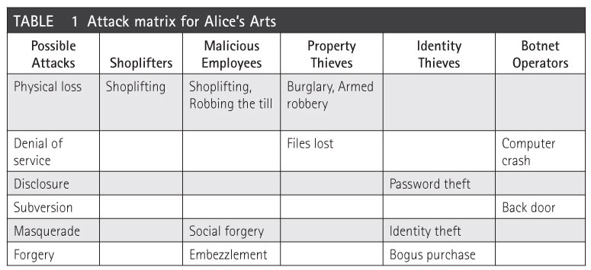
Attack Matrix

Slide 39
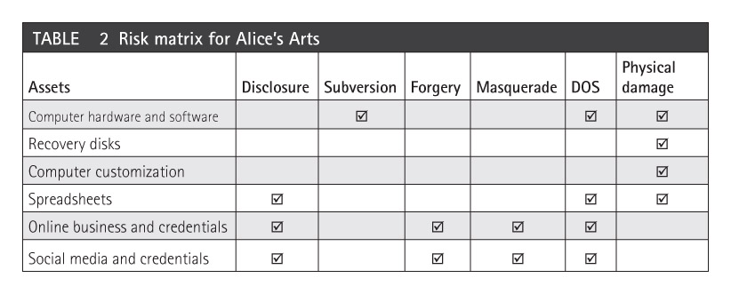
Risk Matrix

Slide 40
Identified Risks
1. Physical damage to computer hardware and software
2. Physical damage to recovery disks
3. Physical damage to computer customization
4. Physical damage to spreadsheets
5. Denial of service for online business and credentials
6. Denial of service for social media and credentials
7. Subversion of computer hardware and software
8. Denial of service by computer hardware and software
9. Disclosure of spreadsheets
10. Identity theft of online business and credentials
11. Identity theft of social media and credentials

Slide 41
Step 3: Estimate Attack Likelihoods
List threat agents and attacks in a spreadsheet
Select a time period – days, months, or years
Estimate how often each attacker is likely to perform each attack
  Do practical jokes always and only happen on April Fools Day?
  How long can an unprotected laptop sit in an empty classroom till an identified threat steals it?
  Will a particular threat steal, or damage, or…?

Slide 42
Step 4: Estimate Impact of An Attack
One attack takes place – how much does it cost Alice to recover from it?
  Replacement costs, labor costs
  Time or money spent on alternatives
  Cost of lost opportunities
  Whatever other “costs” arise
Make a numerical estimate
  Use consistent estimates
    Either “how much money”
    Or “how much time”

Slide 43
Time and Money Estimates
Time Estimates
  Time required to redo lost work, repeat a class
Money Estimates
  Money required to buy replacements
Make all estimates either in Time or Money
  Converting Time to Money
    Calculate lost income
  Convert Money to Time
    Calculate time required to save the money

Slide 44
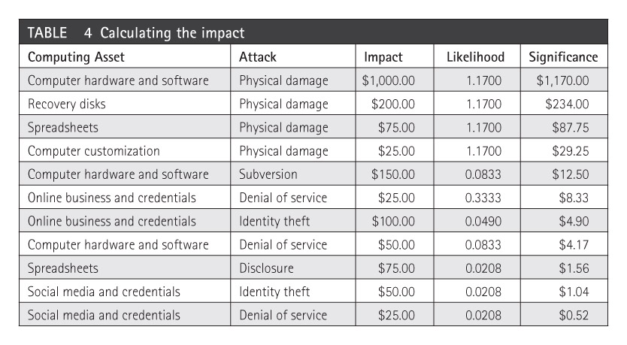
Step 5: Calculate Impacts over Time

Slide 45
Calculating the Impacts
Each row lists a threat agent and attack
  For each, we estimated how often it occurred
  For each, we estimated the impact of a single attack
Now, we compute the overall impact of each attack – we multiply it by its likelihood
Once we calculate all impacts, we sort the list by impact, with highest impact first
Our principal risks have the highest impacts

Slide 46
Alice’s final list of risks
Physical damage of computer hardware or software
Denial of service by hardware or software
Identity theft of online business credentials
Identity theft of social media credentials
Denial of service by social media

Slide 47
Drafting Security Requirements
The last part of PRMF Step A
Requirements say what we want for protection
Writing Requirements
  Take the prioritized list of risks
  For each risk, identify defenses against it
    Write a requirement for each defense
    Each requirement defends against 1 or more risks

Slide 48
Writing a Requirement
Number each requirement
Use the word shall
Each requirement should be testable
Each statement identifies the risks it addresses
Phrase the requirement in a positive and specific form

Slide 49
Constructing the List
We derive the policy from the risks
  Identify how each risk might occur
  Choose a general strategy to protect against it
  Focus on risks to Alice’s information, not to Alice
Example: look at Alice’s top risk:
  Physical damage of computer hardware or software

Slide 50
Analyzing Damage Risks
Equipment resides in the store
Start with physical security
  Requirement 1: the store shall be locked up when no store employees are present.
  R2: there shall be insurance to cover risks of theft, fire, and natural disasters
POS Terminal: prevent its theft
  R3: POS shall be physically secured to the sales counter

Slide 51
Damage Risks, continued
POS Terminal configuration must be safe
  R4: Only Alice or a trusted sales clerk is allowed to change the POS configuration.
    This includes manager overrides for special transactions or error recovery
Alice’s laptop, like all laptops, is a special target
  R5: Alice’s laptop shall be locked in her office when she is not in the store.

Slide 52
Ethical Issues in Security Analysis
In security analysis, we seek vulnerabilities
This poses two problems
  Is the search potentially damaging or illegal?
  If a vulnerability is found, how do we handle the information?
Possible cases of finding vulnerabilities
  A search authorized by the system’s owner
  An unauthorized search
  An unplanned – and unexpected – discovery

Slide 53
An Authorized Analysis
Analyst has written authorization from the authority responsible for the system
Analyst uses appropriate tools
  The analyst knows how to use the tools
  Tools should provide the most information while posing the lowest risk of interfering with or damaging the system
Analyst protects the results
  Keeps the data confidential
  Issues report only to the appropriate authority

Slide 54
Issues for Other Analyses
Examples of “freelance” security testing
  Academic research of a well-known system
  Classroom exercises
  Accidental observations or discoveries
Analyst has no prior relationship or agreements with the system’s owner
What laws, regulations, or codes of conduct specify or restrict such analysis?
  Can we publish any or all results?

Slide 55
Laws, Regulations, Codes of Conduct
Legal restrictions
  US DMCA – restricts “circumvention” of copy protection on copyrighted media
  “Anti-hacking” laws in some jurisdictions
“Classified” national security information: spying
Nondisclosure agreements – may implicitly or explicitly cover such information
Codes of conduct – require compliance with community standards of behavior
Acceptable use policy – restrict network use

Slide 56
Sharing or Publishing Vulnerabilities
A peculiar balance
  Publishing may make the system a target
  If not published, the flaw might not be fixed
An example publishing practice
  Finder reports all vulnerabilities to system owners or vendors
  Vendor and finder decide how and when to publish the information
  If they can’t agree, finder may publish after 30 or 45 days, depending on situation

