Slide 1
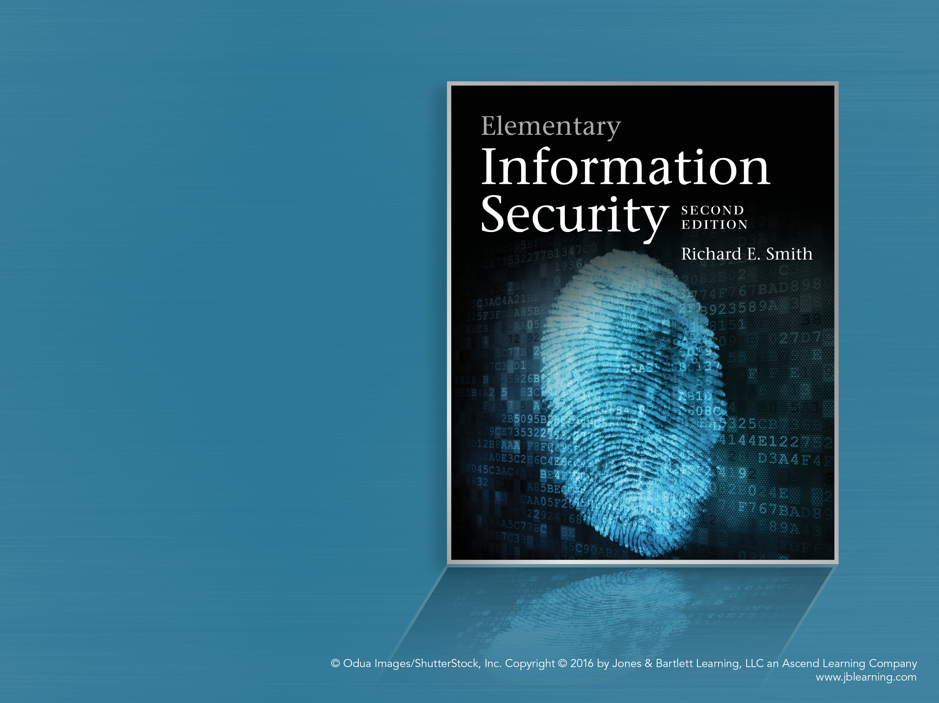
Chapter 2
Controlling a Computer

Slide 2
Overview
Fundamentals of computer hardware
General strategies for access control
Buffer overflow attacks on computers
Access control mechanisms in computers
Security planning: policy and implementation
Protecting processes

Slide 3
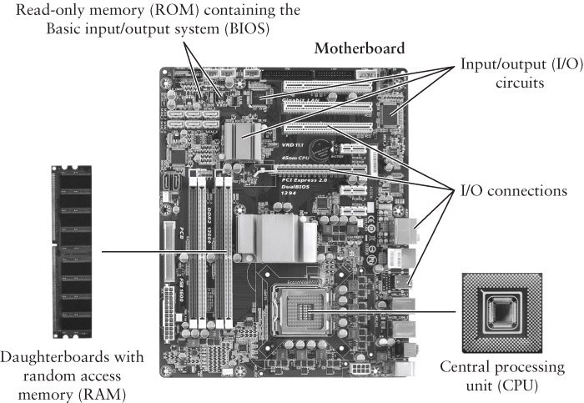
CPU Hardware: Motherboard
© iStockphoto/Thinkstock © Péter Gudella/Dreamstime.com Courtesy of Dr. Richard Smith

Slide 4
Programs
Data resides in RAM
  Numbers and other coded data
  Examined and modified by programs
  Stored in consecutively numbered locations
Programs are lists of instructions
Instructions reside in RAM
  Each is a single arithmetic operation or comparison
  Stored in consecutively numbered locations

Slide 5
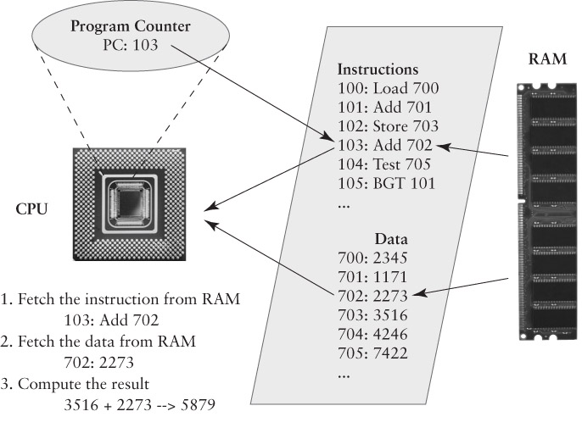
Executing a Machine Instruction
Courtesy of Dr. Richard Smith, © iStockphoto/Thinkstock

Slide 6
Organizing RAM into “Sections”
Control Sections
  Contain instructions to execute
  Contain unchanging data
Data Sections
  Contain variables that change
  Contain “free form” RAM
    Buffers, Stacks

Slide 7
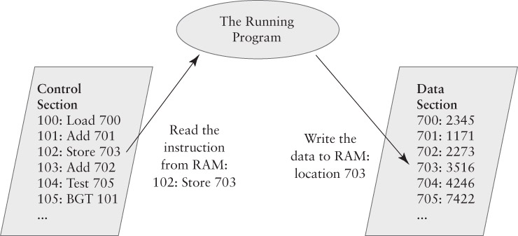
Control and Data Sections

Slide 8
Functions, Procedures, Subroutines
We break programs into pieces
  A piece with a particular job = function or procedure or subroutine, all roughly the same
One function can execute another function
  PC is pointed to the called function’s address
  We save the current function’s “state”
Saving the variables and the caller’s PC
  Saved in RAM, often on a “Stack”

Slide 9
One function calls another function
We save the program counter in the “calling function”
We execute the instructions in the “called function”
At the end of the “called function” we restore the program counter
This returns the CPU to where the “calling function” left off

Slide 10
Processes
A program is a group of instructions
A process is a running program
  Its PC is, or can be, changing
  It has some RAM with instructions and data
Windows Example
  Run two command shells
  One program, two processes
  Looking at processes with the Task Manager
    List Applications; List Processes

Slide 11
Switching Processes
The “dispatcher” procedure in the operating system (OS) switches running processes
Stops (pauses) one process and starts another
  Save the PC for the stopped process
  Save other CPU data from the stopped process
  Locate the “saved state” for the one to start
  Load up the saved CPU data for the process
  Load the PC with the starting process’ PC value

Slide 12
The Operating System
Dispatching and process management is only one of its many tasks.
RAM Management – assigns RAM to active processes and manages free RAM
I/O Management – handles external devices
  File management – hard drives & mass storage
  User interface management – keyboards and GUIs
  Network protocols – connect to other computers

Slide 13
Buffer Overflow: The Morris Worm
Morris Worm – first major Internet worm
  1988 – disabled about 10% of Internet computers
  Used several attacks
Buffer overflow vulnerability
  A program fails to keep track of its input
  The input data modifies RAM that it shouldn’t
  Attacker can take over the computer if the wrong RAM gets modified

Slide 14
The “finger” Program
Retrieved information about other users
  Rarely used today
  Command “finger jsl@bu.edu”
      Retrieved information about JSL at BU.EDU
If the sender typed too many letters, like:
finger jsl@bu.eduXXXXXXXXXXXXXXXXXXXXX XXXXXXXXXXXXXXXXXXXXXXXXXXXXXXXXXX XXXXXXXXXXXXXXXXXXXXXXXXXXXXXXXXXX and so on… the program overflowed a buffer

Slide 15
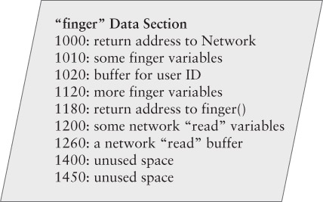
What overflows?

Slide 16
It Overflows the Stack
When we call another procedure, we must save the PC and the current procedure’s working variables inside the CPU
We save the information on a last-in first-out block of RAM called the stack
If a storage area on the stack is overrun, the data may modify the saved PC
When the procedure is finished, it jumps back to the wrong instructions in RAM

Slide 17
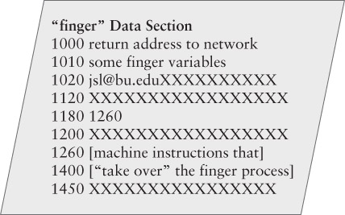
The Stack Overflow

Slide 18
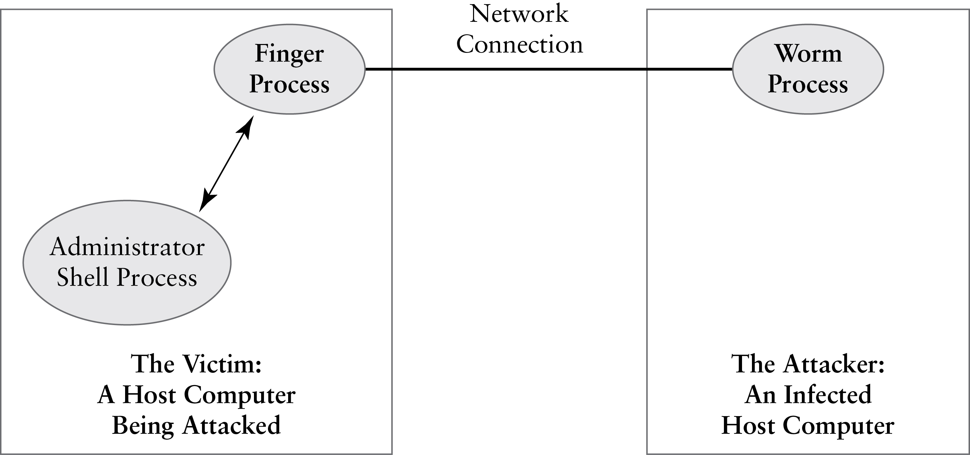
The Worm Connection

Slide 19
Why does the shellcode work?
Programs execute from a control section
The stack is in the data section
If the computer has data execution prevention (DEP), it only executes instructions in a control section.
Not all systems – or programs – can use DEP

Slide 20
The Worm Released
Released in October 1988
Promptly infected 10% of Internet computers
  The worm was designed to infect each computer once
  The restricting code did not work
  Each computer was infected hundreds of times
  Infected computers became unusable
Spread nationwide between 9pm and 11pm

Slide 21
Fighting the Worm
Telephone lines were not affected
  Analysts shared information by phone
  Many were at a meeting in Berkeley, fortunately
As sites cleaned themselves up, they shared status and defensive data via email
  Site cleanup was tricky – a ‘clean’ computer had to be hardened against the worm or it would be infected all over again

Slide 22
Security Alerts and Coordination
The worm incident helped create the Computer Emergency Response Team (CERT)
  First nationwide, multi-organization computer security team – tracked and reported problems
Today, reports are tracked by the Common Vulnerability Enumeration (CVE)
Numerous public and private security organizations, like the “Internet Storm Center”

Slide 23
Studying Cyber Attacks
A systematic analysis, based on attack reports
Attack Scenarios
  May study potential or actual attacks
  Elements are all based on recorded attacks
Attack Case Studies
  Report actual attacks
  A scenario that includes threat agent data

Slide 24
Attack Scenario
Goals—a few sentences describing the goals of the attack.
Resources Required–personnel, skills, equipment, preparation, timing constraints
How it happens—describe how it takes place
Collateral results—attack results in addition to the goals noted above
Recommended mitigation—basic steps that could prevent the attack. Acts
References—authoritative sources

Slide 25
Attack Case Study
Overview – summarizes the attack
Perpetrator – brief description of threat agent
Attack scenario – as described previously
Risk management – how pre-attack risk management steps affected the attack’s outcome (omissions or comissions)
References – consolidated list including those from the attack scenario

Slide 26
Resources required: Details
Skills and/or training—special skills required for the attack
Personnel—number and types of people required for the attack
Equipment—special equipment required for the attack
Preparation time—amount of lead time required to set up the attack
Timing constraint—is the attack tied to a particular schedule or event?

Slide 27
Access Control Strategies
How do we control access? 4 strategies:
Islands
  A process is an island;
Vaults
  Safe deposit box; access control on a computer
Puzzles
  Cryptography; Kerckhoff/Shannon
Patterns
  Photo IDs; anti-virus; biometrics

Slide 28
An Island
On an island, we can only touch what is there
  Everything else is brought from elsewhere
A process can execute its instructions in RAM and modify variables in RAM
  It can only use resources brought into its RAM
  It can’t access anything else
We restrict a process by not allowing it access to resources
“Isolation and mediation”

Slide 29
A Vault
We can retrieve things from the vault only if allowed
  Someone/something restricts access
  Least Privilege: we only have access to some items
A Bank safe deposit box – we have the key
  The banker lets us retrieve the box
  We can modify the box contents
  We can’t retrieve or modify any other boxes
Computer access control – a process can retrieve a file or print data if granted the right permissions

Slide 30
Puzzles
Protect data by presenting a puzzle
  Authorized users know the puzzle’s answer
Security Through Obscurity (STO)
  A weak puzzle, like protecting data by hiding it
Strong puzzles use Cryptography (“crypto”)
  Mathematical techniques to hide or protect data
  Quality cryptography is very hard to break
    Weak cryptography is simply a form of STO

Slide 31
Open Design: A Basic Principle
We open our systems for third-party analysis to help ensure their effectiveness
  We withhold changeable, secret information
  “More eyes make bugs shallow” – Eric Raymond
Kerckhoff’s Principle and crypto design
  Rely on a changeable secret, but make the rest of the design public and open to review
  Shannon’s Maxim: “The enemy knows the system”

Slide 32
Pattern Matching
Make decisions based on similarities
Photo IDs – guard compares face against poor photo
  Photos are often laughably inaccurate
Anti-virus software
  Searches computer for patterns found in viruses
  Must be updated continuously for new viruses
Biometrics – fingerprint readers, for example
  Compare reading against a stored pattern
Problems: false positives and false negatives

Slide 33
Chain of Control: Another Principle
We must never run programs that violate or bypass our security policy. To avoid this, we:
Start the computer using a BIOS that maintains our security policy
If the software we start (i.e. the OS) can start other software, then the other software either
    Complies with the security policy, OR
    Is constrained from violating the policy via access restrictions or other mechanisms

Slide 34
Subverting the Chain of Control
At the BIOS, we may
  Boot a different OS from a CD-ROM
  Boot a different OS from a USB drive
  The other OS doesn’t enforce access restrictions
Inside the OS, we may
  Install a privileged (administrative) program that can bypass access restrictions
  Trick an authorized user into leaking sensitive files

Slide 35
Keeping Processes Separate
Relies on hardware and software
Hardware: two CPU features
  Program Modes
  RAM Protection
Software: Operating System features
  Program dispatcher
  Memory manager
  User identities

Slide 36
Program Modes
Kernel or Supervisor Mode
  For highly privileged operating system programs with full CPU access
  Allows full access to RAM
  Dangerous! Used as rarely as possible
User Mode
  For most programs and all applications
  CPU blocks any attempt to use Kernel Mode instructions

Slide 37
Personal Computer Evolution
1970s: PCs ran one program at a time
  Microprocessor CPUs didn’t support multitasking
1980s: Programs politely took turns
  Allowed several windows to be open at once
  Illusion of multitasking
1990s: Multitasking in desktop computers
  Microprocessor CPUs support multitasking
  Unix on PCs, Windows NT

Slide 38
Operating System Protections
Originally only available on mainframes and higher-end minicomputer OSes (Unix, VMS)
  Adapted to desktop OSes during 1990s
OS Security Features
  Processes must take turns (“dispatching”)
  Processes are assigned different parts of RAM
  Processes can’t damage other areas of RAM
  User-oriented interface and access controls

Slide 39
Sharing a Program

Slide 40
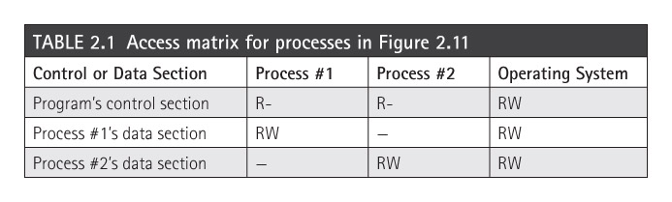
Access Matrix
A way to specify access permissions
  Rows for resources or RAM
  Columns for active entities or processes

Slide 41
Sharing Data
The problem: allow two processes to share data stored in RAM
  Normally we isolate processes from each other
  This prevents one process from damaging the other one
OS provides a separate data section
  Processes still have exclusive access to own data
  All shared data resides in this separate section
    Both processes have RW access to the shared section

Slide 42
Constructing a Security Plan
The Security Plan is a detailed assessment
  A high-level analysis is an overview
The Plan contains the details
  List of Assets (see Chapter 1)
  Full risk assessment (see Chapter 1)
  Prioritized list of risks (see Chapter 1)
  Security Requirements – (see Chapter 1)
  Implementation – a list of security controls

Slide 43
Requirements and Controls
Requirements say what we want for protection
Controls says what we get
For each requirement, pick security controls
    Each control addresses 1 or more policy statements

Slide 44
Security Plan: Process Protection
How does the OS protect processes?
Goals:
  Processes share the CPU
  Processes may share control sections
  Processes don’t share RAM except by request
Risks:
  A process monopolizes the CPU
  A process reads or writes RAM that it shouldn’t

Slide 45
Policy and Implementation
Six policy statements (Table 2.5 in textbook)
  Specifies security to be arranged by the dispatcher
  Specifies when things should happen
Security Controls (Table 2.5 in textbook)
  All are functional controls provided by software
  Some are steps in the dispatcher procedure
  Others are features of how the OS ensures that the dispatcher is run or how security is applied

