Slide 1

Guide to Network Defense and Countermeasures Third Edition
Chapter 6
Wireless Network Fundamentals

Slide 2
Objectives
Explain wireless communication concepts
Describe radio frequency characteristics relevant to wireless networking

Slide 3
Wireless Communications Primer
Wireless networking: any exchange of data between computers and other devices that does not use cables
Different from cabled networks:
Use certain types of electromagnetic radiation
Radio frequency (RF) waves is most commonly used
Infrared (IR) radiation used mainly for communication with peripheral devices

Slide 4
Electromagnetic Radiation
Electromagnetic (EM) radiation: electromagnetic energy traveling as a self-propagating wave and spreading out at the same time
Wave: means of transporting energy from one place to another
Energy is transported by a disturbance that occurs in a distinct repeating pattern
Amplitude: maximum departure of a wave from the undisturbed state
Frequency: number of times an event occurs in a specified period (measured in hertz)

Slide 5
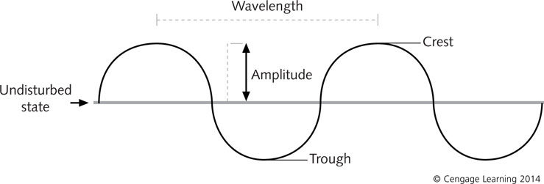
Electromagnetic Radiation
Wavelength: distance between repeating units of the wave (usually the midpoint or crest)
Frequency has an inverse relationship with wavelength
Frequency is number of waves per second
Wavelength is the distance between waves
Figure 6-1 Wave properties

Slide 6
Infrared Transmissions
Infrared transmissions use infrared light pulses
Require an emitter (laser diode or LED) and a detector (sometimes combined with an emitter)
Intensity of the light pulse indicates the on or off status of each bit of data
Directed IR transmission: requires emitter and detector to be pointed directly at one another
Diffused IR transmission: relies on reflected light that can bounce off walls or other objects

Slide 7
Infrared Transmissions
Advantages of IR wireless:
Does not interfere with other signals and is not susceptible to interference from them
IR signals cannot pass through walls
Disadvantages of IR wireless:
Limited range
Low speeds of up to 4 Mbps
Requires direct line of sight or in-the-room conditions

Slide 8
Radio Frequency Transmissions
RF is the most commonly used transmission medium for WLANs
RF can travel through walls and travel great distances
RF involves transmission ranges, signal modulation, and interference
More complex than IR

Slide 9
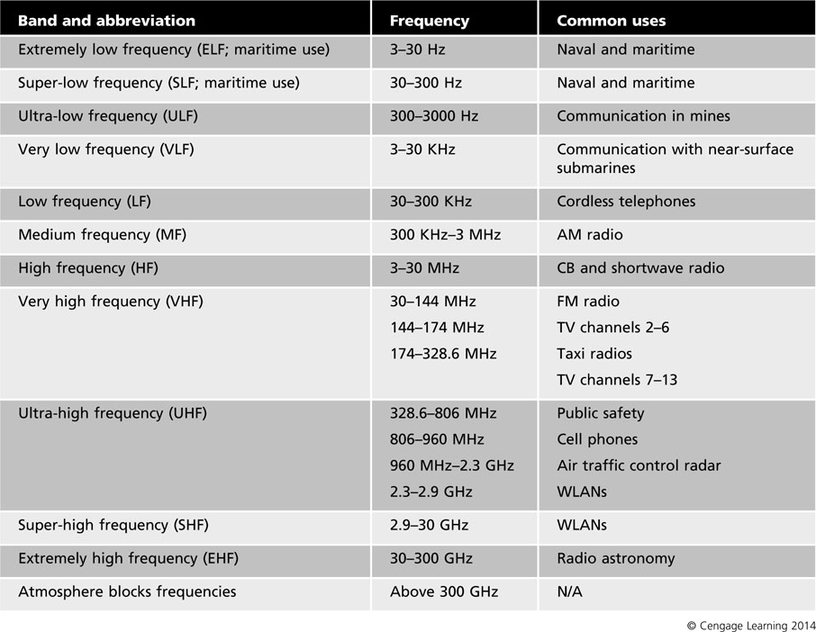
Table 6-1 Common RF bands

Slide 10
Transmission Ranges
Transmission ranges vary depending on the standard in use and environment
Generally, lowering bandwidth increases coverage area
The rate at which a wireless client receives data decreases as client moves away from transmitter
Access point: an electronic device that connects to a wired network and can transmit and receive wireless signals
Enforcing security for wireless signals requires careful placement of APs

Slide 11
Interference
Co-channel interference occurs when signals from APs interfere with each other
Must arrange APs so that overlapping signals do not share the same channel (frequency)
Interference
RF can be highly susceptible to interference from electrical storms, solar activity, laser printers, and other forms of EM radiation (microwave ovens)
Multipath: a signal has more than one path from transmitter to receiver
If signal is reflected, the reflected path can interfere with direct path (this problem is called fading)

Slide 12
Radio Frequency Signal Behavior
RF signal behavior is characterized by whether a factor contributes to an increase (gain) or decrease (loss) in power
Gain: positive difference in amplitude between two signals
Achieved by magnifying the signal
Loss: negative difference in amplitude of signals (sometimes called attenuation)
Common factors that result in loss:
Absorption – when certain types of material absorb RF signals, such as wood, concrete, and asphalt
Reflection – when RF signals bounce off some materials

Slide 13
Radio Frequency Signal Behavior
Common factors that result in loss (cont’d):
Scattering – when small objects and rough textures disperse signals
Refraction – when differences in density between air masses over distances cause problems (signals may bend instead of traveling in a straight line)
Diffraction – similar to refraction, except signal bends around an object in its path
Voltage standing wave ratio (VSWR) – caused by differences in equipment rather than external influences

Slide 14
Measuring RF Signals
RF power is measured on a linear scale using milliwatts (mW)
Watt: measure of power or the rate at which work is done
One mW is equal to one-thousandth of one watt
Decibel-milliwatts (dBm) is the reference point that relates the decibel scale to the linear milliwatt scale
Specifies that 1 mW = 0 dBm
RF power gains and losses on a relative scale are measured in decibels (dB) instead of mW

Slide 15
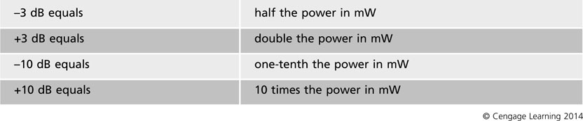
Table 6-3 The 10s and 3s rules of RF math

Slide 16
Measuring RF Signals
Equivalent Isotropically Radiated Power (EIRP): power radiated by a wireless system’s antenna
Uses a measurement known as isotropic decibels (dBi) that applies only to an antenna’s gain
Transmitter Power Output (TPO) measures the power being delivered to the transmitting antenna

Slide 17
RF Signaling
RF transmits a carrier signal
Changes based on the signal’s voltage and direction
RF data is transmitted as analog or digital signals
Analog RF signal: continuous wave that oscillates between positive and negative voltage
Must be converted into digital format
Digital RF signal: divided into discrete segments or defined states within the carrier’s range
Modulation: changing characteristics of the signal
Three characteristics of a carrier signal can be modified to enable it to carry data: height, frequency, and relative starting point of the signal

Slide 18
Analog Modulation
Analog modulation methods:
Amplitude modulation (AM) – the height of the carrier wave is changed so a higher wave represents a 1 bit and a lower wave represents a 0 bit
Frequency modulation (FM) – number of waves representing one cycle is changed so that the number representing a 1 bit is greater
Phase modulation (PM) – cycle’s starting point is changed when the bit being transmitted changes from 1 to 0

Slide 19
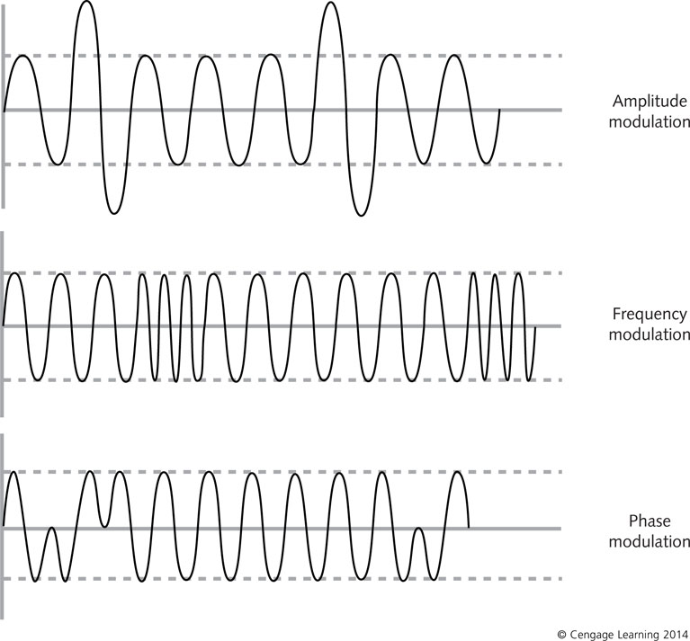
Figure 6-3 Analog modulation techniques

Slide 20
Digital Modulation
Digital modulation techniques are superior to analog methods for four reasons:
More efficient use of bandwidth
Fewer interference problems
Error correction that is more compatible with other digital systems
Less power required to transmit

Slide 21
Digital Modulation
Three binary signaling techniques:
Return-to-zero (RTZ) – Voltage increases to represent a 1 bit, no voltage represents a 0 bit
Voltage for a 1 bit drops back to zero before the end of the bit period
Non-return-to-zero (NRZ) - Voltage increases to represent a 1 bit, no voltage represents a 0 bit
Voltage for a 1 bit does not drop back to zero before the end of the bit period
Polar non-return-to-zero (polar NRZ) – Voltage increases to represent a 1 and drops to negative voltage to represent a 0 bit

Slide 22
Digital Modulation
RF signals are narrowband transmissions
Transmit on one frequency or small frequency range
Common digital modulation methods:
Amplitude shift keying (ASK) – height of the carrier can be changed to represent a 1 or 0 bit
Frequency shift keying (FSK) – carrier signal’s frequency is changed to represent a 1 or 0 bit
Phase shift keying (PSK) – similar to phase modulation
Frequency division multiplexing (FDM) – multiple base signals are modulated on different carrier waves and combined to form a composite signal

Slide 23
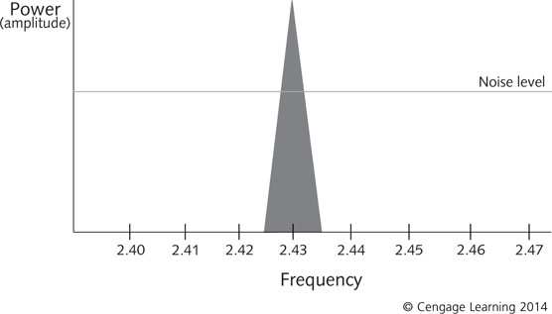
Figure 6-4 Narrowband transmission

Slide 24
Spread Spectrum
Spread spectrum spreads a signal over a broader portion of the radio band
Advantages of spread spectrum over narrowband:
Bandwidth of signal is higher than original message
Bandwidth is determined by the spreading function
Known only to the transmitter and receiver
In spread spectrum:
The spreading function attaches a key (called a spreading code or sequence) to the communication channel

Slide 25
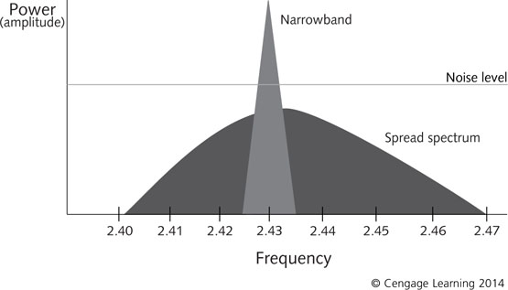
Figure 6-5 Spread-spectrum transmission

Slide 26
Spread Spectrum
Major methods of spread spectrum:
Direct sequence spread spectrum (DSSS) – key is applied at the data level
Frequency hopping spread spectrum (FHSS) – key is applied at the carrier frequency level
Orthogonal frequency division multiplexing (OFDM) – high-speed signal is divided into smaller pieces and sent simultaneously across lower-speed channels

Slide 27
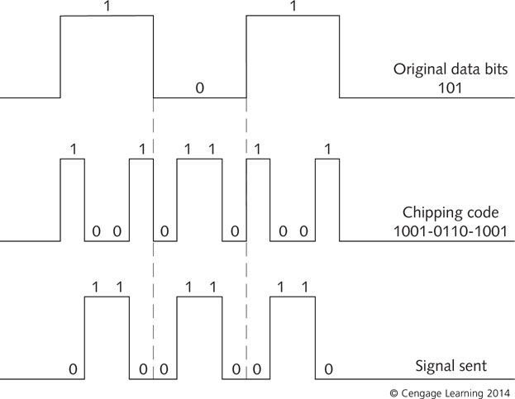
Figure 6-6 DSSS transmission

Slide 28
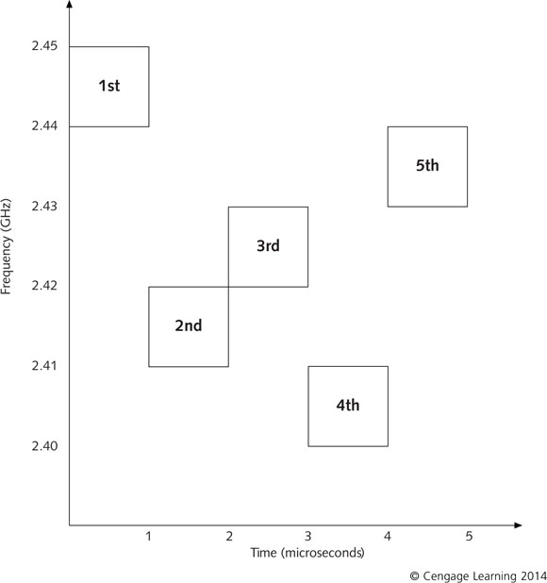
Figure 6-7 FHSS transmission

Slide 29
Spread Spectrum
In DSSS, an expanded redundant chipping code is used to transmit each bit
Chipping code: term for bit pattern
DSSS is less vulnerable to data loss from interference but requires high bandwidth
In FHSS, carrier hops frequencies over a wide band according to a sequence defined by the key
Key is called the hopping code and it determines the sequence and speed of frequency hops
Advantages of FHSS are immunity to jamming and interference and it is secure

Slide 30
Wireless LANs and Their Components
To secure a WLAN, you need to be familiar with:
Wireless components
Topologies
Transmission and frequency ranges
Methods of identifying and eliminating interference sources

Slide 31
Wireless NICs
When a wireless NIC (WNIC) prepares to transmit, it does the following:
Changes the computer’s internal data from parallel to serial transmission
Divides data into packets and attaches address information
Determines where to send the packet
Transmits the packet

Slide 32
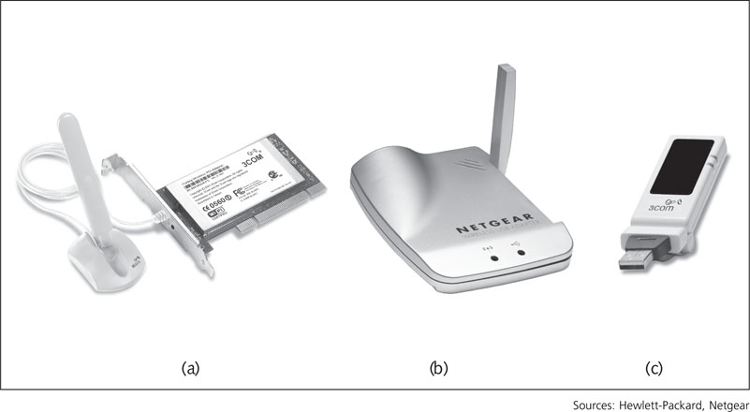
Figure 6-8 Desktop computer WNICs

Slide 33
Access Points
Access point (AP) - an antenna and radio transceiver used to transmit and receive signals and to perform the following functions:
Acts as a base station for the wireless network segment
Serves as the bridge between wired and wireless segments
Preferred placement of APs is on the ceiling or high on a wall
Solution to getting power to APs placed in ceilings or up high: Power over Ethernet (PoE)
PoE: power for AP unit is supplied through unused wires in Ethernet cabling

Slide 34
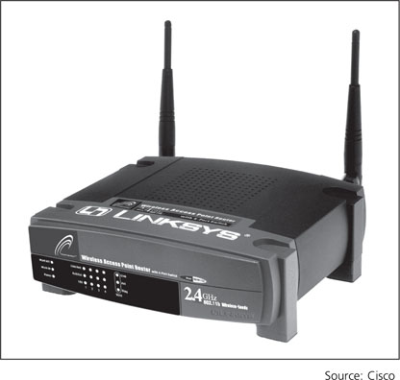
Figure 6-9 Wireless Access Point

Slide 35
Antennas
RF waves are transmitted and received by an antenna
EIRP is the measurement of total power radiated by a wireless system’s antenna
FCC uses the term intentional radiator to describe a device designed to generate radio signals
Fundamental characteristics of antennas:
As frequency gets higher, wavelength gets smaller (requiring a smaller antenna)
Antenna length should be ¼ of the wavelength
As antenna gain increases, coverage area narrows

Slide 36
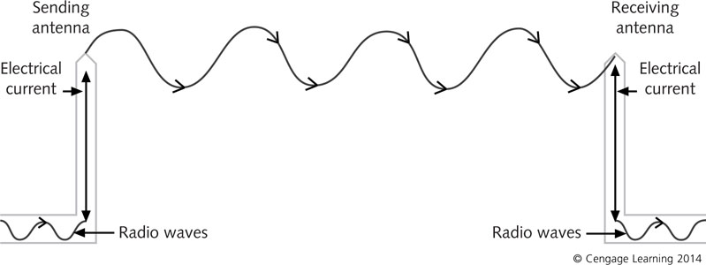
Figure 6-10 Antenna sending and receiving radio signals

Slide 37
Antennas
Other characteristics of RF antenna transmissions:
Polarization – plane in which radio waves propagate or the orientation of radio waves as they leave the antenna
Wave propagation – dispersal pattern of waves as they travel from sending to receiving antennas
Fresnel zone – series of ellipsoidal shapes in the wave calculated to determine the signal strength
Also identifies potential obstacles and multipath distortion between antennas
Free space path loss – phenomenon of signals dispersing as they travel from the sending antenna
Signal becomes weaker

Slide 38
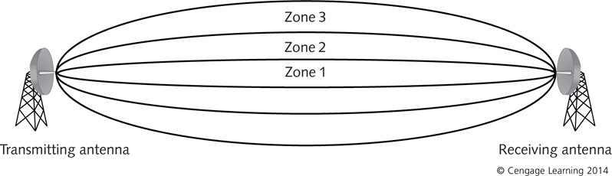
Figure 6-11 The Fresnel zone

Slide 39
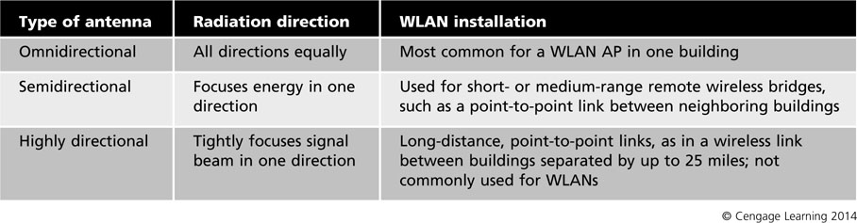
Antennas
There are three basic types of antennas: omnidirectional (also known as dipole), semidirectional, and highly directional
Table 6-4 Basic antenna types

Slide 40
Remote Wireless Bridges
Remote wireless bridges connect wired and wireless segments like APs, with two exceptions:
Transmits at higher power than an AP
Uses a directional antenna to focus transmission in one direction
APs use omnidirectional transmission
Operates in four modes:
Access point mode
Root mode
Nonroot mode
Repeater mode

Slide 41
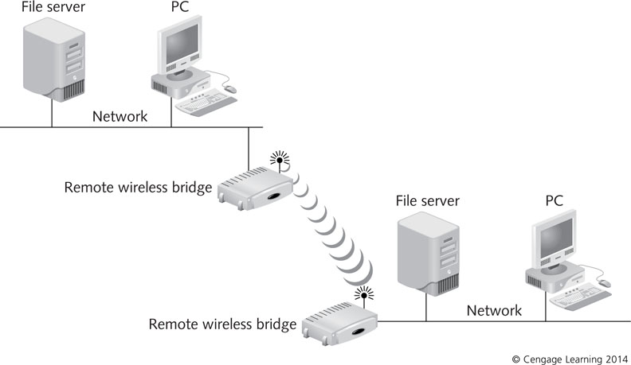
Figure 6-12 Point-to-point wireless bridging

Slide 42
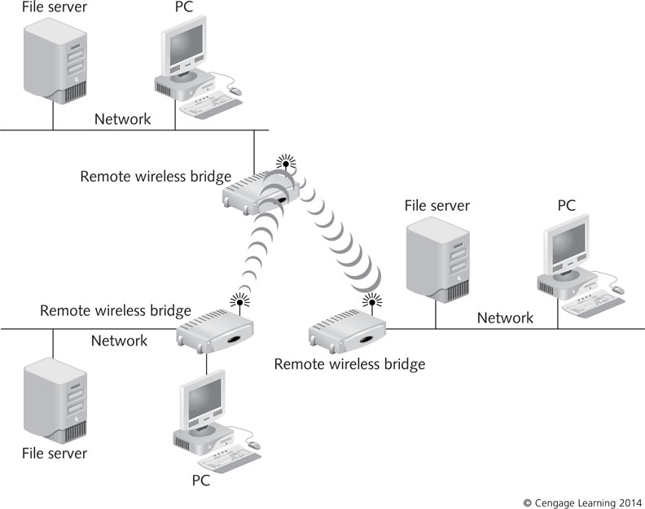
Figure 6-13 Point-to-multipoint wireless bridging

Slide 43
Wireless Gateways
Wireless gateway combines management and security into a single appliance
Can perform the following functions:
Authentication
Encryption
Intrusion detection
Malicious program protection
Bandwidth management
Centralized network management

Slide 44
WLAN Configurations
Three basic WLAN configurations:
Basic Service Set (BSS) – group of wireless devices are served by a single AP
Must be assigned a unique identifier known as the service set identifier (SSID)
Geographical coverage is called the Basic Service Area (BSA)
Extended Service Set (ESS) – APs are set up to provide overlap
Coverage areas are called cells and movement between cells is called roaming
Independent Basic Service Set (IBSS) – wireless network that does not use an AP

Slide 45
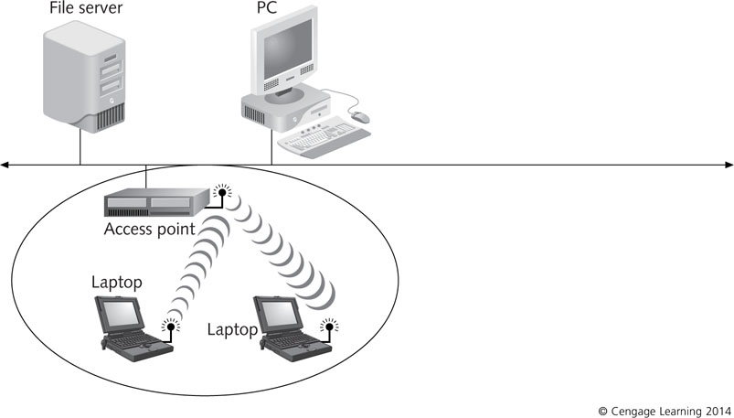
Figure 6-14 BSS configuration

Slide 46
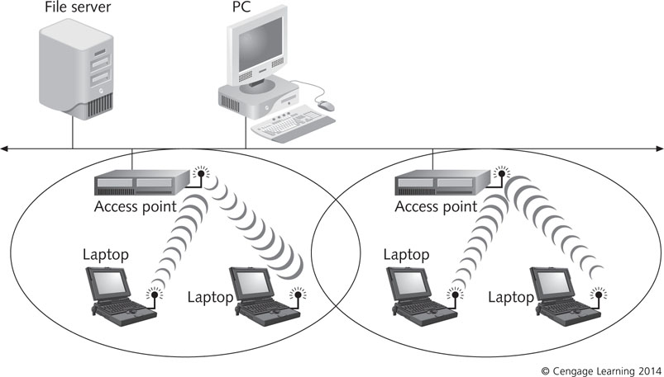
Figure 6-15 ESS configuration

Slide 47
Wireless Networking Standards
Wireless networking technology was developed in a haphazard way
Different companies worked on similar problems and came up with different solutions
Wireless standards process has become more efficient
Still overlaps and uncertainty as wireless networking expands

Slide 48
IEEE 802.11
IEEE 802.11 – first released in 1997
Most recent iteration is IEEE Std. 802.11-2007
Includes all ongoing amendments up to that time
Since 2007, 802.11n (2009) have been added
IEEE 802.11b (1999) – ratified before 802.11a
Operates in the 2.4 GHz band and maximum bandwidth supported is 11 Mbps
No longer used in contemporary WLANs
IEEE 802.11a (1999) – ratified after 802.11b
Operates in the 5 GHz band
Not subject to interference by microwave ovens and cordless phones that operate in 2.4 GHz range
Maximum bandwidth is 54 Mbps

Slide 49
IEEE 802.11
802.11g (2003) – operates in the 2.4 GHz band
Interoperable with 802.11a devices
Maximum bandwidth is 54 Mbps
802.11i (2004) – wireless security standard
WPA 2 was released to map exactly to the 802.11 standard
802.11r (2008) – designed to provide fast basic service set transition (FT)
Involves having a client perform a security association with the next AP before the client leaves the range of the current AP

Slide 50
IEEE 802.11
802.11n (2009) – defines a standard that supports multiple-input multiple-output (MIMO)
Uses both 2.4 GHz and 5 GHz radio frequencies to simultaneously send or receive data
Maximum bandwidth can reach 450 Mbps
802.11v (2011) – defines standards that allow wireless stations to exchange operational information to improve wireless network performance
802.11ac (Draft) – will use the 5 GHz band
Expected to provide multistation WLANs with a bandwidth of 1 Gbps

Slide 51
Radio Frequency and the FCC
Wireless primarily uses RF
Can interfere with critical applications
Regulated strictly by the Federal Communications Commission (FCC)
Regulates what frequencies wireless communications can use, how much power antennas can emit, and other matters concerning the use of radio waves, infrared, and microwaves for communication
When planning deployment, check with your local FCC office to learn about regulations or requirements you must meet

Slide 52
Summary
Wireless transmissions use electromagnetic (EM) radiation, specifically radio frequency (RF) waves or infrared (IR) radiation, to communicate
EM radiation travels in waves
The RF spectrum is divided into bands based on frequency
The speed and transmission range of a wireless network vary depending on the standard, equipment, environmental factors, number of users, location of clients, and purpose

Slide 53
Summary
RF transmits a carrier signal
RF data can be analog or digital
Spread spectrum spreads a narrowband signal over a broader portion of the RF band
Wireless network components include wireless NICs, access points, antennas, remote wireless bridges, and wireless gateways
Antennas transmit and receive radio waves and can be omnidirectional, semidirectional, or highly directional

Slide 54
Summary
A remote wireless bridge operates in four modes: access point, root, nonroot, and repeater
IEEE 802.11 standards define three WLAN configurations: BSS, ESS, and IBSS
IEEE 802.11 standards include: 802.11a, 802.11g, and 802.11n
RF is subject to strict regulations by the FCC because of the potential for interference with critical communications, including radio, TV, military, and emergency services

