Slide 1

Guide to Network Defense and Countermeasures Third Edition
Chapter 7
Understanding Wireless Security

Slide 2
Objectives
Explain basic concepts in wireless security
Describe security solutions for wireless networking
Describe security solutions for handheld wireless devices

Slide 3
Security Concerns of Wireless Networking
In this section you will learn:
How the Media Access Control (MAC) sublayer of the Data Link layer can create vulnerabilities
How passive and active scanning methods are used to find networks to attack
Inherent vulnerabilities of IEEE 802.11’s authentication mechanisms
Common methods for securing wireless networks

Slide 4
IEEE 802.11 Media Access Control: Frames
MAC sublayer of the Data Link layer performs many critical functions:
Discover wireless access point, channels, and signal strengths
Join wireless networks (includes authentication and association to the access point
Transmitting data
Maintaining the connection
Each access point (AP) has a 0- to 32-byte SSID that functions as the name of the network

Slide 5
IEEE 802.11 Media Access Control: Frames
MAC frames are used to locate wireless networks, establish and maintain the connection, and transmit data
The 802.11 standard has three types of MAC frames:
Management frames
Control frames
Data frames

Slide 6
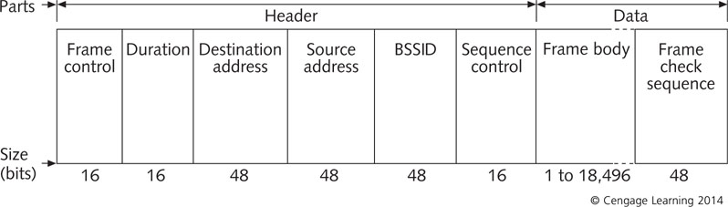
IEEE 802.11 Media Access Control: Frames
Management frames: establish and maintain communications (sent in cleartext with SSIDs)
Anyone who intercepts one can discover the SSID
Figure 7-1 An IEEE 802.11 management frame

Slide 7
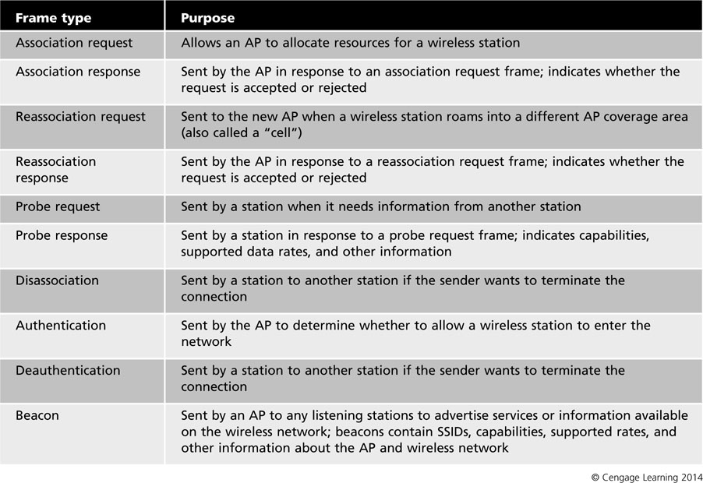
Table 7-1 Management frame types

Slide 8
IEEE 802.11 Media Access Control: Frames
Control frames: help deliver data frames between stations and control access to medium
Four most common types of control frames:
Request to send (RTS) – first step of the two-way handshake before sending a data frame
Clear to send (CTS) – gives a station clearance to send
Acknowledgement (ACK) – after receiving a data frame with no errors, receiving station sends this
Power-save poll (PS-Poll) – used when a station has awakened from power-save mode and sees that an AP has frames buffered for it

Slide 9
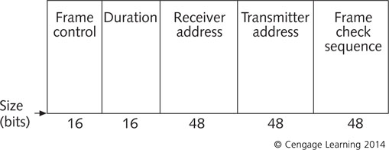
Figure 7-2 An IEEE 802.11 control frame

Slide 10
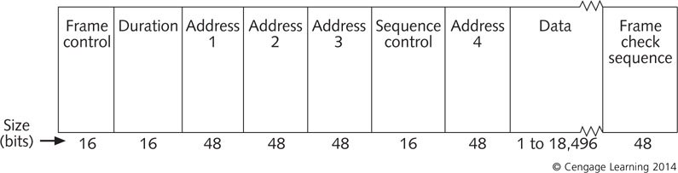
IEEE 802.11 Media Access Control: Frames
Data frames: carry the TCP/IP datagram and the payload
Figure 7-3 An IEEE 802.11 data frame

Slide 11
IEEE 802.11 Media Access Control: Frames
A wireless station could have a null SSID
Allows it to match all SSIDs
If a beacon frame contains a null SSID, attackers just have to capture frames that contain the correct SSID
Beaconing can be turned off on most current APs
Sniffing: capturing network traffic during transmission

Slide 12
Scanning and Attacks
Passive scanning: a WNIC listens to each channel for a few packets, then moves to another channel
A WNIC’s radio frequency (RF) monitor mode allows passive scanning
Passive attack: uses passive scanning to gather information about a wireless network for later use
Active scanning: station sends a probe request frame on each available channel and waits for a probe response frame from available APs
Active attack: attackers use several techniques to probe wireless networks in an attempt to gather information
Can be detected by network security measures

Slide 13
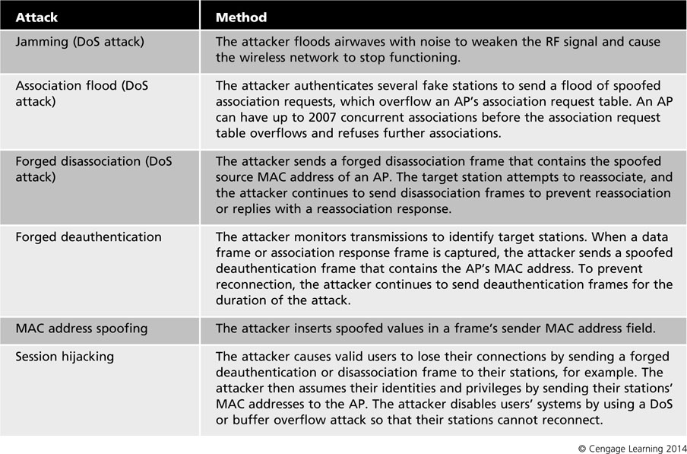
Table 7-2 Common active attacks

Slide 14
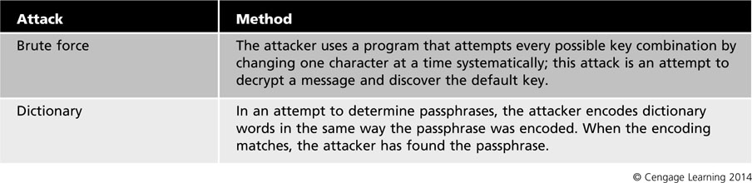
Table 7-2 Common active attacks (continued)

Slide 15
Wardriving and Exploitation of Rogue Devices
Wardriving: a potential attacker drives around with a laptop and WNIC in RF monitor mode to detect unsecured wireless signals
Rogue devices: wireless devices that employees connect and use without authorization or verified configurations
Usually configured poorly, so attackers can locate easily

Slide 16
Wireless Man-in-the-Middle Attacks
Man-in-the-middle (MITM) attack: attackers intercept the transmission of two nodes without the users’ knowledge
Transmission can be modified and then forwarded to the intended destination, blocked from being delivered, or read and passed on
Attackers often set up a fake AP to intercept transmissions
Make stations think they are connecting to an authentic AP

Slide 17
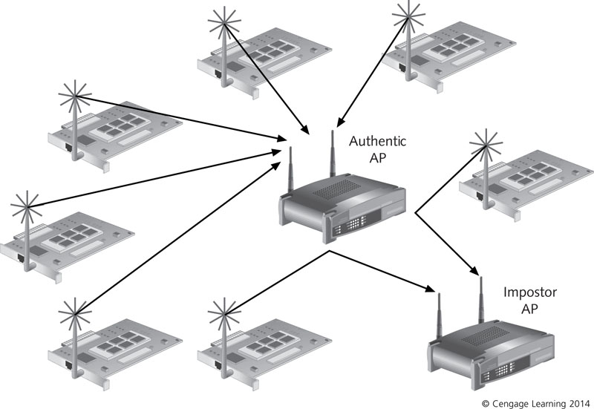
Figure 7-4 A wireless man-in-the-middle attack

Slide 18
Association with a Wireless Network
To access services and resources:
A station must be associated with an AP or other station
Association: Two-step process:
A station listens for beacon frames to join a network and goes through authentication process
Station sends an association request frame
If AP accepts it will send back an association response frame that contains the association ID
A station can be authenticated to several APs but it can be associated with only one network at a time

Slide 19
Wireless Authentication
Difference between wireless and wired networks:
The wireless station, not the user, is authenticated before being connected to the network
Two types of IEEE 802.11 authentication:
Open system authentication – station is authenticated without further checking as long as SSID matches the network it is attempting to join
Provides little security
Shared key authentication – uses a standard challenge-response process with shared key encryption

Slide 20
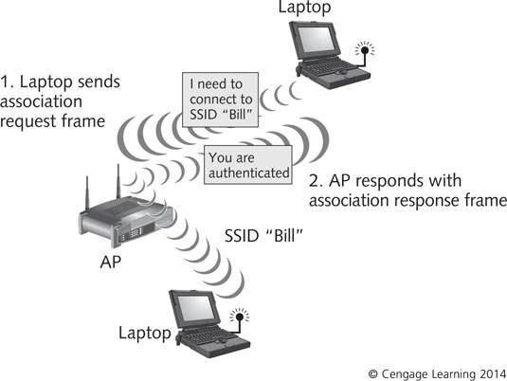
Figure 7-5 Open system authentication

Slide 21
Wireless Authentication
In shared key authentication:
Station sends an authentication frame to an AP
AP returns an authentication response frame that contains challenge text
Station encrypts the text with its shared key and returns it to the AP
Using its own copy of the shared key, the AP decrypts the text and compares to original challenge text
If they match, AP sends another authentication frame with the results and station is authenticated
If they do not match, station is rejected

Slide 22
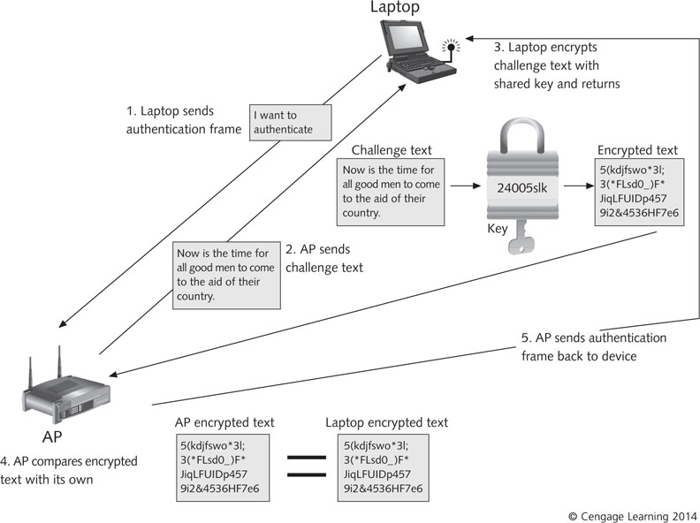
Figure 7-5 Open system authentication

Slide 23
Wireless Authentication
Shared key authentication is considered weak if it uses WEP for encryption
Attackers can use passive scanning to capture packets and crack the shared key
802.11 standard uses a 40-bit or 104-bit key with a 24-bit initialization vector (IV) added to the beginning of the key
IV is transmitted in cleartext, giving attackers 24 bits of the key
After enough packets have been captured, attackers can crack they key with a brute-force or dictionary attack

Slide 24
Wireless Authentication
WEP provides adequate protection against casual users, but not against attackers determined to gain access
Dynamic WEP, a newer version, offers slightly better protections (rotates keys frequently)
WEP2 was developed to address WEP vulnerabilities
Uses a 120-bit key and Kerberos authentication
No more secure than WEP

Slide 25
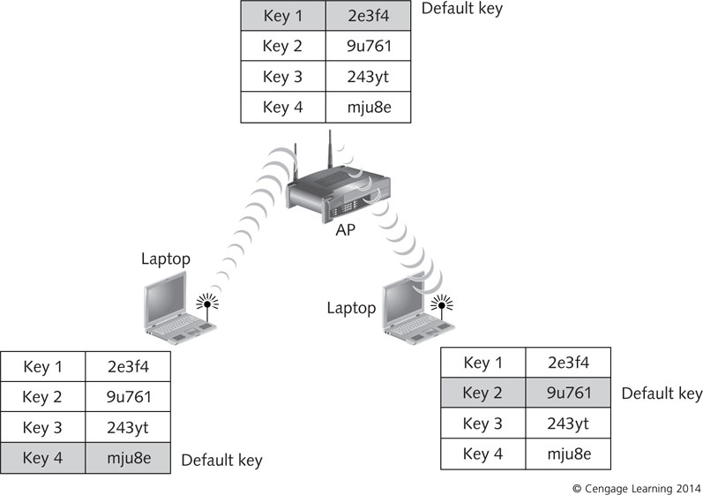
Default WEP Keys
APs and stations can hold up to four keys but only one is chosen as the default key
Does not have to be the same on every station but same key must be used for encryption and decryption
Figure 7-7 Default WEP keys

Slide 26
Key Management Concerns in 802.11 Networks
802.11 standard leaves the details of key management up to vendors and users
Is a challenge in wireless security
WEP was intended to prevent casual eavesdropping but does not prevent unauthorized access
WEP keys must be installed on all stations in a network, which takes a lot of time
Keys are changed infrequently or not at all
If stronger encryption methods are used, an effective key management method is still crucial

Slide 27
MAC Address Filtering and Spoofing
Wireless stations use MAC addresses for identification between stations and APs
MAC addresses are hard-coded into NIC firmware
Can use configuration tools to change a WNIC’s MAC address
Basic security mechanism is MAC address filtering
Addresses of legitimate stations can be entered into AP’s MAC address table so that only recognized stations can connect to the AP
MAC address spoofing: attackers alter their frames with legitimate MAC addresses

Slide 28
Wireless Device Portability
Wireless devices are designed to be portable
Makes them vulnerable to theft, unauthorized use, improper or unsafe storage and handling, established connection protocols being bypassed, and more
Mobile devices may not be backed up properly or may not have updates installed
Make sure highly sensitive data is not stored on mobile devices
Must use strong encryption and authentication

Slide 29
Examining Wireless Security Solutions and Countermeasures
In early years of wired networking, wireless standards focused on connectivity instead of security
Wireless security has lagged a few years behind wired network security
In the following sections you will learn about:
Common solutions for addressing security flaws
Special security requirements of wireless networks
Common configurations that mitigate wireless vulnerabilities and protect against wireless networking threats

Slide 30
Incorporating a Wireless Security Policy
A wireless security policy should address:
Scope and goals of the policy
Responsibilities for wireless matters and contact information for responsible parties
Physical security of APs
Approved hardware and software
Procedures for requesting, testing, installing, and configuring hardware and software
Assignment of responsibilities for installing, maintaining, and managing wireless devices
Guidelines and penalties for scanning or accessing the wireless network without authorization

Slide 31
Incorporating a Wireless Security Policy
A wireless security policy should address (cont’d):
Explicit statements about the nature of wireless communications, including measures to protect the rest of the network from potential harm
Details on wireless security awareness training
Internet access via wireless connections
Assignment of responsibilities for protecting data, privacy, and devices
Penalties for attempting to bypass security measures willfully
Requirements for encryption methods, authentication, and storage of confidential data

Slide 32
Ensuring Physical Security
Best tool for ensuring physical security is to provide security awareness training for users
Should be made aware of the potential for theft and consequences of stolen devices
Should be trained not to leave wireless devices logged on to the network
Include instructions for protecting mobile devices from damage
Never leave laptops in cars during summer or winter
Never leave laptops unattended in public

Slide 33
Planning AP Placement
Site survey: procedure for assessing the environment and determining where APs are needed to provide adequate coverage
Help determine whether to use directional or omnidirectional antennas
Also tells you if your signal extends beyond areas that are within your physical control
Network components require careful placement to provide adequate coverage but prevent indiscriminant radiation of the signal

Slide 34
Changing Default Hardware and Software Settings
Change the following default settings:
SSID – default SSIDs commonly include information about a device’s manufacturer
Administrator password
Beaconing interval – to reduce traffic
Manufacturer’s keys
Channels
Security measures
MAC ACLS, authentication, and encryption

Slide 35
Strong Encryption and Authentication
802.1x and Extensible Authentication Protocol
802.1x was developed to provide port-based access control on Ethernet LANs
Was revised to work for wireless networks
Uses Extensible Authentication Protocol (EAP) – a group of management protocols that stations use to request port access and includes a method of secure key exchange
Involves three participants: supplicant (station), authenticator (AP), and authentication server (RADIUS server)

Slide 36
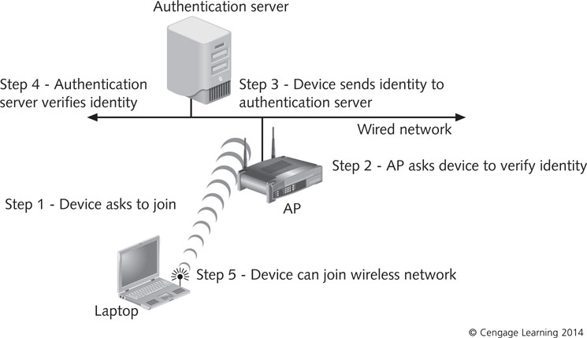
Figure 7-8 802.1x authentication

Slide 37
Strong Encryption and Authentication
802.11i and Advanced Encryption Standard
Uses 802.1x authentication and Advanced Encryption Standard (AES)
AES is strong enough to meet the U.S. Federal Information Processing Standard (FIPS)
Is a block cipher which breaks data into blocks of 8 to 16 bits, then encrypts each block separately
For additional security, blocks can arranged randomly rather than sequentially

Slide 38
Strong Encryption and Authentication
Wi-Fi Protected Access (WPA)
Replaced WEP encryption with Temporal Key Integrity Protocol (TKIP)
TKIP is based on WEP but includes a method for generating new keys for each packet
Different TKIP keys
Pairwise keys: used between a pair of stations
Pairwise master key (PMK): generates data encryption keys, data integrity keys, and session group keys for multicasts
Pairwise transient key (PTK): first key created from the PMK
Actually four keys shared between AP and client

Slide 39
Strong Encryption and Authentication
Wi-Fi Protected Access (WPA) (cont’d)
Message Integrity Check (MIC): mathematical function used to check messages for evidence of alteration (similar to cyclic redundancy check – CRC)
WPA offers improvements over WEP:
Minimum key length is increased
IV sequencing is enforced (IVs are not reused)
IV length is doubled from 24 bits to 48 bits
Packet-tampering detection is built-in
Key rotation is automatic

Slide 40
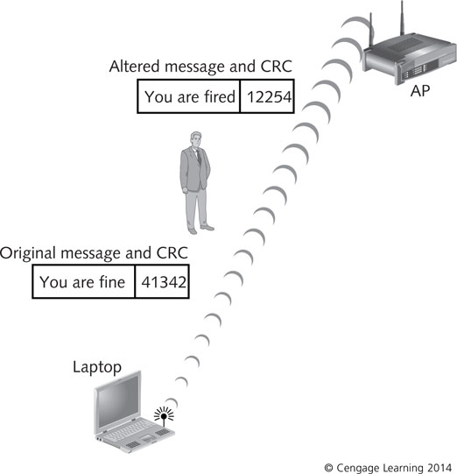
Figure 7-9 The MIC process

Slide 41
Strong Encryption and Authentication
Wi-Fi Protected Access version 2 (WPA2)
Based on the final ratified 802.11i standard
Uses AES for encryption and 802.1x or preshared keys for authentication
Allows both TKIP and AES clients to communicate (802.1x recognizes only AES)
WPA and WPA2 have two modes:
Personal Security – for single user or SOHO
Enterprise Security – for medium to large businesses

Slide 42
Strong Encryption and Authentication
Recent research has shown serious weaknesses in WPA and WPA2 when using TKIP
WPA2-TKIP is now considered far less secure than WPA2-AES
WPA2-AES Enterprise Security provides the highest security available
Wi-Fi Protected Setup (WPS): protocol designed to automate key distribution in small office and home networks
Allows users to enter an eight-digit PIN
In 2011, a flaw was discovered that made it unsecure and should be disabled

Slide 43
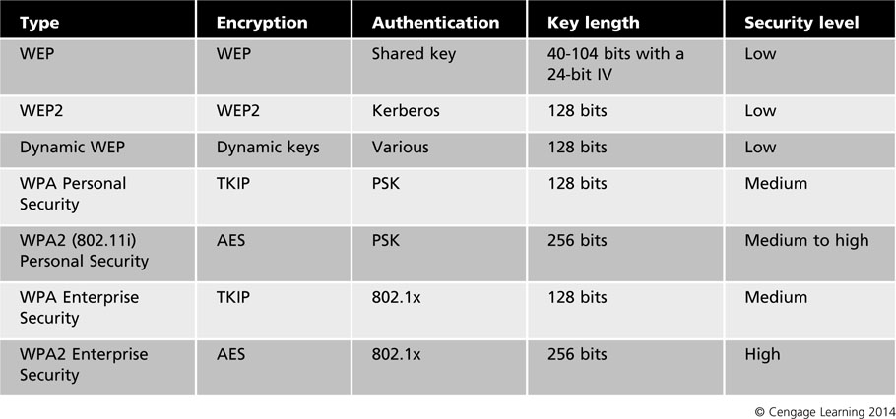
Table 7-3 Wireless security solutions

Slide 44
Wireless Auditing
Auditing wireless networks is an integral part of security management
Audits are based on security policies
Hiring third-party experts can be a good idea:
They see your network with fresh eyes and no preconceived ideas
They are likely to have different skills and tools
They have the focus and experience of a specialist
Check credentials and ask for references

Slide 45
Wireless Auditing
Risk and Security Assessments
Risk assessment: identifies what your assets are and how critical they are so you know how to protect them
Includes:
Inventory of company assets
Analysis of possible threats
Consequences if a threat materializes
Probability that the threat could occur
Security controls available to mitigate the risk
Organization’s acceptable level of risk
Security assessment: identifies existing security measures

Slide 46
Wireless Auditing
Auditing Tools
Penetration testing: intended to identify security vulnerabilities that attackers could exploit
Attackers use sniffers in the reconnaissance phase to capture packets
Used to gather information about targets
Auditors use sniffers to see what kind of information attackers can gain by using them
Hundreds of sniffing programs are available for PCs, handheld devices, and any available OS

Slide 47
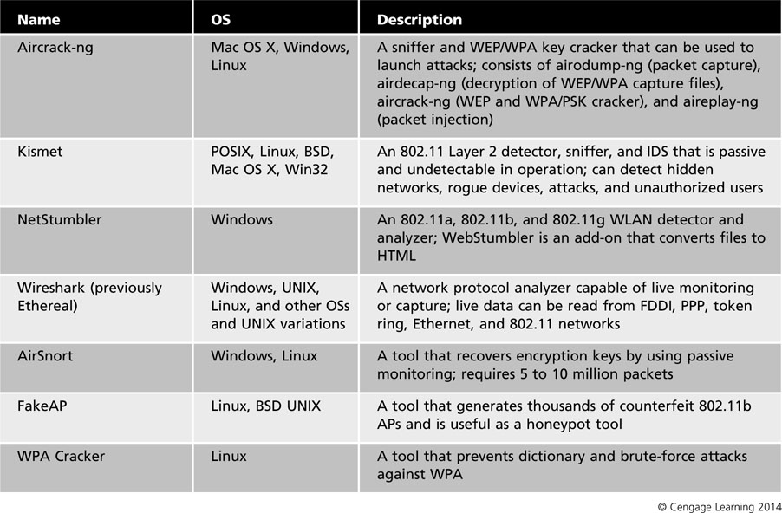
Table 7-4 Wireless sniffers

Slide 48
AP Logging Functions
Many enterprise-class AP models can maintain complex event logs and connection statistics
Some can interface with a Simple Network Management Protocol (SNMP) tool
SNMP requires an SNMP agent on the device you want to monitor
Logged information is stored in the SNMP agent’s management information base (MIB)
Can set an SNMP alarm that sends an alert message, called an SNMP trap
Management station queries all stations for details about the event that triggered alarm

Slide 49
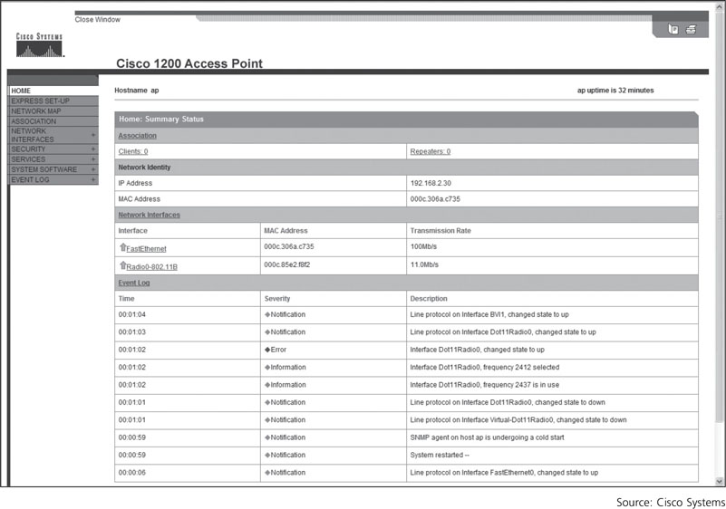
Figure 7-10 An AP event log

Slide 50
Best Practices for Wireless Network Security
Use strong authentication, such as 802.1x
Use strong encryption, preferably end to end
Perform a site survey and place APs strategically
Make sure that a comprehensive wireless security policy is kept up to date and users are trained
Change default settings, such as SSIDs
Avoid using protocols that send traffic in cleartext
If appropriate, use VPNs for wireless transmissions
Use wireless IDPSs

Slide 51
Best Practices for Wireless Network Security
Make sure that all stations use updated antivirus protection
Make sure that wireless devices use firewalls
Audit the wireless network periodically
Monitor your wireless network traffic with the best tools available

Slide 52
Mobile Device Security
Mobile devices that can now access the Internet and use mobile applications for business activities have to be added to the corporate network
Difficulties:
Devices are often outside the physical control of the IT security team
Transmission media used might be beyond a company’s control
Users may synchronize their devices with computers that are not controlled by the corporate IT department
Increases the risk of malware infection

Slide 53
Approaches to Mobile Device Security
Checklist that ensures the security of handheld devices should include the following:
Device configuration management
Critical patch and OS update management
Application installation/configuration management
Elimination of unneeded applications
Antivirus software
Firewall software
IDPS software
Antispam software
Antispyware software
Remote content erasure capability
Remote password reset capability

Slide 54
Approaches to Mobile Device Security
Checklist (cont’d):
VPN software
Backup management
Authentication management
Encryption
Log management
Incident response policy and procedures
Restriction of application downloads
Restriction of camera, microphone, removable media use
Remote diagnostics
Subscriber Identity Module (SIM) security
User training

Slide 55
Summary
A major challenge for wireless networking is security
Wireless networks use the airwaves as a transmission medium, so packets are vulnerable
The MAC sublayer of the Data Link layer performs many critical functions in a wireless network
Passive scanning involves listening for beacon frames and a passive attack uses passive scanning to gather information for later use
Active scanning involves sending probe request frames on each channel and waiting for a response

Slide 56
Summary
A station must be authenticated in order to join a wireless network
SSIDs and other information are vulnerable in standard 802.11 transmission because management frames send network information in cleartext
WEP was implemented in original 802.11 and uses a default key for encryption
Effective security solutions include: IEEE 802.11x, WPA/WPA2, and IEEE 802.11i

Slide 57
Summary
Auditing a wireless network is crucial to maintaining and improving security
Less sophisticated APs might generate simple logs but enterprise-class models can maintain an event log and can interface with a SNMP tool
Some best practices for wireless security include training users, developing a wireless security policy, restricting the data stored on portable devices, and ensuring that default settings are changed

