Slide 1

Guide to Network Defense and Countermeasures Third Edition
Chapter 2
TCP/IP

Slide 2
Objectives
Explain the fundamentals of TCP/IP networking
Describe IPv4 packet structure and explain packet fragmentation
Describe Internet Protocol version 6 (IPv6)

Slide 3
The OSI Model and TCP/IP Protocols
Transmission Control Protocol/Internet Protocol (TCP/IP) is a suite of many protocols for transmitting information from point to point on a network
Often referred to as a “stack”
This section covers:
Open System Interconnection (OSI) model
IP addressing
subnetting

Slide 4
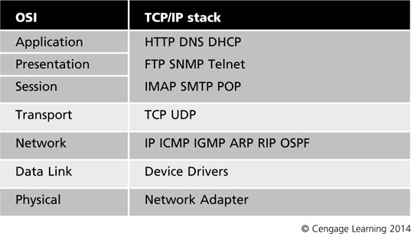
The OSI Model
OSI reference model: divides the communication functions used by two hosts into seven separate layers
TCP/IP has its own stack of protocols that correspond to these layers
Table 2-1 The OSI model and the subprotocols of the TCP/IP stack

Slide 5
The OSI Model
TCP/IP subprotocols are services that support a number of network functions:
HTTP (Hypertext Transfer Protocol)
DNS (Domain Name System)
DHCP (Dynamic Host Configuration Protocol)
FTP (File Transport Protocol)
SNMP (Simple Network Management Protocol)
Telnet
IMAP, SMTP, POP

Slide 6
TCP/IP Addressing
IP addresses are a method used to identify computers
Processed at the Network layer of the OSI model
Most common in use conform to Internet Protocol version 4 (IPv4)
32-bit address divided into four groups called octets
Each octet contains 8 bits of data
In binary, an IP address looks like:
10000000.00100110.00101100.11100010
Binary is converted to dotted decimal notation
192.168.10.1

Slide 7
TCP/IP Addressing
IP address components
Network identifier – shared among computers in a network segment
Host address – unique to each computer on the network segment
Subnet mask – used to identify which part of the IP address is the network identifier and which is the host identifier
Attackers can gain access to a network by determining IP addresses of computers
IP addresses need to be concealed to prevent certain attacks

Slide 8
TCP/IP Addressing
If an attacker can find a PC’s IP address, they can run a port scan to look for open ports to exploit
To hide addresses, use Network Address Translation (NAT)
Translates private network’s internal addresses into external addresses that can be used on the public Internet
Private network’s internal addresses are not routable on the Internet
Today IP addresses are in short supply, so Internet Protocol version 6 (IPv6) is being implemented

Slide 9
Address Classes
IPv4 addresses are separated by classes
Class is determined by the number of its networks compared to number of hosts
Example: a Class A address uses 8 bits for the network portion and 24 bits for the host portion

Slide 10
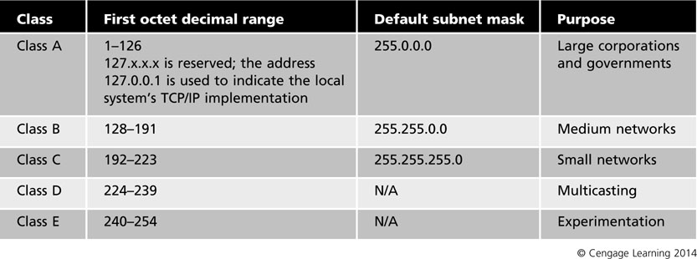
Table 2-2 IP address classes

Slide 11
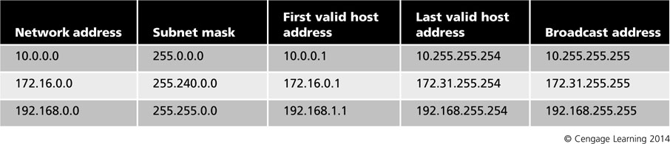
Private IP Address Ranges
Private addresses are needed so that organizations can build internal infrastructures
Public IP addresses require registration and a fee for each address
Private addressing scheme eliminates the need to purchase addresses for every group of machines
Table 2-3 Private IP address ranges

Slide 12
Subnetting
Address classes already have network id octets by default
Class A uses first octet
Class B uses first two octets
Class C uses first three octets
Default Class B has 16 bits available for hosts
This means a Class B network can have more than 65,000 host addresses
Some of host bits can be used to identify the network
Creates smaller subnetworks with fewer hosts

Slide 13
Subnetting
Subnetting can be used for:
Mirroring the organization’s physical layout
Mirroring the organization’s administrative structure
Planning for future growth
Reducing and controlling network traffic
Increasing network security
If all users with similar security and access needs are grouped into a single subnet, the entire group can be managed instead of managing each user separately

Slide 14
Subnetting
Subnetting
Borrow bits from host portion of IP address
Number of borrowed bits determines how many subnets and hosts are available
At least two bits must be available for hosts
Up to 14 bits can be borrowed for a Class B network

Slide 15
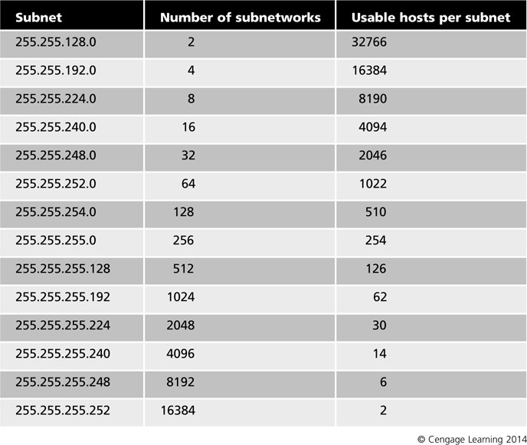
Table 2-4 Class B subnetting

Slide 16
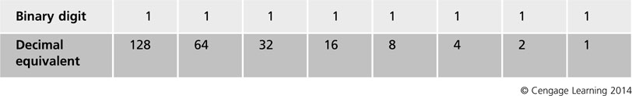
Table 2-5 Binary-to-decimal values

Slide 17
Subnetting
Subnetting a Class C address example:
Network address: 199.1.10.0
Default subnet mask: 255.255.255.0
Selected mask: 255.255.255.224
Mask in binary: 11111111.11111111.11111111.11100000
Last masked digit occupies the binary value of 32
Starting with network address, increment by 32 until you reach the mask’s number (224)

Slide 18
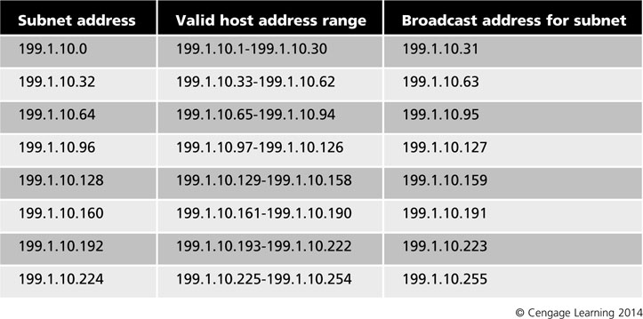
Table 2-6 Subnetting example

Slide 19
Variable Length Subnet Masking
Networks that do not have a large number of available IP addresses use variable length subnet masking (VLSM)
Involves applying masks of varying sizes to the same network
Creates subnets within subnets
Often used to secure stub networks (only have one connection to any other network

Slide 20
Classless Interdomain Routing
Classless Interdomain Routing (CIDR) – specifies the number of masked bits in an IP address/subnet mask combination
Example:
A network address of 192.168.6.0 with a subnet mask of 255.255.255.224 would have a CIDR notation of 192.168.6.0/27
CIDR overcomes limitations of default subnet masks so that unused addresses do not go to waste

Slide 21
Unicasting, Multicasting, and Broadcasting
Unicast transmission: one packet is sent from one server to each client computer individually
Multicast transmission: server can treat several computers as a group and send one transmission that reaches all of them
Example: streaming video presentation
Broadcast transmission: sent to all nodes on a specific network
Flooded broadcasts: sent to any subnet
Directed broadcasts: sent to a specific subnet

Slide 22
Examining Internet Protocol Version 4 (IPv4)
IP datagrams
Portion of the packet that is responsible for routing through networks
Processed at the Network layer of the OSI model
Complete message is transmitted using multiple datagrams
Contain information about source and destination IP addresses, control settings, and data
Divided into different sections
Primary subdivisions are header and data
Some packets have a footer (or trailer) that indicates the end of a packet or error checking (CRC)

Slide 23
IP Header Structure
Part of an IP packet that computers use to communicate
IP header plays an important role in terms of network security and intrusion detection
Contains a number of fields and is similar to a TCP header

Slide 24
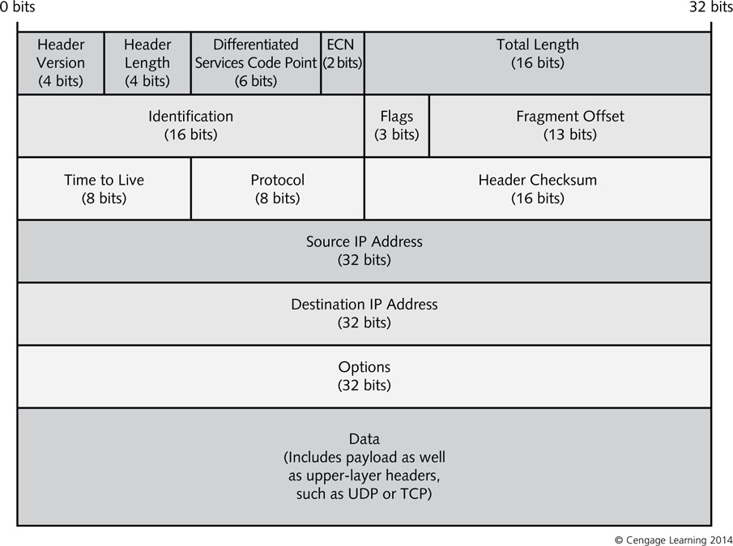
Figure 2-1 IP header structure

Slide 25
IP Header Structure
Most network operating systems (NOSs) have a type of built-in or add-on program to monitor network activity
Most administrators prefer third-party applications for their versatility and extra features
Wireshark (formerly Ethereal) is an example

Slide 26
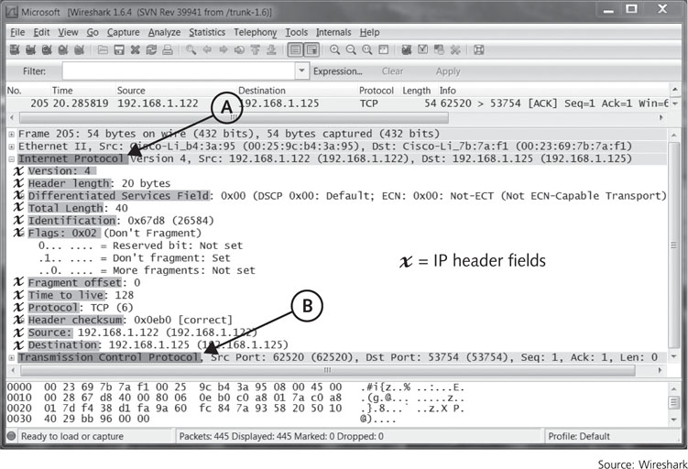
Figure 2-2 IP header structure as seen in a Wireshark packet capture

Slide 27
ICMP Messages
Internet Control Message Protocol (ICMP) used to assist with troubleshooting communication problems
Ping command uses ICMP to check whether a remote host has connectivity
Processed at the network layer of the OSI model
Firewalls or packet filters can be configured to accept or deny certain ICMP packets through the network
Some ICMP packets could be used as part of an attack

Slide 28
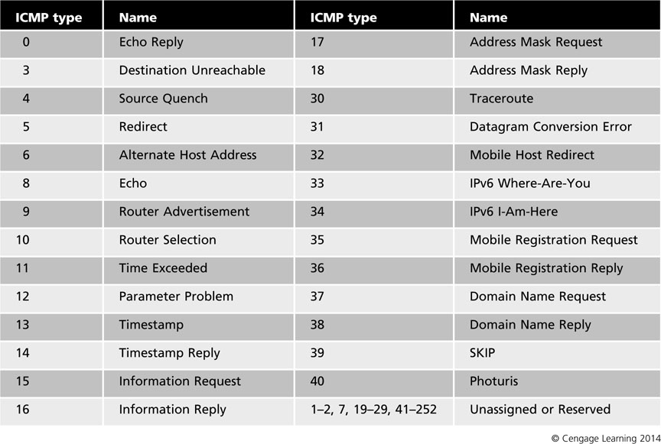
Table 2-7 ICMP types

Slide 29
TCP Headers
TCP/IP packets may also contain TCP headers
TCP headers are processed at the Transport layer of OSI model
TCP portion of a packet is called TCP segment
Flags section of a TCP header are important:
You can specify them when you create packet-filtering rules

Slide 30
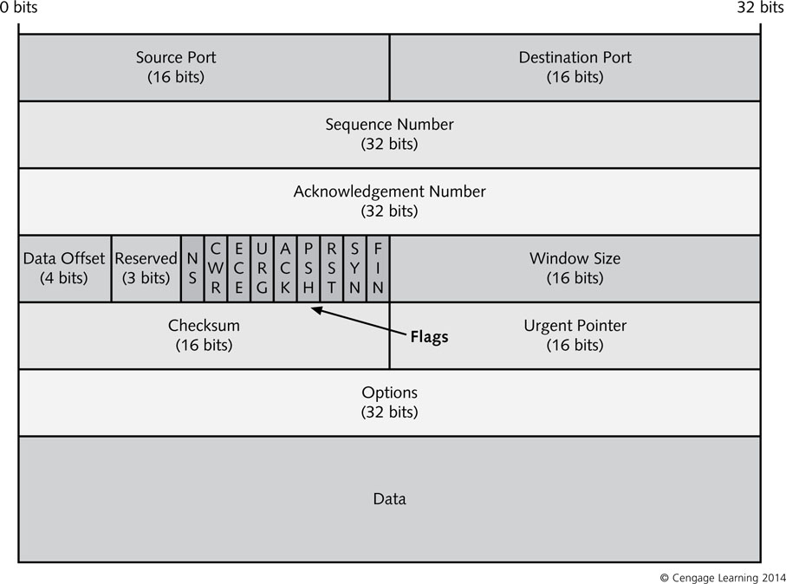
Figure 2-3 TCP header structure

Slide 31
UDP Headers
User Datagram Protocol (UDP): provides a transport service for IP
Processed at Transport layer of OSI model
Considered unreliable because it is connectionless
UDP packet does not contain sequence or acknowledgement numbers that enable TCP to guarantee delivery
Much faster than TCP
Used for broadcasting messages or for protocols that do not require the same level of service as TCP
Attackers can scan for open UDP services

Slide 32
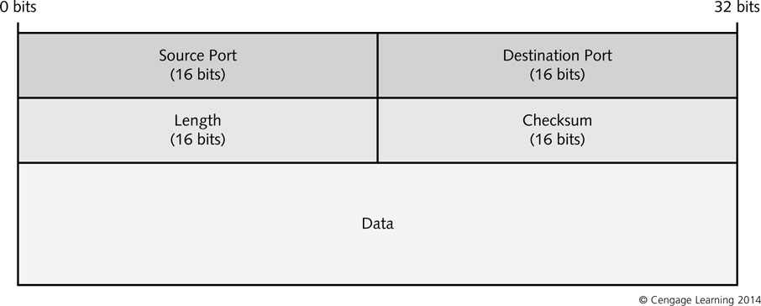
Figure 2-5 UDP header structure

Slide 33
Packet Fragmentation
Originally developed to allow large packets to pass through routers with frame size limitations
Routers divide packets into multiple fragments and send them along the network
Fragmentation creates security problems
Port numbers appear only in fragment 0
Fragments 1 and higher pass through filters without being scrutinized
Attacker can modify the IP header to make all fragment numbers start at 1 or higher
Configure firewall to drop all fragmented packets

Slide 34
The TCP Life Cycle and the TCP Three-Way Handshake
Establishing connection-oriented communication using a three-way handshake:
Host A sends an initial sequence number in its first packet to Host B
Called a SYN packet
Host B receives SYN packet - responds with SYN ACK with an initial sequence number for Host B
Includes an acknowledgement number that is one more than the initial sequence number
Host A sends an ACK packet to Host B
Increases Host B’s sequence number by one

Slide 35
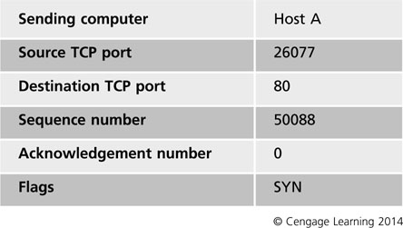
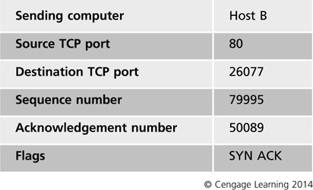
Table 2-8 TCP three-way handshake: SYN
Table 2-9 TCP three-way handshake: SYN ACK

Slide 36
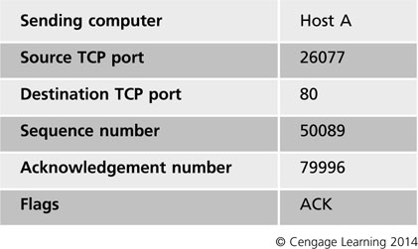
Table 2-10 TCP three-way handshake: ACK

Slide 37
The TCP Life Cycle and the TCP Three-Way Handshake
Sliding window size: determines the number of packets that can be sent before ACKs must be received
Controls the flow and efficiency of communications
Sender controls size of sliding window
FIN flag is set when either side is ready to end the session
Station that receives the initial flag sends a response packet with the ACK flag and its own FIN flag set to acknowledge receipt and to show it is ready to end the session

Slide 38
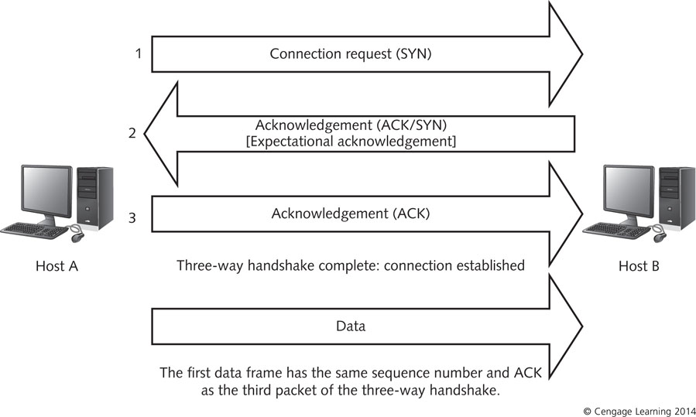
Figure 2-7 Summary of the TCP three-way handshake

Slide 39
Domain Name Service
DNS servers translate fully qualified domain names (FQDNs) to IP addresses
DNS can be used to block unwanted communications
Administrators can block Web sites containing offensive content
DNS attacks
Buffer overflow
Zone transfer
Cache poisoning

Slide 40
Internet Protocol Version 6 (IPv6)
IPv6 addresses the many limitations of IPv4
IPv6 has a larger address space of 128 bits
Routing tables need only the entries of other routers that are directly connected to them
IPv6 has integrated support for security called IPsec
Network Address Translation (NAT) is not needed
NAT has security problems
IPv6 can determine its own settings based on two different models:
Stateful autoconfiguration
Stateless autoconfiguration

Slide 41
IPv6 Core Protocols
IPv6 has major differences to IPv4 in its core architecture and functions
It is a connectionless, unreliable datagram protocol used mainly for addressing and routing packets
IPv6 datagram consists of the IPv6 header and IPv6 payload
Header is made up of IPv6 base header and optional extension headers

Slide 42
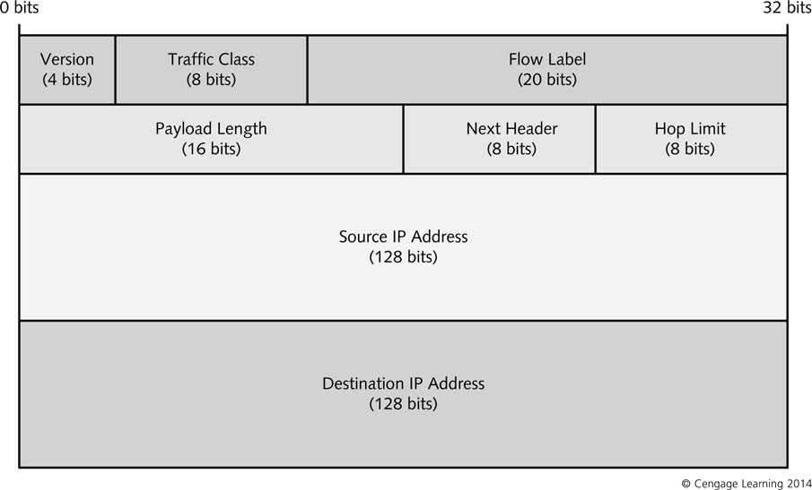
Figure 2-8 IPv6 header structure

Slide 43
IPv6 Core Protocols
Extension headers are not normally found in a typical IPv6 packet
If needed, the sending host adds appropriate header
IPv6 extension headers:
Hop-by-Hop Options
Destination Options
Routing
Fragment
Authentication
Encapsulating Security Payload (ESP)

Slide 44
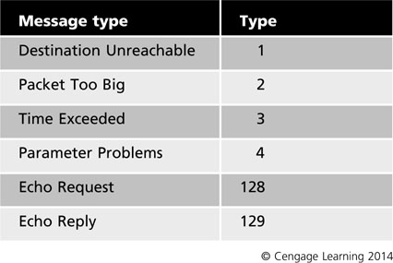
Internet Control Message Protocol for IPv6
ICMPv6 messages are grouped into two classes:
Error messages: 0-127
Informational messages: 128-255
ICMPv6 messages is preceded by an IPv6 header
Sometimes by extension headers
Type field contains the value for a type of message
Table 2-11 Common ICMPv6
message type codes

Slide 45
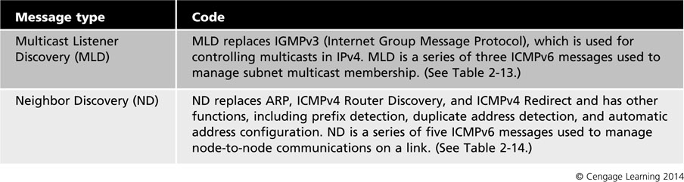
Table 2-12 ICMPv6 features

Slide 46
Multicast Listener Discovery
Multicasts: connectionless delivery of information to multiple subscribers at the same time
Has a single stream on any link instead of one stream per recipient
IP multicast traffic is sent to a single address but is processed by all members of a multicast group
Hosts listening on a specific multicast address are part of the multicast group
Group membership is dynamic
Members can be on different subnets

Slide 47
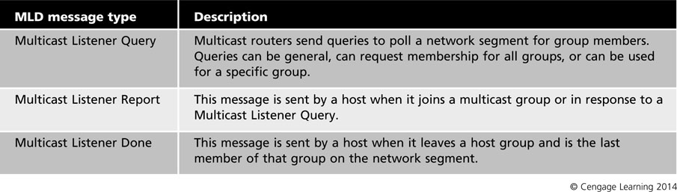
Multicast Listener Discovery
Multicast Listener Discovery (MLD) enables IPv6 routers to discover multicast listeners and decide which multicast addresses are of interest to nodes
Table 2-13 Multicast Listener Discovery message types

Slide 48
Neighbor Discovery
Neighbor Discovery (ND): new IPv6 protocol that replaces ARP, ICMP Router Discovery and ICMP Redirect in IPv4
Uses ICMPv6 messages to manage node-to-node communications
Five different types of ICMP messages:
Router Solicitation
Router Advertisement
Neighbor Solicitation
Neighbor Advertisements
Redirect

Slide 49
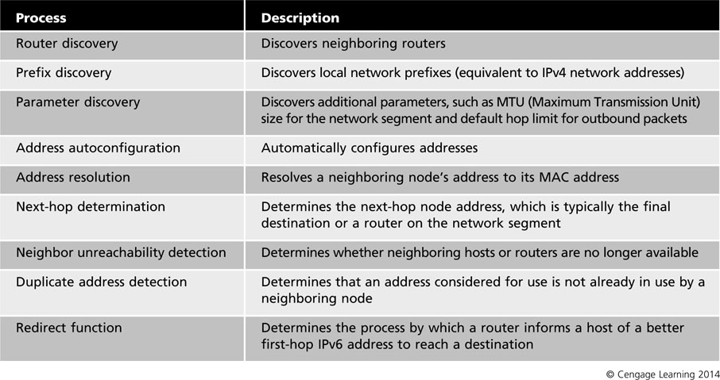
Table 2-14 IPv6 Neighbor Discovery functions

Slide 50
IPv6 Addressing
IPv6 addresses:
128 bits long and use the hexadecimal numbering format
Consist of eight hex groups separated by colons
Each hex group contains a 16-bit value
Examples:
4EDC:0000:7654:3210:F3DC:BA98:7654:AB1F
Including leading zeros is not necessary
1080:0:0:0:8:800:200C:417A
Can replace consecutive zeros with a double colon
1080::8:800:200C:417A

Slide 51
IPv6 Addressing
Unicast addressing: used for one-to-one communication (between two host or two routers)
Scopes of unicast addresses:
Global unicast address: public addresses routable on the Internet
Site-local unicast address: similar to private IPv4 addresses
Unique local IPv6 unicast address: replacing site-local unicast address
Link-local unicast address: used by hosts to communicate with other hosts on same network

Slide 52
IPv6 Addressing
Multicast addresses: used for one-to-many communications
Always begin with FF in the first byte
Anycast addresses: used for one-to-one or one-to-many communications
Created automatically when a unicast address is assigned to more than one interface
Offers flexibility in providing services
Currently only used by routers but will expand as technology becomes widespread

Slide 53
IPv6 Configuration
Microsoft OSs since Windows XP SP1 have built-in support for IPv6 support
Support stateless autoconfiguration
A link-local address is assigned to every Ethernet interface during startup
Assigned automatically based on receipt of IPv6 Router Advertisement messages
Must have a correctly configured IPv6 capable router on network segment

Slide 54
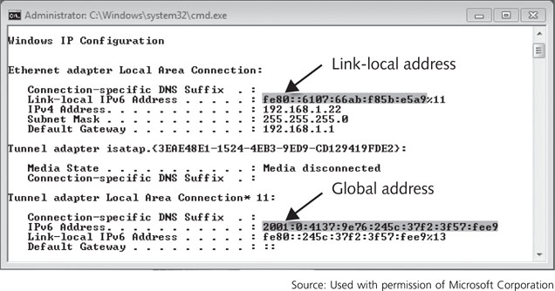
IPv6 Utilities
Ipconfig: shows IPv6 configuration details
Can also use the command with IPv4
Figure 2-10 Using the ipconfig command

Slide 55
IPv6 Utilities
Netstat: display system’s routing tables by using netstat –r command
Netstat -n option shows current sessions with the associated port numbers
Netstat –ps IPv6 option displays detailed statistics on IPv6 activity since the last boot
Netsh: command-line scripting tool on Windows systems that allows troubleshooting and configuration of network interfaces

Slide 56
Summary
TCP/IP is a suite of protocols for transmitting information from point to point on a network
TCP and UDP map to the Transport layer and IPv4, IPv6, ICMP, and ICMPv6 map to the Network layer of the OSI model
IP addresses most commonly used on the Internet conform to IPv4
You must understand the normal configuration of fields in IP, TCP, and UDP headers to recognize and filter unwanted or malicious traffic

Slide 57
Summary
Fragmentation of IP packets allows large packets to pass through routers with frame size limits
DNS translates fully qualified domain names into IP addresses
TCP three-way handshake establishes a reliable connection between two points
IPv6 was designed to address problems with IPv4
IPv6 is a connectionless, unreliable protocol used mainly for addressing and routing packets
ICMP is used for reporting errors and diagnostics

Slide 58
Summary
MLD enables IPv6 routers to discover multicasts
IPv6 uses ND to perform tasks that ARP, ICMP Router Discovery and ICMP Redirect handled
Hexadecimal numbering format makes IPv6 addresses manageable
IPv6 uses three types of addresses: unicast, multicast, and anycast
You can monitor and configure IPv6 using tools such as Ipconfig, Netstat, and Netsh

