Slide 1

Guide to Network Defense and Countermeasures Third Edition
Chapter 12
Internet and World Wide Web Security

Slide 2
Objectives
Describe weak points in the structure of the Internet
Explain attack techniques against Web sites and Web users
Explain methods for hardening Web and Internet resources

Slide 3
Examining the Structure of the Internet
Internet use as increased exponentially in the past 10 – 15 years
Opportunists seek to exploit poorly designed systems on the Internet
As attackers discover new exploits
Vendors distribute notifications and patches to defend against exploits

Slide 4
Understanding the Structure of the Internet
Internet: group of networks tied together to form an infrastructure for communication
First established in mid-1960’s
World Wide Web: uses Hypertext Transfer Protocol (HTTP) and is just one of the services the Internet offers
E-mail (uses SMTP) and file transfer (uses FTP) are other services offered by the Internet
Uses web servers, web browsers, and web pages to communicate information through the Internet

Slide 5
Tier System
Tier System
Begins with a backbone network connected via network access points (NAPs) to regional Internet service providers (ISPs)
Regional ISPs service point of presence (POP) ISPs that connect to business, education, or home networks

Slide 6
Tier System
Routers and the Internet Communication Backbone
Internet Communication Backbone: network of backbones owned by businesses or network service providers (NSPs)
Routers direct network traffic to its destination via routing tables
Routers in NSP backbones differ from LAN routers by high amount of traffic they are designed to handle
Physical memory, CPU speeds, interfaces, and OSs can support enormous amounts of traffic

Slide 7
Tier System
Network Access Points (NAPs)
Highly secure public facilities where backbones are interconnected
Provide physical space, power, and network connectivity between different levels of Internet tier
Positioned in each country to provide interconnectivity
Internet Service Providers (ISPs)
Local or POP ISP provides Internet access directly to consumers or businesses
Regional ISP sells bandwidth to local ISPs
Backbone ISP or NSP gives regional ISPs backbone access

Slide 8
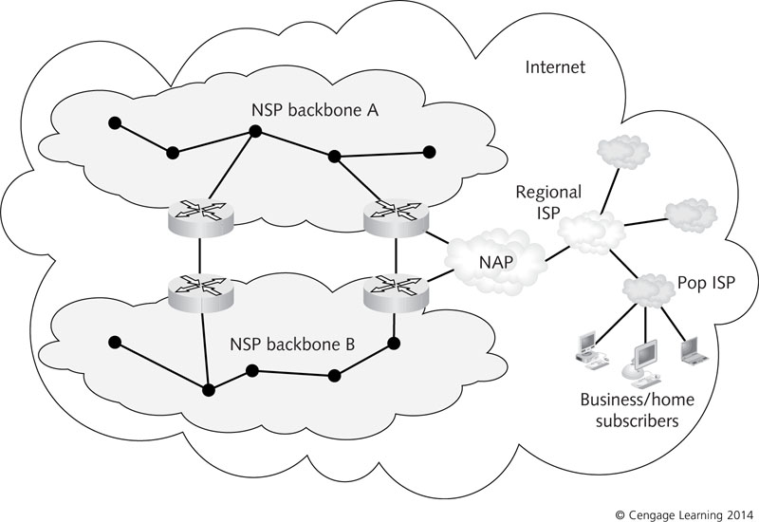
Figure 12-1 The Internet backbone: a network of NSP backbones

Slide 9
Tier System
Domain Name System (DNS)
Name-resolution service that translates fully qualified domain names to IP addresses
DNS is a hierarchical system
Root servers know which servers on the Internet are responsible for top-level domains
Each top-level domain has its own servers that delegate responsibility for domain name-to-IP address resolution to lower name servers
Anycast addressing enables any group of servers to act as a root server

Slide 10
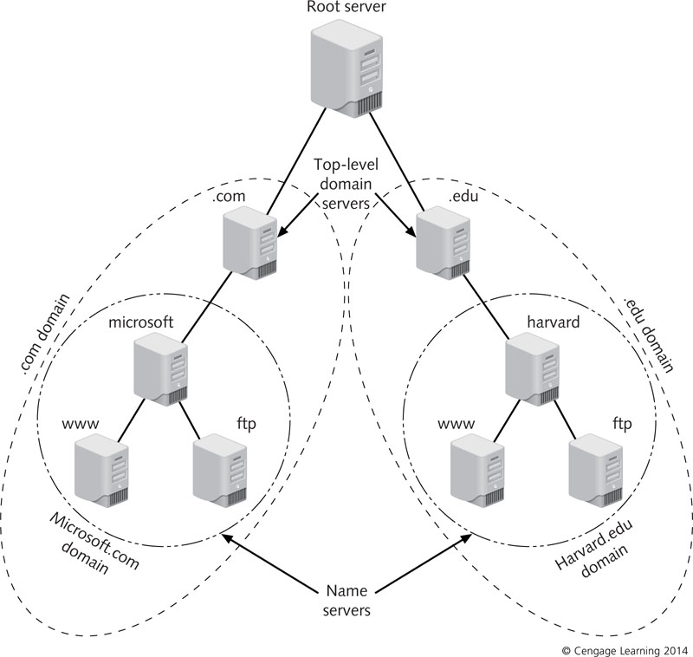
Figure 12-2 DNS hierarchy

Slide 11
Understanding Weak Points in the Internet’s Structure
Attackers constantly discover new ways of exploiting the Internet infrastructure
IP Spoofing: When attackers change the source IP address in the headers of malicious packets they are sending to match a trusted host’s IP address
Attackers send ping packets into a network to find legitimate IP addresses
Used most often in denial of service (DoS) attacks
Goal is to flood the network with packets and cause it to crash
Packet filtering through routers is a major defense

Slide 12
Understanding Weak Points in the Internet’s Structure
Routing Security
Routing protocols are used to communicate information updates for routing tables
Routing information is not authenticated
Vulnerable to compromise
DNS Security
DNS information is not authenticated
DNS cache poisoning (DNS spoofing): attackers can send false data to a name server
Steer unsuspecting victims to a server of their choice
DNS information leakage: attackers gain access to DNS database entries

Slide 13
Understanding Weak Points in the Internet’s Structure
Internet Host Security
Attackers hijack unprotected computers and use them as “zombie” computers to deliver spam e-mail, DoS attacks, and malicious code
Botnets: networks of zombie computers
Assembled by attackers to magnify the scope and intensity of their attacks
According to M86 Security Labs:
91 percent of spam e-mail sent in May 2012 was delivered by hijacked zombie computers
Practices to minimize risks:
Antivirus software, firewalls, and system patches

Slide 14
Web Site Attack Techniques
Attack Techniques Against Web Servers
Attackers probe common hardware/software server configurations in an attempt to discover security holes
Attackers often select Web servers that handle banking and e-commerce
Targets for identity theft

Slide 15
Buffer Overflow Attacks
Exploits software vulnerabilities over which users and network security personnel have little or no control
Attacks often come with no warning and are almost impossible to detect and fix
Source code is wrapped in a “black box” to protect it from tampering
Many attackers have the skill to access anyway
Security problem starts when attackers discover poorly written code that causes buffer overflows
Inject malicious code into this breach

Slide 16
Buffer Overflow Attacks
Buffer: section of random access memory shared by application processes that depend on one another
Coordinate data intended for use by separate activities
Critical buffer component for coordination is the call or function stack
Buffer flow attacks are usually aimed at this
Stacks are allocated a fixed size in memory
If process of pushing instructions on the stack consumes all space allocated for stack, a buffer overflow occurs

Slide 17
Buffer Overflow Attacks
Defending against a buffer attack is usually reactive
Best defense is to install patches and updates as soon as they are available
Most buffer attack damage is inflicted on unpatched systems
Installing intrusion detection and prevention software can also be beneficial

Slide 18
SQL Injection Attacks
Structured Query Language (SQL): used to communicate with most relational database management systems (RDBMSs)
SQL injection: plaintext scripting that is easy to learn and apply
Does not attack a Web server directly
Attacks the database used to support Web sites housed on the Web server

Slide 19
SQL Injection Attacks
SQL Injection: Web Form Attacks
Web forms used to gather information are potential entry points for attackers
If form’s entry text boxes are not verified correctly, attackers can use them to send malicious code to the database, database server, or Web server
Common method of finding candidates:
Use a Google search for login pages
Attacker hopes to generate an error on the login page in order to find information

Slide 20
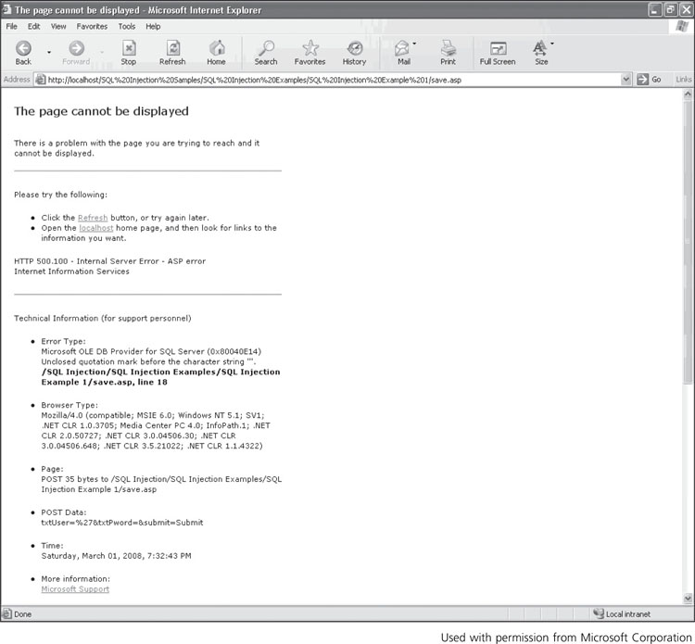
Figure 12-4 A database-generated error message

Slide 21
SQL Injection Attacks
SQL Injection: Web Form Attacks (cont’d)
With input from an error message, the attacker might be able to learn:
The Web page is not well protected from intrusion
The database uses SQL Server and the Web server uses Internet Information Services
A careless administrator has not changed the default database username (sa)
Pages are constructed with Active Server Pages (ASP)
Could be a clue about the coding languages used on this Web site
Requires patience but attackers could learn enough to cause serious damage

Slide 22
SQL Injection Attacks
SQL Injection: Query String Attacks
Involves the query string used to send information to a database
When a user clicks on a link on a Web page, information is sent to the Web server
Attackers use this method to probe Web databases for vulnerabilities
Same technique as Web form attacks with a different injection point
Goal of a query string probe is to gain additional information about a database’s structure for future attacks

Slide 23
SQL Injection Attacks
Defenses Against SQL Injection Attacks
SQL injection attacks are isolated custom applications
Administrators can prevent them, unlike buffer overflows
Take the following steps to close all potential holes:
Tighten database authentication and limit table access
Use stored procedures to eliminate passing any SQL commands to the database
Validate all user entries to make sure they are formed properly

Slide 24
SQL Injection Attacks
Defenses Against SQL Injection Attacks
Take the following steps to close all potential holes (cont’d):
Place the Web server and database server in a network DMZ
Use nonstandard naming conventions in database construction
Inevitably, database errors do occur, so configure a custom error message that does not reveal information for attackers to exploit

Slide 25
Attack Techniques Against Web Users
Social engineering attacks prey on emotions such as curiosity, anxiety, fear, and greed
Almost all attacks against Web users can be prevented
Attacks on Web users:
Identity theft
Simple malicious behavior
Informed Web users should understand attack methods and know how to prevent them

Slide 26
Phishing Attacks
Phishing: attack through a Web browser that displays false information masquerading as legitimate data
Designed to steal personal information such as credit card data, account numbers, usernames, and passwords
Simple form of phishing is the Nigeria money scam
Perpetrator send e-mail asking for help in transferring money from Nigeria to US
Another form involves Web page deception
Attacker send email that appears to come from trusted source (banks, insurance companies, etc…)

Slide 27
Phishing Attacks
Phishing e-mails have the following characteristics:
E-mail is unsolicited and unexpected
Logo and graphics are copies of corporate images
Message uses generic greeting, such as “Dear valued customer” or “Corporate bank user”
Message conveys a sense of urgency, such as “Please respond immediately”
Personal account information is requested
Contains a link that seems to be a secure HTTPS link
Usually the link to which you are redirected is no longer active after several hours
Attacker play a game of hit-and-run to avoid authorities

Slide 28
Phishing Attacks
Objective of a phishing attack is to entice e-mail recipients to click on the bogus link, visit fake Web site, and enter personal information
Variations of phishing:
Pharming: traffic to a legitimate Web site is redirected to the attacker’s Web server
Spear phishing: attacker identifies users or groups in an organization by using common avenues
Such as e-mail, telephone, Facebook, and corporate Web pages
Then mounts a campaign to exploit employee’s authentication credentials

Slide 29
Phishing Attacks
Train employees to follow these simple guidelines for preventing phishing attacks:
Check the browser address bar and footer
If no HTTPS address or lock icon, it is not secure
If you get an e-mail from a familiar company
Call to check that e-mail is legitimate
Forward any obvious phishing e-mails to company being portrayed in the phishing attempt
PayPal and eBay have forwarding addresses set up for this purpose
Delete any unsolicited e-mails about foreign banking

Slide 30
File Attachment Attacks
Attacks first occurred in 2002
JPEG attachments had virus code embedded in file header code
Attack requires two virus components:
First part spreads in the form of a traditional Win32 executable virus
Virus makes changes to the Registry so that JPEG files are run through an extractor
Virus strikes is user tries to view a JPEG image
Extractor find the second virus component in the graphics file header
Users should be cautious of viewing image file attachments from unknown sources

Slide 31
ActiveX Control Attacks
ActiveX control: a Windows object coded in languages such as C++, Visual Basic, and Java
Purpose is to deliver dynamic, interactive content to Web pages
Attackers discovered that an ActiveX control can be programmed to run malicious code on a user’s Web browser
They run automatically when browser loads and have almost full access to the Windows OS
Can access and download files, plant Trojan programs and worms, or destroy system programs

Slide 32
ActiveX Control Attacks
Defense against malicious ActiveX controls:
Use security settings on Web browsers to block ActiveX controls from running
Adjust browser settings to permit certain types of ActiveX controls to run and block others

Slide 33
Java Applet Attacks
Java applet: small program sometimes used as embedded code in Web pages
In Internet Explorer attacks:
Malicious code embedded in a Java applet was used to exploit a proxy server network connection
User’s session was redirected so the attacker was able to capture user’s information
In Netscape attacks:
Java applet code gained access to unauthorized local and remote files
By opening a connection to a URL
Patch your system with latest updates and fixes

Slide 34
Hardening Web and Internet Resources
Establishing and maintaining a hardened network with secure hosts requires vigilance with updates
New versions of software, hardware, and network media are released frequently
Threats against networks change just as often
Enlist help of security experts and adopt a preventative stance toward network security
Check with supplier of your firewall and antivirus software for guidelines on how to best use products
Many offer automatic, timely downloads of latest virus signature databases

Slide 35
Hardening DNS Servers
Primary DNS server – authoritative for specific domains and has DNS zone files
Zone file: set of instructions for resolving domain names into IP addresses
Internal zone file contains entries of all internal hosts on a network
External zone file contains only host entries visible to public
Secondary DNS server – receives a read-only copy of the zone file
Zone transfer: occurs when a zone file is sent from primary to secondary DNS servers

Slide 36
Hardening DNS Servers
If zone transfers are not secured
Attackers might be able to intercept and retrieve a complete listing of network resources and possible targets for attack
Transfers should be allowed only between primary and secondary DNS servers
Administrators who allow untrusted Internet users to perform zone transfers are making a huge mistake
If DNS server does not use a segregation method to separate external DNS information from private internal information, internal IP address and host name information could be exposed

Slide 37
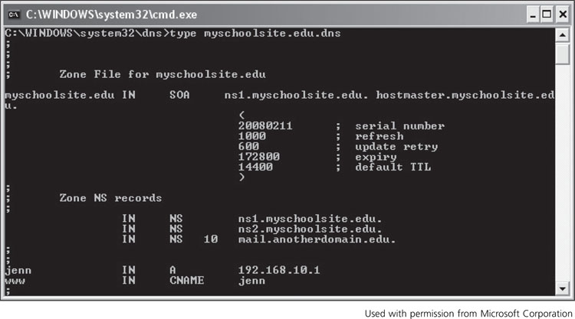
Figure 12-6 A zone file for myschoolsite.edu

Slide 38
Hardening DNS Servers
Securing zone transfers is straightforward:
Configure all DNS servers to restrict zone transfers to specific authorized servers
If an organization has a DNS server that is authoritative for its domain on the Internet
DNS server should be in a DMZ using a split DNS architecture
Split DNS architecture: physically separates public DNS servers from organization’s internal DNS servers
Split brain DNS architecture: physical separation exist between internal and external DNS servers, but both DNS systems use the same domain

Slide 39
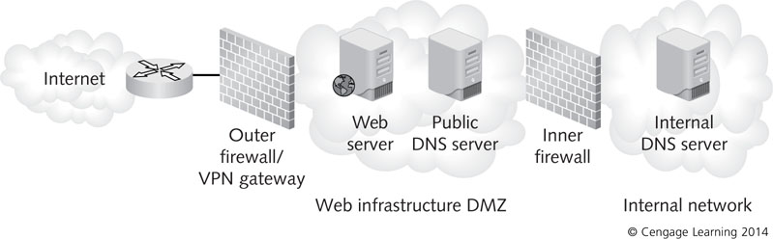
Figure 12-7 A split DNS architecture

Slide 40
DNSSEC
DNS Security Extensions (DNSSEC)
Created to thwart some DNS attacks
Uses cryptographic techniques to provide security for DNS data
Goals of DNSSEC:
Provide authentication of DNS data
Ensure integrity of DNS data
Authenticate the denial of existence of DNS data
Security-aware resolver: system that is compliant with DNSSEC and attempts to use a DNS server to resolve a fully qualified domain name to IP address

Slide 41
DNSSEC
Larger ISPs have begun implementing DNSSEC
Does have weaknesses:
Does not provide message confidentiality
Does not protect against DDoS attacks
Attacker may be able to enumerate the contents of a DNS zone by following the NSEC resource record chain
NSEC resource record: Next Secure record that allows a resolver to trace the authentication path of the RRSIG
DNSSEC is more complicated than DNS
Increases possibility of errors

Slide 42
Hardening Windows Web Servers
Web servers are usually secured by hardening the underlying OS, installing patches, disabling unused services, and restricting number of user accounts and their access permissions
Internet Information Services (IIS) is the Web server used in:
Windows 2000, Windows XP Professional, Windows Server 2003 and 2008, Windows Vista, and Windows 7

Slide 43
Hardening Windows Web Servers
Authentication
When configuring Web server security, IIS 7 allows you to select one of two forms of authentication:
Challenge-based authentication – web client must respond to a challenge from the Web server
Login redirection-based authentication – users must enter credentials on a login page
Windows Basic Authentication requires users to enter a username and password (not browser specific)
Transmits passwords in plain text
Windows Digest Authentication uses Active Directory to authenticate users
Client browser must support HTTP 1.1 protocol

Slide 44
Hardening Windows Web Servers
Authentication (cont’d)
Windows Authentication supports both Kerberos and NTLM (New Technology LAN Manager) authentication
Extended Protection – authentication method available in IIS 7.5
Designed to decrease risks associated with man-in-the-middle attacks
Provides additional information, such as channel-binding tokens and service-binding identifiers

Slide 45
Hardening Windows Web Servers
Access Control
IIS 7 allows you to restrict access to Web server based on IP address, IP address ranges, and domain names
Can be limited based on other parameters such as computers, groups of computers, or domains
Access can also be restricted to certain Web sites, applications, directories, and individual files
Data Confidentiality
IIS supports SSL encryption
Can request and install Internet server and domain server digital certificates

Slide 46
Hardening Windows Web Servers
Controlling Dynamic Content
Windows Web servers use Internet Server Application Programming Interface (ISAPI) and Common Gateway Interface (CGI) to provide interactive and dynamic content
IIS 7 allows restriction of the activity of ISAPI and CGI components
Shared Configuration
IIS 7 supports shared configuration
Allows administrators to import configuration files and cryptographic keys from a centralized location
Can also be exported to a single server as a backup

Slide 47
Hardening Windows Web Servers
Other Security Considerations
Underlying Windows OS must be hardened and maintained with latest updates and patches
A domain controller should not function as an IIS Web server
Place the Web server in a secure room
Do not connect the IIS Web server to the Internet before it is fully hardened
Remove NTFS write and execute permissions when possible to minimize risk of unauthorized users changing files or running programs

Slide 48
Hardening Windows Web Servers
Other Security Considerations
Grant permissions for modifying and viewing IIS logs to system and local administrators only
Allow only the administrator to log on locally to the Web server
Place the Web server in a firewall-protected DMZ
If serving Web pages to the Internet

Slide 49
Configuring Security Settings in Apache Web Server
Apache Web Server – most widely used Web server application
Installed mainly on UNIX and Linux systems
A Windows version is available
Must still be hardened to ensure security for Web sites and users
Center for Internet Security (CIS) recommends the following security settings for Apache:
Harden underlying OS
Install latest Apache binary distribution code from the OS vendor

Slide 50
Configuring Security Settings in Apache Web Server
Recommended security for Apache (cont’d):
Disable unnecessary Apache modules and services
Create Web groups so that users can be granted limited administrative rights, not root access
Create user and group accounts with limited privileges for running Apache Web Server
Never run Apache as the root account
Subscribe to OS vendor and Apache security advisories to stay informed about security issues
Develop customized messages for Web pages that display errors

Slide 51
Configuring Security Settings in Apache Web Server
Recommended security for Apache (cont’d):
Install ModSecurity module to have URLs in Web traffic inspected for anomalies
Use Digest authentication instead of Basic
Use SSL to encrypt communication from user to Web server
Limit Web server to accept and process only certain HTTP request methods
Disable HTTP traces
Enable logging on the Web server

Slide 52
Summary
The Internet is an interconnected web of networks and computers that work together to provide worldwide communications
Domain Name System (DNS) is a hierarchical system that provides name-resolution services for translating host names to IP addresses
Internet weak points are caused by problems with IP address authentication, routing protocol security, DNS security, and Internet host security
TCP/IP does not authenticate IP addresses

Slide 53
Summary
DNS was originally designed as a public database for name-resolution services
Checking the authenticity and integrity of information stored in name servers wasn’t considered necessary
Millions of host computers around the world are the weakest point of the Internet infrastructure
Web servers are the Internet components that attackers target most often
A buffer overflow attacks exploits coding flaws in common commercial software, such as OSs

Slide 54
Summary
A SQL injection attack uses plaintext scripting in an effort to generate information attackers can use to destroy data, disrupt Web site operations, and launch further attacks
Web user attacks exploit social engineering techniques to target users and take advantage of vulnerabilities in Web browsers
Phishing is an attack through a Web browser
ActiveX controls do not require user action to be activated and have almost full access to Windows

Slide 55
Summary
To harden DNS servers, allow zone transfers only between primary and secondary DNS servers
IIS 7 has features that allow you to improve security
Controls for authentication, encryption, authorization, and access
CIS recommendations are helpful guidelines for configuring server processes to harden Apache Web servers

