Slide 1

Chapter 6
Authenticating People

Slide 2
Chapter 6 Overview
Elements of Authentication
Passwords
  Evolution of Password Systems
  Password Guessing
  Attacking Password Biases
Authentication Tokens
Biometrics
Authentication Requirements and Controls

Slide 3
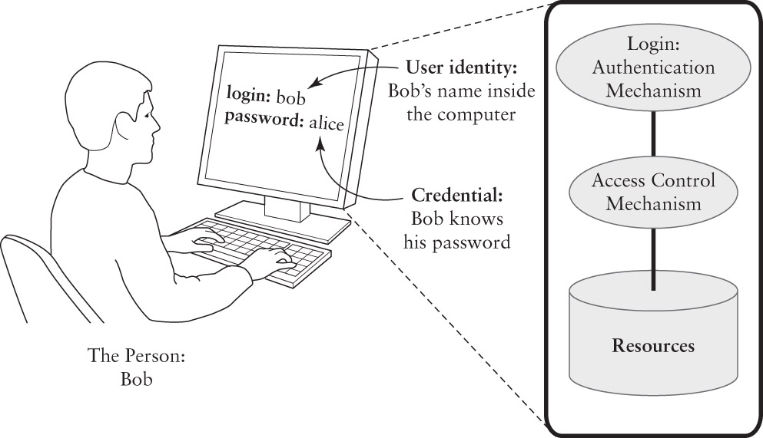
Elements of Authentication

Slide 4
Authentication Factors
Something you know
  Password or PIN
Something you have
  Key or Token
Something you are
  Personal trait
Traditional parallel terms:
Something you know, are, have

Slide 5
Multi-factor Authentication
Using different factors in authentication
  NOT two or three instances of the same factor
Two-factor authentication
  ATM authentication: ATM card + PIN
  Biometric laptop: Fingerprint + password
  NOT: Password + PIN
Three-factor authentication
  Biometric access card: fingerprint+card+PIN
  NOT: fingerprint+PIN+password

Slide 6
Authentication Threats
Focus in this chapter
  Trick the authentication system or access assets through the system
  No “remote” attacks via Internet or LAN
  Threats must have physical access to system
Range of threats
  Weak Threat – authentication is effective
  Strong Threat – authentication may work
  Extreme Threat – authentication not effective

Slide 7
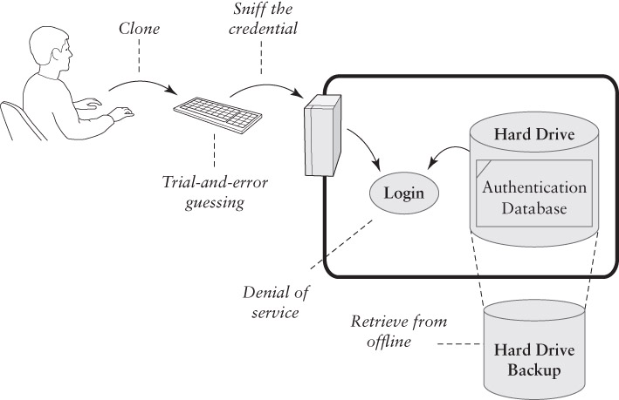
Attacks on Authentication

Slide 8
Password Authentication
Each User ID is associated with a secret
  User presents the secret when logging in
  System checks the secret against the authentication database
  Access granted if the secret matches
Risks
  Shoulder surfing at the keyboard
  Reading the password off of printer paper
  Sniffing the password in transit or in RAM
  Retrieving the authentication database

Slide 9
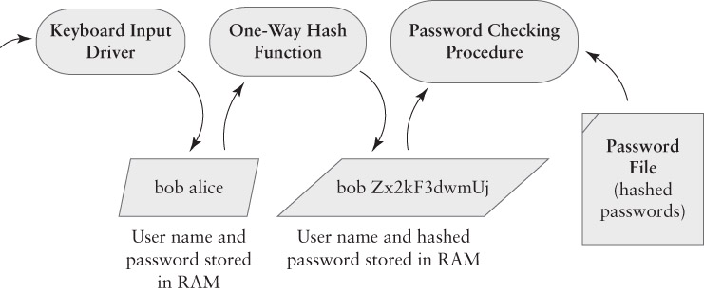
Password Hashing

Slide 10
One-Way Hash Functions
A Cryptographic Building Block function
  We will see more building blocks later
Input:
  An arbitrarily large amount of data, from a few bytes to terabytes – RAM or files or devices
Output:
  A fixed-size result
  Impractical to reverse
  Minor change to input = big change to output

Slide 11
Sniffing Passwords
Goal: intercept the password before it is hashed
Keystroke loggers
  In Hardware: devices that connect to a keyboard’s USB cable
  In Software: procedures that eavesdrop on keyboard input buffers

Slide 12
Password Guessing
DOD Password Guideline (1985) required a minimum 1 in a million chance of successful guessing.
  This was designed to defeat interactive password guessing: a person or machine made numerous guesses
Some guessing succeeds based on social and personal knowledge of the targeted victim
Modern network-based guessing can try tens of thousands of alternatives very quickly.

Slide 13
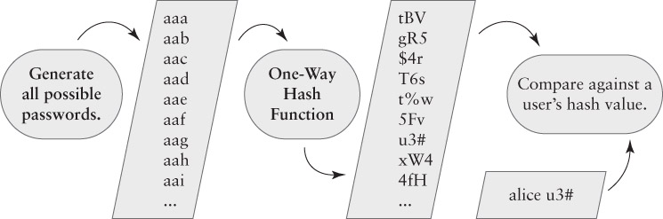
Off-line password cracking

Slide 14
How fast is off-line cracking?
It depends on the size of the search space
  I.e. how many legal – or likely – passwords?
Legal passwords are limited to specific sets of characters, typically from the ASCII set
  Single-case letters only:
    Two letter passwords = 26²
    Three letter passwords = 26³
    … etc.
    Password with L letters = 26^{L}

Slide 15
Increasing the search space
Two options
  Increase L – the length of passwords
  Increase A – the range of letters and other characters in the password’s alphabet
    Also called the character set
Search space for fixed length password = A^{L}
Search space for range of lengths from 1 to L
  A summation of individual lengths
  Reduces to algebra: (A^{L+1} – 1)/(A – 1)

Slide 16
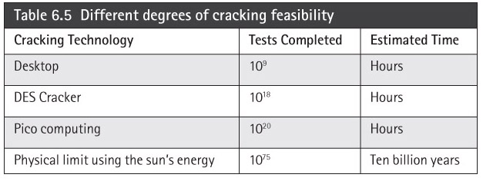
Speed of Cracking
Varies with different hardware and assumptions
  Best case: cracking with a desktop computer
  Bad case: using custom hardware
  Worst case: using the limits of physics

Slide 17
Exploiting Password Bias
Attacker doesn’t try every possible password
Restricts the search space to likely passwords
  Morris worm successfully used this attack
  Similar attack used by Anonymous and Lulz in 2011 to extract passwords from hashes
A dictionary attack
  Uses a list of likely passwords as the password space
  There are far fewer likely passwords than possible passwords

Slide 18
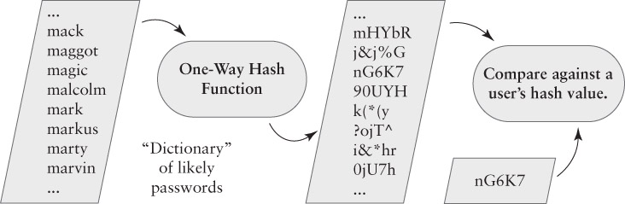
A Dictionary Attack

Slide 19
Dictionary Attacks Work
The attacks don’t recover all passwords, but they recover enough to make them worthwhile
  Exploit the likelihood that some user choose weak passwords
Research or Incident | % Guessed
Morris worm, estimated success (1988) | ~50%
Klein’s Study (1990) | 24.2%
Spafford’s Study (1992) | 20%
CERT Incident 1998-03 | 25.6%
Cambridge study by Yan, et al. (2000) | 35%
Lulz and Anonymous, estimated success (2011) | 30%

Slide 20
Assessing Bias-based Attacks
Entropy in data indicates the likelihood that a particular message may appear
  It considers the range of possible messages and the likelihood of each one
Randomly chosen characters have more entropy that readable text
  Language enforces a bias in the choice of letter sequences
  Estimated entropy in English text is 1 to 3 bits per character

Slide 21
Average Attack Space
An estimate of the likelihood that a trial-and-error attack will succeed against a community
  We construct a dictionary of passwords that the community is likely to use
  We estimate the likelihood that the community chooses those passwords
      V = S / (2L)
V = # of trials for a 50% chance of success
S = size of the search space (dictionary)
L = Likelihood that users choose from dictionary

Slide 22
An Example: 4-digit Luggage Lock
Assume that there are hundreds of these locks being used
25% of the owners pick a 4-digit date as the combination
  1 out of 366, not 1 out of 10000
      V = 366 / (2 x .25)
      V = 732
50% chance of success requires 732 date trials, not 5000
Must try different locks at random!

Slide 23
Password Ping-Pong
Attacks
Defenses
??
One-Time Passwords
Network Sniffing
Password Tokens
Password Sharing
Memory Protection
Keystroke Sniffing
Help Desk Restrictions
Social Engineering
Guess Detection
Guessing
Password Hashing
Steal the Password File
Passwords

Slide 24
Authentication Tokens
Benefits
Hard to attack - uses a stronger secret than you get in a typical password
Hard to forge - must hack the hardware
Hard to share – secret stored in hardware
Problems
Expensive - must buy hardware and/or special authentication software
Can be lost or stolen
Risk of hardware failure

Slide 25
Types of Tokens
Passive Tokens – the most common
  Stores an unchanging credential
  Examples: card keys for hotel rooms
    Magnetic stripes on credit cards
Active Tokens – the most secure
  Stores a secret that generates a different credential for each login
  Examples: one-time password tokens
    Challenge Response tokens (older devices)

Slide 26
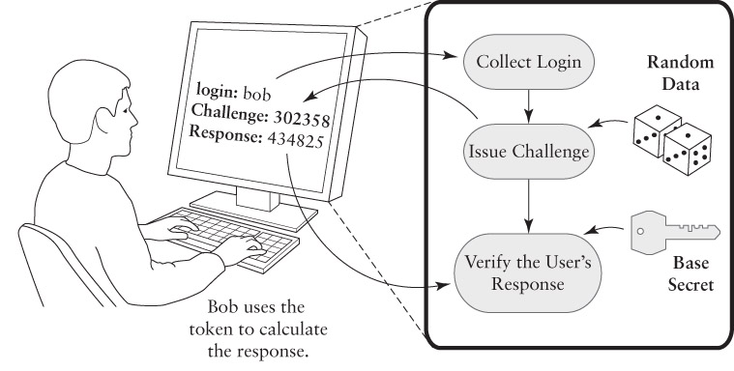
Challenge Response Authentication

Slide 27
Another Crypto Building Block
Challenge Response is a protocol
  An exchange of data to yield a shared result
Four steps:
  Bob says, “Authenticate me!”
  Alice says, “The challenge is 56923”
  Bob calculates the response and says, “The response is 17390.”
  Alice checks Bob’s response against what she expected, using the same calculation
Calculation relies on a shared secret

Slide 28
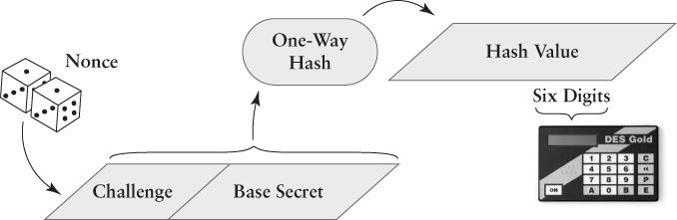
A challenge response calculation

Slide 29
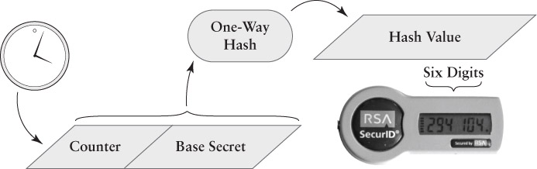
A one-time password token

Slide 30
Token Vulnerabilities
Clone or borrow credential
  Borrowing is possible, but detectable
  Cloning should be impractical
Sniffing and trial-and-error guessing
  Both should be impractical
Denial of service
  Token may be lost, damaged, or stolen
Retrieve from backup
  Attacker could steal the authentication database – 2011 incident with SecurID

Slide 31
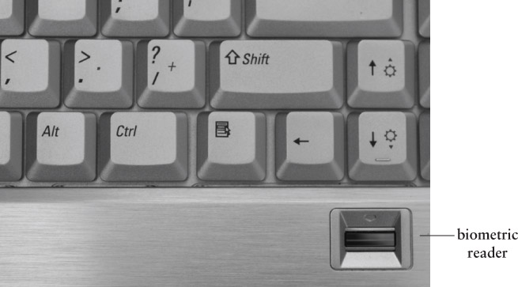
Biometric Authentication
Courtesy of Dr. Richard Smith

Slide 32
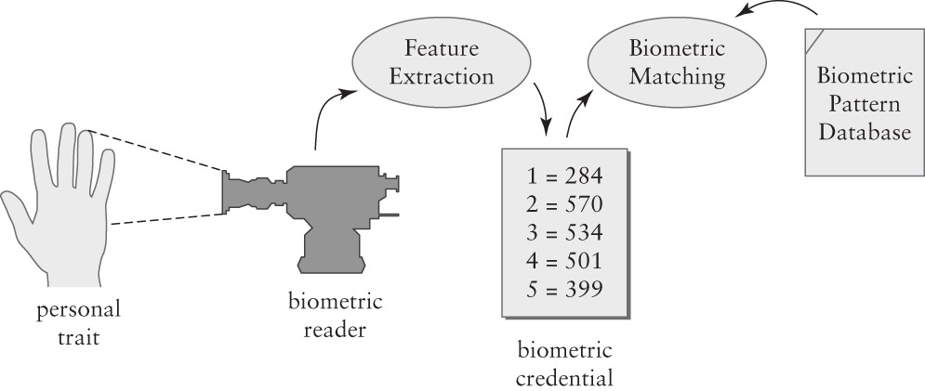
Elements of Biometric Authentication

Slide 33
Biometric Accuracy
Two types of errors
  False acceptance – incorrectly detects a match with a credential and the database
  False rejection – fails to detect a match between a credential and the database
False Acceptance Rate (FAR)
  Likelihood of incorrectly authenticating someone as an authorized user
    Average attack space = 1 / (2 x A_{FAR})
False Rejection Rate (FRR) – denial of service

Slide 34
Biometric Vulnerabilities
Clone or borrow credential – often
  Demonstrated many times with fingerprints, faces, voices, etc.
Sniff the credential and replay – often
  Possible in networked and remote systems
Trial and error guessing – slight
  Requires a team of attackers
Denial of service – possible
Retrieve from backup – possible

Slide 35
Authentication Requirements
Constructing a policy for an isolated computer
Answer these questions:
  Is the computer used at home, at work, or both?
  For each environment, are there threats?
  For each threat, is it a weak or strong threat?
Weak threat: Might make an opportunistic attack on a vulnerable computer.
Strong threat: Will spend time and effort on an attack, if unlikely to be detected and/or caught

Slide 36
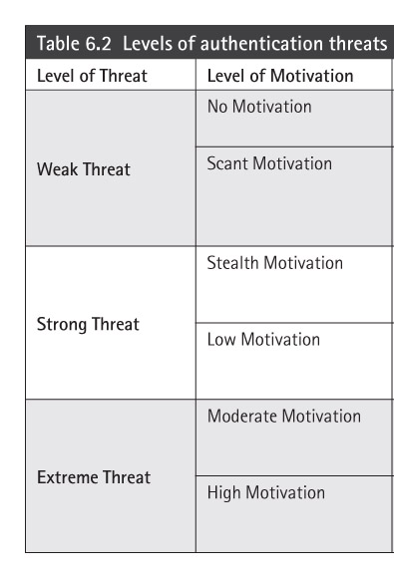
Threats and Motivations

Slide 37
Weak Threat Environments
At Home
  Avoid opportunities for shoulder surfing
  Do not write down passwords that are at risk of being stolen
  Passwords should be hard to guess and easy to remember
At Work – similar to home, except:
  Passwords may be written down as long as the user keeps physical possession of the list
  Authentication tokens may be used

Slide 38
Strong Threat Environment
Using Passwords
  System should track failed password guesses to try to detect guessing attacks
  Protect against keyboard sniffers
  Pick passwords that resist off-line attacks
  The system should provide “secure attention”
Other options:
  Passwords plus tokens (Not for home use)
  Passwords plus biometrics

Slide 39
Password Selection and Handling
Password selection
  Choose passwords according to the risk faced by the assets it protects
    Pick strong passwords for valuable assets
  Use different passwords to protect different types of assets (if you reuse passwords)
Password protection
  Keep an electronic, password-protected list
  Keep a paper list of less critical passwords
  Lock up a list of essential passwords safely

