Slide 1
WireShark & SNORT
Chad Ballay
CYBR420-342N
Week7

Slide 2
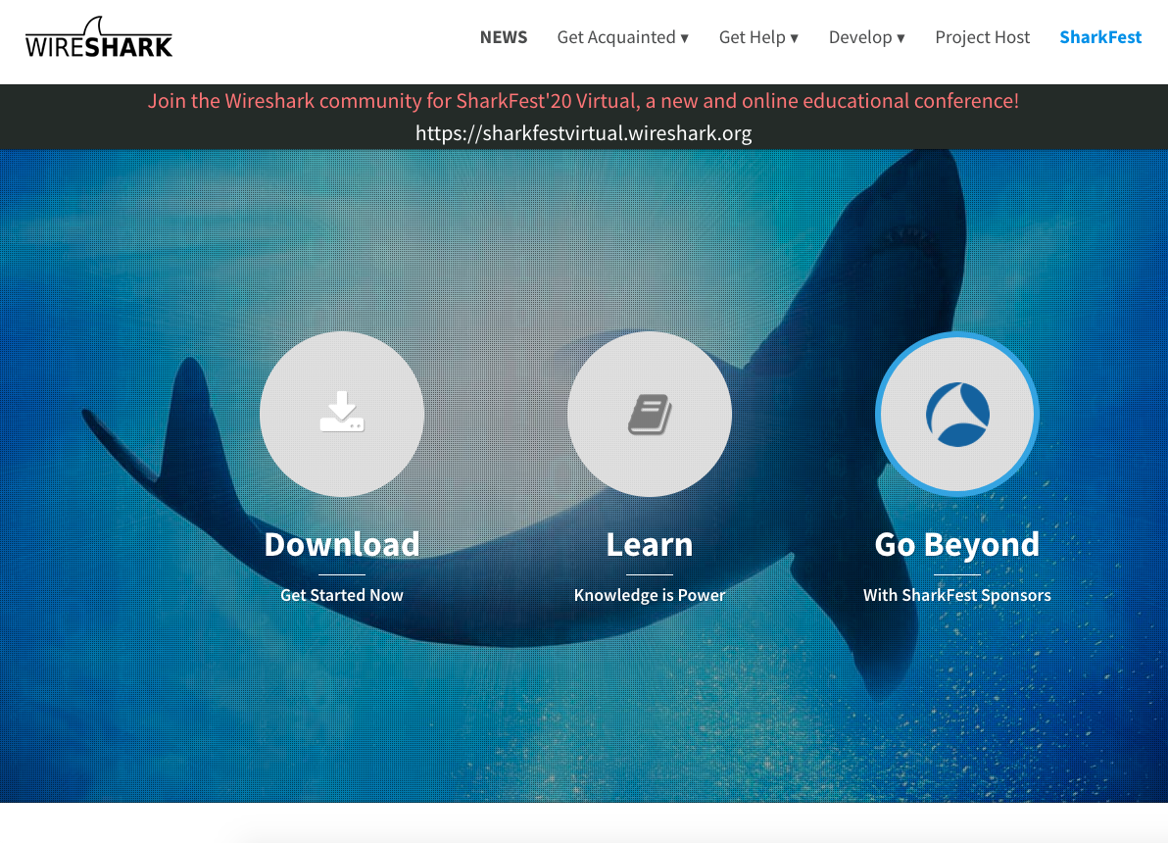
Initial Release: 1998
Current Version: 3.2.7 (Sept 23, 2020)
License: GPLv2
Repository: https://github.com/wireshark/wireshark
https://www.wireshark.org/

Slide 3
Origin and Governance
Gerald Combs faced a problem at his job as a network engineer. He needed to troubleshoot networking problems and wanted to learn more about networking in general. Compounding this was that the existing tools were either expensive or didn’t run on his available hardware.
Originally released under the product name Ethereal, when Combs changed jobs the project underwent a rename to WireShark. (In case you see references.) Gerald Combs is still actively involved in the day to day operations of the Wireshark governance but this name change precipitated a much more resilient governing structure. The long term viability seems assured.
More details can be read here about the history and current organizational structure:
https://www.wireshark.org/docs/wsug_html_chunked/ChIntroHistory.html
https://blog.wireshark.org/2018/07/wireshark-is-now-twenty/

Slide 4
What Does It Do?
Wireshark is a network packet analyzer.
Core Features:
Capture packets across a live network interaface
Import packet captures from existing tool exports
Display packet details in a user friendly GUI
Multiple filtering criteria to aid research
Export some or all of the packets captured
Additional analysis tools as well as a plugable architecture for thirdparty tools.

Slide 5
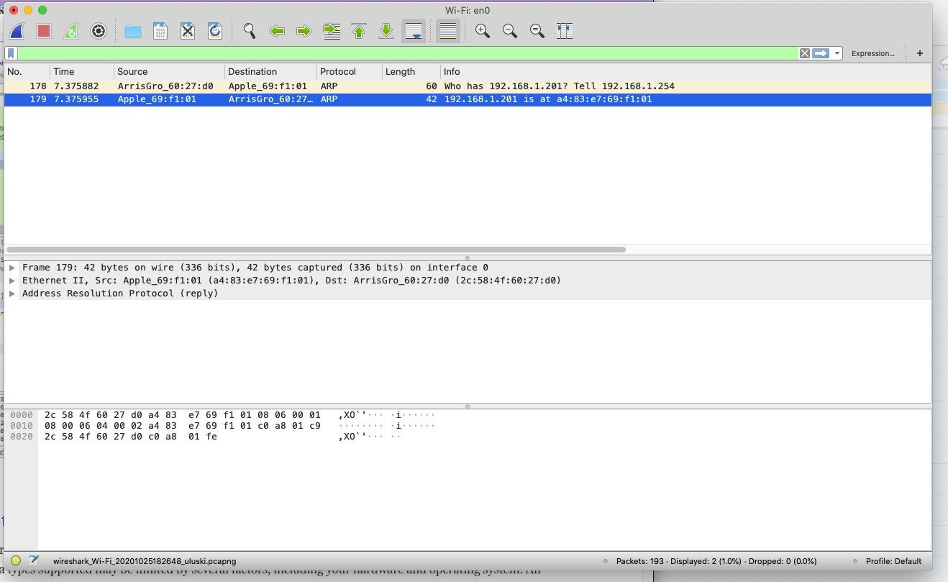
Simple example using ARP packets
Listening in on Wi-Fi en0 interface
Filtering only for ARP protocol
Can see that two ARP packets came across.
Knowing my network, I don’t recognize the ArrisGro_60. (OUI)
https://www.wireshark.org/tools/oui-lookup.html
Able to quickly identify that this is the manufacture for my Cable Modem/Gateway.

Slide 6
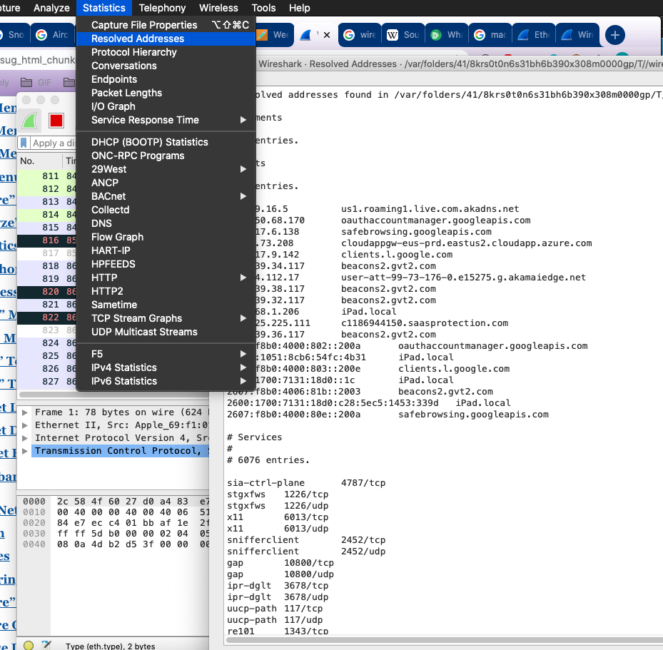
Built-in Analysis Tool Example
Start a capture and wait for a short duration.
Select Statistics -> Resolved Addresses
Review the new window it opens
During this capture you can begin to see what endpoints are being communicated with
*Upon further review, I need to install more adblocking software and possible start blocking more outgoing traffic…..

Slide 7
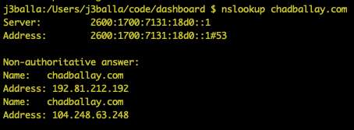
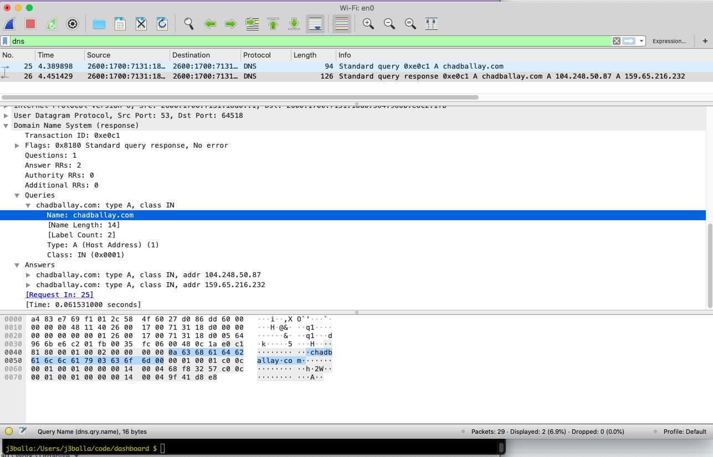
Example Using DNS Query
Start capture
Use nslookup tool to do a DNS lookup for chadballay.com
Filter in Wireshark for DNS queries
Inspect the packets be able to see what nslookup is actually sending/receiving.
Well one layer of the infrastructure onion. There is more to it than just this.

Slide 8
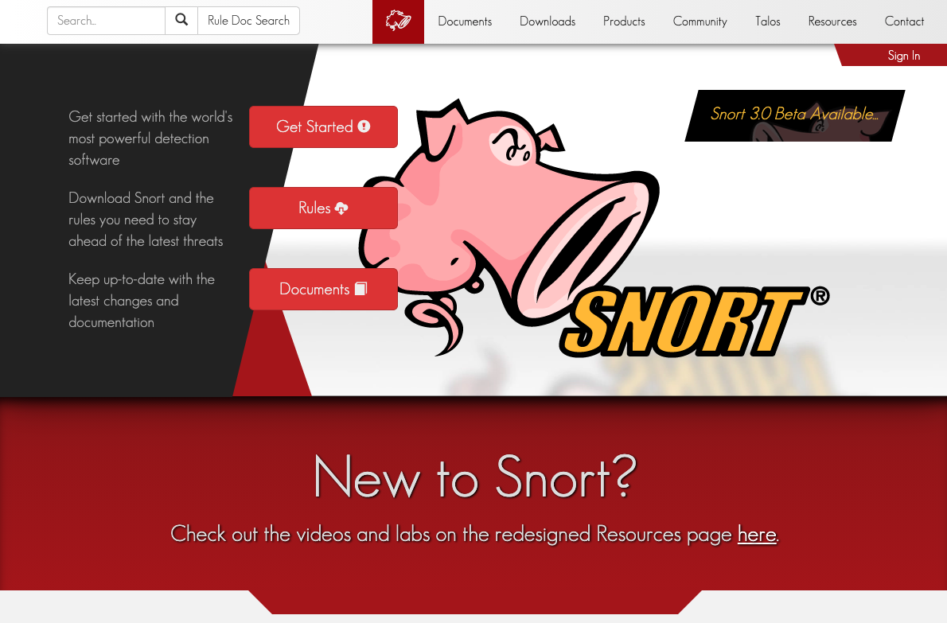
Initial Release: 1998
Current Version: 2.9.16.1 (Aug 4, 2020)
License: GPLv2+
Repository: https://github.com/snortadmin/snort3
https://www.snort.org/

Slide 9
Snort was developed in 1998 by Martin Roesch.
Originally developed under Sourcefire. Conveyed to Cisco when Cisco acquired SourceFire in 2013.
The governance seems to be within the Talos group of Cisco and there are some transparency questions that have been raised.
Origin and Governance

Slide 10
What Does It Do?
Snort is an open source network intrusion prevention system, capable of performing real-time traffic analysis and packet logging on IP networks. It can perform protocol analysis, content searching/matching, and can be used to detect a variety of attacks and probes, such as buffer overflows, stealth port scans, CGI attacks, SMB probes, OS fingerprinting attempts, and much more.
https://www.snort.org/faq

Slide 11
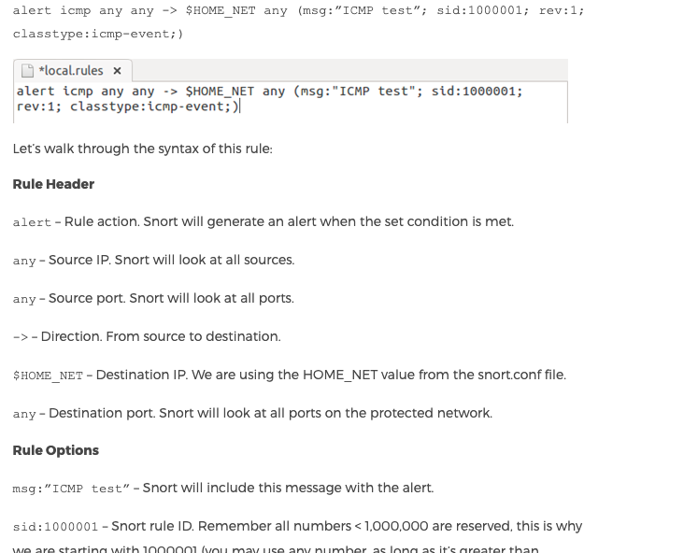
Snort Rules
The heart and soul of defining behavior in Snort.
Complex behavior requires complex and nuanced language domain.
This example captures all ICMP pings and logs an alert.
Rule complexity only increase from this point.
You can write your own or there are several businesses that are willing to sell you Snort rules.
Most notably
https://www.snort.org/products

