Slide 1

Guide to Network Defense and Countermeasures Third Edition
Chapter 1
Network Defense Fundamentals

Slide 2
Objectives
Describe the threats to network security
Explain the goals of network security
Describe a layered approach to network defense
Explain how network security defenses affect your organization

Slide 3
Overview of Threats to Network Security
Network intrusions cause:
Loss of data
Loss of privacy
Other problems
Businesses must actively address information security

Slide 4
Threats to Network Security
Knowing the types of attackers helps you anticipate
Motivation to break into systems
Status
Revenge
Financial gain
Industrial espionage

Slide 5
Threats to Network Security
Hackers
Attempt to gain access to unauthorized resources
Circumventing passwords, firewalls, or other protective measures
Disgruntled employees
Usually unhappy over perceived injustices
Steal information to give confidential information to new employees
When an employee is terminated, security measures should be taken immediately

Slide 6
Threats to Network Security
Terrorists
Attack computer systems for several reasons
Making a political statement
Achieving a political goal
Example: release of a jailed comrade
Causing damage to critical systems
Disrupting a target’s financial stability
Government Operations
A number of countries see computer operations as a spying technique

Slide 7
Threats to Network Security
Malicious Code
Malware
Use system’s well known vulnerabilities to spread
Viruses
Executable code that copies itself from one place to another
Can be benign or harmful
Spread methods
Running executable code
Sharing disks or memory sticks
Opening e-mail attachments
Viewing infected Web pages

Slide 8
Threats to Network Security
Worm
Creates files that copy themselves and consume disk space
Does not require user intervention to be launched
Some worms install back doors
A way of gaining unauthorized access to computer or other resources
Others can destroy data on hard disks
Trojan program
Harmful computer program that appears to be something useful
Can create a back door to open system to additional attacks

Slide 9
Threats to Network Security
Macro viruses
Macro is a type of script that automates repetitive tasks in Microsoft Word or similar applications
Macros run a series of actions automatically
Macro viruses run actions that tend to be harmful
Other Threats to Network Security
It is not possible to prepare for every possible risk to your systems
Try to protect your environment for today’s threat
Be prepared for tomorrow’s threats

Slide 10
Threats to Network Security
Social Engineering: The People Factor
Attackers try to gain access to resources through people
Employees are fooled by attackers into giving out passwords or other access codes
To protect against employees who do not always observe accepted security practices:
Organizations need a strong and consistently enforced security policy and rigorous training program

Slide 11
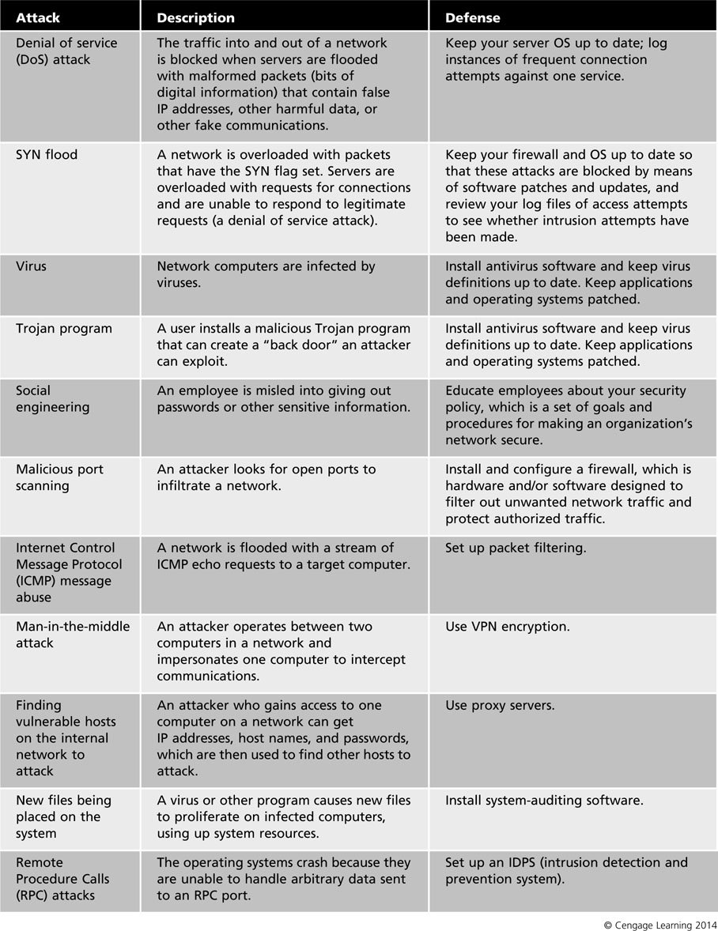

Slide 12
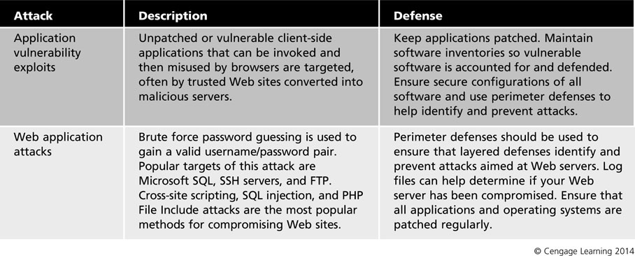

Slide 13
Internet Security Concerns
Socket
Port number combined with a computer’s IP address constitutes a network connection
Attacker software looks for open sockets
Open sockets are an invitation to be attacked
Sometimes sockets have exploitable vulnerabilities
Hypertext Transport Protocol (HTTP) uses port 80
HTTP is among most commonly exploited services

Slide 14
E-mail and Communications
Home users who regularly surf the Web, use e-mail and instant messaging programs
Personal firewalls keep viruses and Trojan programs from entering a system
Comodo Internet Security is an example of personal firewall program

Slide 15
Scripting
A network intrusion that is increasing in frequency is the use of scripts
Executable code attached to e-mail messages or downloaded files that infiltrates a system
Difficult for firewalls and intrusion-detection and prevention systems (IDPSs) to block all scripts
Specialty firewalls and other programs should be integrated with existing security systems to keep scripts from infecting a network
A specialty email firewall can monitor ad control certain types of content that pass into and out of a network

Slide 16
Always-On Connectivity
Computers using always-on connections are easier to locate and attack
IP addresses remain the same as long as they are connected to the Internet
Remote users pose security problems to network administrators
Network security policy should specify that remote users have their computers equipped with firewall and antivirus protection software
Always-on connections effectively extend the boundaries of your corporate network

Slide 17
Goals of Network Security
Providing Secure Connectivity
Secure Remote Access
Ensuring Privacy
Providing Nonrepudiation
Confidentiality, Integrity, and Availability

Slide 18
Providing Secure Connectivity
In the past, network security emphasized blocking attackers from accessing the corporate network
Now secure connectivity with trusted users and networks is the priority
Activities that require secure connectivity
Placing orders for merchandise online
Paying bills
Accessing account information
Looking up personnel records
Creating authentication information

Slide 19
Secure Remote Access
One of the biggest security challenges is to provide secure remote access for contractors and traveling employees
VPN
Uses a combination of encryption and authentication mechanisms
Ideal and cost-effective solution
VPNs are explained in more detail in Chapter 11

Slide 20
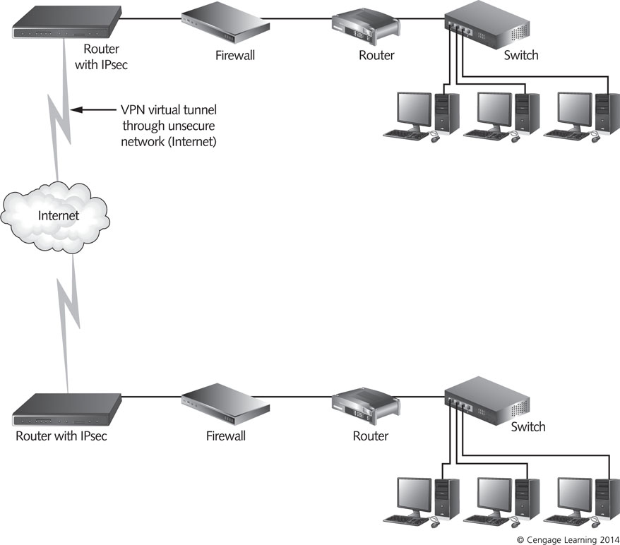
Figure 1-1 Many businesses provide secure remote access using VPNs

Slide 21
Ensuring Privacy
Databases with personal or financial information need to be protected
US laws exist that protect private information
Mandates severe penalties for failure to protect it
Education is an effective way to maintain the privacy of information
All employees must be educated about security dangers and security policies
Employees are most likely to detect security breaches
And to cause one accidentally
Employees can monitor activities of their co-workers

Slide 22
Providing Nonrepudiation
Nonrepudiation: capability to prevent a participant in an electronic transaction from denying that it performed an action
Ensuring that the sender cannot deny sending a message and the recipient cannot deny receiving it
Encryption provides integrity, confidentiality, and authenticity of digital information
Encryption can also provide nonrepudiation
Nonrepudiation is an important aspect of establishing trusted communication between organizations

Slide 23
Confidentiality, Integrity, and Availability
Confidentiality
Prevents intentional or unintentional disclosure of communications between sender and recipient
Integrity
Ensures the accuracy and consistency of information during all processing
Creation, storage, and transmission
Availability
Assurance that authorized users can access resources in a reliable and timely manner

Slide 24
Using a Layered Defense Strategy: Defense in Depth
No single security measure can ensure complete network protection
Instead, assemble a group of methods
That work in a coordinated fashion
Defense in depth (DiD)
Layering approach to network security
Designed by the National Security Agency (NSA) as a best practices strategy for achieving information assurance

Slide 25
Using a Layered Defense Strategy: Defense in Depth
In general, the layers are:
Physical security
Authentication and password security
Operating system security
Antivirus protection
Packet filtering
Firewalls
Demilitarized zone (DMZ)
Intrusion detection and prevention system (IDPS)
Virtual private networks (VPNs)
Network auditing and log files
Routing and access control methods

Slide 26
Physical Security
Refers to measures taken to physically protect a computer or other network device
Physical security measures
Computer locks
Lock protected rooms for critical servers
Burglar alarms
A computer can easily be compromised if a malicious intruder has physical access to it

Slide 27
Authentication and Password Security
Password security
Simple strategy
Select good passwords, keep them secure, and change them as needed
Use different passwords for different applications
Authentication – verifying the identity of a user, service, or computer
Uses three methods
Verifying something a user knows (basic authentication)
Verifying something a user has
Verifying something a user is
In large organizations, authentication is handled by centralized servers

Slide 28
Operating System Security
OSs must be timely updated to protect from security flaws
Protect operating systems by installing
Patches
Hot fixes
Service packs
Stop any unneeded services
Disable Guest accounts

Slide 29
Antivirus Protection
Virus scanning
Examines files or e-mail messages for indications that viruses are present
Viruses have suspicious file extensions
Antivirus software uses virus signatures to detect viruses in your systems
You should constantly update virus signatures
Firewalls and IDPSs are not enough
You should install antivirus software in hosts and all network computers

Slide 30
Packet Filtering
Block or allow transmission of packets based on
Port number
IP addresses
Protocol information
Some types of packet filters
Routers
Most common packet filters
Operating systems
Built-in packet filtering utilities that come with some OSs
Software firewalls
Enterprise-level programs

Slide 31
Firewalls
Installing and configuring a firewalls is the foundation of organization’s overall security policy
Permissive versus restrictive policies
Permissive
Allows all traffic through the gateway and then blocks services on case-by-case basis
Restrictive
Denies all traffic by default and then allows services on case-by-case basis
Enforcement is handled primarily through setting up packet-filtering rules

Slide 32
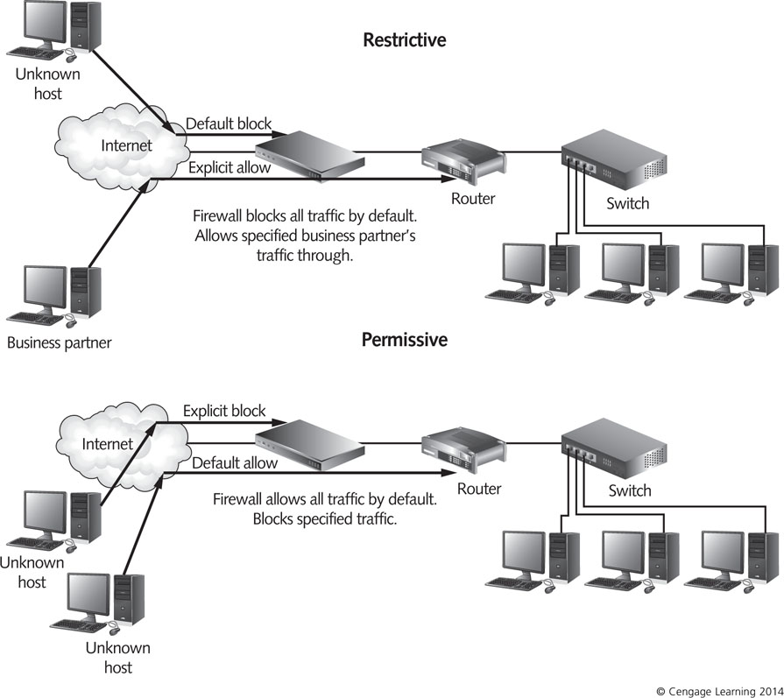
Figure 1-2 Permissive vs. restrictive firewall policies

Slide 33
Demilitarized Zone (DMZ)
Network that sits outside the internal network
DMZ is connected to the firewall
Makes services like HTTP and FTP publicly available
While protecting the internal LAN
It might also contain a DNS server
DNS server resolves domain names to IP addresses
DMZ is sometimes called a “service network” or “perimeter network”

Slide 34
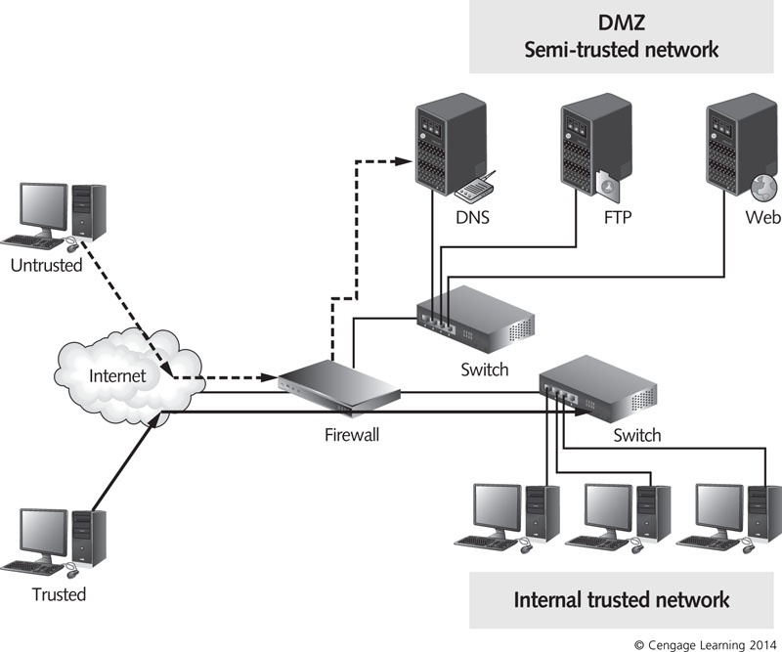
Figure 1-3 Firewall used to create a DMZ and protect the internal network

Slide 35
Intrusion Detection and Prevention System (IDPS)
Use of an IDPS offers an additional layer of protection
Works by recognizing the signs of a possible attack
Notifies the administrator
Some traffic can trigger a response that attempts to actively combat the threat (intrusion prevention)
Signs of possible attacks are called signatures
Combinations of IP address, port number, and frequency of access attempts

Slide 36
Virtual Private Networks (VPNs)
A VPN is a network that uses public telecommunications infrastructure to provide secure access to corporate assets for remote users
Provide a low-cost and secure connection that uses the public Internet
Alternative to expensive leased lines
Provides point-to-point communication
Use authentication to verify users’ identities and encrypt and encapsulate traffic

Slide 37
Network Auditing and Log Files
Auditing
Recording which computers are accessing a network and what resources are being accessed
Information is recorded in a log file
Reviewing and maintaining log files helps you detect suspicious patterns of activity
Example: regular and unsuccessful connection attempts that occur at the same time each day
You can set up rules to block attacks based on logged information from previous attack attempts

Slide 38
Network Auditing and Log Files
Log file analysis
Tedious and time consuming task
Record and analyze rejected connection requests
Sort logs by time of day and per hour
Check logs during peak traffic time and use to identify services that consume bandwidth
Configuring log files to record
System events
Security events
Traffic
Packets

Slide 39
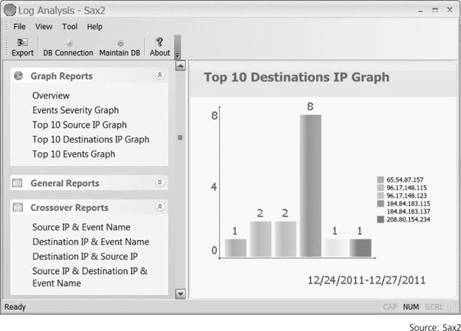
Figure 1-4 Graphic display of log file entries

Slide 40
Routing and Access Control Methods
Routers at the perimeter of a network are critical to the movement of all network traffic
Can be equipped with their own firewall software
Attackers exploit open points of entry, such as
Vulnerable services – attackers might be able to exploit known vulnerabilities in an application
E-mail gateways – attackers might attach a virus to an e-mail message
Porous borders – an attacker might discover a port that a computer has left open that is not being used

Slide 41
Routing and Access Control Methods
Three methods of access control
Mandatory Access Control (MAC) – all access capabilities are defined in advance
Discretionary Access Control (DAC) – allows users to share information with other users
Gives users more flexibility in accessing information
Role Based Access Control (RBAC) – establishes organizational roles to control access to information
Limits access by job function or job responsibility

Slide 42
The Impact of Defense
Cost of securing systems might seem high
Cost of a security breach can be much higher
Support from upper management
Key factor in securing systems
Securing systems will require
Money
Time
Down time for the network
Support from upper management

Slide 43
Summary
Network intruders are motivated by a variety of reasons
Revenge by disgruntled, current, or former employees might be the primary motivation
Some attackers break into accounts and networks for financial gain
Some attackers may steal proprietary information for their own use or for resale to other parties
E-mail is one of the most important services to secure

Slide 44
Summary
Always-on connections present security risks that need to be addressed with firewall and VPN solutions
Goals of network security
Confidentiality
Integrity
Availability
An effective network security strategy involves many layers of defense working together to prevent threats
Auditing helps identify possible attacks and prevent from other attacks

Slide 45
Summary
Routers at the perimeter of a network are critical to the movement of all traffic
Access control ensures that users can access resources they need but that unauthorized people cannot access network resources to exploit them
Defense affects the entire organization
Always look for support from upper management

