Slide 1
Acquiring and Understanding NBA Player Data
Chad Huntebrinker

Slide 2
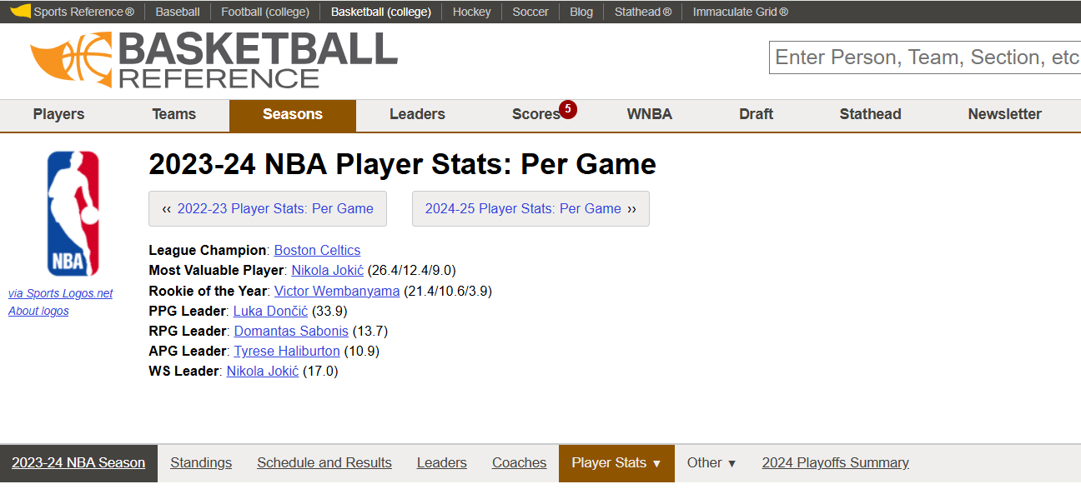
This project demonstrates how to collect and analyze NBA player performance data from the 2023–2024 season.
We will specifically be going over individual player stats
Data Source: Basketball Reference
URL: https://www.basketball-reference.com/leagues/NBA_2024_per_game.html

Slide 3
How the Data Was Collected (Using R)
R Packages: rvest, dplyr
R Code:
library(rvest)
library(dplyr)
url <- 'https://www.basketball-reference.com/leagues/NBA_2024_per_game.html'
nba_stats <- url %>% read_html() %>% html_table() %>% .[[1]]
nba_stats <- nba_stats %>% filter(Player != 'Player')
head(nba_stats)
Steps:
1. Read the webpage using rvest.
2. Extract and clean the player statistics table.
3. Save as a data frame.

Slide 4
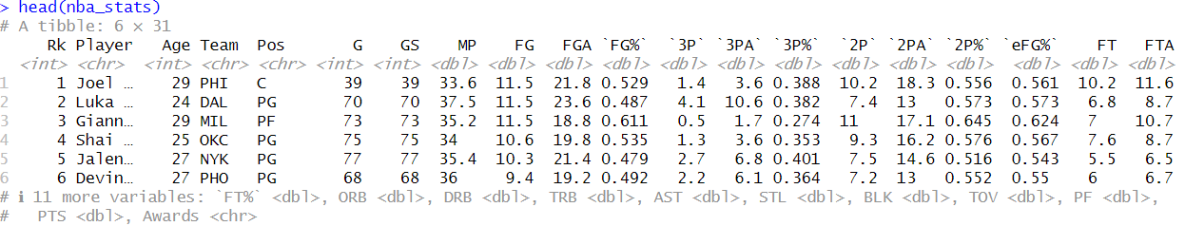
Dataset Description
• Source: Basketball Reference
• Season: 2023–2024
• Observations: Over 500 players
• Variables: 31 (including player name, position, game stats)
  Each row = one NBA player’s statistics.

Slide 5
Variable Types
Categorical
  Player, Pos (player position), Tm (team abbreviation)
Numeric
  Age, G (games played), GS (games started), MP (minutes played), PTS (points), etc.
Numeric (percentages)
  FG% (field goal percentage), 3P% (3-point percentage), FT% (free throw percentage), etc.

Slide 6
Handling Missing Data
Check missing values:
  colSums(is.na(nba_stats))
Findings:
  Some missing shooting % for players with no attempts.
  Team info missing for traded players.
  Overall, very few missing
Solution:
  Replace numeric NA with 0, retain all rows.

Slide 7
Privacy, Security, and Ethics
• Publicly available sports statistics
• No personal or sensitive data
• Ethical for research and analysis
• Data collected legally and responsibly

Slide 8
Example Analyses
Correlation between points and assists:
  cor(nba_stats$PTS, nba_stats$AST, use='complete.obs')
Average points by position:
  nba_stats %>% group_by(Pos) %>% summarise(mean_pts = mean(PTS, na.rm = TRUE))
Insights:
  Guards have higher assists.
  Forwards/Centers lead in rebounds and efficiency.

