Slide 1
What Does It Take to Win?
Chad Huntebrinker

Slide 2
How to Win in the NBA?
Throughout the NBA season, all teams have one common goal: win
But what does it take to win in the NBA?
Are there specific team stats that help or hurt a team?
This report will use our created data dashboard to find some common indicators

Slide 3
How Can We Find This?
We will take the top 4 and bottom 4 teams in the NBA season last year (2024 – 2025)
We’ll compare them directly head-to-head and also compare their stats across the board
And we’ll see if the top 4 teams have something in common that the bottom ones don’t

Slide 4
What is the Data?
NBA team-level performance data for the 2024–2025 season
  The season can be changed in the dashboard but we will be using the 2024-2025 only
Includes offensive, defensive, shooting, rebounding, and possession‑based stats
Allows comparison of team styles, strengths, and weaknesses across key metrics
Useful for understanding what separates top-performing teams from bottom teams

Slide 5
Where Does the Data Come From?
Public NBA statistics sourced through hoopR (R package) API calls
Data collected from NBA official box scores and advanced stat repositories
Reliable and commonly used in basketball analytics research
https://github.com/sportsdataverse/hoopR

Slide 6
Dataset Complexity & Justification
Dataset contains dozens of advanced metrics that interact in non‑trivial ways.
Data span the full season and integrate both box score and pace-adjusted stats.
Complexity supports visual exploration, filtering, and multi-dimensional comparison.
Appropriate for interactive dashboards and multivariate analysis.

Slide 7
What the Application Does
Allows users to select any two teams and compare them across key performance metrics
Generates radar plots, box plots, and tables with data for quick, visual interpretation of multi-dimensional stats
Users can explore trends, strengths, and weaknesses in an intuitive interface
Accessible via the GitHub link here

Slide 8
Visualization Principles
Dashboard uses consistent color, scale, and labeling for intuitive comparison
Interactive elements keep it both engaging and clutter-free
Visualizations are both useful and informative to even novice users

Slide 9
Insight Provided by the Tool
Radar plots reveal multi‑metric profiles and differences between teams
Interactive dashboard supports selecting specific teams for direct comparison
Tools help users identify patterns such as strong defense vs. high‑pace offense
Supports deeper interpretation beyond simple win/loss records

Slide 10
What to Expect When Using the Application
Clear, interactive, team dashboards
Visualization of multi‑metric comparisons
Ability to switch teams and explore various parts of the dataset
Flexible tool that works for casual users or deeper analytic exploration

Slide 11
Top and Bottom 4 NBA Teams
Top 4 Teams
Bottom 4 Teams
Oklahoma City Thunder (68 Wins)
Cleveland Cavaliers (64 wins)
Boston Celtics (61 wins)
Houstin Rockets (52 wins)
Utah Jazz (17 wins)
Washington Wizards (18 wins)
Charlotte Hornets (19 wins)
New Orleans Pelicans (21 wins)

Slide 12
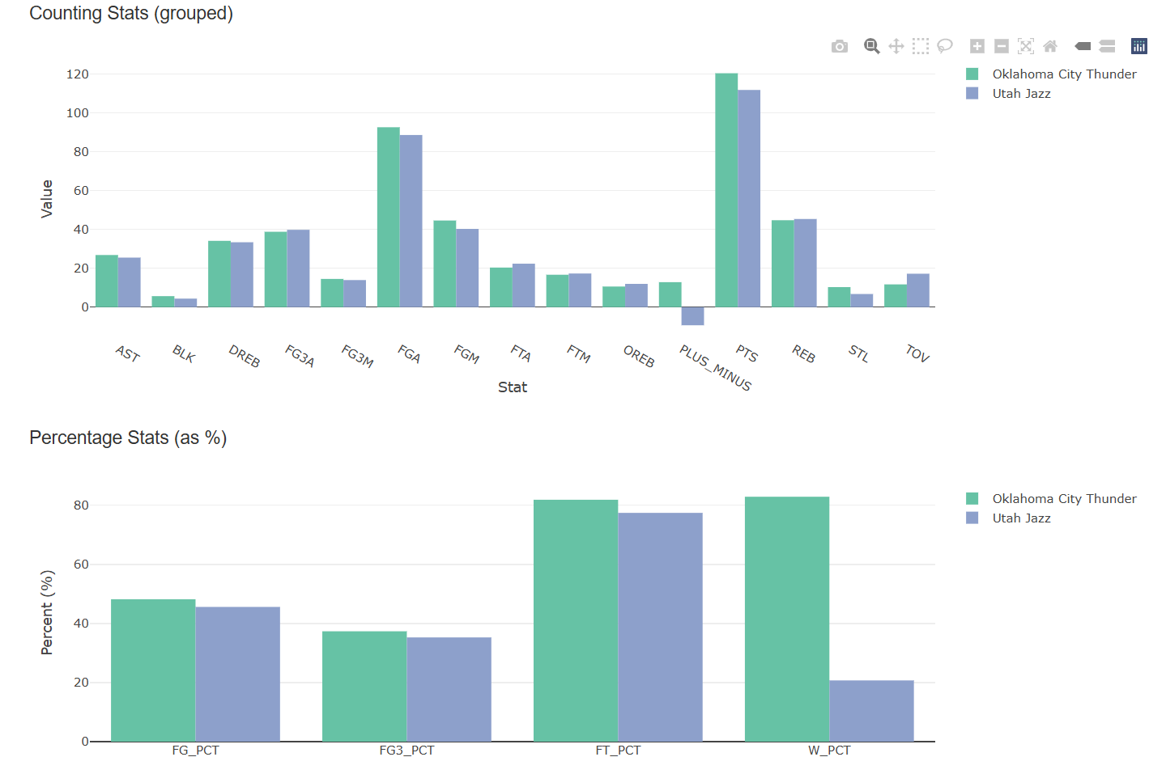
Oklahoma City Thunder vs Utah Jazz

Slide 13
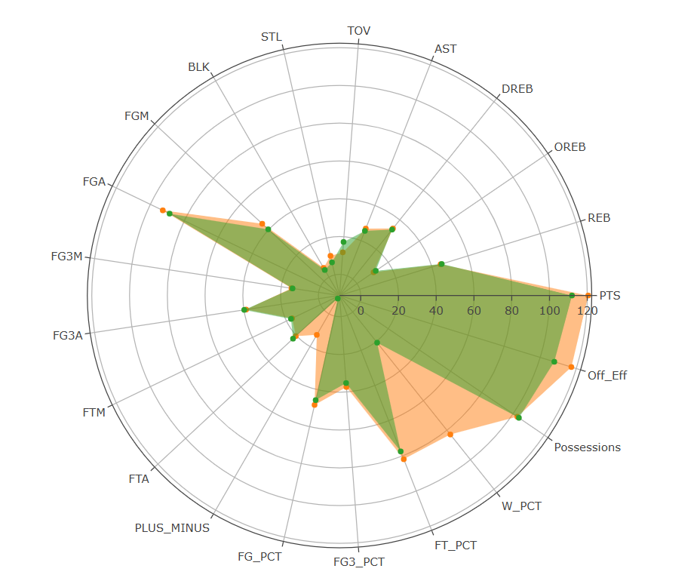
OKC (Orange) vs Jazz (Green)
Quick Stats:
Off_Eff
  OKC: 117.27
  Jazz: 107.83
FG_PCT
  OKC: 48.21%
  Jazz: 45.61%
FG3_PCT
  OKC: 37.36%
  Jazz: 35.29%
FT_PCT
  OKC: 81.9%
  Jazz: 77.46%
Turnovers
  OKC: 11.72
  Jazz: 17.22
Possessions
  OKC: 102.75
  Jazz: 103.77
Plus-Minus
  OKC: 12.87
  Jazz -9.34

Slide 14
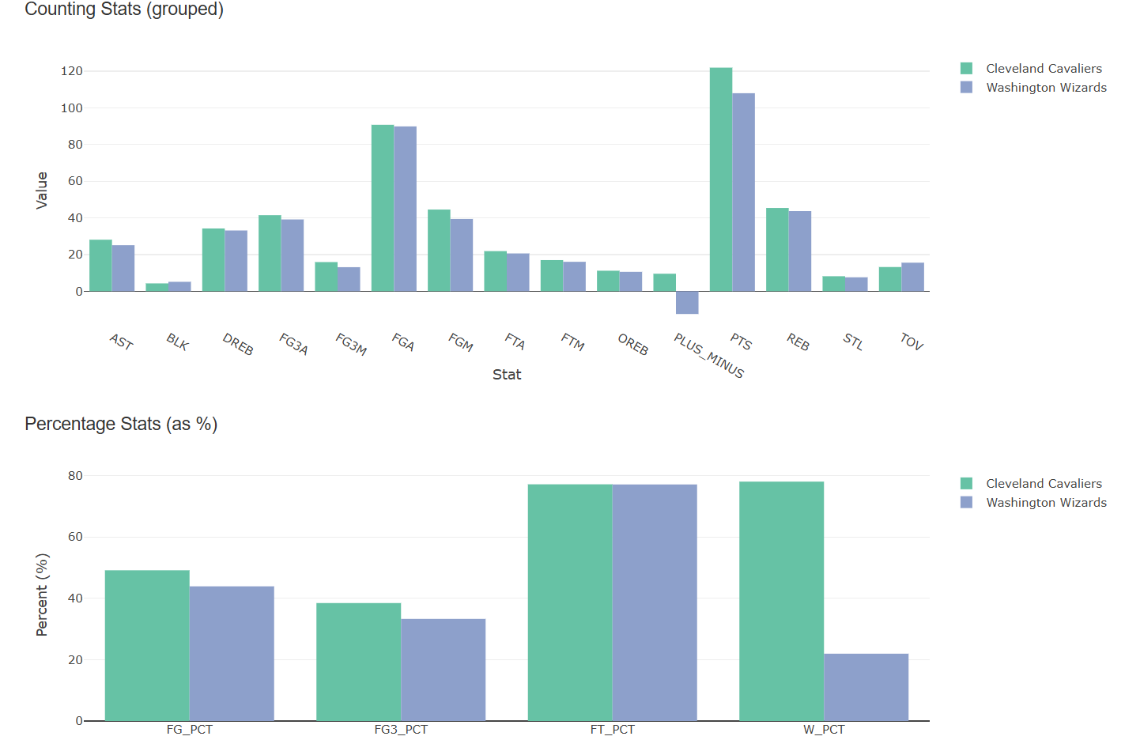
Cleveland Cavaliers vs Washington Wizards

Slide 15

Cavaliers (Orange) vs Wizards (Green)
Quick Stats:
Off_Eff
  Cavaliers: 119.07
  Wizards: 103.9
FG_PCT
  Cavaliers: 49.15%
  Wizards: 43.91%
FG3_PCT
  Cavaliers: 38.46%
  Wizards: 33.3%
FT_PCT
  Cavaliers: 77.17%
  Wizards: 77.13%
Turnovers
  Cavaliers: 13.2
  Wizards: 15.56
Possessions
  Cavaliers: 102.41
  Wizards: 103.95
Plus-Minus
  Cavaliers: 9.54
  Wizards: -12.44

Slide 16
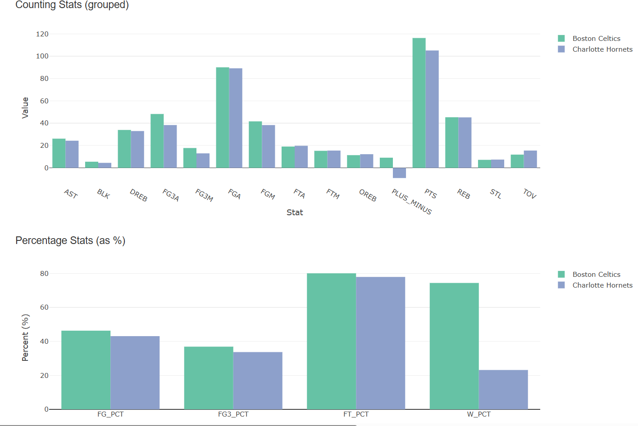
Boston Celtics vs Charlotte Hornets

Slide 17
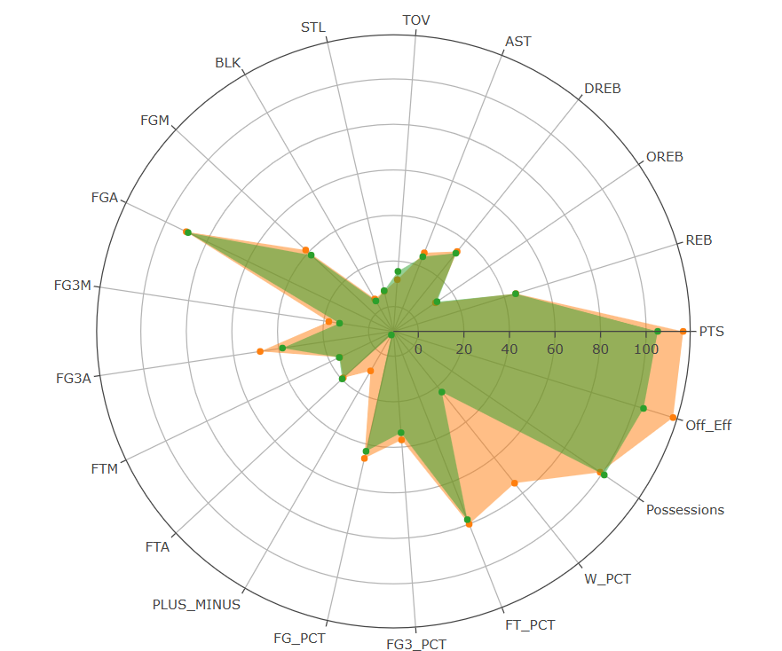
Celtics (Orange) vs Hornets (Green)
Quick Stats:
Off_Eff
  Celtics: 117.55
  Hornets: 103.97
FG_PCT
  Celtics: 46.31%
  Hornets: 43.1%
FG3_PCT
  Celtics: 36.91%
  Hornets: 33.72%
FT_PCT
  Celtics: 80.07%
  Hornets: 77.93%
Turnovers
  Celtics: 11.87
  Hornets: 15.5
Possessions
  Celtics: 98.91
  Hornets: 101.09
Plus-Minus
  Celtics: 9.11
  Hornets: -9.11

Slide 18
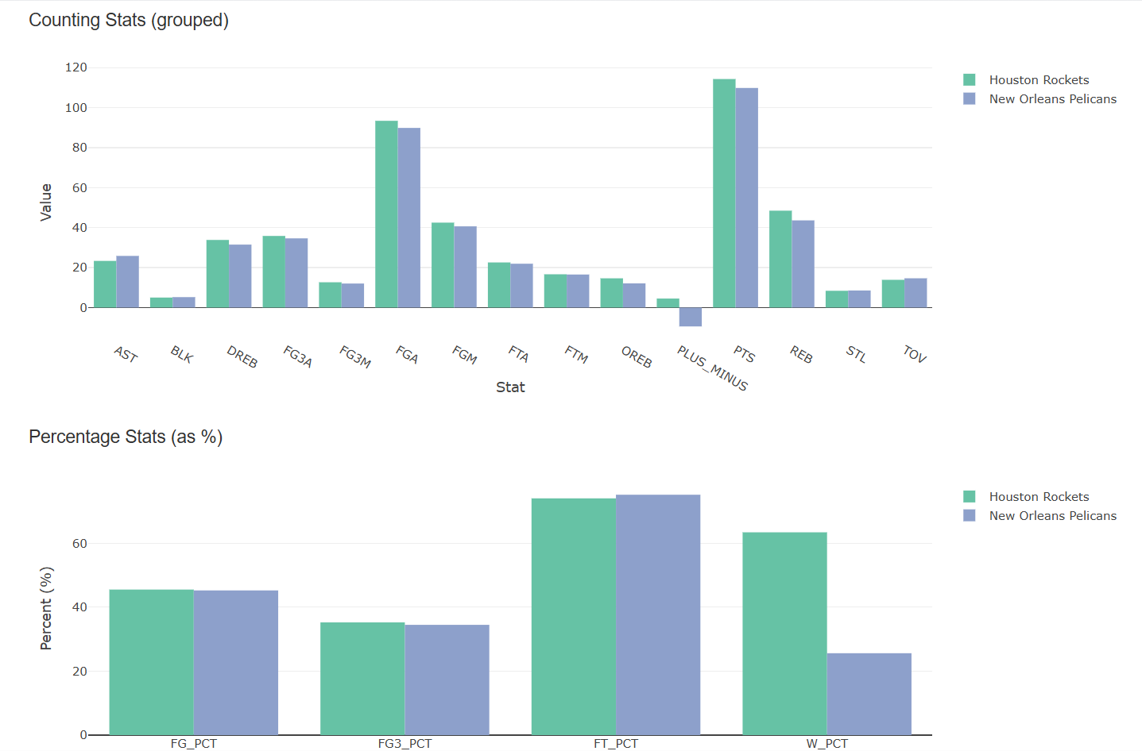
Houstin Rockets vs New Orleans Pelicans

Slide 19
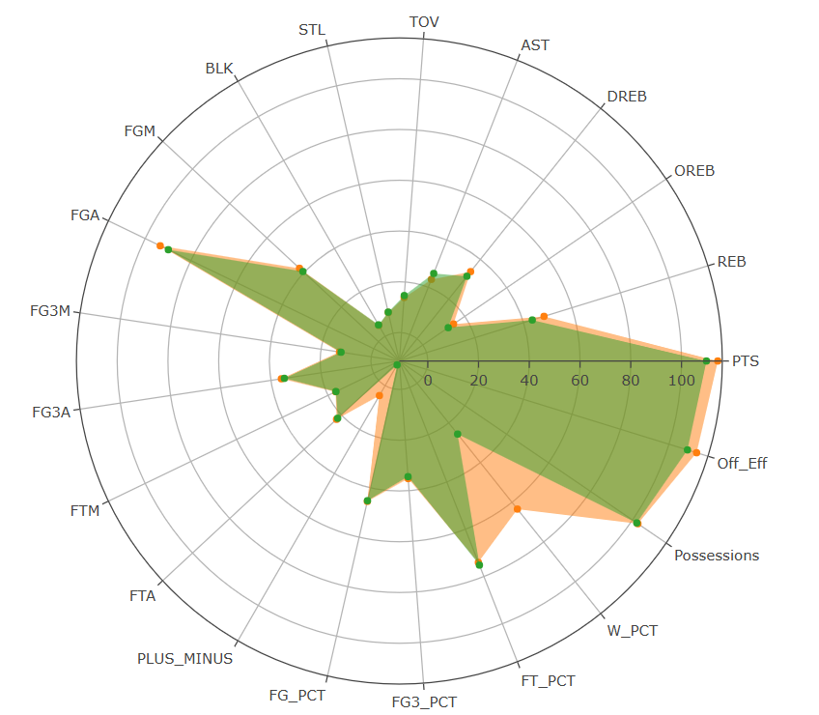
Rockets (Orange) vs Pelicans (Green)
Quick Stats:
Off_Eff
  Rockets: 107.63
  Pelicans: 111.41
FG_PCT
  Rockets: 45.25%
  Pelicans: 45.51%
FG3_PCT
  Rockets: 34.49%
  Pelicans: 35.25%
FT_PCT
  Rockets: 75.17%
  Pelicans: 74.03%
Turnovers
  Rockets: 14.65
  Pelicans: 13.89
Possessions
  Rockets: 102.04
  Pelicans: 102.59
Plus-Minus
  Rockets: 4.51
  Pelicans: -9.43

Slide 20
What Do Winning Teams Do?
Winning teams are more efficient on offense
  Top 4 average offensive efficiency: 115.38
  Bottom 4 average offensive efficiency: 106.78
    Offensive efficiency is how many points are scored per 100 possessions
So winning teams take better shots and are more efficient

Slide 21
What Do Winning Teams Do?
Winning teams have a higher shot percentage:
  Top 4 NBA Teams:
    Average FG Percentage: 47.23%
    Average 3FG Percentage: 36.81%
    Average FT Percentage: 78.58%
  Bottom 4 NBA Teams:
    Average FG Percentage: 44.53%
    Average 3FG Percentage: 34.39%
    Average FT Percentage: 76.64%

Slide 22
What Do Winning Teams Do?
This isn’t due to pace or teams playing with a faster offense
  Top 4 average possessions: 101.53
  Bottom 4 average possessions: 102.85
This is the average estimated possessions per team per game
  Using the following formula (vouched by ESPN and stats.NBA.com):
  (FGA + 0.44*FTA – ORB + TOV)
  We don’t divide by 2 in our formula because we already have team level possessions
Meaning that winning teams are just more efficient offensively

Slide 23
What Do Winning Teams Do?
However, winning teams do play tough defense
  Top 4 plus-minus average: 9.01
  Bottom 4 plus-minus average: -10.08
    Plus-minus is just Points Scored – Points Allowed
So it requires both effective offense and defense

Slide 24
What Do Winning Teams Do?
We see this in the number of turnovers too:
  Top 4 average number of turnovers: 12.86
  Bottom 4 average number of turnovers: 15.54
That’s around 3 less possessions due to losing the ball
Teams that win take better care of the ball
Teams that lose the ball to better defenses will lose the game

Slide 25
In Conclusion
Winning teams in the NBA:
  Are more offensively efficient with scoring points
  Are more accurate making shots
  Play better defense
  Have less turnovers

