Slide 1
Final Project Presentation
Chad Huntebrinker

Slide 2
Introduction
Goal: to predict market share of a food product
Prediction will be done with assorted predictor variables
Methods: Linear Regression model and assorted checks for validity

Slide 3
What is Market Share?
Percentage of total sales in an industry generated by a company
Company product sold / total industry products sold x 100

Slide 4
What are the predictor variables (part 1)
There’s two continuous predictor variables
price: average monthly price of a product
gnrpoints: Gross Nielson rating points

Slide 5
What are the predictor variables (part 2)
There are 4 discrete variables
discount: whether there was or wasn’t a discount that month
promotion: whether there was or wasn’t a promotion that month
month
year

Slide 6
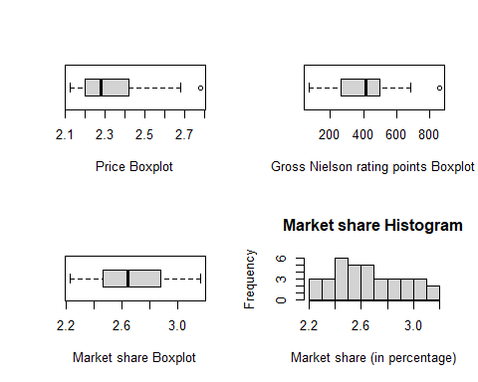
Individual Predictor and Response Variable Investigation

Slide 7
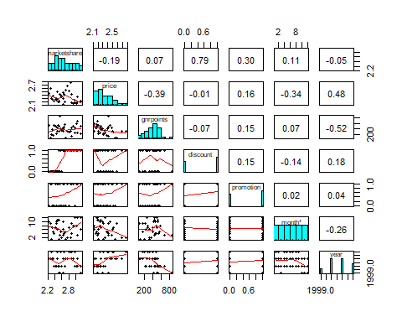
Multicollinearity

Slide 8
Automatic Model Selection (part 1)
## [1] "Cp:"
## [1] 8.051324 5.889624 3.367129 4.130333 6.000000
## [1] "R^2:"
## [1] 0.6252543 0.6641938 0.7065091 0.7180814 0.7193009
## [1] "BIC:"
## [1] -28.16723 -28.53340 -29.79864 -27.66333 -24.23587

Slide 9
Automatic Model Selection (part 1)
## (Intercept) price gnrpoints discount promotion year ## TRUE TRUE FALSE TRUE TRUE FALSE

Slide 10
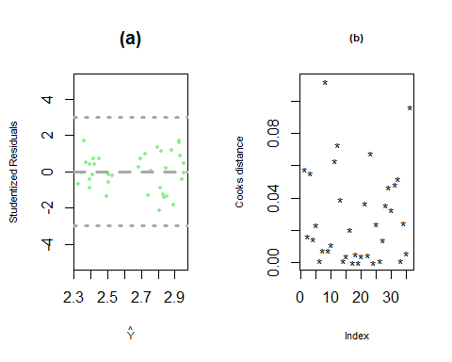
Final Checks on the Model (part 1)
## [1] "Value to use for Cook's Distance:"
## [1] 0.5722362

Slide 11
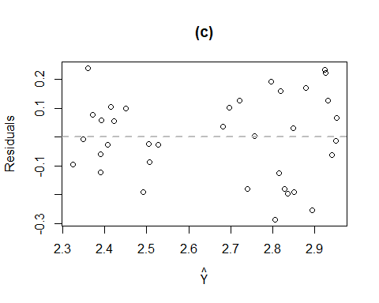
Final Checks on the Model (part 2)

Slide 12
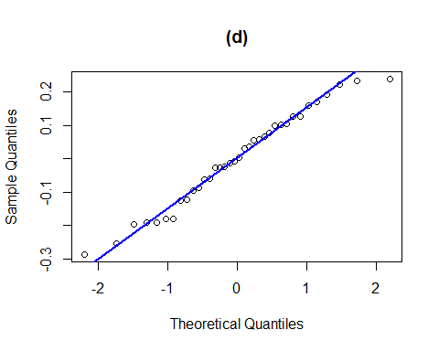
Final Checks on the Model (part 3)

Slide 13
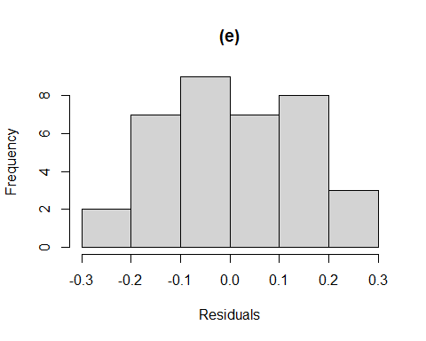
Final Checks on the Model (part 4)

Slide 14
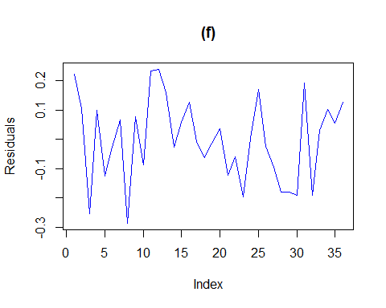
Final Checks on the Model (part 5)

Slide 15
Final Checks on the Model (part 6)
## fit lwr upr ## 1 2.815898 2.495096 3.136701
## [1] "Actual value: 2.69"
## fit lwr upr ## 1 2.506228 2.184902 2.827555
## [1] "Actual value: 2.42"

Slide 16
Final Checks on the Model (part 7)
## fit lwr upr ## 1 2.392427 2.073172 2.711683
## [1] "Actual value: 2.45"
## fit lwr upr ## 1 2.682583 2.352566 3.012599
## [1] "Actual value: 2.72"

Slide 17
Final Checks on the Model (part 8)
#Check p-score p_score <- coeftest(final_model) abs(p_score[2,4]) <= 0.05
## [1] TRUE
abs(p_score[3,4]) <= 0.05
## [1] TRUE
abs(p_score[4,4]) <= 0.05
## [1] TRUE

Slide 18
General Discussion and Conclusions (part 1)
## Ŷ = 3.19 + -0.35 X1 + 0.4 X2 + 0.12 X3
Yhat is the market share
X1 would be the price
X2 would be whether there was a discount
X3 would be whether there was a promotion

Slide 19
General Discussion and Conclusions (part 2)
Different tests and checks like residual plots, Cook’s Distance, and homorskedasticity were checked
The model also predicted some of the values in the data accurately
Price of the product, offered discounts, and potential promotions impact the market share

