Slide 1

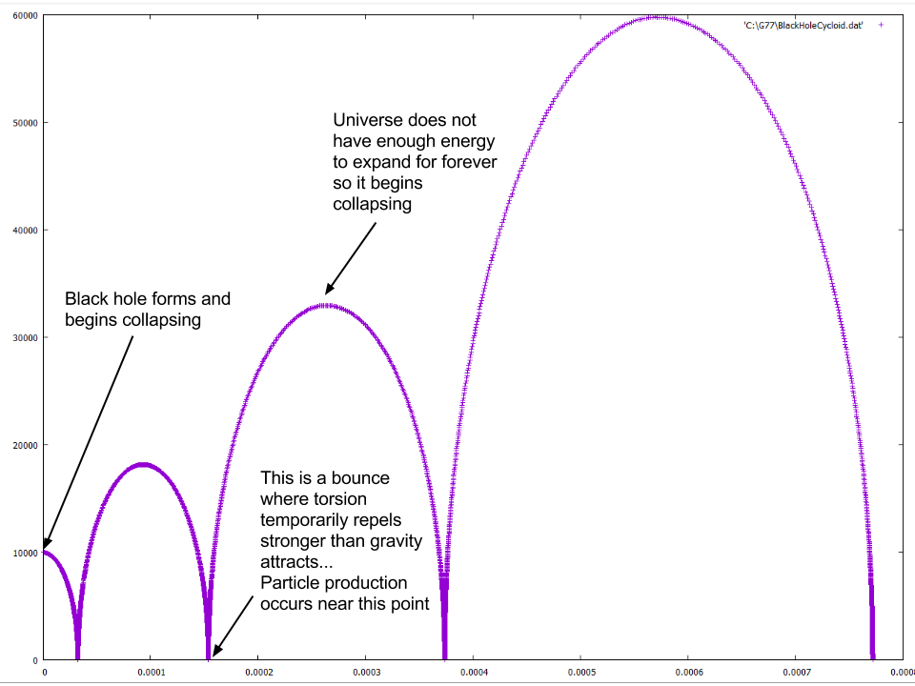
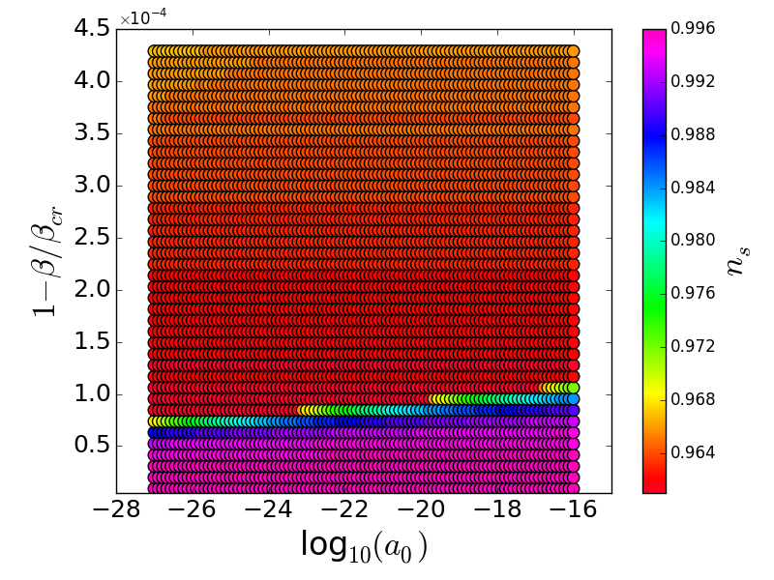
Was Our Universe Born in a Black Hole?
Charles Peterson, Mechanical Engineering
Mentors: Dr. Nikodem Poplawski & Dr. Chris Haynes
BACKGROUND
HYPOTHESIS
METHOD
Black holes (regions of space from where nothing can escape) form from massive stars that collapse because of their gravity.
The Universe is expanding, like the 3-dimensional analogue of the 2-dimensional surface of a growing balloon.
Problem. According to general theory of relativity, the matter in a black hole collapses to a point of infinite density (singularity). The Universe also started from a point (Big Bang). But infinities are unphysical.
Solution: Adding quantum-mechanical angular momentum (spin) of elementary particles generates a repulsive force (torsion) at extremely high densities which opposes gravitational attraction and prevents singularities.
We argue that the matter in a black hole collapses to an extremely high but finite density, bounces, and expands into a new space (it cannot go back). Every black hole becomes a wormhole (Einstein-Rosen bridge) to a new universe on the other side of its boundary (event horizon).
If this theory is correct then we would expect that:
Such a universe never contracts to a point.
This universe may undergo multiple bounces between which it expands and contracts.
Our Universe may thus have been formed in a black hole existing in another universe. The last bounce would be the Big Bang (Big Bounce). We would then expect that:
The scalar spectral index (ns) obtained from mathematical analysis of our hypothesis is consistent with the observed value n_{s} = 0.965 ± 0.006 obtained the Cosmic Microwave Background (CMB) data.
To evaluate our expectations:
1. We wrote a code in Fortran programming language to solve the equations which describe the dynamics of the closed universe in a black hole and then graph the solutions. These equations give the radius a and temperature T of the universe as functions of time t (see Fig. 1).
2. From the obtained graphs we found the values of the scalar spectral index n_{s} and compared them with the observed CMB value (see Fig. 2).
RESULTS
CONCLUSIONS
Inflation can be caused by particle production with torsion.
The dynamics of the early universe formed in a black hole depends on the quantum-gravitational particle production rate β, but is not too sensitive to the initial scale factor a₀.
Our results are consistent with the 2015 data from the Planck satellite, indicating that our hypothesis may be correct.
ACKNOWLEDGMENTS
I would like to thank my to awesome teachers and mentors Dr. Nikodem Poplawski, and Dr. Chris Haynes as well Shantanu Desai who analyzed and confirmed our data, Carol Withers who lead the summer research program, and the donors who supported our research.
Fig. 2. The simulated values of ns in our model are consistent with the observed CMB value n_{s} for a small range of β and a wide range of a₀ (m).
Fig. 1. Sample scale factor a(t). Several bounces, at which a is minimum but always >0, may occur.

