Slide 1
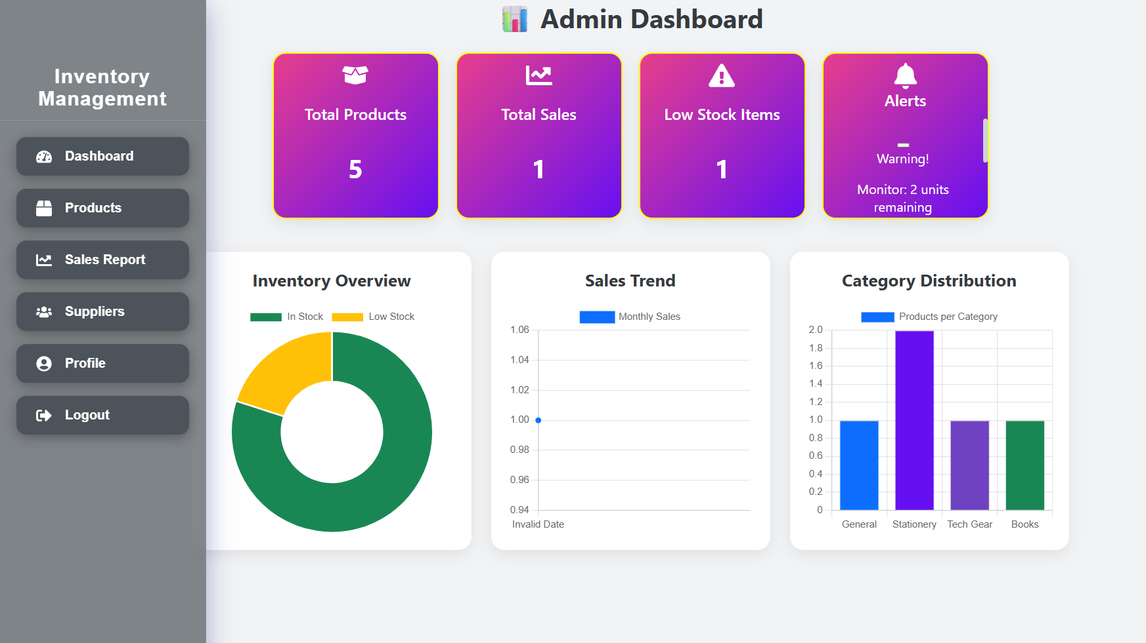
Coding in Progress…

