Slide 1
Text Analytics Gateway Project Background
Michael Black
Drew Schmidt

Slide 2
What are the “digital humanities”?
Started as a service model “humanities computing” but was rebranded in the early 2000s to reflect increased efforts to incorporate digital methodologies into scholarship
Spans humanities academic departments, university libraries, and independent search units/labs
Close and far, small and big
TEI, digital editions of print texts, digitization of narrowly available archives
Large scale text analysis, digital media education initiatives, social media collaborative networks

Slide 3
Problems in the digital humanities
Humanities undergraduate and graduate programs emphasize a tradition model of scholarship that does not offer access to technical training nor provide incentive, opportunity, or reward for students or faculty to develop those skills independently
To compensate, DH has a largely collaborative work model; however, the humanities do not reward collaboration. Single author publications remain the gold standard

Slide 4
Beginnings of TAG Project
Summer/Fall 2014: Alan Craig organizes a group of seven faculty with appointments in at least eight different departments from two universities to discuss how a gateway could lower the barrier to entry for researchers interested in text mining
Highlights from these conversations:
Support cultural/literary/linguistic research
Capable of using data from public repositories as well as smaller, local collections (such as teaching materials collected in education studies)
Social media and web analysis (social science + business school)
Topic modeling, clustering, classification, sentiment analysis

Slide 5
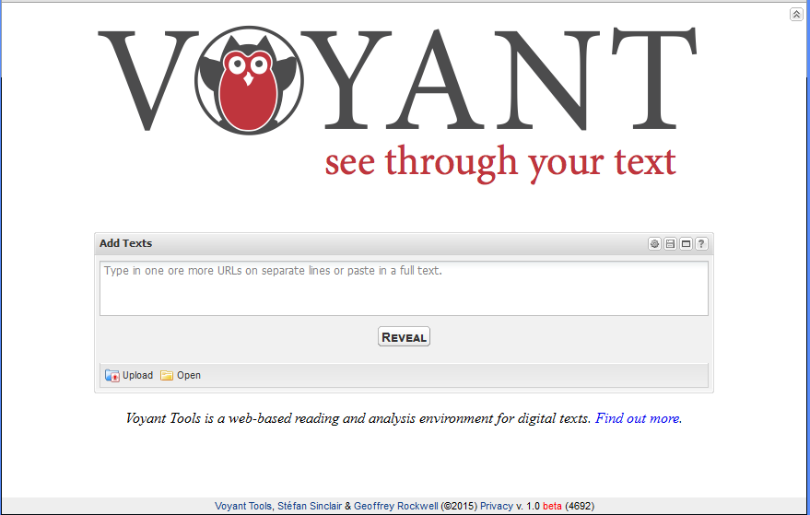
Academic Example #1: Voyant

Slide 6
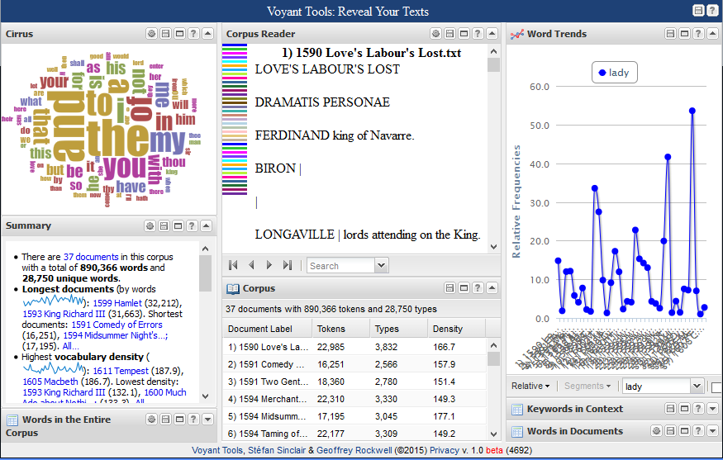
Information Overload!

Slide 7
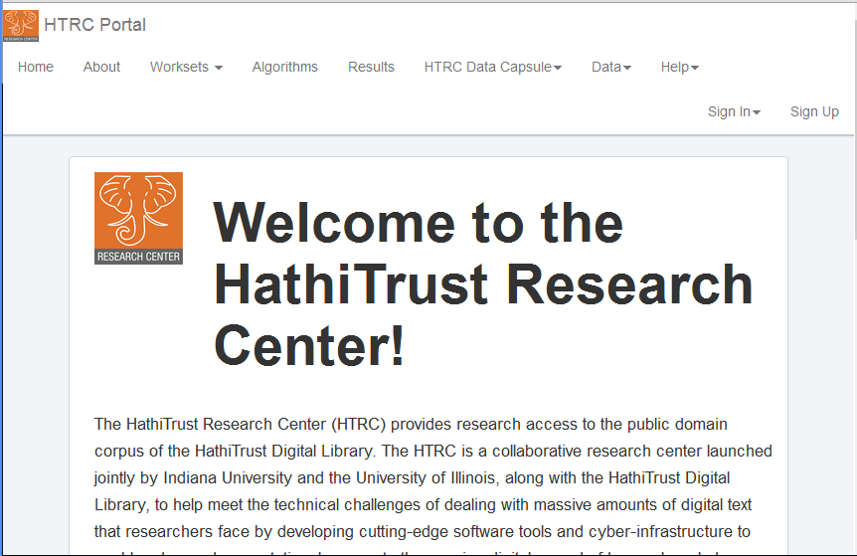
Academic Example #2: HTRC

Slide 8
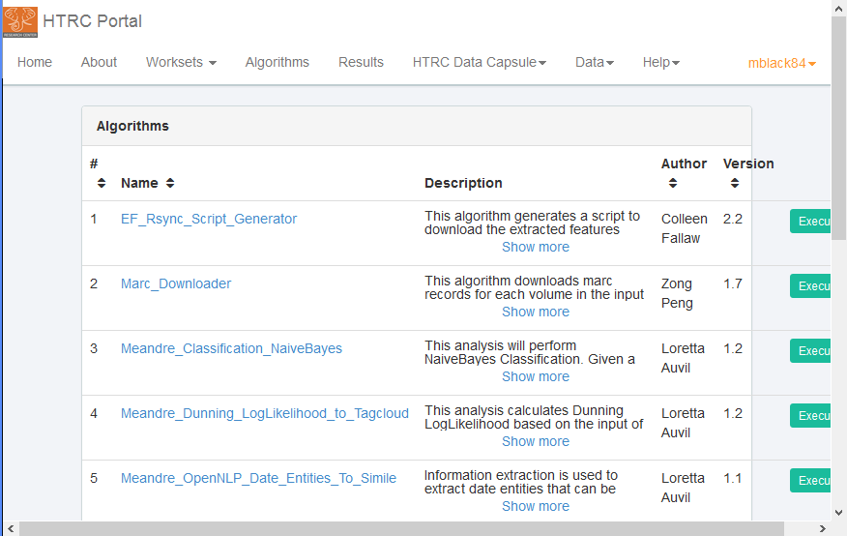
Not portable + assumes prior familiarity with methods

Slide 9
Thinking beyond the lone researcher…
Education: let students/faculty learn the concepts behind text mining without having to learn to code first.
Helps faculty better articulate their needs during collaborations with technical staff
Provides students a goal to structure programming training around
Project profiling: let technical staff quickly demonstrate the procedures they are recommending

Slide 10
Goals: User-friendliness + Transparency
How do we present text analysis in a way that is both immediately useful while also providing some instruction on project design?
Design an interface that will help researchers recognize the effect of each procedure being performed on their data rather than offering a huge set of finished products
Can we make the gateway flexible enough to address the diversity of research taking place in the humanities and social sciences?
Design an interface that will let researchers translate their normal modes of inquiry into algorithms by exposing the processes that produce data
Is it possible to design a user-friendly tool that could also serve as a launching pad for larger, more complex projects?
Offer a way for more experienced researchers to take their workflows out of the gateway’s interface, whether onward to a larger batch process on XSEDE or off to more detailed experimentation in R

Slide 11
The Text Analytics Gateway
Basic Text Analysis Tools Without the Programming

Slide 12
Background
Spent a year as a statistics consultant.
Primarily served students in the social sciences.
Didn't understand how they thought about computing...
"Want to learn R?"
"NO!"

Slide 13
Computing in HASS
What they're used to
Programming
GUI/Web service.
Generally like local installs.
Interactive.
Not in their wheelhouse.
So why expect users to start with this?
corpus <- tm::tm_map(corpus, tm::content_transformer(base::tolower))
corpus <- tm::tm_map(corpus, tm::removePunctuation)
corpus <- tm::tm_map(corpus, tm::removeNumbers)
corpus <- tm::tm_map(corpus, tm::stripWhitespace)
corpus <- tm::tm_map(corpus, tm::removeWords, tm::stopwords("english"))
tdm <- tm::TermDocumentMatrix(corpus)
wordcount_table <- sort(rowSums(as.matrix(tdm)), decreasing=TRUE)

Slide 14
TAG: Text Analytics Gateway
The TAG Team
Timeline
PI Mike Black
Drew Schmidt
New ECSS Staff soon...
November 12, 2014: Allocation awarded.
March 20, 2015: Developent begins.
July 7, 2015: Stood up on AWS, small usability studies begin.
Soon: Live on comet, workshops, ...

Slide 15
The TAG Philosophy
Easy to use.
Reproducibility should not be an afterthought.
Interactivity is good!
Community contributions, comments, suggestions should be encouraged.
We're not chasing exascale.

Slide 16
Most Importantly...
If you give busy people a chance to not do something, they'll take you up on it.

Slide 17
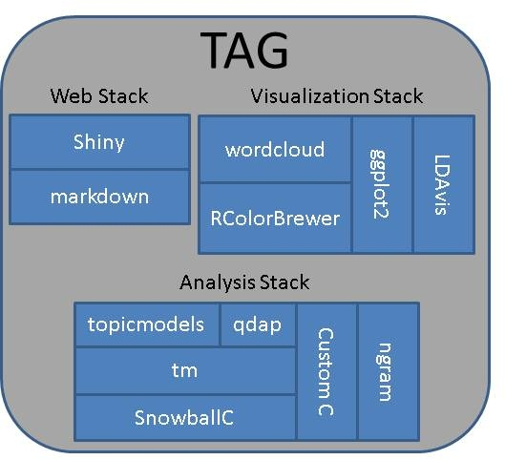
TAG Design
Written mostly in R.
Some custom high-performance C.
Extensively uses existing R packages.
UI served via shiny.
Help files written in Markdown.

Slide 18
TAG Installation
Easy to install and run locally.
Relatively easy to stand up in a vm.
Installation and updating:
R> devtools::install_github('XsedeScienceGateways/TAG')
Starting:
TAG::runTAG()
Deployment script for Ubuntu: https://raw.githubusercontent.com/XSEDEScienceGateways/TAG/master/inst/deploy.sh

Slide 19

How about a live demo?

Slide 20
Challenges and Future Work
Integration within XSEDE.
Add multidocument support.
Better I/O.
Add sentiment analysis.
Develop userbase and community.
Legal issues?
Sustainability.
Proper UI/UX.

Slide 21
Community Building
Encourage usage and contributions.
GitHub: https://github.com/XSEDEScienceGateways/TAG
Help written in Markdown.
Plans to include reporting system that doesn't require GitHub account.

Slide 22
Thanks!

